Slide 1

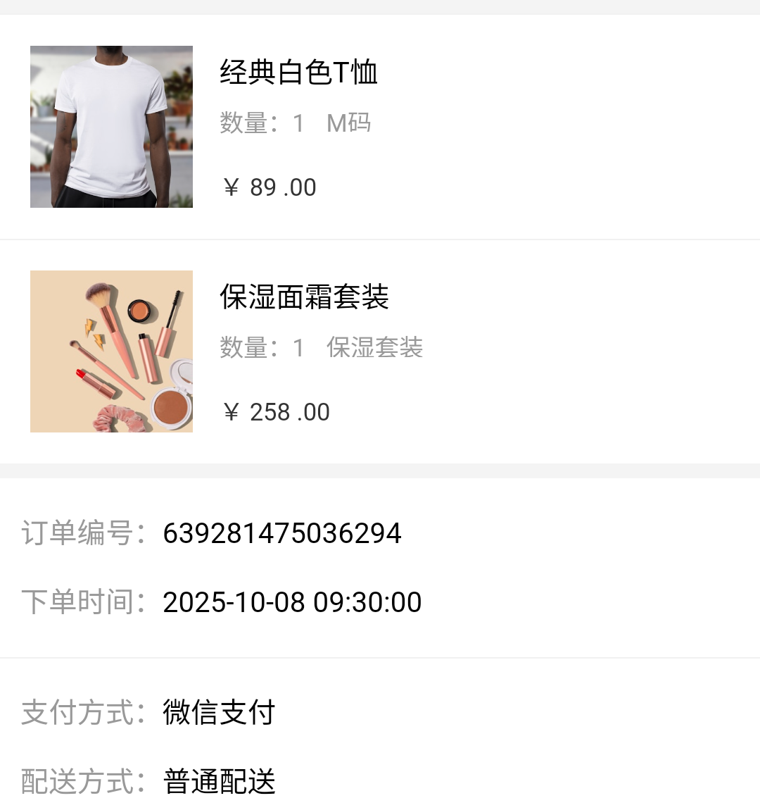
Recent-4
×
Shared Context
Recent High-Fidelity Images
type:
Women's Cotton
Short Sleeve T-shirt,
202306010001
Goal
pending shipment → SMS reminder
e11
e12
e13
e14
Current Keyboard Image
Complete event trace
e1
…
e6
e7
e8
…
e11
e12
e13
e14
CausalCache
e6
e7
e8
e12
CausalCache
✓
e6
open pending orders
e7
inspect item + order ID
type:
经典白色T恤,
保湿面霜套装,
639281475036294
e8
switch to Messages
e12
choose recipient
e14
focus composer
Notes:
[Sources]
- Internal audited case: data/results/mobileworld_hgkv_selected_b4/qualitative_cart_audit.json
- Local de-identified crops: paper/figures/assets/cart_order_evidence.png; paper/figures/assets/cart_message_input.png
[/Sources]

