Slide 1

Credit Risk Statistical Learning
Group 3: Fangling Zhang, Huayi Zhang,
Jiexuan Sun, Jun Dao, Ziqi Lin

Slide 2
Outline
Introduction
Dataset Overview
Statistical Learning
Data Cleaning
Prediction of Default/Late Payment (Bad Behavior)
Prediction of Loan Grade/Interest Rate
Conclusion

Slide 3
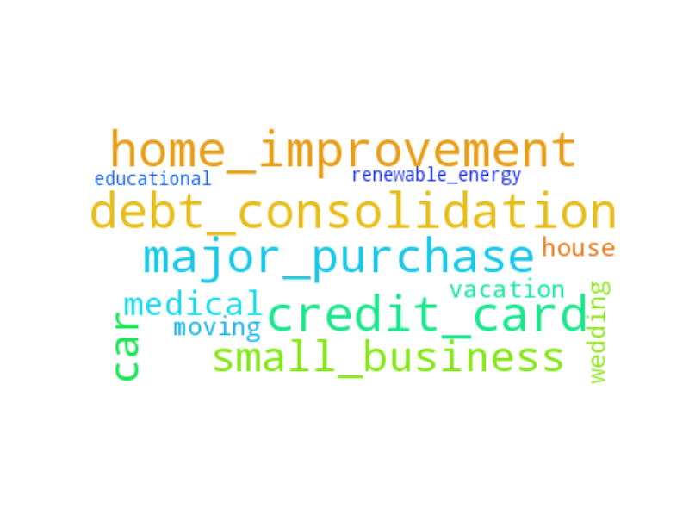
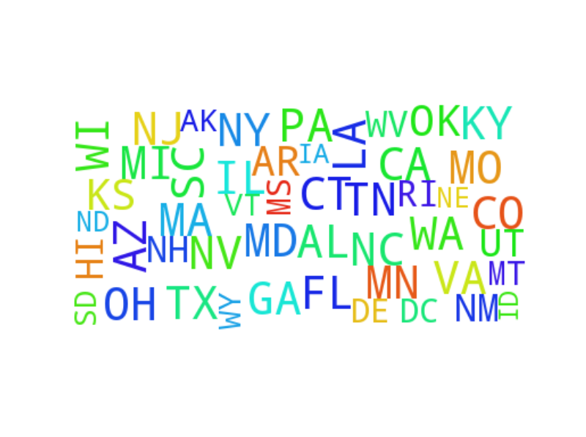
Introduction
Lending Club is the largest online credit marketplace in the word.
personal loans
business loans
medical procedures
No Matter What U Want No Matter Where U From
Notes:
Add logo

Slide 4


Introduction
Can Help !

Slide 5
Introduction
BI systems enable an organization to provide users throughout the extended enterprise with the ability to gain insight into the organization's business and operations by understanding the company's information assets.
Integration of BI system and Statistical Learning:
1.Float interest rate and customer grade based on borrower’s behavior during the loan process.
2.Detect potential default borrowers and help managers to make early reactions.

Slide 6
2. Dataset Overview: Summary
Number of Variables: 50
Number of Observations: 40,000
Variables' Types:
Customer Information: addr_state, annual_inc….
Loan application Information: purpose, application_type….
Post-loan Information: int_rate, default….
Notes:
description-Lynn

Slide 7
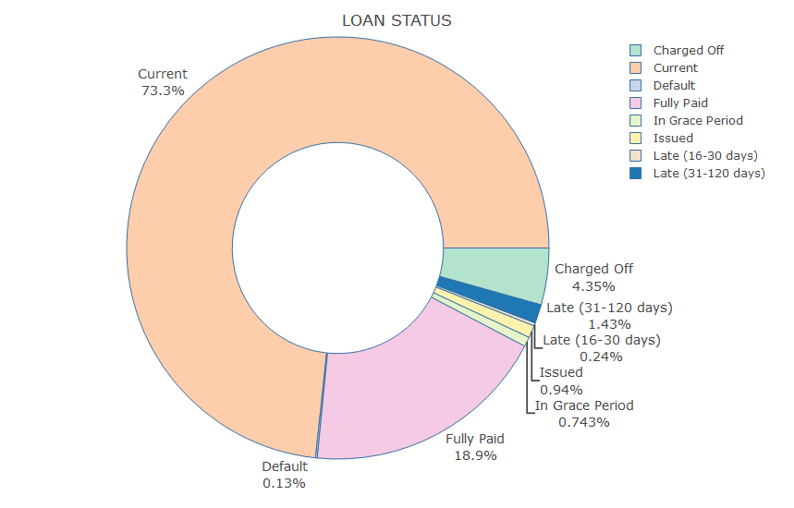
2. Dataset Overview: Loan Status

Slide 8
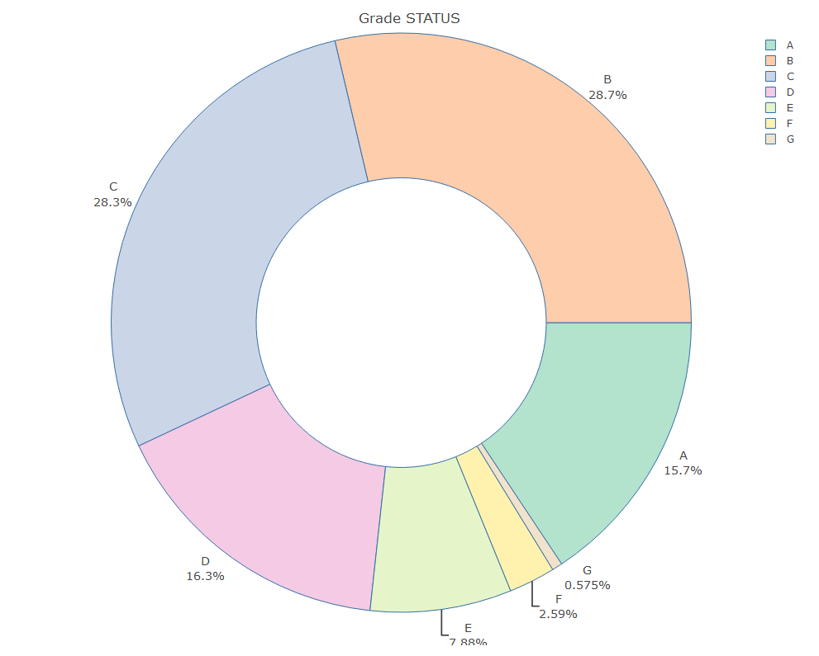
2. Dataset Overview: Loan Grade Status

Slide 9
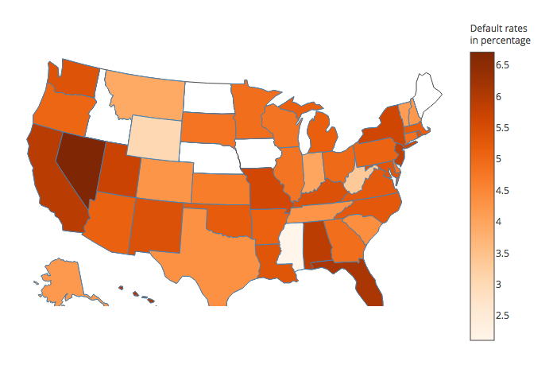
2. Dataset Overview:
Geographic Distribution of Default Rates

Slide 10
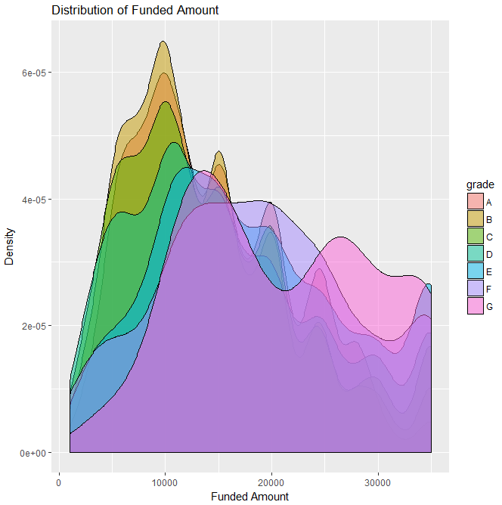
2. Dataset Overview:
Distribution of Funded Amount by Grade

Slide 11

3. Statistical Learning

Slide 12
3.1 Data Cleaning & Normalization
Observations not Consistency (Interest Rate > 0.9) Casewise Deletion
Observations with too many NULL value Casewise Deletion
Center and scale values (Normalization)
Variables with near zero variance Near-zero-var Deletion
Highly correlated Variables Variable Deletion
Etc.

Slide 13
3.2 Prediction of Default/Late Payment (Bad Behavior)

Slide 14
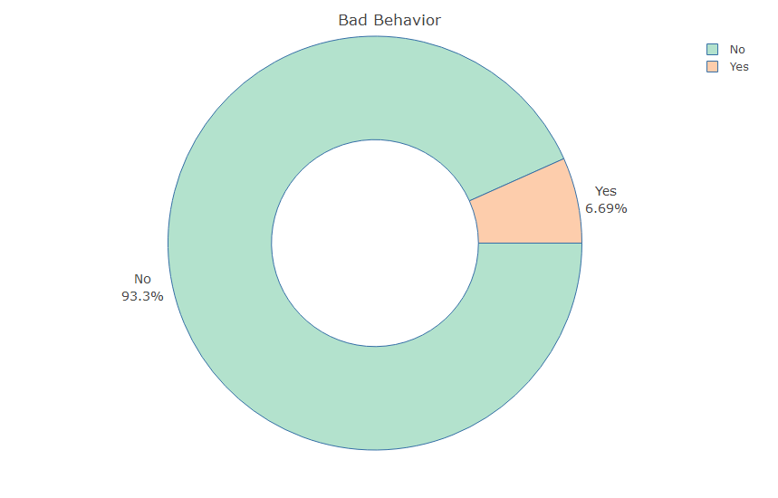
3.2 Prediction of Default/Late Payment (Bad Behavior)
‘Bad Behavior’ =
Paid late fee records+Late(16-30 days)+Late(31-120 days)+Default+Charged Off

Slide 15
3.2 Prediction of Bad Behaviors: Lasso
The 8 variables selected by Lasso:
Funded_amnt: The total amount committed to that loan at that point in time.
Int_rate: Interest Rate on the loan
Installment: The monthly payment owed by the borrower if the loan originates.
Out_prncp: Remaining outstanding principal for total amount funded
Total_rec_prncp: Principal received to date
Total_rec_int: Interest received to date
Recoveries: Post charge off gross recovery
Last_pymnt_d: Last month payment was received
Notes:
ZHANG

Slide 16
3.2 Prediction of Bad Behaviors: Logistic Regression
Data: 80% training set, 20% test set.
Threshold: 0.5 (Predicted probability > 0.5 classified as Pred Bad Behavior).
Result:
Sensitivity = Pred Bad Behavior / Bad Behavior = 60.26%
Precision = Bad Behavior / Pred Bad Behavior = 99.46%
 | NOT Bad Behavior | Bad Behavior
Pred NOT Bad Behavior | 7655 | 122
Pred Bad Behavior | 1 | 185

Slide 17
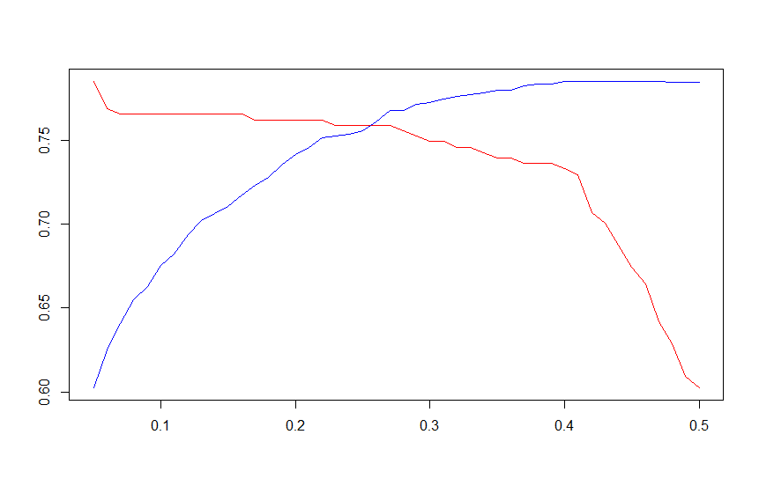
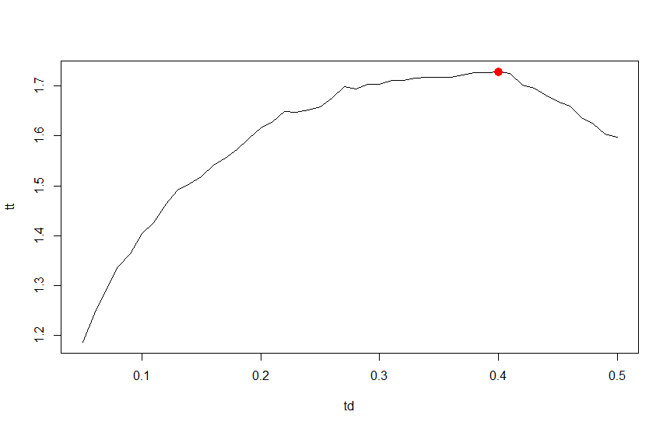
3.2 Prediction of Bad Behaviors: Logistic Regression
Threshold Selection:
Trade-off
Red: Sensitivity Blue: Precision
Sum = Sensitivity + Precision
Best Cutoff = 0.4

Slide 18
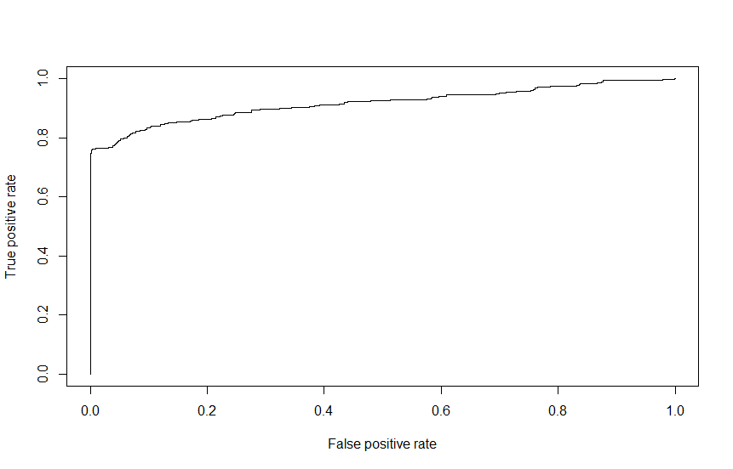
3.2 Prediction of Bad Behaviors: Logistic Regression
Final Result for 0.4 Threshold:
Sensitivity = 73.29%
Precision = 99.56%
Sensitivity increases from 60.26%
Precision increases from 99.46%
ROC Curve
The area under ROC curve (AUC) = 0.92
 | NOT Bad Behavior | Bad Behavior
Pred NOT Bad Behavior | 7655 | 82
Pred Bad Behavior | 1 | 225

Slide 19
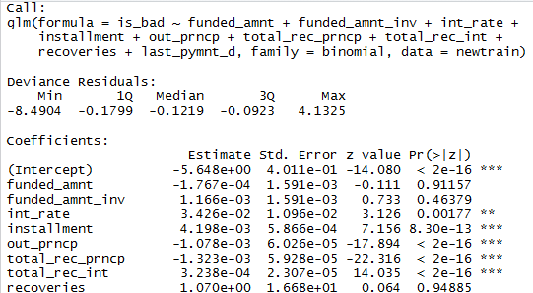
3.2 Prediction of Bad Behaviors: Logistic Regression
Interpretation:
installment coefficient: 0.0042
exp(0.0042) = 1.00427
Notes:
When holding all the predictors other than installment constant, per unit increase in the monthly payment owed by the borrower , the odds of not default the loan go up by 0.42%.

Slide 20
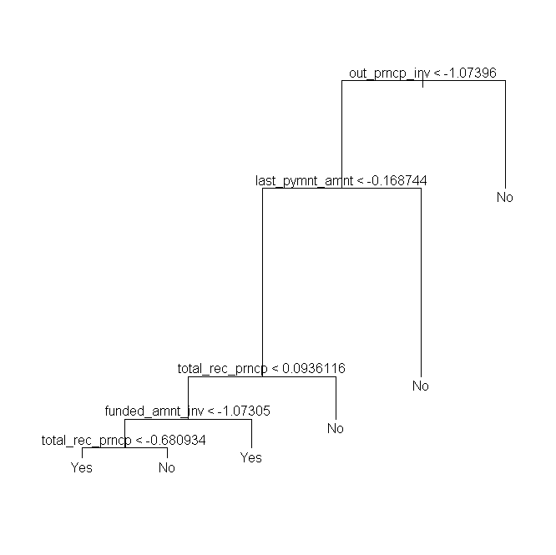
3.2 Prediction of Bad Behaviors: Tree(Before Pruning)
Data: 80% training set, 20% test set. The Tree:
Result before pruning:
 | NOT Bad Behavior | Bad Behavior
Pred NOT Bad Behavior | 7540 | 184
Pred Bad Behavior | 0 | 275
Sensitivity = 59.9%
Accuracy = 97.7%

Slide 21
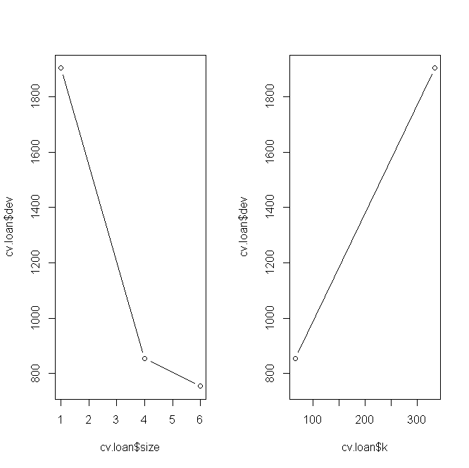
3.2 Prediction of Bad Behaviors: Tree
Pruning:
Choosing size = 4
Notes:
Though size=4 is not the best, size =6 and size =5 both have the same result as before.

Slide 22
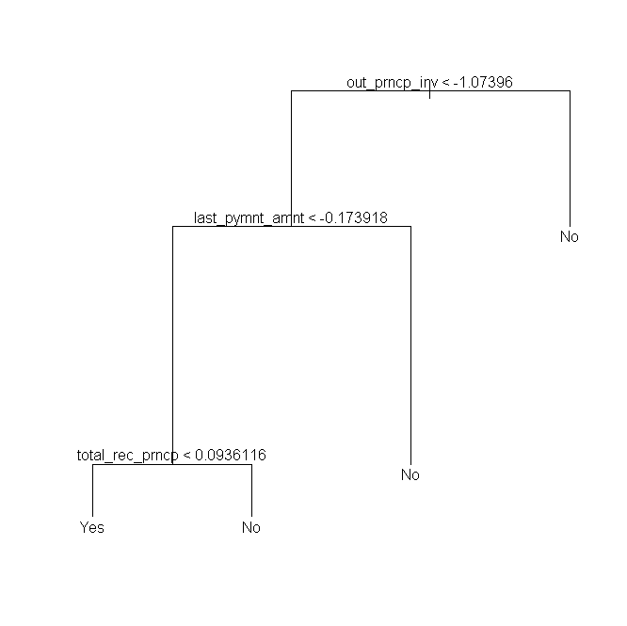
3.2 Prediction of Bad Behaviors: Tree(After Pruning)
Result after Pruning: The tree after pruning:
 | NOT Bad Behavior | Bad Behavior
Pred NOT Bad Behavior | 7492 | 160
Pred Bad Behavior | 49 | 299
Sensitivity = 65.14%
Accuracy = 97.39%
Sensitivity increases from 59.9%
Accuracy is the same

Slide 23
3.2 Prediction of Bad Behaviors: Random Forest
Data: 80% training set, 20% test set.
Result:
 | NOT Bad Behavior | Bad Behavior
Pred NOT Bad Behavior | 7540 | 126
Pred Bad Behavior | 1 | 333
Sensitivity = 72.55%
Accuracy = 98.41%
Sensitivity increase from 65.14%(Compared with Tree)
Accuracy increase from 97.39%(Compared with Tree)

Slide 24
3.3 Prediction of Loan Grade/Interest Rate

Slide 25
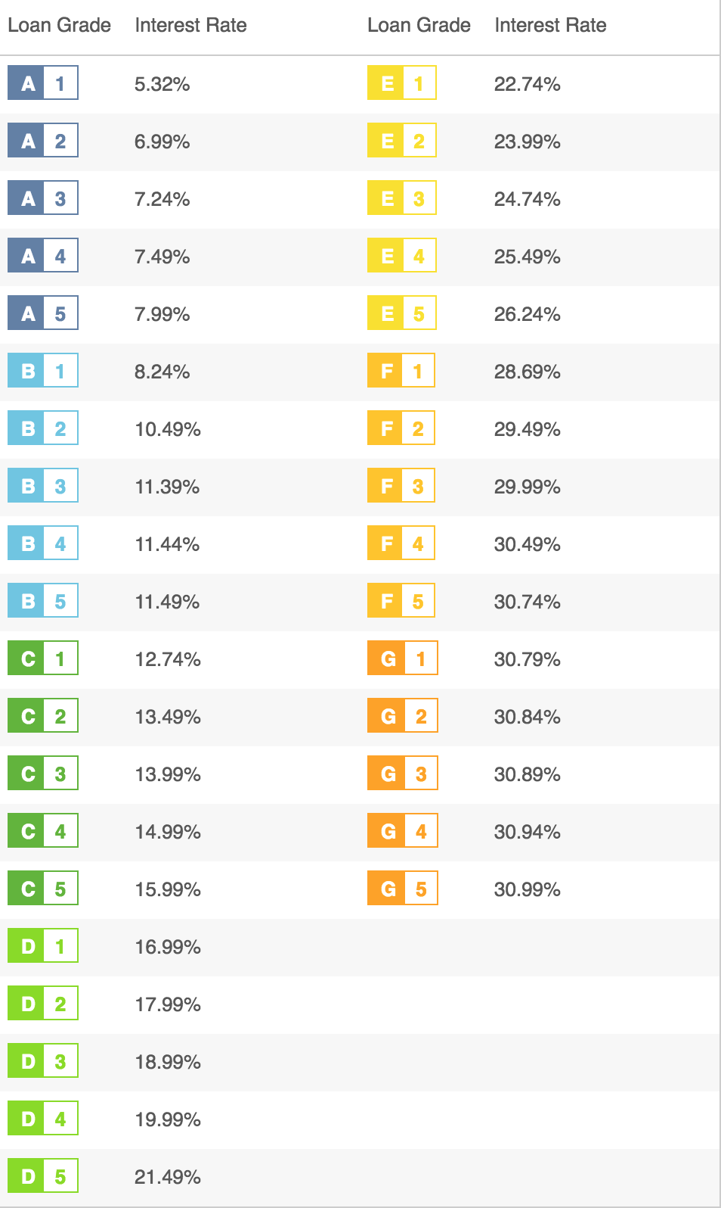
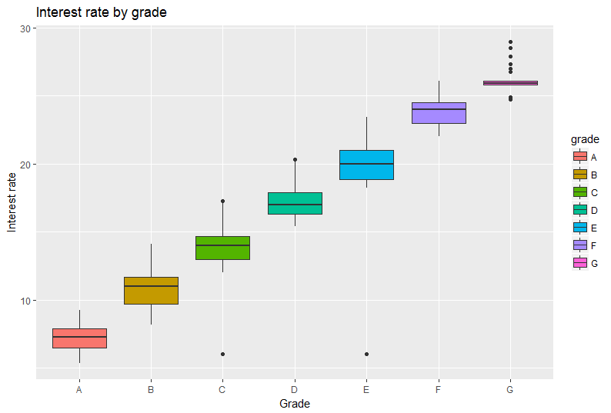
3.3 Prediction of Loan Grade/Interest Rate
Loan Grade & Interest Rate:

Slide 26
3.3 Prediction of Loan Grade: Lasso
There are 23 variables selected by Lasso.
Variables with high coefficient:
Home ownership | Loan status | Verification status
Purpose | Debt-to-income ration | Inquiries in past 6 mths
Term | Derogatory public records | Initial list status
Employment length | Delinquency 2 years
Notes:
Jun

Slide 27
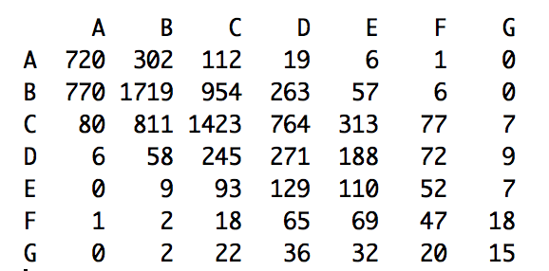
3.3 Prediction of Loan Grade: LDA
Data: 80% training set, 20% test set.
Result:
We get the Accuracy = 43.05%.
Notes:
Jason

Slide 28
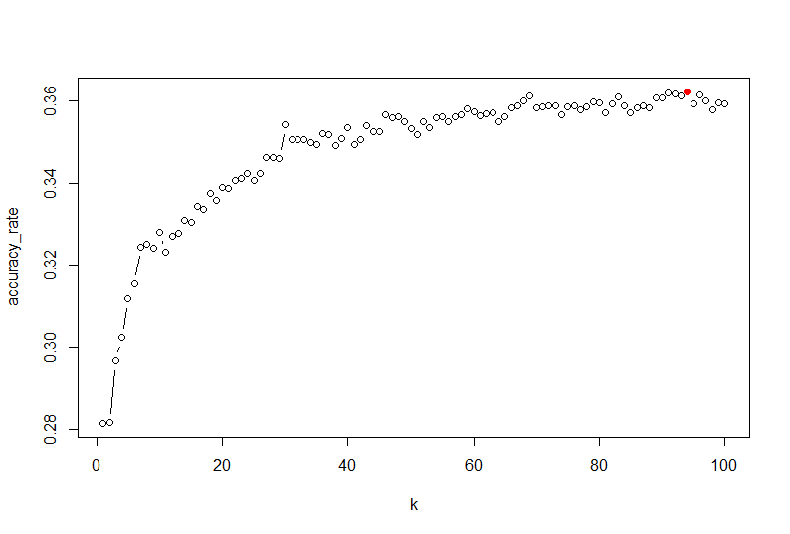
3.3 Prediction of Loan Grade: KNN (7 Grades)
Data: 80% training set, 20% test set.
K Selection:
K , accuracy_rate
But, we choose K = 32.

Slide 29
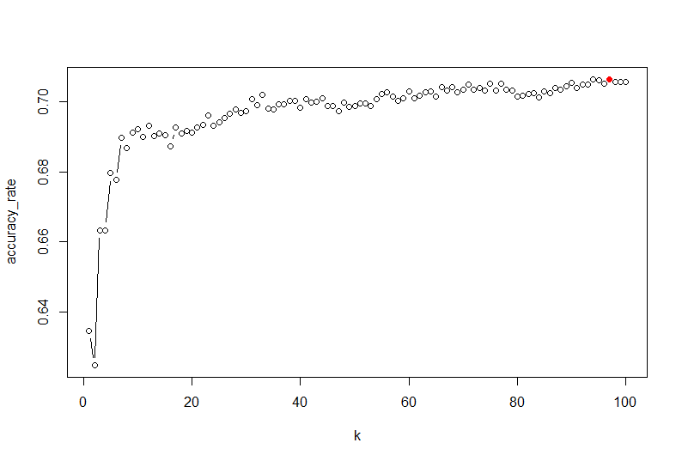
3.3 Prediction of Loan Grade: KNN (7 Grades 2 Grades)
Data: 80% training set, 20% test set.
K Selection:
High: A, B
Low: C, D, E, F, G
We choose K = 35.

Slide 30
3.3 Prediction of Loan Grade: KNN (7 Grades VS. 2 Grades)
7 Grades Result with k=32:
2 Grades Result with k=35:
 | A | B | C | D | E | F | G
A | 451 | 407 | 188 | 64 | 13 | 4 | 1
B | 624 | 1202 | 903 | 438 | 96 | 29 | 3
C | 187 | 567 | 925 | 629 | 316 | 107 | 22
D | 14 | 78 | 192 | 199 | 121 | 48 | 19
E | 2 | 11 | 26 | 47 | 42 | 17 | 2
F | 0 | 0 | 0 | 0 | 3 | 1 | 0
G | 0 | 0 | 0 | 0 | 0 | 0 | 0
 | High | Low
High | 2534 | 1405
Low | 1010 | 3051
Accuracy = 69.81%
Accuracy = 35.25%

Slide 31
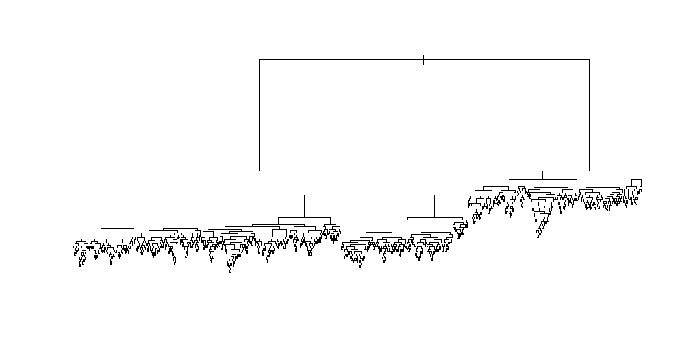
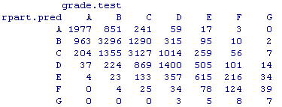
3.3 Prediction of Loan Grade: Rpart Classification(Before Pruning)
Data: 80% training set, 20% test set.
Result before Pruning:
Grade has 7 levels, rpart instead of tree.
Accuracy = 52.7%.

Slide 32

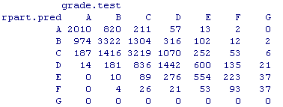
3.3 Prediction of Loan Grade: Rpart Classification(After Pruning)
Result after Pruning:
After pruning, Accuracy = 53.2%,
increasing from 52.7%.

Slide 33
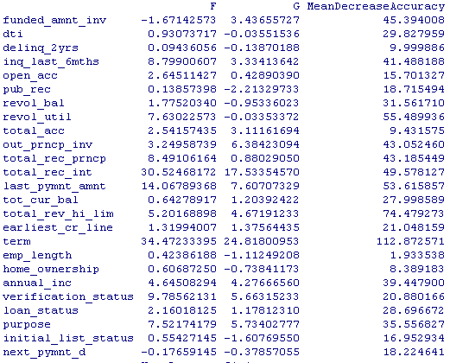
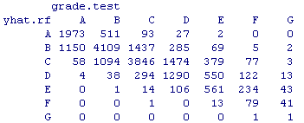
3.3 Prediction of Loan Grade: Random Forest (7 Grades)
Data: 80% training set, 20% test set.
Result:
By using random forest, we get
accuracy = 59.3%. The variables
Importance is as right figure.

Slide 34
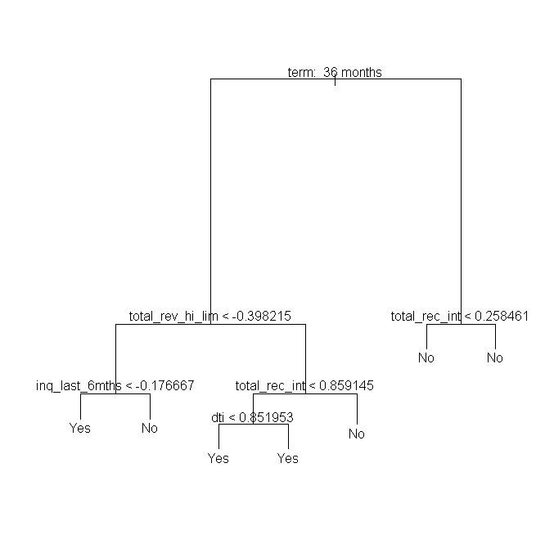
3.3 Prediction of Loan Grade: Tree (2 Grades before pruning)
Data: 80% training set, 20% test set.
Result before pruning：
We get accuracy = 71.0%
 | Low Grade | High Grade
Pred Low Grade | 2935 | 823
Pred High Grade | 1495 | 2747

Slide 35
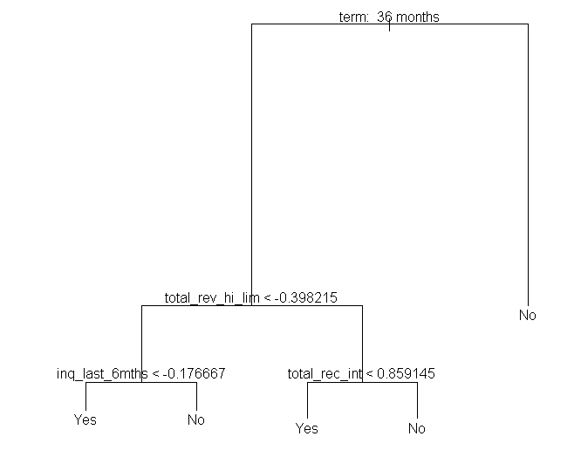
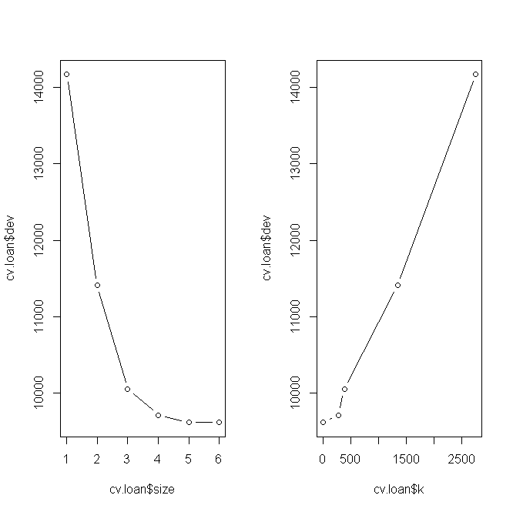
3.3 Prediction of Loan Grade: Tree (2 Grades after pruning)
Pruning:
Choosing size = 5
Accuracy = 71.0% (No change). However, the tree becomes simpler.

Slide 36
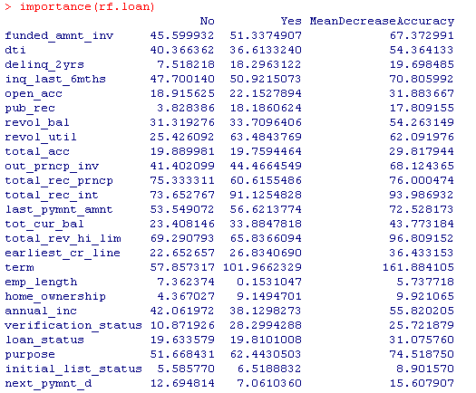
3.3 Prediction of Loan Grade: Random Forest (2 Grades)
Data: 80% training set, 20% test set.
Result:
By using random forest, we get
Accuracy = 88.0%. The variables
Importance is as right figure.
 | Low Grade | High Grade
Pred Low Grade | 3917 | 451
Pred High Grade | 513 | 3119
Notes:
Lynn

Slide 37
4. Conclusion: Prediction of ‘bad behaviors’
 | Logistic Regression | Tree | Random Forest
Sensitivity | 73.29% | 65.14% | 72.55%
Accuracy | 98.96% | 97.39% | 98.41%
Selection | ✔️ | ❌ | ❌

Slide 38
4. Conclusion: Prediction of Loan Grade
 | 7 Grades Accuracy | 2 Grades Accuracy | Selection
KNN | 35.25% | 69.81% | ❌
LDA | 43.05% | / | ❌
Rpart | 53.2% | / | ❌
Tree | / | 71% | ❌
Random Forest | 59.3% | 88% | ✔️

Slide 39

Question Time!

