Slide 1
Image Classification with Deep CNN and AlexNet
Fangyu Lin
Fangling Zhang

Slide 2
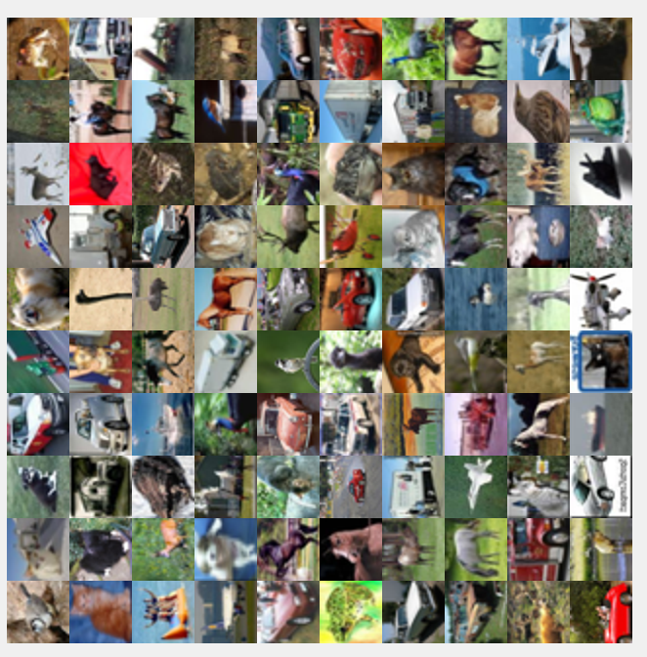
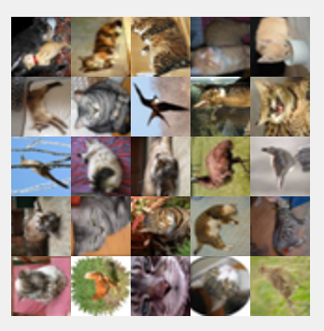
Dataset
60000 images, 10 classes
VS 5000 ‘bird’ and 5000 ‘cat’

Slide 3
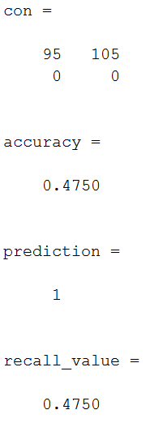
Deep CNN
Model with 1 convolutional layer and 2 fully connected layers as hidden layers
Model name | Parameters | Time take(s) | Test Accuracy
model1_0 | basic model with all default options in CNN function | 872 | 0.475
model1_1 | based on model 1_0 and change 'InitialLearnRate':0.001 | 854 | 0.475
model1_2 | based on model 1_0 and change 'InitialLearnRate':0.01 | 810 | 0.475
model1_3 | based on model 1_2 and change 'L2Regularization',0.04 | 759 | 0.475
model1_4 | based on model 1_3 and change 'MaxEpochs',50 | 1142 | 0.475
model1_5 | based on model 1_4 and change 'MiniBatchSize',64 | 1221 | 0.475
All predicted value is 0;
Predict all images as ‘cat’

Slide 4
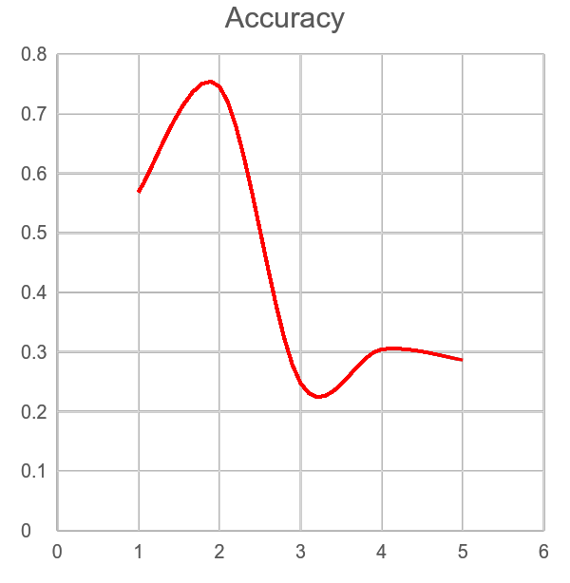
Deep CNN
Model with 3 convolutional layer and 2 fully connected layers as hidden layers
Model name | Parameters | Time take(s) | Test Accuracy
model2_0 | basic model with all default options in CNN function | 2139 | 0.725
model2_1 | add initial bias to lay 2 to above basic model, layers(2).Bias=0.01*ones(1,1,[numFilters]); | 2070 | 0.750
model2_2 | add local normalization layers to model 2_1 | 2213 | 0.475
model2_3 | add dropout layers to model 2_1 | 2367 | 0.740
model2_4 | use whitening transformation firstly, then use model 2_1 | 2947 | 0.475

Slide 5
Deep CNN
use Normally distributed random numbers other than uniform distribution as initial weights
Model name | Parameters | Time take(s) | Test Accuracy
model2_1 | Use uniform distribution as initial weights | 2070 | 0.750
model3_1 | based on model 2_1 and use normally distributed | 2316 | 0.760
model3_2 | use whitening transformation firstly, then use model 3_1 | 2850 | 0.730

Slide 6
Pre-trained AlexNet
Pre-trained AlexNet can make classification much faster and more accurately
Model name | Parameters | Time take(s) | Test Accuracy
model2_1 | Use uniform distribution as initial weights | 2070 | 0.750
model3_1 | based on model 2_1 and use normally distributed | 2316 | 0.760
model3_2 | pre-trained AlexNet | 131 | 0.857

Slide 7
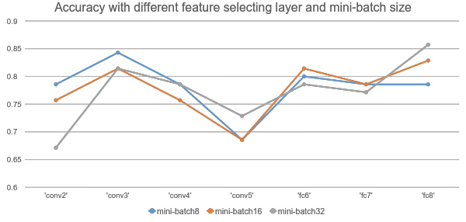
AlexNet Experiment

Slide 8
AlexNet Experiment for 10 classes
classes number | Brief description of the experiment | Time take(s) | Test Accuracy
10 | Use pre-trained cifar10Net to classify 10 classes image | 200 | 0.7456
10 | Use pre-trained AlexNet to classify 10 classes image (learner:linear, feature selecting layer(l):’fc8’, Mini-Batch size(m):32 | 654 | 0.5686
2 | basic model: Use pre-trained AlexNet to classify 10 classes image (parameter is the same as above model) | 131 | 0.8571

Slide 9
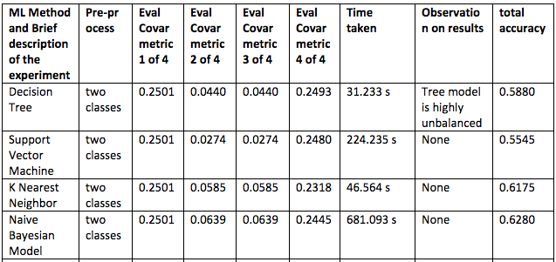
Compared Other Models

Slide 10
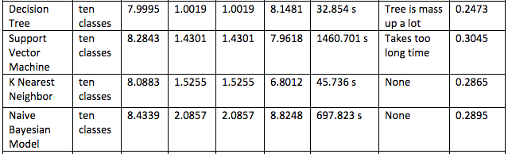
Compared Other Models
Now we run ten classes of images

Slide 11
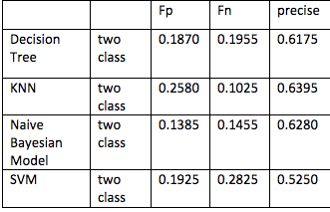
Compared Other Models
False Positive
False Negative
Precise
Recall

Slide 12
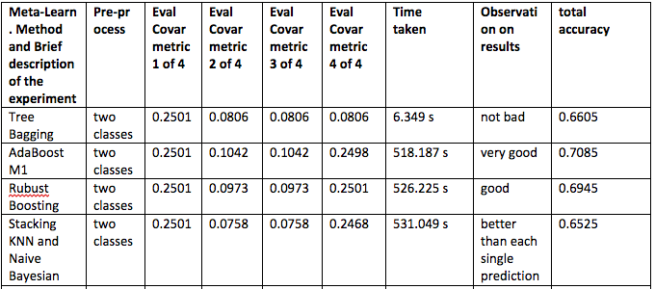
Meta-Learning Model
Apply Tree Bagging, AdaBoosting, and Stacking

Slide 13
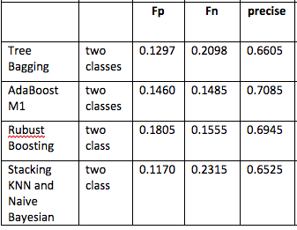
Meta-Learning Model
False Positive
False Negative
Precise
Recall

Slide 14
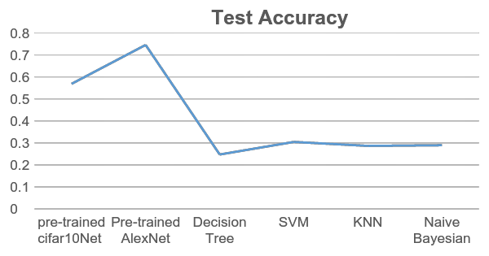
Result Analysis for 2 classes
Model | Accuracy
DCNN | 0.7600
Pre-trained AlexNet | 0.8140
Decision Tree | 0.5880
SVM | 0.5545
KNN | 0.6175
Naive Bayesian | 0.6280

Slide 15
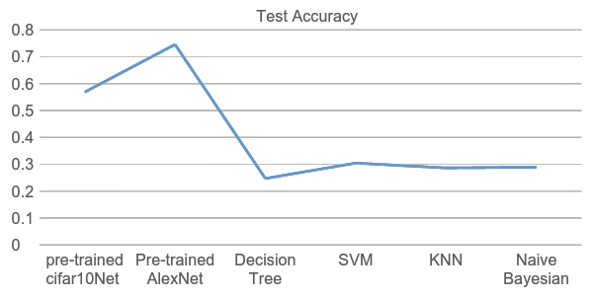
Result Analysis for 10 classes
Model | Accuracy
pre-trained cifar10Net | 0.5686
Pre-trained AlexNet | 0.7456
Decision Tree | 0.2473
SVM | 0.3045
KNN | 0.2865
Naive Bayesian | 0.2895

Slide 16
Conclusion
Deep CNN can get higher accuracy than Decision tree, Naive Bayes, Logistic classification, SVM.
To get more than 50% accuracy of classification, we need to use multiple convolutional layers.
Use pre-trained network can make classification much faster and more accurately.
Use normally distributed random numbers as initial weights of the 1st CNN layer can get higher accuracy than uniform distribution.
Add initial bias to convolutional layer can enhance the test accuracy.

