Slide 1
Lest We Remember: Cold Boot Attacks on Encryption Keys
S211000831霍晓飞

Slide 2
Idea for this article
01

Slide 3
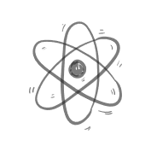

What’s the article about
Contrary to popular belief, DRAMs hold their values for surprisingly long intervals without power or refresh.

Slide 4
Why does this article raise this question
Wrong standpoint:
1)a computer’s memory is erased almost immediately when it loses power
2)whatever data remains is diffificult to retrieve without specialized equipment.
our standpoint:
1) DRAMs typically lose their contents gradually over a period of seconds

Slide 5
2)data will persist for minutes or even hours if the chips are kept at low temperatures.
3)Residual data can be recovered using simple techniques that require only momentary physical access to the machine.

Slide 6
To prove our point
02

Slide 7
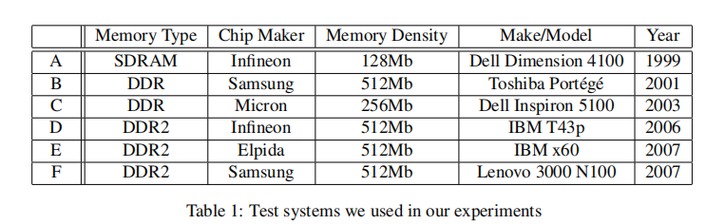
Characterizing Remanence Effects
using PC systems with different memory technologies to performe trails.

Slide 8
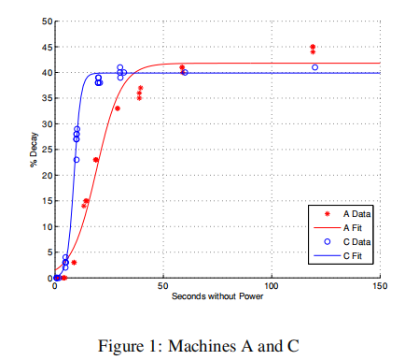
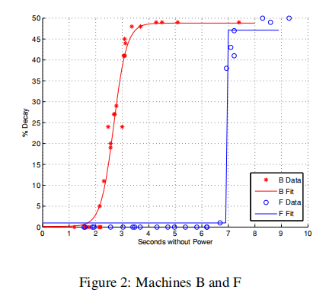
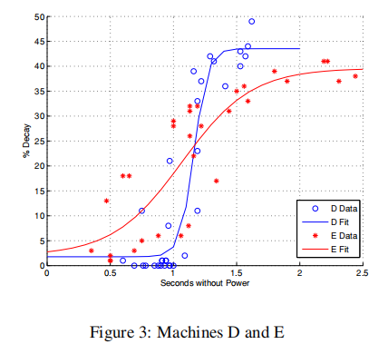
Decay at operating temperature

Slide 9
What have we gotten?
Phenomenon
1)the fastest exhibiting complete data loss in approximately 2.5 seconds and the slowest taking an average of 35 seconds.
2)machines using newer memory technologies tend to exhibit a shorter time to total decay than machines using older memory technologies
Why
3)this trend to the increasing density of the DRAM cells as the technology improves.
limit
4)the shorter times are long enough to facilitate most of our attacks

Slide 10
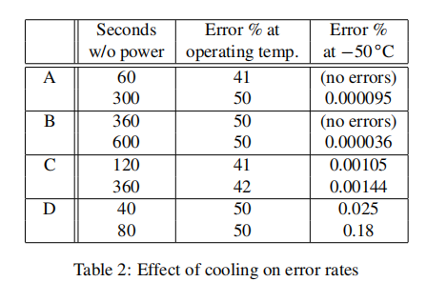
Decay at reduced temperature
a signifificantly lower rate of decay under these reduced temperatures

Slide 11
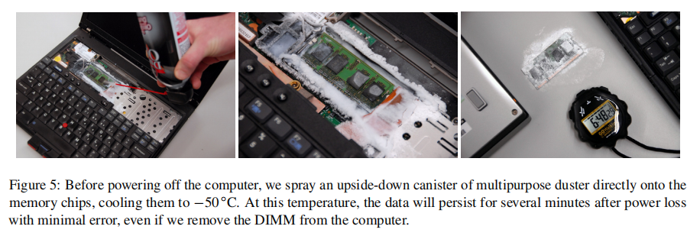
An extreme case of low temperature
This suggests that, even in modern memory modules, data may be recoverable for hours or days with suffificient cooling

Slide 12
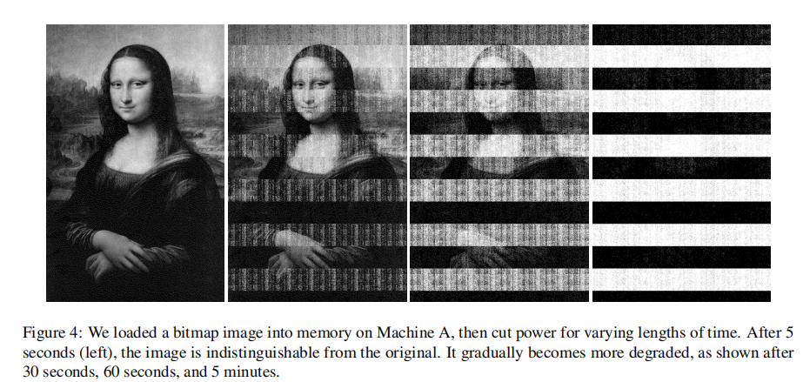
What happens if you don’t refresh(without power)
We can pull this memory out of the memory stick and plug it into another memory reader to read almost everything

Slide 13
Countermeasures and their Limitations
03

Slide 14
Scrubbing memory
how to do
1)avoid storing keys in memory
2)Runtime libraries and operating systems should clear memory proactively
limit
3)these precautions cannot protect keys that must be kept in memory because they are still in use.

Slide 15
Limiting booting from network or removable media
how to do
1)Computers can be confifigured to require an administrative password to boot from these sources.
limit
3)that even if a system will boot only from the primary hard drive, an attacker could still swap out this drive

Slide 16
Suspending a system safely
how to do
1)users can protect themselves by powering off the machine completely when it is not in use
limit
3)this countermeasure is inconvenient, since the user will have to wait through the lengthy boot process before accessing the machine again.

Slide 17
Encrypting in the disk controller
how to do
To be secure, such a system must ensure that the key register is erased whenever a new operating system is booted on the computer; otherwise, an attacker can reboot into a malicious kernel that simply reads the disk contents.

Slide 18
Countermeasures and their Limitations
04

Slide 19
The central conclusion of the paper
1)use cold reboots to mount successful attacks on popular disk encryption systems using no special devices or materials.
2)remanence times can be increased dramatically with simple cooling techniques.
3) Though we discuss several strategies for partially mitigating these risks, we know of no simple remedy that would eliminate them.

Slide 20
Thanks

