Slide 1
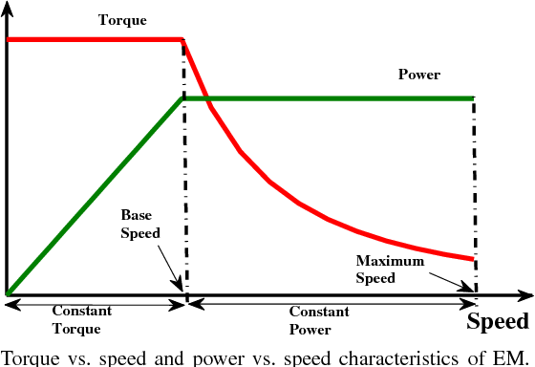
Torque/Power
T_{Tmax}
1/w(1/v)
P_{Tmax}
w(v)
Base Speed

Slide 2
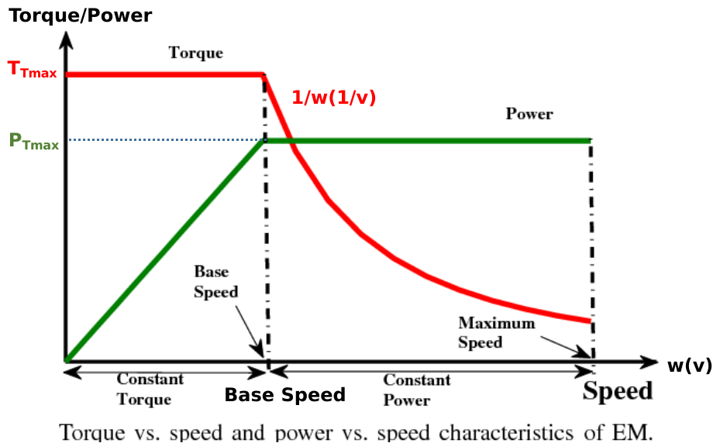
Road Load
Force Speed Characteristics
F_{R}
F_{Tmax}
F_{T}
1/§M
dv/dt
1/S
v

Slide 3
Radius of the wheel
1/r_{d}
F_{T}
1/§M
v
1/r_{d}
F_{R}
T_{T}
w
T_{M}
GR
GRADE
GR
w_{M}
From machine
AERO.
To machine
ROLLING
Resistive Model

Slide 4
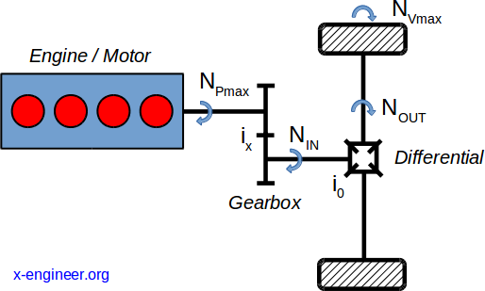
T_{out} & w_{out}
T_{in} & w_{in}

Slide 5
25m/s
speed [m/s]
t
2.5
Force [KN]
t
-2.5
62.5
62.5
Power [kW]
t
10s
-62.5

Slide 6
Torque/Power
3625N
P_{T} = F_{T}*v
P_{Tmax}
w(v)
v_{B} = 10m/s

Slide 7
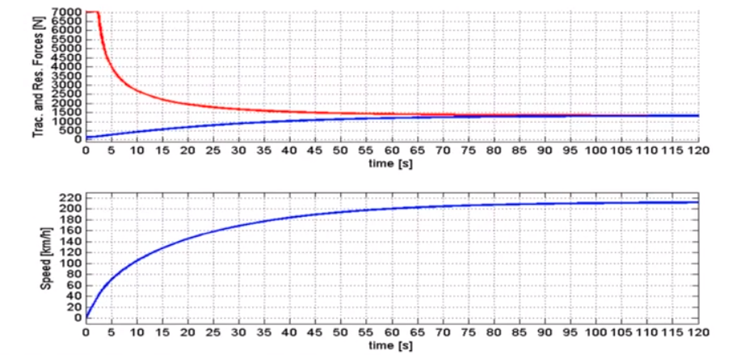
V_{B}
212.7[km/h]

Slide 8
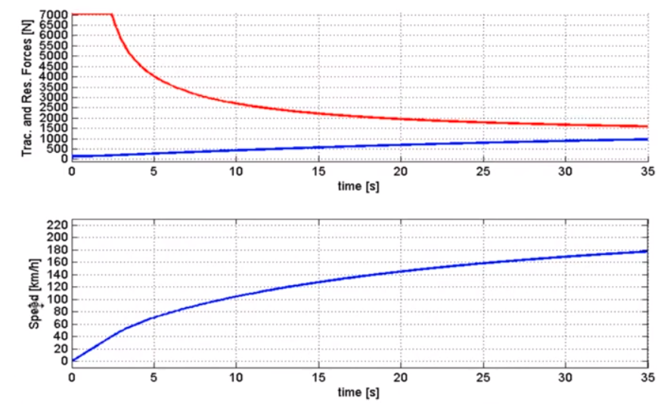
V_{B}
Non- Linear
Linear

Slide 9
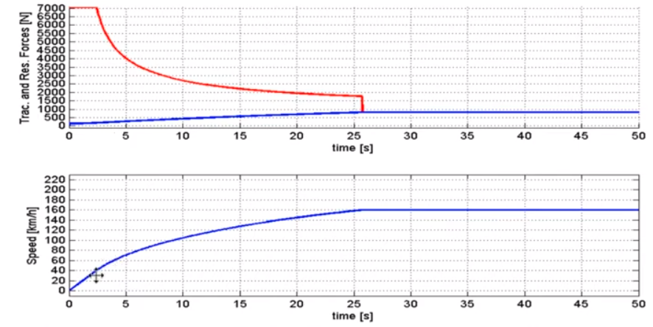

Slide 10
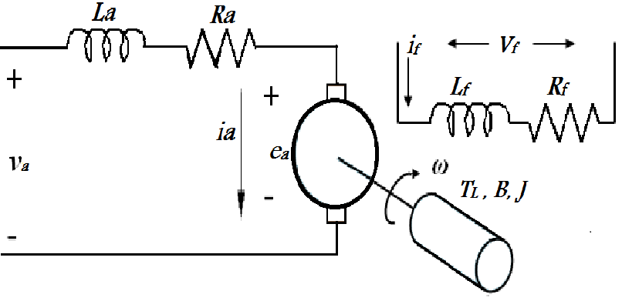
Fixed Field
Armature Circuit

Slide 11
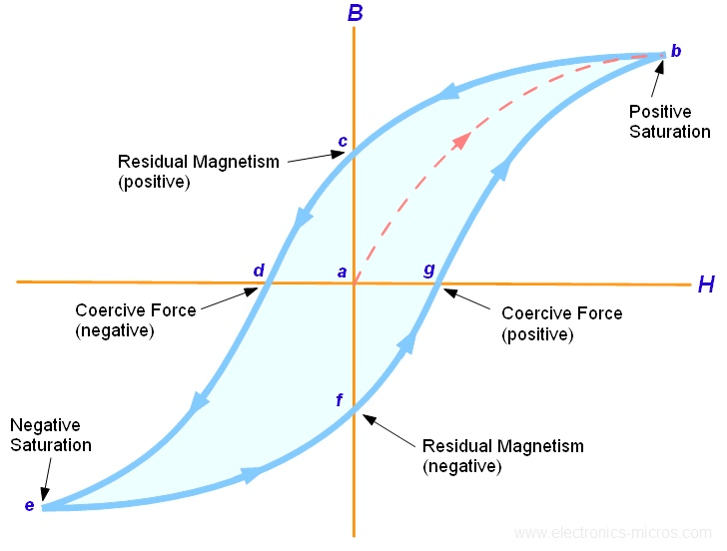
Magnetic Flux Density
proportion to phi
K∅
K_{f}
i_{f}
Magnetic Field Intensity
proportion to i
K∅ = K_{f}i_{f}

