Slide 1
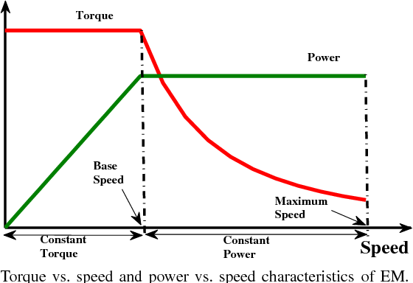
Torque/Power
T_{Tmax}
1/w(1/v)
P_{Tmax}
w(v)
Base Speed

Slide 2
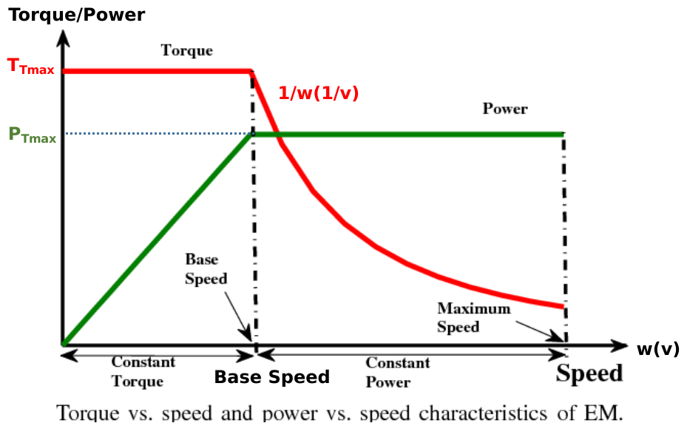
Road Load
Force Speed Characteristics
F_{R}
F_{Tmax}
F_{T}
1/§M
dv/dt
1/S
v

Slide 3
Radius of the wheel
1/r_{d}
F_{T}
1/§M
v
1/r_{d}
F_{R}
T_{T}
w
T_{M}
GR
GRADE
GR
w_{M}
From machine
AERO.
To machine
ROLLING
Resistive Model

