Slide 1
Akka
code: http://github.com/RayRoestenburg
blog: http://roestenburg.agilesquad.com
twtr: @RayRoestenburg

Slide 2
Akka
Core
Actors, Remote, TestKit, Serialization, STM, Agents, Dataflow, Async HTTP (Mist), FSM, Transactors
Modules
MicroKernel, Camel, AMQP, Scalaz, Spring, OSGi, Persistence

Slide 3
Actors
Mailbox
Message Loop
Fire & Forget or Request/Response
Actor
ActorRef
Dispatchers
Memory Model (before-rules)
Supervision

Slide 4
ActorRef
val actor = actorOf(new MyActor()).start
ator ! Msg
actor.forward(msg)
(actor !! msg) foreach {…}
val future = actor !!! Msg
val actor2 = actorOf(new Actor2()).start
val actor3 = actorOf(new Actor3(actor2)).start

Slide 5
Actor
def receive {
case msg:Msg => {
//handle msg
}
}
self.reply(msg)
self.reply_?(msg)

Slide 6
Remote Actors
remote.start(“localhost”, 2552)
remote.register(“id”, actorRef)
val actorRef = remote.actorFor(“id”, “localhost”, 2552)
actorRef ! msg

Slide 7
Camel Consumer
Consumer
class Consumer1 extends Actor with Consumer {
def endpointUri = "file:data/input/actor"
def receive = {
case msg: Message => println("received %s" format msg.bodyAs[String])
}
}

Slide 8
Camel Producer
Producer
class Producer1 extends Actor with Producer {
def endpointUri = "http://localhost:8080/news"
}
val producer = actorOf[Producer1].start
val response = producer !! "akka rocks"
val body = response.bodyAs[String]

Slide 9
MicroKernel
akka.kernel.Main
Boot class in akka.conf
sbt dist

Slide 10
Testing Actors
TestActorRef, CallingThreadDispatcher
val actorRef = TestActorRef(new MyActor)
val result = actorRef !! Say42
result must be (42)
TestKit
within(100 millis) {
forwardRef ! "test"
expectMsg("test")
}

Slide 11
Futures
val f1 = Future { "Hello" + "World" }
val result = f1.get
val f = for {
a <- Future(10 / 2)
b <- Future(a + 1)
c <- Future(a - 1)
} yield b * c
val result = f.get()

Slide 12
Akka 1.1
Less dependencies
Hardening of remoting
Futures (monadic, on dispatcher, DataFlow API)
TestKit
Dispatchers
EventHandler

Slide 13
Akka 2.0
Cloudy Akka OSS
Transparent and adaptive load-balancing/routing
Transparent adaptive cluster rebalancing
Automatic replication with automatic fail-over upon node crash
Durable actor mailboxes (Disk, Zookeeper/BookKeeper, AMQP, JMS..)
Subscription-based cluster membership service (add/remove nodes on the fly)
Event Sourcing based on a highly available scalable transaction log
Highly available centralized configuration service
Leader election
Post Akka 2.0
Compute Grid/MapReduce
Data Grid
Distributed STM

Slide 14
Akka 2.0 dev list
Remote 2.0
Multi-jvm tests
Rewrite of typed actors
Experimenting with NIO
Pluggable Serializers
Unification sender, senderFuture into channel

Slide 15
Patterns
“One-way Process chains” for scaling up
Load Balancer
EndPoint (Consumer/Producer)
Forwarding Actor

Slide 16
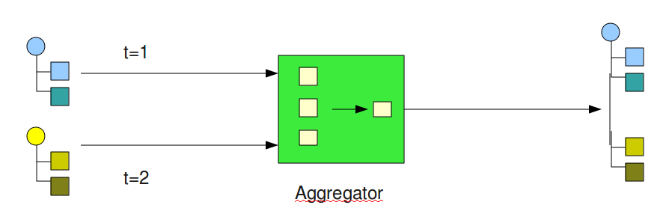
Patterns
Aggregator

Slide 17
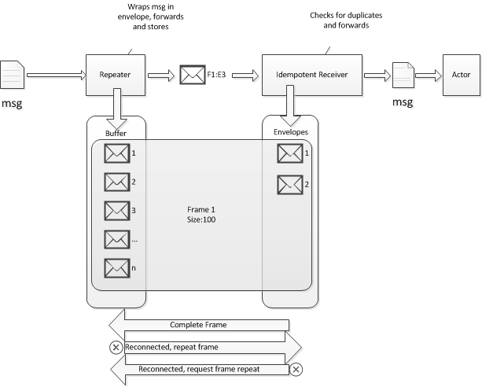
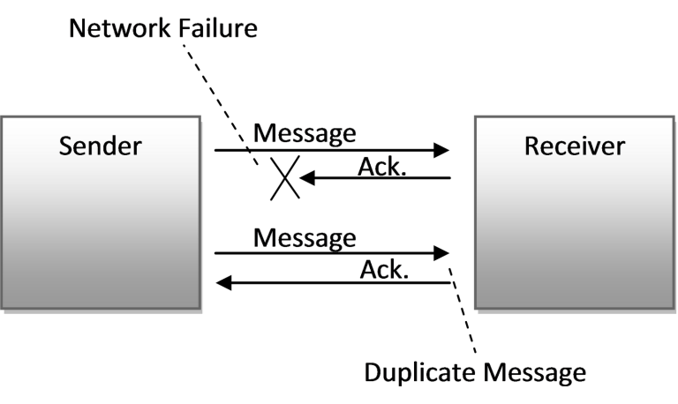
Patterns
Idempotent Receiver

Slide 18
Patterns
Pre 1.1:
Own Load Balancer, RecipientList, Test Actors (Cyclic Barriers, Countdowns)

Slide 19
Akka workshop
code: http://github.com/RayRoestenburg/duse12

Slide 20
Junction
T-Junction, Traffic Lights
Swing App with embedded Remote Server (2553)
Sends queued vehicles
Receives Traffic Light signals
MicroKernel with Remote Server (2552)
Receives queued vehicles
Junction handles commands (ResetJunction and ControlTraffic) (CQRS)
JunctionQueryModel handles Queries and listens async to Junction (CQRS)
target/scala_2.9.0/dist/bin/start
target/scala_2.9.0/dist/bin/gui
Goal: get it to work by implementing the actors based on the specs.

