Slide 1
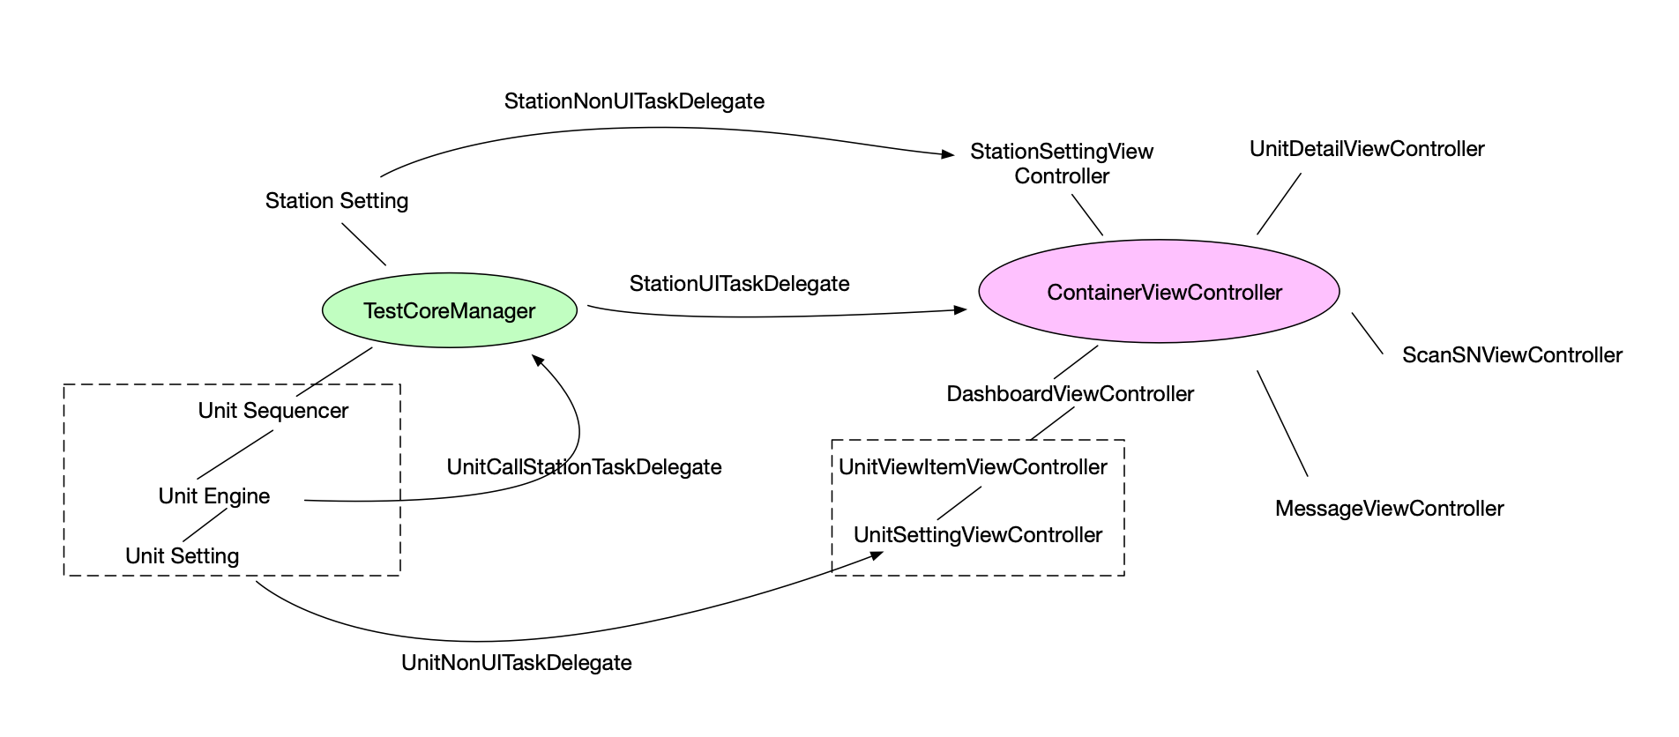
CallFunctionMap

Slide 2
UnitView I/O
Unit-1
Out
1.Enabled/Disabled -> Dashboard -> TestCoreManager
2.Click DetailBtn -> Dashboard -> Container -> show detail view
3.Click SettingBtn -> Dashboard -> Container -> show set view
SN1234567890
In
1.TestMode changed <- Dashboard (select test mode)
2.Testing/Finished <- TestCoreManager(event)
set

Slide 3
TestCoreManager I/O
Out
1.Test Start -> Dashboard/UnitView
2.Unit Finished -> UnitView
3.All Finished ->Dashboard/UnitView
Test Core Manager
In
1.Start Test <- Dashboard
2.Sequencer Finished <- Test Sequencer
3.UnitCallStationTaskEvent <- Test Engine

Slide 4
Container & Sub View
Load View
Dashboard
Setting View
Container
Detail View
FatalError View

Slide 5
Dashboard & Dialogs
Scan SN Form
Password Form
Dashboard
Other dialog form

