Slide 1

Shanghai University
Online Survey Prediction Model for High Response Rate via Decision Tree
Naibin Luo
jsluonaibin@163.com

Slide 2
Contents
INTRODUCTION
II. RELATED WORK
CONSTRUCTION OF PREDICTION MODEL BASED ON ID3 ALGORITHM
EXPERIMENTAL RESULTS AND ANALYSIS
V. CONCLUSION

Slide 3

1 First Part
Introduction

Slide 4
1. INTRODUCTION
Online survey is an essential method to collect data;
But low response rate exists;
How to acquire high response from desirable users;
A new and effective prediction model has proposed;
Model used to forecast response behavior of user samples;
Extensive experiments demonstrate the effectiveness.

Slide 5
2 Second Part
Related Work

Slide 6
2. RELATED WORK
The research and application in online survey developed in late 90’s;
JM Stanton from Syracuse University presented collecting data from Internet;
MD Kaplowits demonstrated design way affect response rate;
Chen et al presented data mining in online survey system;
This paper aims at investigating the prediction model for high response via classification in data mining.

Slide 7
3 Third Part
Construction of Prediction Model Based on ID3 Algorithm

Slide 8
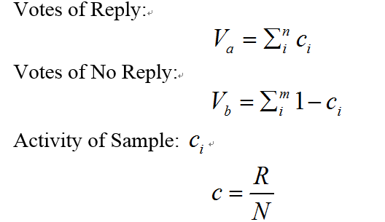
3. CONSTRUCTION OF PREDICTION MODEL
Improved ID3 based on Samples Active
Notes:
R presents the number of reply and N is the total number of online survey. Under the equation 1, we can obtain Va which is vote for reply. In equation 2, Vb can be got as voting for no reply. If Va>Vb, return the reply, otherwise we return no reply. The results can not only reflect the recovery of the current sample, but also reflect the high active.

Slide 9
3. CONSTRUCTION OF PREDICTION MODEL
ID | Attribute | Attribute Values | Info Gain
1 | Gender | Male; Female | 0.0751
2 | Occupation | Director; Manager; Staff: Other | 0.0008
3 | Income | Low; Mid;Upper; High | 0.0182
4 | Education | Pri; Mid; BSC; MSC;PHD | 0.0936
5 | Marriage | Married; Unmarried | 0.0220
6 | Mobile | Yes; No | 0.0437
7 | Email | Yes; No | 0.0481
8 | From | Inner; Outer | 0.0213
9 | AvgQues/Year | Few: Less; More; Multi | 0.0058
10 | Success Res Rate | Low; General; High | 0.0076
11 | Log Times/Year | Low; General; High | 0.0097
12 | Ques Type | Consumption; Product; Ad; Satisfaction; Rapid; Tracking; Contact; Other | 0.0811
13 | Ques Size | Short; Mid; Long | 0.0213
B. Construction of Prediction Model
The Input Data of Training Model

Slide 10
3. CONSTRUCTION OF PREDICTION MODEL
Top-K (K=7) attributes in terms of information gain are Gender, Education, Marriage, Mobile, Email, From, and Ques Type.
The input sequence is as follows.
<Gender, Education, Marriage, Mobile, Email, From, Ques Type>

Slide 11
3. CONSTRUCTION OF PREDICTION MODEL
2). Prediction Model of Decision tree

Slide 12
3. CONSTRUCTION OF PREDICTION MODEL
<?xml version=”1.0”?> <root> <Ques Size = Long> <Mobile = Yes> Response </Mobile> <Mobile = No> No Response </Mobile> </Ques Size> <Ques Size = Mid> Response </Ques Size> <Ques Size = Short> <Gender = Male> No Response </Gender> <Gender = Female> <Occupation = Director> Response </Occupation> <Occupation = Manager> No Response </Occupation> <Occupation = Staff> No Response </Occupation> <Gender> </Ques Size> </root>
3). XML Storage Structure for Prediction Model

Slide 13
3. CONSTRUCTION OF PREDICTION MODEL
4). Application of Prediction Model
ID | Mobile | Gender | Occupation | Ques Size | Response
001 | Yes | Female | Director | Long | Yes
002 | Yes | Male | Staff | Short | No
003 | No | Female | Staff | Mid | Yes
004 | No | Male | Manager | Short | No
005 | No | Female | Director | Short | Yes
006 | Yes | Male | Manager | Long | Yes

Slide 14
4 Fourth Part
Experimental Results and Analysis

Slide 15
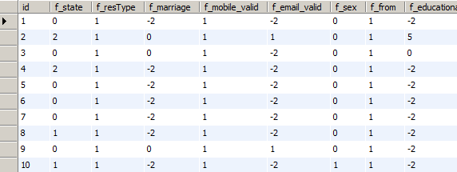
4. EXPERIMENTAL RESULTS AND ANALYSIS
1). Experimental Data
user information table, questionnaire table and questionnaire trace table
training data id3_data is constructed which consists of users’ ID, questionnaire ID, Ques Type and all attributes
id | attrName | attrValue
1 | from | 0;1
2 | mobile_valid | 1;0
3 | email_valid | 1;0
4 | marriage | 0;1
5 | sex | 1;0
6 | educational | 0;3;4;5;6
7 | Type | 1;2;3;4;5;6;7;8;9
8 | state | 1;2;8;21

Slide 16
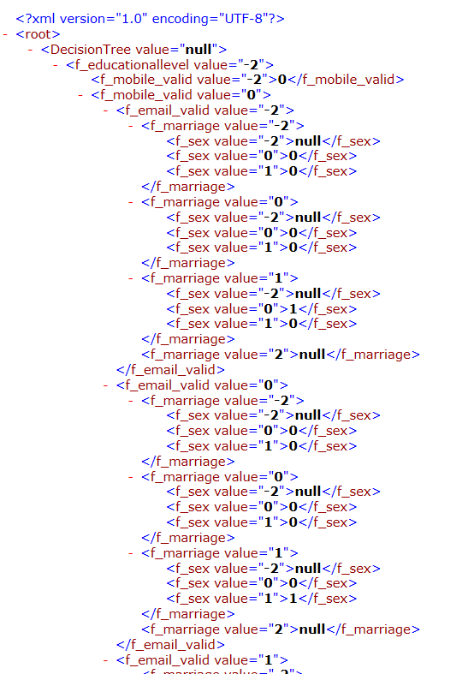
4. EXPERIMENTAL RESULTS AND ANALYSIS
2). Experimental Method
Process 1: Type 3-->Mobile 1-->Gender 1-->0 Result 1: Forecast Value:0 Real Value:1 Process 2: Type3-->Mobile 1-->Gender 0-->1 Result 2: Forecast Value:1 Real Value:1 Process 3: Type 3--> Mobile 1--> Gender 1-->0 Result 3: Forecast Value:0 Real Value:0 Process 4: Type 3--> Mobile 1--> Gender 0-->1 Result 4: Forecast Value:1 Real Value:1

Slide 17
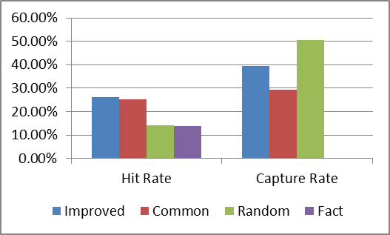
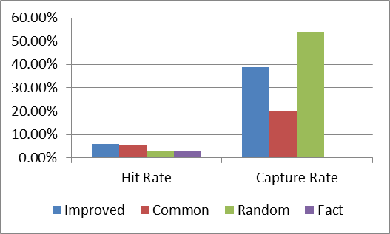
4. EXPERIMENTAL RESULTS AND ANALYSIS
C. Experimental Results

Slide 18
5 Fifth Part
Conclusion

Slide 19
5. CONCLUSION
Propose a prediction model for forecasting response rate based on ID3 in decision tree;
Store the generated prediction model using XML;
Feasibility and effectiveness of proposed prediction model with high response rate;
Improved decision tree model achieve high capture rate compared with common decision tree.

Slide 20
Thank you for your attention!
请对不足之处提宝贵意见！
Naibin Luo
jsluonaibin@163.com

