Slide 1
CS 193A
Making Basic 2D Games
This document is copyright (C) Marty Stepp and Stanford Computer Science.
Licensed under Creative Commons Attribution 2.5 License. All rights reserved.

Slide 2
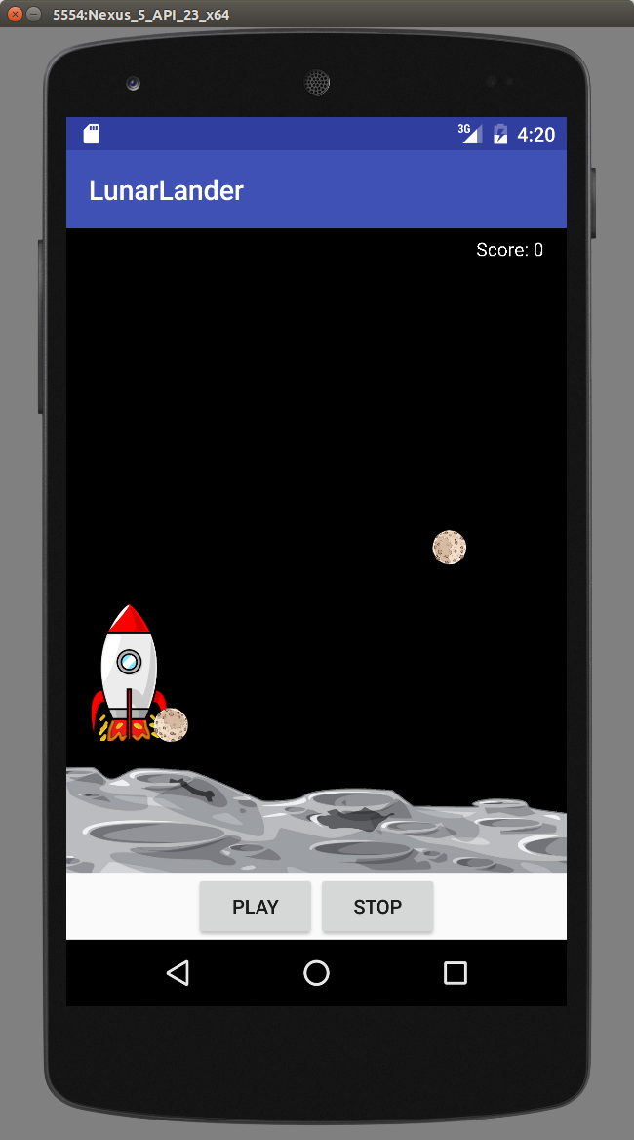
Lunar Lander game
Let's write a lunar lander game.
  Rocket falls with 4 initial velocity, 0.5 downward acceleration.
  Touch screen and hold to thrust; when thrusting,
  rocket accelerates upward at 0.3 acceleration.
  Once per second, an asteroid appears at right
  edge of screen, going left with 12 velocity.
  If it hits rocket, game is over.
  Player earns 1 point per second alive.
  If rocket can touch the bottom of the screen with
  a velocity of 7 or less, player wins.

Slide 3
A basic animation loop
The code to animate a view must do the following in a loop:
  1) process any user input (mouse touch events, key presses, etc.)
  2) update the game state (move any sprites, handle collisions, etc.)
  3) tell the view to redraw itself (which happens on the main UI thread)
  4) pause for some number of milliseconds
// game animation loop pseudo-code
function myAnimationLoop():
while true:
1) process user input
2) update game's state
3) tell view to redraw self on main UI thread
4) pause/sleep for some number of MS

Slide 4
Animation loop in GCanvas
The library's GCanvas has an animate method to start animation.
  It will call your onAnimateTick method once per frame.
  It contains the while loop and the part to invalidate the view.
  Any GSprites in the GCanvas will also automatically move themselves.
  You can just focus on the code to update the game state.
// in MyCanvas.java
animate(20); // 20 fps = 50ms
...
// called once per frame of animation
public void onAnimateTick() {
// process user input
// update your game's state
my game update code goes here;
}

Slide 5
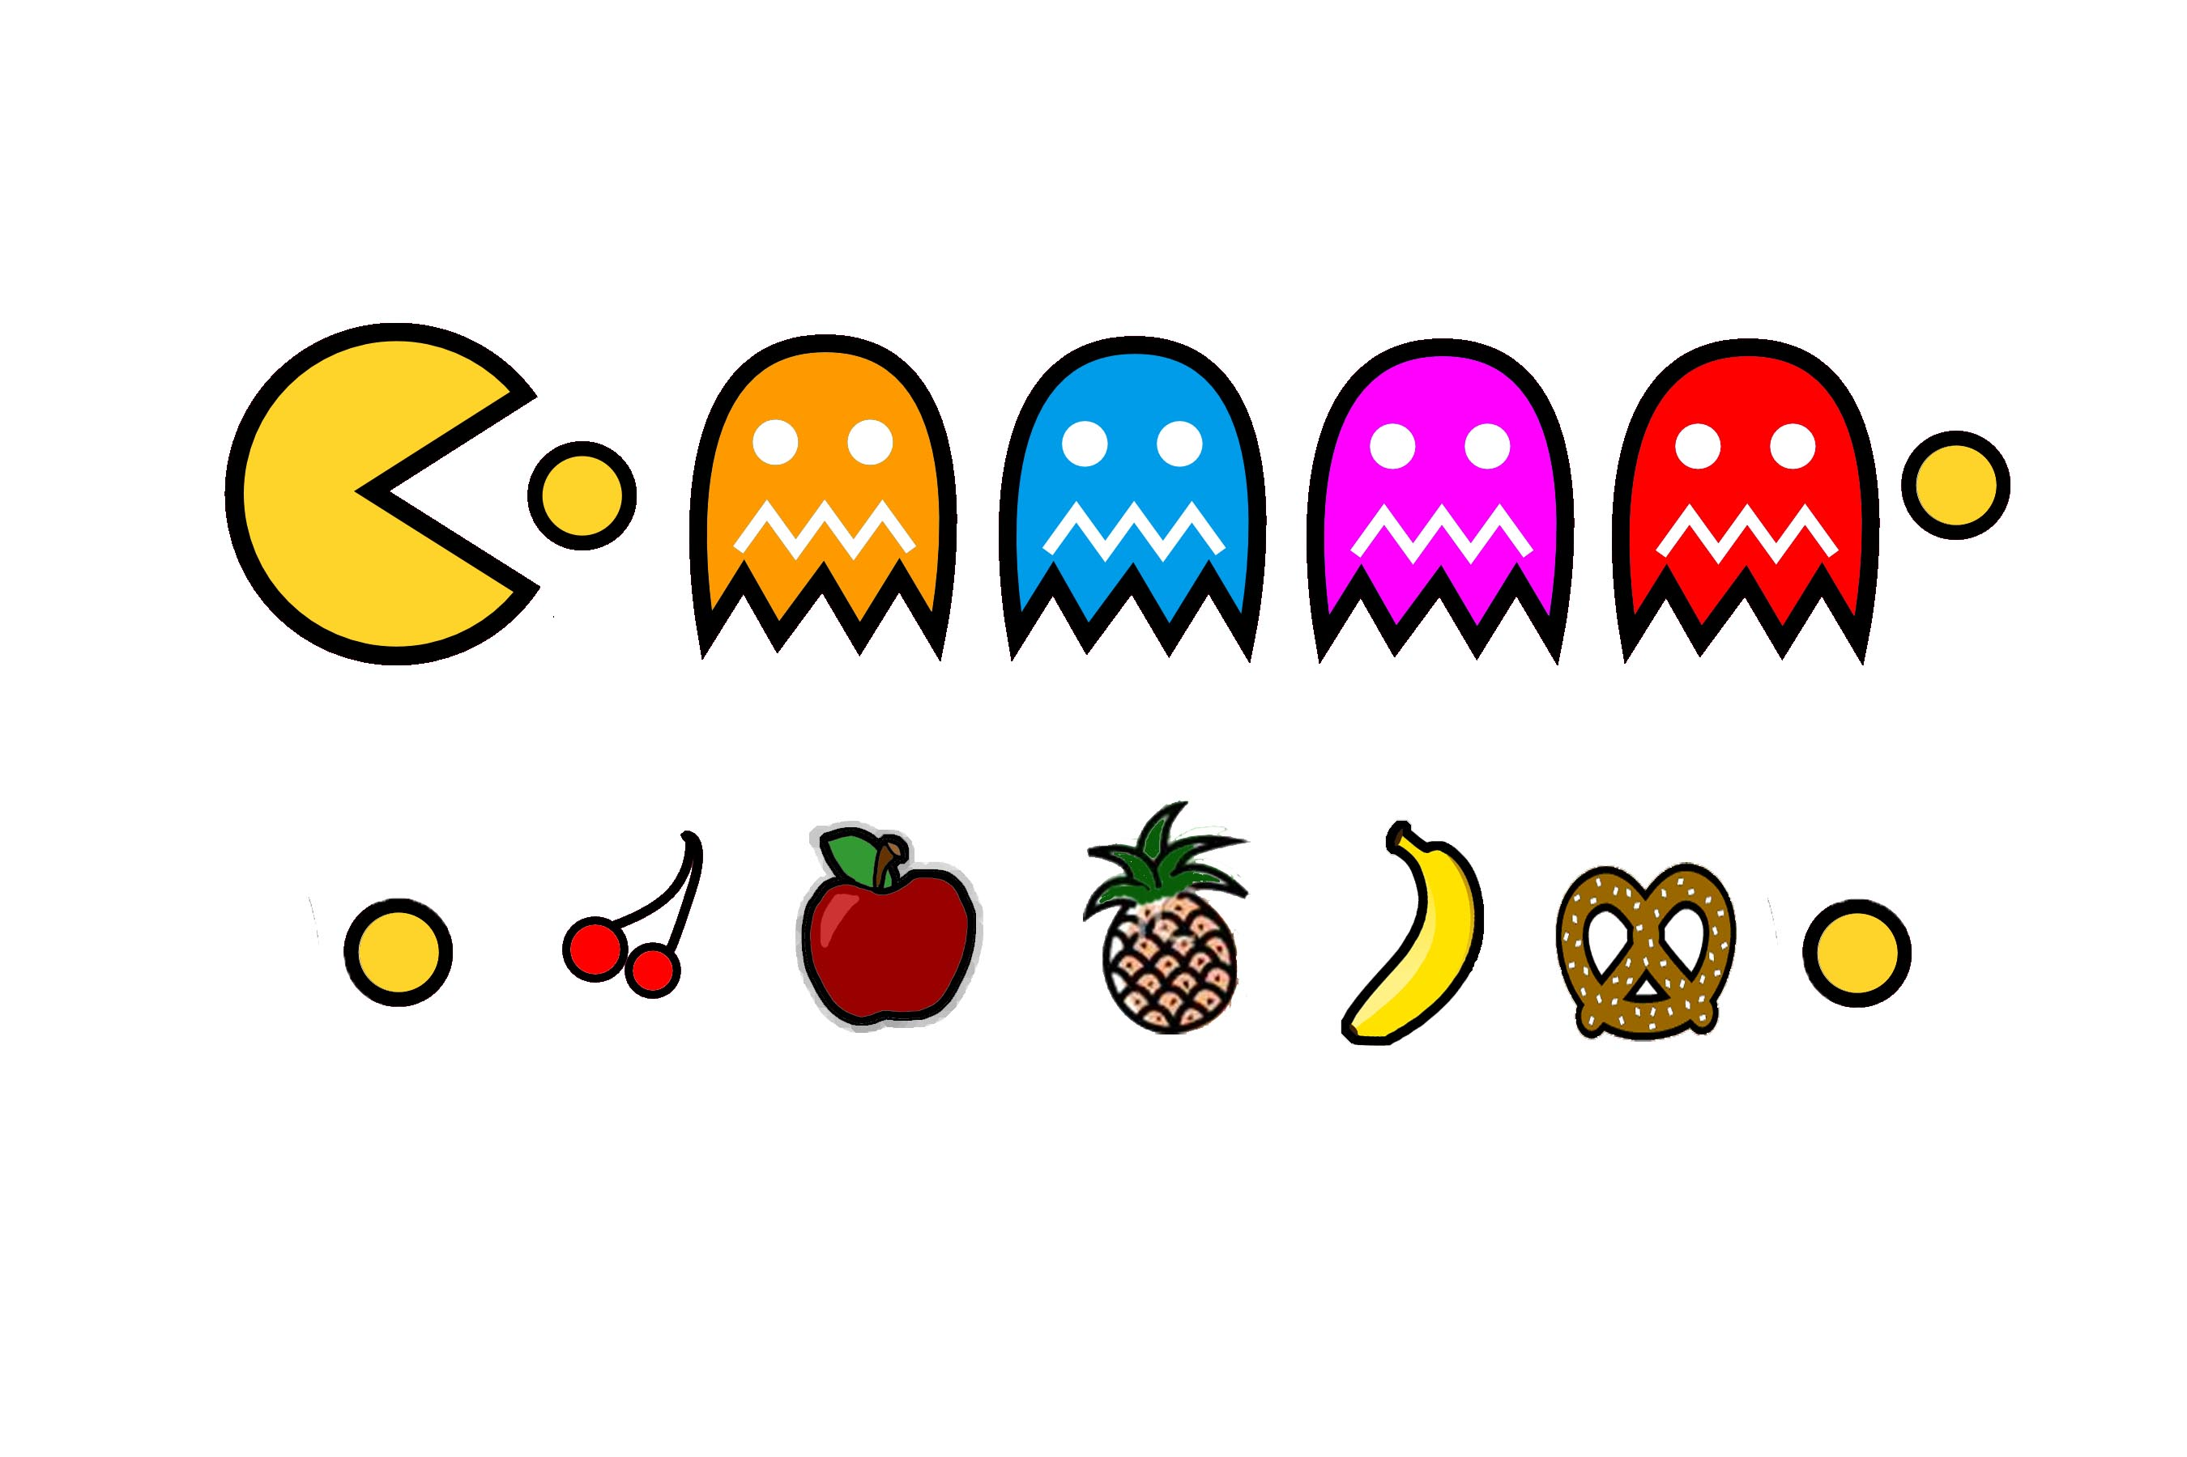
A Sprite class
sprite: An object of interest in a game.
  possible data: location, size, velocity, shape/image, points, ...
  Many games declare some kind of Sprite class to represent the sprites.
  Useful sprite operations: drawing, movement, visibility, collisions
  See Stanford library class: GSprite
// an example sprite class
public class Sprite {
float x, y, w, h;
float dx, dy;
Paint paint;
...
}

Slide 6
Sprite drawing code
Sprites can contain code to draw themselves.
  Game's onDraw tells each sprite to draw itself in a loop.
public class Sprite {
float x, y, w, h;
float dx, dy;
Paint paint;
...
public void draw(Canvas canvas) {
canvas.drawRect(x, y, x+w, y+h, paint);
}
}

Slide 7

Sprite with bitmap
Most games draw their sprites as bitmap images.
  GSprite: setBitmap, constructor
public class Sprite {
float x, y, w, h;
float dx, dy;
Bitmap bitmap;
...
public void draw(Canvas canvas) {
canvas.drawBitmap(bitmap, x, y, paint);
}
}

Slide 8
Moving Sprites
One way to do movement: Have each sprite store a velocity.
  dx/dy pair, or write a simple 2D Vector class
  usually write a simple method to tell the sprite to move/update itself
    this method is called once for each frame in your game's animation loop
  GSprite: setVelocity, rotateVelocity
public class Sprite {
float x, y, w, h;
float dx, dy;
...
public void move() {
x += dx;
y += dy;
}
}
dx = 5, dy = 0

Slide 9
Acceleration
More advanced: You may want to apply acceleration to movement.
  could be a single value (scale up/down), separate ax/ay, or another 2D vector
  updates velocity when object moves
    need to watch out for sign issues if velocity components are negative
    GSprite: setAcceleration
public class Sprite {
float x, y, w, h;
float dx, dy;
float ax, ay;
...
public void move() {
x += dx;
y += dy;
dx *= (1.0 + ax); // accelerate
dy *= (1.0 + ay);
}
}

Slide 10
Frame rate independence
You may want to move objects at a constant speed regardless of the number of frames/sec used in your animation.
  To do this, allow sprites to see FPS and weight their velocity accordingly.
  Now dx/dy means change per second, not per frame of animation.
  Advanced: On slower/older devices, can implement a frame skip .
public class Sprite {
float x, y, w, h;
float dx, dy;
...
public void move(int fps) {
x += dx / fps;
y += dy / fps;
}
}

Slide 11
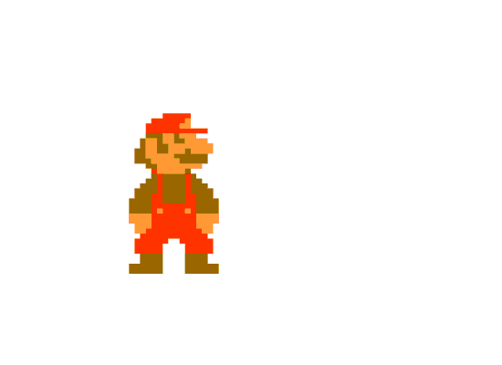
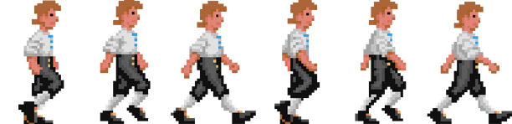
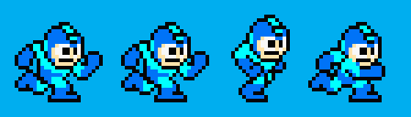
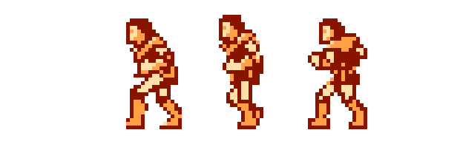
Sprite animation / walk cycle
Make the sprite change image as it animates (a "walk cycle"):
  Store a list of bitmap images to display.
    Cycle through the images in the list by remembering a current index.
  Don't change images every frame; this will be too fast.
  List of bitmaps may change based on game events.
    Example: Change direction; get shot; get powerup.
  GSprite: setBitmaps, setFramesPerBitmap

Slide 12
Sprite with walk cycle
public class Sprite {
ArrayList<Bitmap> bitmaps;
int bitmapIndex = 0;
int frame = 0;
int framesPerBitmap = 10;
...
public void move() {
frame++;
if (frame % framesPerBitmap == 0) {
// move to next bitmap in cycle
bitmapIndex = (bitmapIndex + 1) % bitmaps.size();
}
}
public void draw(Canvas canvas) {
canvas.drawBitmap(bitmaps.get(bitmapIndex), x, y,
null);
}
}

Slide 13
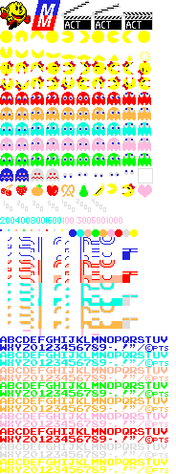
Image strips
pacman-strip.png
Loading lots of small images can be slow.
image strip: Many images in one large file.
  Can load it just once and then chop it apart.
  Code is a bit more complex,
  but load/run time is very fast.
In Android's Bitmap class:
  public Bitmap createBitmap(
  Bitmap source,
  int x, int y,
  int width, int height)
    Extracts the given sub-range of pixels of this bitmap
    as its own Bitmap and returns it.

Slide 14
Collision detection
collision detection: Determining whether sprites in the game world are touching each other (and reacting accordingly).
  You can calculate whether two sprites have collided
  by seeing whether their bounds overlap.
Android's RectF (link) and other shapes have
methods to check whether they touch:
  rect1.contains(x, y)
  rect1.contains(rect2)
  RectF.intersects(rect1, rect2)
  GSprite: collidesWith

Slide 15

Sprite with collision detection
Suggested: Have sprite represent its bounds as a rectangle.
  The rectangle object will know if it hits another sprite.
public class Sprite {
RectF bounds;
float dx, dy;
...
public void move() {
bounds.left += dx;
bounds.top += dy;
}
public boolean collides(Sprite other) {
return RectF.intersects(bounds, other.bounds);
}
}

Slide 16
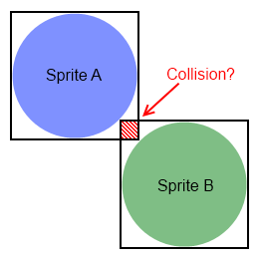
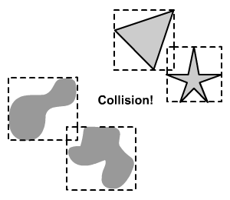
Collision margin
Collisions are harder to compute for
non-rectangular sprites.
  Don't want the empty edges to collide.
  Even for rectangular shapes, it can be
  preferable to have a bit of collision "slack".
Some games use a collision rectangle
smaller than the overall bounding box
to give the collisions a bit of lenience.
  GSprite: setCollisionMargin(...)

Slide 17
Common collision bug
When an object moves at high velocity, it may wrongly "jump through" a sprite it ought to collide with.
Several possible fixes to this issue:
  perform more/smaller "updates" per frame of
  animation to effectively reduce velocity
    e.g. update (move 5px), update (move 5px), redraw;
    works well with FPS-independent movement shown before
  temporarily enlarge collision rectangles for
  some fast-moving sprites
    enlarge; do collision detection; shrink
  use a proper physics engine, vectors, etc.
  for game movement
    most professional-quality game engines will
    help you address this bug in some way
v = 10
5px

Slide 18

GSprite methods
Method | Description
GSprite(...) | initializes a new sprite with given shape, coords
canvas: addTo(GCanvas), remove() | adds/removes sprite from screen
collisions: collidesWith(sprite), is/setCollidable(), get/setCollisionMarginTop/Bottom/Left/Right/X/Y() | returns true if two sprites touch each other; sets collision margin to reduce collisions
location: get/setX/Y, get/setLocation(), bound(), boundHorizontal/Vertical(), isInBounds(), moveTo(x, y), translate(dx, dy) | where the sprite is on the screen
velocity: get/setVelocity, flipVelocity/X/Y, isMoving, moveBy(dx, dy) | whether the sprite will move on each update()
acceleration: get/setAcceleration/X/Y() | whether velocity will change on each update()
bitmaps: get/setBitmaps, scale, get/setFramesPerBitmap, isSetLoopBitmaps | images to draw on the sprite; if multiple images are passed, can cycle between them/animate
extras: get/setExtra(s), hasExtra, clearExtras | stuff "extra" data inside a sprite for convenience
size: get/setWidth/Height/Size/Bounds | size of sprite on screen
color: get/setColor, Paint, get/setFillColor, is/setFilled | color for sprites that are shapes

Slide 19
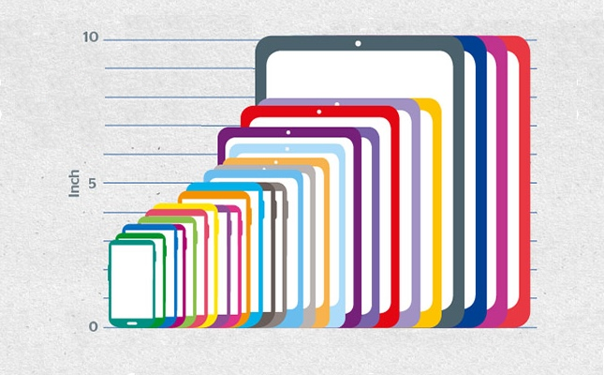
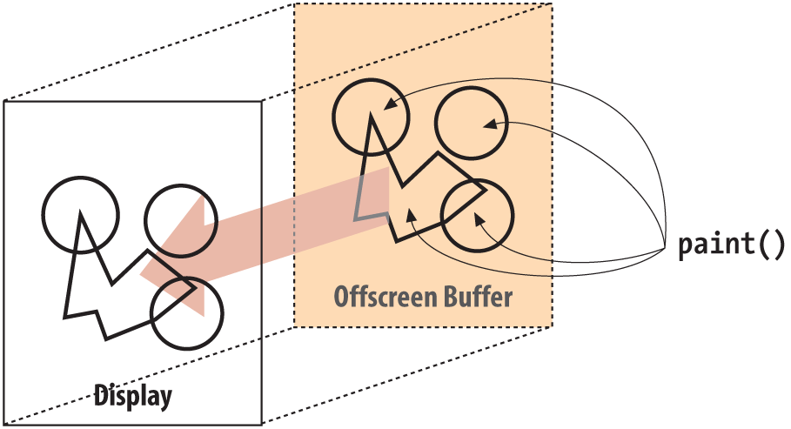
Different screen sizes
Android devices come in a variety of
screen sizes and shapes.
  Your game should run on a variety of
  device sizes.
Some ways to handle device sizing:
  Scale your bitmaps/coordinates relative to getWidth(), getHeight()
    Bitmap.createScaledBitmap(bitmap, width, height)
  Draw onto a backing buffer and then scale the buffer to fit the screen
    Bitmap.createBitmap(width, height,
    Bitmap.Config.ARGB_8888)

Slide 20
SimpleBitmap methods
Method | Description
SimpleBitmap.with(activity) | get a SimpleBitmap instance
get(id) get(id, width, height) | load a bitmap from a resource ID (possibly scaling it)
getAll(ids) | load a list of bitmaps from resource IDs
rotate(bmp or id, degrees) rotate(bmp or id, degrees, rx, ry) | rotate counter-clockwise about a given point
rotateLeft(bmp or id) rotateRight(bmp or id) | rotate 90 degrees counter-clockwise or clockwise
scale(bmp or id, scaleFactor) scale(bmp or id, sfX, sfY) | scale size of bitmap by given ratio
scaleToFit(bmp or id, canvas) | scale size of bitmap to largest size to fit within given canvas (maintain aspect ratio)
scaleToWidth(bmp or id, width) scaleToHeight(bmp or id, height) | scale size of bitmap to given width or height (maintain aspect ratio)
setFiltered(bool) | whether to anti-alias/smooth pixels (default true)

Slide 21
Double buffering
double buffering: Drawing all individual shapes/sprites onto an auxiliary image first, then drawing that image onto the screen.
  // hypothetical code to draw onto buffer
  Bitmap bmp = Bitmap.createBitmap(
  width, height, Bitmap.Config.ARGB_8888);
  Canvas bmpCanvas = new Canvas(bmp);
  for (Sprite sprite : mySprites) {
  sprite.draw(bmpCanvas);
  }
  ...
  protected void onDraw(Canvas canvas) {
  // scale the buffer and draw it onto the screen
  Rect src = new Rect(0, 0, bmp.getWidth(), bmp.getHeight());
  RectF dst = new RectF(0, 0, getWidth(), getHeight());
  canvas.drawBitmap(bmp, src, dst, /* paint */ null);

Slide 22
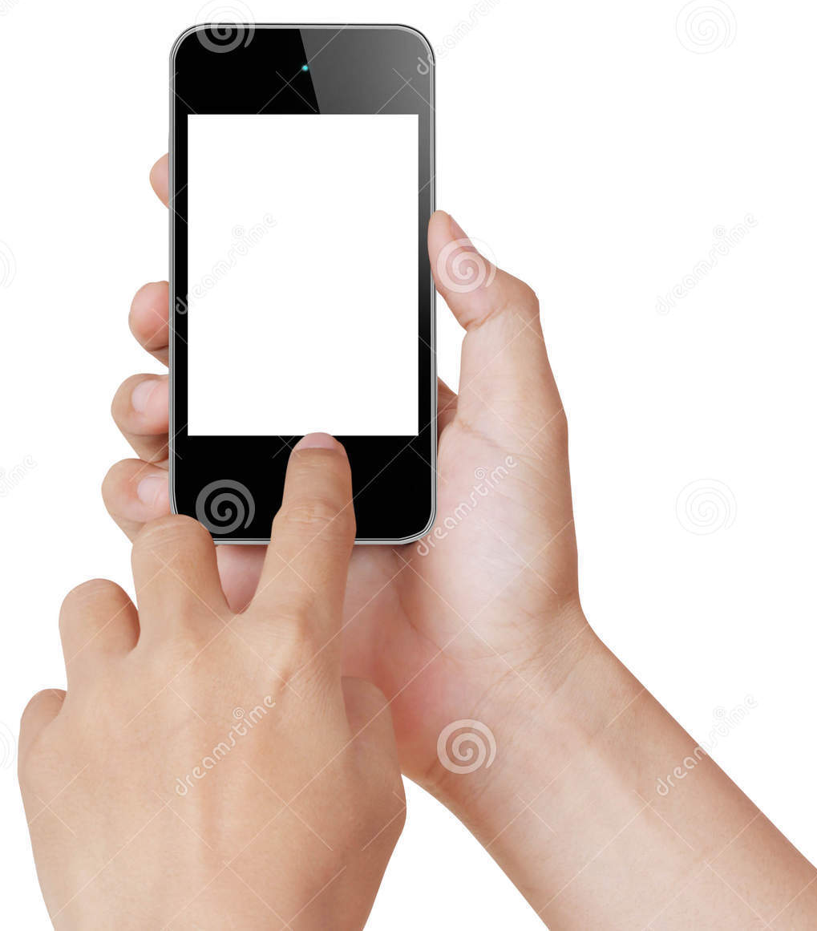
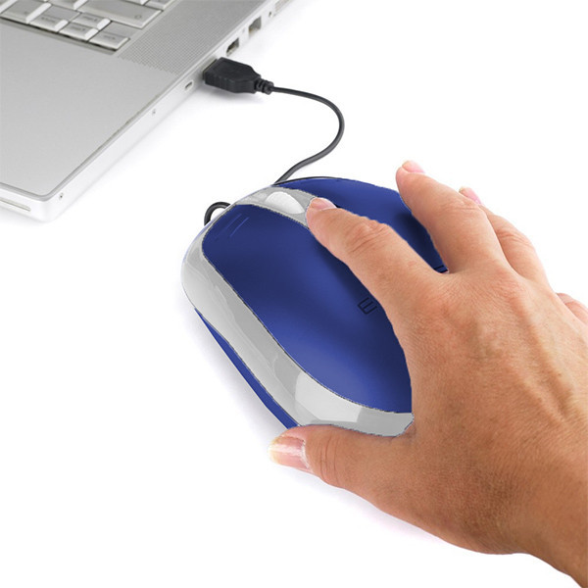
"Mouse" (touch) events
old mouse events: a physical mouse attached to a device
  types: button press, release; cursor moved; drag; enter/exit; hover
new touch events: a finger touching the screen
  types: button press, release; drag
  mouse movement, hovering largely absent
  multi-touch input now possible (not covered today)

Slide 23
Mouse touch events (link)
To handle finger presses from the user, write an onTouch method in your GCanvas or custom View class.
  actions: ACTION_DOWN, ACTION_UP, ACTION_MOVE, ...
  caution: don't write confusingly-similar onTouchEvent method
@Override
public boolean onTouch(View v, MotionEvent event) {
float x = event.getX();
float y = event.getY();
if (event.getAction() == MotionEvent.ACTION_DOWN) {
// code to run when finger is pressed
}
return super.onTouch(v, event);
}

Slide 24
Mouse event handling
Typically you don't draw sprites or handle much in a mouse event handler.
  Instead, remember the user 's action; use it in your next animation "tick" frame update.
private GSprite car;
...
public boolean onTouchEvent(MotionEvent event) {
float x = event.getX();
if (event.getAction() == MotionEvent.ACTION_DOWN) { // finger press
if (x < getWidth() / 2) {
car.setVelocityX(-10); // will move left
} else {
car.setVelocityX(10); // will move right
}
} else if (event.getAction() == MotionEvent.ACTION_UP) { // finger lift
car.setVelocityX(0);
}
return super.onTouchEvent(event);
}

Slide 25
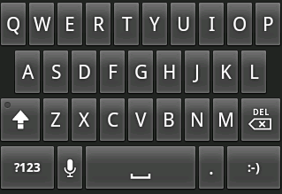
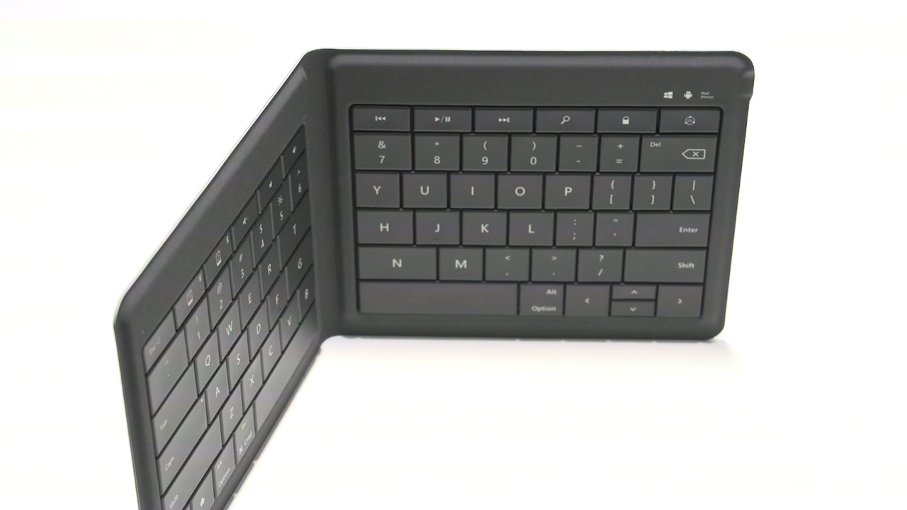
Keyboard events
Most Android devices do not have physical keyboards!
  If they do, it's likely an external device and not always attached.
  Onscreen keyboard generates events, but it's flaky and usually hidden.
Therefore, no app should ever use keyboard input for a critical part of its UI.
  Should always provide a mouse/touch / other method of input.
  Keyboard events are mostly for testing on a PC or dev machine.

Slide 26
Keyboard events (link)
If you want to handle key presses (if the device has a keyboard):
set your app to receive keyboard "focus" in View constructor:
    requestFocus();
    setFocusableInTouchMode(true);
write onKeyDown/Up methods in your custom View class.
  each key has a "code" such as KeyEvent.KEYCODE_ENTER
  or call setOnKeyListener and pass an OnKeyListener
@Override
public boolean onKeyDown(int keyCode, KeyEvent event) {
if (keyCode == KeyEvent.KEYCODE_X) {
// code to run when user presses the X key
}
return super.onKeyDown(keyCode, event);
}

Slide 27
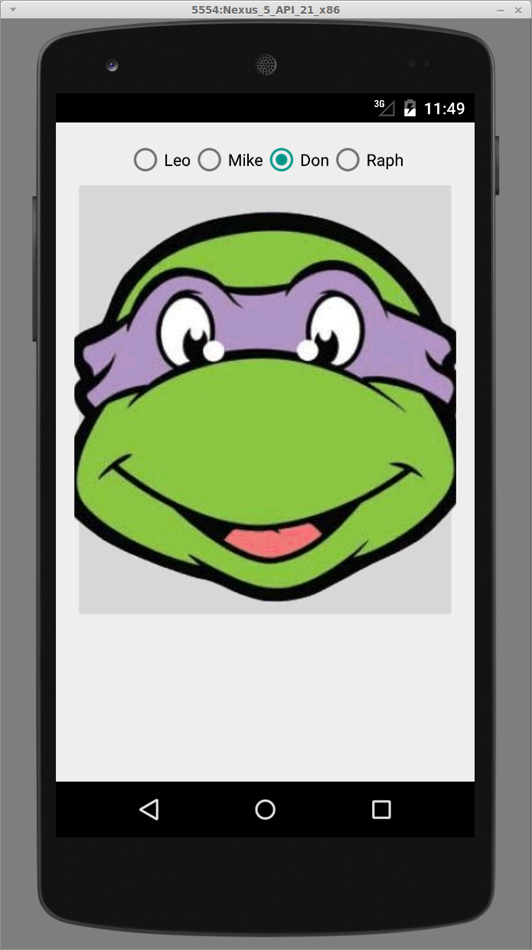
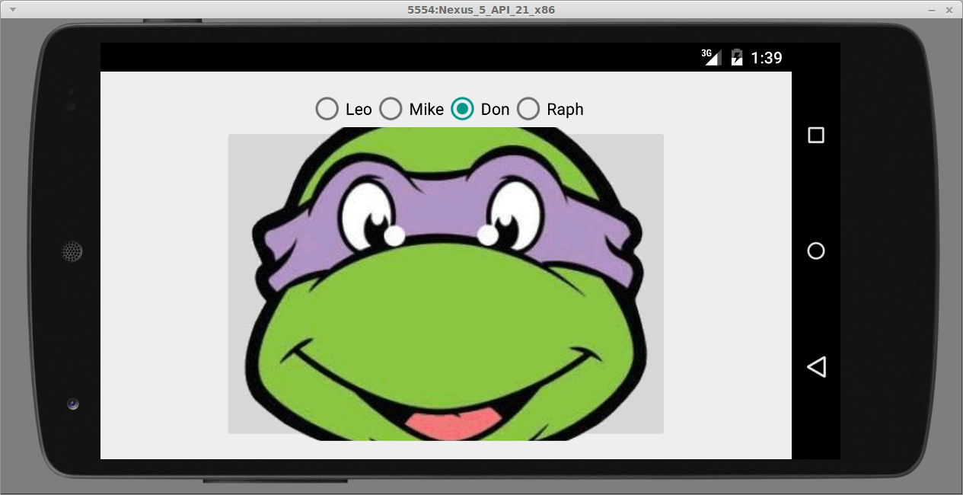
Recall: Keeping state on orientation
By default, rotating your app nukes your activity, reloads it, and loses any unsaved instance state.
  e.g. private fields, some GUI widget state information
<!-- add the following in AndroidManifest.xml -->
<activity android:name=".MainActivity"
android:configChanges="orientation|screenSize"
...>

Slide 28
Enemy AI
Many games have enemy characters with some
kind of behavior or AI.
  Can be implemented in several ways.
strategy pattern: Making small objects to represent
different AI styles/strategies.
  public class AggressiveStrategy extends GhostStrategy {
  public void decideMove() { ... }
  }
  ...
  myGhost.setStrategy(new AggressiveStrategy());

Slide 29

OpenGL ES (link)
OpenGL: Open standard graphics package supported on many computers and devices. Commonly used for 3D graphics.
  hardware-accelerated (uses GPU, not CPU)
  widely supported, freely available
Android devices include a version of OpenGL for embedded systems ("ES").
  public class MyGLRenderer implements GLSurfaceView.Renderer { ...
Used to provide big performance boost, even in 2D.
  In more recent Android versions, standard Canvas uses OpenGL, too.
  Now Canvas is often faster than explicitly using OpenGL ES for 2D.
  Therefore, OpenGL ES is not covered here.

Slide 30



Android Game Libraries
Unity: Popular cross-platform game library.
  http://unity3d.com/
  (comprehensive, deploys to many platforms)
libgdx: Another cross-platform game lib based on OpenGL.
  https://github.com/libgdx/libgdx/
  (in my opinion, a bit bare)
Google Play Games Services: Set of libraries made by Google for social gaming features.
  Achievements, High Scores/Leaderboard, Network Multiplayer
  https://developers.google.com/games/services/

Slide 31
Pros/cons of game frameworks
You don't even code in Java!
  Cocos2d-x: C++, JavaScript
  Unity: C# and others
  Skia: Python
  Xamarin: C#
Have their own editing software (not Android Studio)
Many are cross-platform and deploy (mostly) the same game code to multiple platforms
  code game once and deploy it on web, Android, iOS, etc.

Slide 32
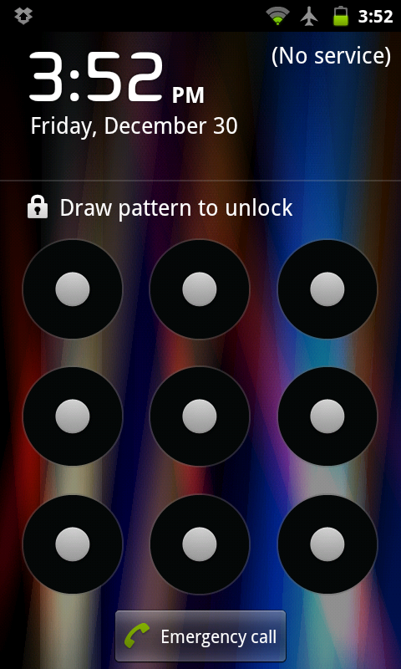
WakeLock
To prevent screen from blanking, use a wake lock.
in AndroidManifest.xml:
  <uses-permission
  android:name="android.permission.WAKE_LOCK" />
in app's activity Java code:
// create the lock (probably in onCreate)
PowerManager pwr = (PowerManager) getSystemService(POWER_SERVICE);
PowerManager.WakeLock lock =
pwr.newWakeLock(PowerManager.PARTIAL_WAKE_LOCK,
"my lock");
// turn on the lock (in onResume)
lock.acquire();
// turn off the lock (in onPause)
lock.release();

Slide 33
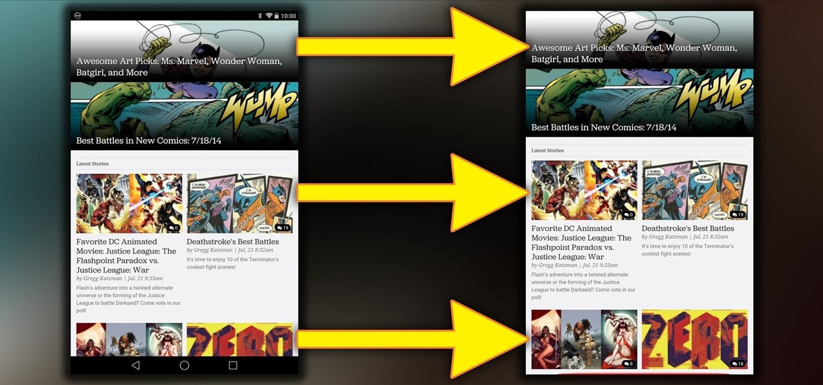
Full screen mode
To put an app (e.g. a game) into full screen mode,
which hides the notifications and status bar,
put the following in your activity's onCreate method:
requestWindowFeature(Window.FEATURE_NO_TITLE);
getWindow().setFlags(
WindowManager.LayoutParams.FLAG_FULLSCREEN,
WindowManager.LayoutParams.FLAG_FULLSCREEN);

Slide 34
SimpleActivity game methods
Method | Description
setWakeLock(boolean); | set whether wake lock should be on/off
wakeLockIsEnabled() | returns true if you called setWakeLock(true); before
setFullScreenMode(boolean); | set whether app should go into full screen mode

