Slide 1
CS 193A
Java Review
This document is copyright (C) Marty Stepp and Stanford Computer Science.
Licensed under Creative Commons Attribution 2.5 License. All rights reserved.

Slide 2

Variables
variable: A piece of the computer's memory that is given a name and type, and can store a value.
A variable can be declared/initialized in one statement.
Syntax:
  type name = value;
  double myGPA = 3.95;
  int x = (11 % 3) + 12;
x | 14
myGPA | 3.95

Slide 3
Java's primitive types
primitive types: 8 simple types for numbers, text, etc.
  Java also has object types, which we'll talk about later
  Name Description Examples
  int integers 42, -3, 0, 926394
  double real numbers 3.1, -0.25, 9.4e3
  char single text characters 'a', 'X', '?', '\n'
  boolean logical values true, false
  Why does Java distinguish integers vs. real numbers?
Notes:
We're basically going to manipulate letters and numbers.
We make the integer / real number distinction in English as well. We don't ask, "How many do you weigh?" or, "How much sisters do you have?"
Part of the int/double split is related to how a computer processor crunches numbers. A CPU does integer computations and a Floating Point Unit (FPU) does real number computations.
Why does Java separate int and double? Why not use one combined type called number?

Slide 4
Type casting
type cast: A conversion from one type to another.
  To promote an int into a double to get exact division from /
  To truncate a double from a real number to an integer
Syntax:
  (type) expression
  Examples:
  double result = (double) 19 / 5; // 3.8
  int result2 = (int) result; // 3
  int x = (int) Math.pow(10, 3); // 1000

Slide 5
Increment and decrement
shortcuts to increase or decrease a variable's value by 1
  Shorthand Equivalent longer version
  variable++; variable = variable + 1;
  variable--; variable = variable - 1;
  int x = 2;
  x++; // x = x + 1;
  // x now stores 3
  double gpa = 2.5;
  gpa--; // gpa = gpa - 1;
  // gpa now stores 1.5

Slide 6
Precedence
precedence: Order in which operators are evaluated.
  Generally operators evaluate left-to-right.
  1 - 2 - 3 is (1 - 2) - 3 which is -4
  But */% have a higher level of precedence than +-
  1 + 3 * 4 is 13
  6 + 8 / 2 * 3
  6 + 4 * 3
  6 + 12 is 18
  Parentheses can force a certain order of evaluation:
  (1 + 3) * 4 is 16
  Spacing does not affect order of evaluation
  1+3 * 4-2 is 11

Slide 7
String concatenation
string concatenation: Using + between a string and another value to make a longer string.
  "hello" + 42 is "hello42"
  1 + "abc" + 2 is "1abc2"
  "abc" + 1 + 2 is "abc12"
  1 + 2 + "abc" is "3abc"
  "abc" + 9 * 3 is "abc27"
  "1" + 1 is "11"
  4 - 1 + "abc" is "3abc"
Use + to print a string and an expression's value together.
  System.out.println("Grade: " + (95.1 + 71.9) / 2);
  Output: Grade: 83.5

Slide 8

Variable scope
scope: The part of a program where a variable exists.
  From its declaration to the end of the { } braces
    A variable declared in a for loop exists only in that loop.
    A variable declared in a method exists only in that method.
  public static void example() {
  int x = 3;
  for (int i = 1; i <= 10; i++) {
  System.out.println(x);
  }
  // i no longer exists here
  } // x ceases to exist here
x's scope

Slide 9
Class constants
class constant: A value visible to the whole program.
  value can only be set at declaration
  value can't be changed while the program is running
Syntax:
public static final type name = value;
  name is usually in ALL_UPPER_CASE
  Examples:
  public static final int DAYS_IN_WEEK = 7;
  public static final double INTEREST_RATE = 3.5;
  public static final int SSN = 658234569;

Slide 10
Passing parameters
Declaration:
  public void name (type name, ..., type name) {
  statement(s);
  }
Call:
  methodName (value, value, ..., value);
Example:
  public static void main(String[] args) {
  sayPassword(42); // The password is: 42
  sayPassword(12345); // The password is: 12345
  }
  public static void sayPassword(int code) {
  System.out.println("The password is: " + code);
  }

Slide 11
Return
return: To send out a value as the result of a method.
  The opposite of a parameter:
    Parameters send information in from the caller to the method.
    Return values send information out from a method to its caller.
-42
Math.abs(42)
42
main
2.71
3
Math.round(2.71)

Slide 12
Java's Math class
Method name | Description
Math.abs(value) | absolute value
Math.round(value) | nearest whole number
Math.ceil(value) | rounds up
Math.floor(value) | rounds down
Math.log10(value) | logarithm, base 10
Math.max(value1, value2) | larger of two values
Math.min(value1, value2) | smaller of two values
Math.pow(base, exp) | base to the exp power
Math.sqrt(value) | square root
Math.sin(value) Math.cos(value) Math.tan(value) | sine/cosine/tangent of an angle in radians
Math.toDegrees(value) Math.toRadians(value) | convert degrees to radians and back
Math.random() | random double between 0 and 1
Constant | Description
Math.E | 2.7182818...
Math.PI | 3.1415926...

Slide 13
Returning a value
  public type name(parameters) {
  statements;
  ...
  return expression;
  }
Example:
  // Returns the slope of the line between the given points.
  public double slope(int x1, int y1, int x2, int y2) {
  double dy = y2 - y1;
  double dx = x2 - x1;
  return dy / dx;
  }

Slide 14
Strings
string: An object storing a sequence of text characters.
  String name = "text";
  String name = expression;
  Characters of a string are numbered with 0-based indexes:
  String name = "P. Diddy";
  The first character's index is always 0
  The last character's index is 1 less than the string's length
  The individual characters are values of type char
index | 0 | 1 | 2 | 3 | 4 | 5 | 6 | 7
char | P | . |  | D | i | d | d | dy

Slide 15
String methods
These methods are called using the dot notation:
  String gangsta = "Dr. Dre";
  System.out.println(gangsta.length()); // 7
Method name | Description
indexOf(str) | index where the start of the given string appears in this string (-1 if it is not there)
length() | number of characters in this string
substring(index1, index2) or substring(index1) | the characters in this string from index1 (inclusive) to index2 (exclusive); if index2 omitted, grabs till end of string
toLowerCase() | a new string with all lowercase letters
toUpperCase() | a new string with all uppercase letters

Slide 16
String test methods
  String name = console.next();
  if (name.startsWith("Dr.")) {
  System.out.println("Are you single?");
  } else if (name.equalsIgnoreCase("LUMBERG")) {
  System.out.println("I need your TPS reports.");
  }
Method | Description
equals(str) | whether two strings contain the same characters
equalsIgnoreCase(str) | whether two strings contain the same characters, ignoring upper vs. lower case
startsWith(str) | whether one contains other's characters at start
endsWith(str) | whether one contains other's characters at end
contains(str) | whether the given string is found within this one

Slide 17
The equals method
Objects are compared using a method named equals.
  Scanner console = new Scanner(System.in);
  System.out.print("What is your name? ");
  String name = console.next();
  if (name.equals("Barney")) {
  System.out.println("I love you, you love me,");
  System.out.println("We're a happy family!");
  }
  Technically this is a method that returns a value of type boolean,
  the type used in logical tests.

Slide 18
Type char
char : A primitive type representing single characters.
  Each character inside a String is stored as a char value.
  Literal char values are surrounded with apostrophe
  (single-quote) marks, such as 'a' or '4' or '\n' or '\''
  It is legal to have variables, parameters, returns of type char
  char letter = 'S';
  System.out.println(letter); // S
char values can be concatenated with strings.
  char initial = 'P';
  System.out.println(initial + " Diddy"); // P Diddy

Slide 19
char vs. String
"h" is a String
'h' is a char (the two behave differently)
String is an object; it contains methods
  String s = "h";
  s = s.toUpperCase(); // 'H'
  int len = s.length(); // 1
  char first = s.charAt(0); // 'H'
char is primitive; you can't call methods on it
  char c = 'h';
  c = c.toUpperCase(); // ERROR: "cannot be dereferenced"
What is s + 1 ? What is c + 1 ?
What is s + s ? What is c + c ?

Slide 20
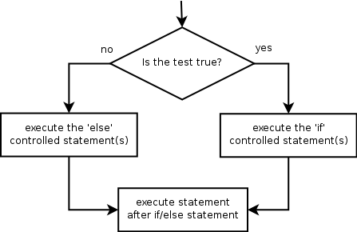
if/else
Executes one block if a test is true, another if false
  if (test) {
  statement(s);
  } else {
  statement(s);
  }
Example:
  double gpa = console.nextDouble();
  if (gpa >= 2.0) {
  System.out.println("Welcome to Mars University!");
  } else {
  System.out.println("Application denied.");
  }

Slide 21
Relational expressions
A test in an if is the same as in a for loop.
  for (int i = 1; i <= 10; i++) { ...
  if (i <= 10) { ...
  These are boolean expressions.
Tests use relational operators:
Operator | Meaning | Example | Value
== | equals | 1 + 1 == 2 | true
!= | does not equal | 3.2 != 2.5 | true
< | less than | 10 < 5 | false
> | greater than | 10 > 5 | true
<= | less than or equal to | 126 <= 100 | false
>= | greater than or equal to | 5.0 >= 5.0 | true
Notes:
Note that == tests equality, not = . The = is used for the assignment operator!

Slide 22
Logical operators: &&, ||, !
Conditions can be combined using logical operators:
"Truth tables" for each, used with logical values p and q:
Operator | Description | Example | Result
&& | and | (2 == 3) && (-1 < 5) | false
|| | or | (2 == 3) || (-1 < 5) | true
! | not | !(2 == 3) | true
p | q | p && q | p || q
true | true | true | true
true | false | false | true
false | true | false | true
false | false | false | false
p | !p
true | false
false | true

Slide 23
Type boolean
boolean: A logical type whose values are true and false.
  A test in an if, for, or while is a boolean expression.
  You can create boolean variables, pass boolean parameters, return boolean values from methods, ...
  boolean minor = (age < 21);
  boolean expensive = iPhonePrice > 200.00;
  boolean iLoveCS = true;
  if (minor) {
  System.out.println("Can't purchase alcohol!");
  }
  if (iLoveCS || !expensive) {
  System.out.println("Buying an iPhone");
  }

Slide 24
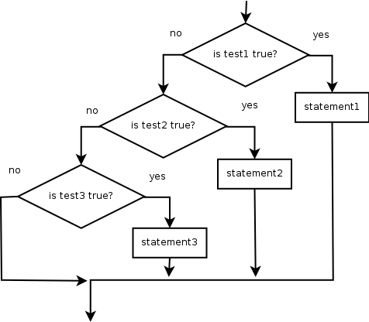
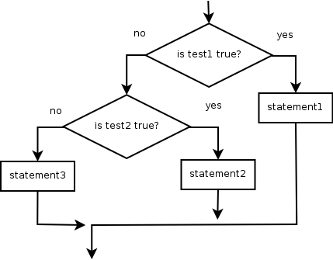
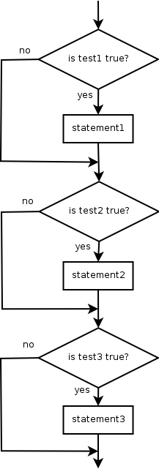
if/else Structures
Exactly 1 path: (mutually exclusive) if (test) { statement(s); } else if (test) { statement(s); } else { statement(s); } | 0 or 1 path: if (test) { statement(s); } else if (test) { statement(s); } else if (test) { statement(s); }
0, 1, or many paths: (independent tests, not exclusive) if (test) { statement(s); } if (test) { statement(s); } if (test) { statement(s); }

Slide 25
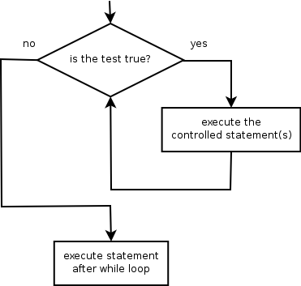
while loops
while loop: Repeatedly executes its
body as long as a logical test is true.
  while (test) {
  statement(s);
  }
Example:
  int num = 1; // initialization
  while (num <= 200) { // test
  System.out.print(num + " ");
  num = num * 2; // update
  }
  OUTPUT:
  1 2 4 8 16 32 64 128

Slide 26
do/while loops
do/while loop: Executes statements repeatedly while a condition is true, testing it at the end of each repetition.
  do {
  statement(s);
  } while (test);
  Example:
  // prompt until the user gets the right password
  String phrase;
  do {
  System.out.print("Password: ");
  phrase = console.next();
  } while (!phrase.equals("abracadabra"));

Slide 27
The Random class
A Random object generates pseudo-random* numbers.
  Class Random is found in the java.util package.
  import java.util.*;
  Example:
  Random rand = new Random();
  int randomNumber = rand.nextInt(10); // 0-9
Method name | Description
nextInt() | returns a random integer
nextInt(max) | returns a random integer in the range [0, max) in other words, 0 to max-1 inclusive
nextDouble() | returns a random real number in the range [0.0, 1.0)

Slide 28
break
break statement: Immediately exits a loop.
  Can be used to write a loop whose test is in the middle.
  Such loops are often called "forever" loops because their header's boolean test is often changed to a trivial true.
  while (true) {
  statement(s);
  if (test) {
  break;
  }
  statement(s);
  }
  Some programmers consider break to be bad style.

Slide 29
Arrays
array: object that stores many values of the same type.
  element: One value in an array.
  index: A 0-based integer to access an element from an array.
index | 0 | 1 | 2 | 3 | 4 | 5 | 6 | 7 | 8 | 9
value | 12 | 49 | -2 | 26 | 5 | 17 | -6 | 84 | 72 | 3
element 0
element 4
element 9

Slide 30
Array declaration
type[] name = new type[length];
  Example:
  int[] numbers = new int[10];
index | 0 | 1 | 2 | 3 | 4 | 5 | 6 | 7 | 8 | 9
value | 0 | 0 | 0 | 0 | 0 | 0 | 0 | 0 | 0 | 0

Slide 31
Accessing elements
name[index] // access
name[index] = value; // modify
  Example:
  numbers[0] = 27;
  numbers[3] = -6;
  System.out.println(numbers[0]);
  if (numbers[3] < 0) {
  System.out.println("Element 3 is negative.");
  }
index | 0 | 1 | 2 | 3 | 4 | 5 | 6 | 7 | 8 | 9
value | 27 | 0 | 0 | -6 | 0 | 0 | 0 | 0 | 0 | 0
index | 0 | 1 | 2 | 3 | 4 | 5 | 6 | 7 | 8 | 9
value | 0 | 0 | 0 | 0 | 0 | 0 | 0 | 0 | 0 | 0

Slide 32
Out-of-bounds
Legal indexes: between 0 and the array's length - 1.
  Reading or writing any index outside this range will throw an ArrayIndexOutOfBoundsException.
Example:
  int[] data = new int[10];
  System.out.println(data[0]); // okay
  System.out.println(data[9]); // okay
  System.out.println(data[-1]); // exception
  System.out.println(data[10]); // exception
index | 0 | 1 | 2 | 3 | 4 | 5 | 6 | 7 | 8 | 9
value | 0 | 0 | 0 | 0 | 0 | 0 | 0 | 0 | 0 | 0

Slide 33
The length field
An array's length field stores its number of elements.
  name.length
  for (int i = 0; i < numbers.length; i++) {
  System.out.print(numbers[i] + " ");
  }
  // output: 0 2 4 6 8 10 12 14
  It does not use parentheses like a String's .length().

Slide 34
Quick array initialization
  type[] name = {value, value, … value};
  Example:
  int[] numbers = {12, 49, -2, 26, 5, 17, -6};
  Useful when you know what the array's elements will be.
  The compiler figures out the size by counting the values.
index | 0 | 1 | 2 | 3 | 4 | 5 | 6
value | 12 | 49 | -2 | 26 | 5 | 17 | -6

Slide 35
The Arrays class
Class Arrays in package java.util has useful static methods for manipulating arrays:
Method name | Description
binarySearch(array, value) | returns the index of the given value in a sorted array (< 0 if not found)
equals(array1, array2) | returns true if the two arrays contain the same elements in the same order
fill(array, value) | sets every element in the array to have the given value
sort(array) | arranges the elements in the array into ascending order
toString(array) | returns a string representing the array, such as "[10, 30, 17]"

Slide 36
Arrays as parameters
Declaration:
  public type methodName(type[] name) {
  Example:
  public double average(int[] numbers) {
  ...
  }
Call:
  methodName(arrayName);
  Example:
  int[] scores = {13, 17, 12, 15, 11};
  double avg = average(scores);

Slide 37
Arrays as return
Declaring:
  public type[] methodName(parameters) {
  Example:
  public int[] countDigits(int n) {
  int[] counts = new int[10];
  ...
  return counts;
  }
Calling:
  type[] name = methodName(parameters);
  Example:
  public static void main(String[] args) {
  int[] tally = countDigits(229231007);
  System.out.println(Arrays.toString(tally));
  }

Slide 38
Value semantics (primitives)
value semantics: Behavior where values are copied when assigned to each other or passed as parameters.
  When one primitive variable is assigned to another,
  its value is copied.
  Modifying the value of one variable does not affect others.
  int x = 5;
  int y = x; // x = 5, y = 5
  y = 17; // x = 5, y = 17
  x = 8; // x = 8, y = 17
x
y

Slide 39
Reference semantics (objects)
reference semantics: Behavior where variables actually store the address of an object in memory.
  When one reference variable is assigned to another, the object is not copied; both variables refer to the same object.
  Modifying the value of one variable will affect others.
  int[] a1 = {4, 5, 2, 12, 14, 14, 9};
  int[] a2 = a1; // refer to same array as a1
  a2[0] = 7;
  System.out.println(a1[0]); // 7
a1
index | 0 | 1 | 2 | 3 | 4 | 5 | 6
value | 4 | 5 | 2 | 12 | 14 | 14 | 9
index | 0 | 1 | 2 | 3 | 4 | 5 | 6
value | 7 | 5 | 2 | 12 | 14 | 14 | 9
a2

Slide 40
Null
null : A reference that does not refer to any object.
  Fields of an object that refer to objects are initialized to null.
  The elements of an array of objects are initialized to null.
  String[] words = new String[5];
  Point[] points = new Point[3];
index | 0 | 1 | 2 | 3 | 4
value | null | null | null | null | null
words
index | 0 | 1 | 2
value | null | null | null
points

Slide 41
Null pointer exception
dereference: To access data or methods of an object with the dot notation, such as s.length().
  It is illegal to dereference null (causes an exception).
  null is not any object, so it has no methods or data.
  String[] words = new String[5];
  System.out.println("word is: " + words[0]);
  words[0] = words[0].toUpperCase();
  Output:
  word is: null
  Exception in thread "main" java.lang.NullPointerException
  at Example.main(Example.java:8)

Slide 42
Classes and objects
class: A program entity that represents either:
  1. A program / module, or
  2. A template for a new type of objects.
  The Point class is a template for creating Point objects.
object: An entity that combines state and behavior.
  object-oriented programming (OOP): Programs that perform their behavior as interactions between objects.

Slide 43
Fields
field: A variable inside an object that is part of its state.
  Each object has its own copy of each field.
  encapsulation: Declaring fields private to hide their data.
Declaration syntax:
  private type name;
  Example:
  public class Student {
  private String name; // each object now has
  private double gpa; // a name and gpa field
  }

Slide 44
Instance methods
instance method: One that exists inside each object of a class and defines behavior of that object.
  public type name(parameters) {
  statements;
  }
  Example:
  public void shout() {
  System.out.println("HELLO THERE!");
  }

Slide 45
A Point class
  public class Point {
  private int x;
  private int y;
// Changes the location of this Point object.
  public void draw(Graphics g) {
  g.fillOval(x, y, 3, 3);
  g.drawString("(" + x + ", " + y + ")", x, y);
  }
  }
  Each Point object contains data fields named x and y.
  Each Point object contains a method named draw that draws that point at its current x/y position.

Slide 46
The implicit parameter
implicit parameter:
The object on which an instance method is called.
  During the call p1.draw(g);
  the object referred to by p1 is the implicit parameter.
  During the call p2.draw(g);
  the object referred to by p2 is the implicit parameter.
  The instance method can refer to that object's fields.
    We say that it executes in the context of a particular object.
    draw can refer to the x and y of the object it was called on.

Slide 47
Kinds of methods
Instance methods take advantage of an object's state.
  Some methods allow clients to access/modify its state.
accessor: A method that lets clients examine object state.
  Example: A distanceFromOrigin method that tells how far a Point is away from (0, 0).
  Accessors often have a non-void return type.
mutator: A method that modifies an object's state.
  Example: A translate method that shifts the position of a Point by a given amount.

Slide 48
Constructors
constructor: Initializes the state of new objects.
  public type(parameters) {
  statements;
  }
  Example:
  public Point(int initialX, int initialY) {
  x = initialX;
  y = initialY;
  }
  runs when the client uses the new keyword
  does not specify a return type; implicitly returns a new object
  If a class has no constructor, Java gives it a default constructor with no parameters that sets all fields to 0.

Slide 49
toString method
tells Java how to convert an object into a String
  public String toString() {
  code that returns a suitable String;
  }
  Example:
  public String toString() {
  return "(" + x + ", " + y + ")";
  }
called when an object is printed/concatenated to a String:
  Point p1 = new Point(7, 2);
  System.out.println("p1: " + p1);
Every class has a toString, even if it isn't in your code.
  Default is class's name and a hex number: Point@9e8c34

Slide 50
this keyword
this : A reference to the implicit parameter.
  implicit parameter: object on which a method is called
Syntax for using this:
  To refer to a field:
  this.field
  To call a method:
  this.method(parameters);
  To call a constructor from another constructor:
  this(parameters);

Slide 51
Static methods
static method: Part of a class, not part of an object.
  shared by all objects of that class
  good for code related to a class but not to each object's state
  does not understand the implicit parameter, this;
  therefore, cannot access an object's fields directly
  if public, can be called from inside or outside the class
Declaration syntax:
  public static type name(parameters) {
  statements;
  }

Slide 52
Inheritance
inheritance: A way to form new classes based on existing classes, taking on their attributes/behavior.
  a way to group related classes
  a way to share code between two or more classes
One class can extend another, absorbing its data/behavior.
  superclass: The parent class that is being extended.
  subclass: The child class that extends the superclass and inherits its behavior.
    Subclass gets a copy of every field and method from superclass

Slide 53
Inheritance syntax
  public class name extends superclass {
  Example:
  public class Secretary extends Employee {
  ...
  }

Slide 54
Overriding methods
override: To write a new version of a method in a subclass that replaces the superclass's version.
  No special syntax required to override a superclass method.
  Just write a new version of it in the subclass.
  public class Secretary extends Employee {
  // overrides getVacationForm in Employee
  public String getVacationForm() {
  return "pink";
  }
  ...
  }

Slide 55
super keyword
Subclasses can call overridden methods with super
  super.method(parameters)
  Example:
  public class LegalSecretary extends Secretary {
  public double getSalary() {
  double baseSalary = super.getSalary();
  return baseSalary + 5000.0;
  }
  ...
  }

Slide 56
Polymorphism
polymorphism: Ability for the same code to be used with different types of objects and behave differently with each.
  Example: System.out.println can print any type of object.
    Each one displays in its own way on the console.
A variable of type T can hold an object of any subclass of T.
  Employee ed = new LegalSecretary();
  You can call any methods from Employee on ed.
  You can not call any methods specific to LegalSecretary.
When a method is called, it behaves as a LegalSecretary.
  System.out.println(ed.getSalary()); // 55000.0
  System.out.println(ed.getVacationForm()); // pink

Slide 57
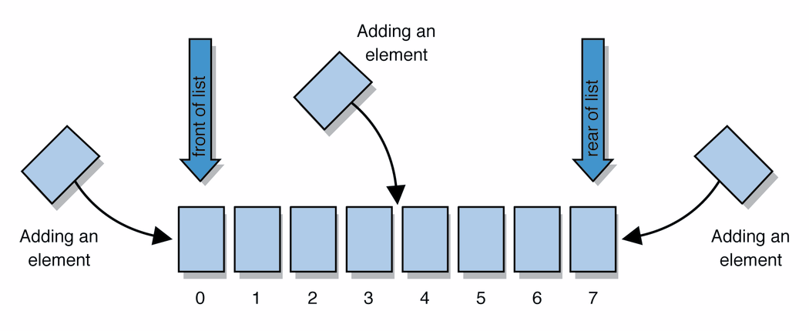
Collections and lists
collection: an object that stores data ("elements")
    import java.util.*; // to use Java's collections
list: a collection of elements with 0-based indexes
  elements can be added to the front, back, or elsewhere
  a list has a size (number of elements that have been added)
  in Java, a list can be represented as an ArrayList object

Slide 58
Idea of a list
An ArrayList is like an array that resizes to fit its contents.
When a list is created, it is initially empty.
  []
You can add items to the list. (By default, adds at end of list)
  [hello, ABC, goodbye, okay]
  The list object keeps track of the element values that have been added to it, their order, indexes, and its total size.
  You can add, remove, get, set, ... any index at any time.

Slide 59
Type parameters (generics)
ArrayList<Type> name = new ArrayList<Type>();
When constructing an ArrayList, you must specify the
type of its elements in < >
  This is called a type parameter ; ArrayList is a generic class.
  Allows the ArrayList class to store lists of different types.
  ArrayList<String> names = new ArrayList<String>();
  names.add("Marty Stepp");
  names.add("Stuart Reges");

Slide 60
ArrayList methods
add(value) | appends value at end of list
add(index, value) | inserts given value just before the given index, shifting subsequent values to the right
clear() | removes all elements of the list
indexOf(value) | returns first index where given value is found in list (-1 if not found)
get(index) | returns the value at given index
remove(index) | removes/returns value at given index, shifting subsequent values to the left
set(index, value) | replaces value at given index with given value
size() | returns the number of elements in list
toString() | returns a string representation of the list such as "[3, 42, -7, 15]"

Slide 61
ArrayList vs. array
  String[] names = new String[5]; // construct
  names[0] = "Jessica"; // store
  String s = names[0]; // retrieve
  for (int i = 0; i < names.length; i++) {
  if (names[i].startsWith("B")) { ... }
  } // iterate
  ArrayList<String> list = new ArrayList<String>();
  list.add("Jessica"); // store
  String s = list.get(0); // retrieve
  for (int i = 0; i < list.size(); i++) {
  if (list.get(i).startsWith("B")) { ... }
  } // iterate

Slide 62
ArrayList as param/return
public void name(ArrayList<Type> name) { // param
public ArrayList<Type> name(params) // return
Example:
  // Returns count of plural words in the given list.
  public int countPlural(ArrayList<String> list) {
  int count = 0;
  for (int i = 0; i < list.size(); i++) {
  String str = list.get(i);
  if (str.endsWith("s")) {
  count++;
  }
  }
  return count;
  }

Slide 63
Throwing exceptions
throw new ExceptionType();
throw new ExceptionType("message");
Generates an exception that will crash the program,
unless it has code to handle ("catch") the exception.
Common exception types:
  ArithmeticException, ArrayIndexOutOfBoundsException, FileNotFoundException, IllegalArgumentException, IllegalStateException, IOException, NoSuchElementException, NullPointerException, RuntimeException, UnsupportedOperationException
Why would anyone ever want a program to crash?

Slide 64
Sets
set: A collection of unique values (no duplicates allowed)
that can perform the following operations efficiently:
  add, remove, search (contains)
  We don't think of a set as having indexes; we just
  add things to the set in general and don't worry about order
"the"
"of"
"if"
set.contains("to")
"to"
"down"
"from"
true
"by"
"she"
set.contains("be")
"you"
false
"in"
"why"
"him"
set

Slide 65
Set implementation
in Java, sets are represented by Set type in java.util
Set is implemented by HashSet and TreeSet classes
  HashSet: implemented using a "hash table" array;
  very fast: O(1) for all operations
  elements are stored in unpredictable order
  TreeSet: implemented using a "binary search tree";
  pretty fast: O(log N) for all operations
  elements are stored in sorted order
  LinkedHashSet: O(1) but stores in order of insertion;
  slightly slower than HashSet because of extra info stored

Slide 66
Set methods
List<String> list = new ArrayList<String>();
...
Set<Integer> set = new TreeSet<Integer>(); // empty
Set<String> set2 = new HashSet<String>(list);
  can construct an empty set, or one based on a given collection
add(value) | adds the given value to the set
contains(value) | returns true if the given value is found in this set
remove(value) | removes the given value from the set
clear() | removes all elements of the set
size() | returns the number of elements in list
isEmpty() | returns true if the set's size is 0
toString() | returns a string such as "[3, 42, -7, 15]"

Slide 67
The "for each" loop
for (type name : collection) {
statements;
}
Provides a clean syntax for looping over the elements of a Set, List, array, or other collection
  Set<Double> grades = new HashSet<Double>();
  ...
  for (double grade : grades) {
  System.out.println("Student's grade: " + grade);
  }
  needed because sets have no indexes; can't get element i

Slide 68
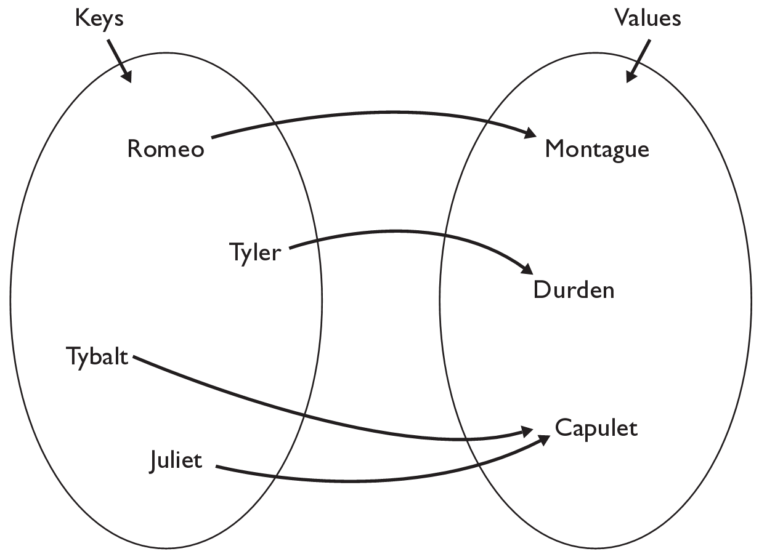
Maps
map: Holds a set of unique keys and a collection of values, where each key is associated with one value.
  a.k.a. "dictionary", "associative array", "hash"
basic map operations:
  put(key, value ): Adds a
  mapping from a key to
  a value.
  get(key ): Retrieves the
  value mapped to the key.
  remove(key ): Removes
  the given key and its
  mapped value.
myMap.get("Juliet") returns "Capulet"

Slide 69
Map implementation
in Java, maps are represented by Map type in java.util
Map is implemented by the HashMap and TreeMap classes
  HashMap: implemented using an array called a "hash table";
  extremely fast: O(1) ; keys are stored in unpredictable order
  TreeMap: implemented as a linked "binary tree" structure;
  very fast: O(log N) ; keys are stored in sorted order
  LinkedHashMap: O(1) ; keys are stored in order of insertion
A map requires 2 type params: one for keys, one for values.
// maps from String keys to Integer values
Map<String, Integer> votes = new HashMap<String, Integer>();

Slide 70
Map methods
put(key, value) | adds a mapping from the given key to the given value; if the key already exists, replaces its value with the given one
get(key) | returns the value mapped to the given key (null if not found)
containsKey(key) | returns true if the map contains a mapping for the given key
remove(key) | removes any existing mapping for the given key
clear() | removes all key/value pairs from the map
size() | returns the number of key/value pairs in the map
isEmpty() | returns true if the map's size is 0
toString() | returns a string such as "{a=90, d=60, c=70}"
keySet() | returns a set of all keys in the map
values() | returns a collection of all values in the map
putAll(map) | adds all key/value pairs from the given map to this map
equals(map) | returns true if given map has the same mappings as this one

Slide 71
Using maps
A map allows you to get from one half of a pair to the other.
  Remembers one piece of information about every index (key).
  Later, we can supply only the key and get back the related value:
    Allows us to ask: What is Suzy's phone number?
// key value
put("Suzy", "206-685-2181")
Map
get("Suzy")
Map
"206-685-2181"

Slide 72
keySet and values
keySet method returns a Set of all keys in the map
  can loop over the keys in a foreach loop
  can get each key's associated value by calling get on the map
  Map<String, Integer> ages = new TreeMap<String, Integer>();
  ages.put("Marty", 19);
  ages.put("Geneva", 2); // ages.keySet() returns Set<String>
  ages.put("Vicki", 57);
  for (String name : ages.keySet()) { // Geneva -> 2
  int age = ages.get(name); // Marty -> 19
  System.out.println(name + " -> " + age); // Vicki -> 57
  }
values method returns a collection of all values in the map
  can loop over the values in a foreach loop
  no easy way to get from a value to its associated key(s)

Slide 73
The compareTo method
The standard way for a Java class to define a comparison function for its objects is to define a compareTo method.
  Example: in the String class, there is a method:
  public int compareTo(String other)
A call of A.compareTo(B) will return:
  a value < 0 if A comes "before" B in the ordering,
  a value > 0 if A comes "after" B in the ordering,
  or 0 if A and B are considered "equal" in the ordering.

Slide 74
Using compareTo
compareTo can be used as a test in an if statement.
  String a = "alice";
  String b = "bob";
  if (a.compareTo(b) < 0) { // true
  ...
  }
Primitives | Objects
if (a < b) { ... | if (a.compareTo(b) < 0) { ...
if (a <= b) { ... | if (a.compareTo(b) <= 0) { ...
if (a == b) { ... | if (a.compareTo(b) == 0) { ...
if (a != b) { ... | if (a.compareTo(b) != 0) { ...
if (a >= b) { ... | if (a.compareTo(b) >= 0) { ...
if (a > b) { ... | if (a.compareTo(b) > 0) { ...

Slide 75
compareTo and collections
You can use an array or list of strings with Java's included binary search method because it calls compareTo internally.
  String[] a = {"al", "bob", "cari", "dan", "mike"};
  int index = Arrays.binarySearch(a, "dan"); // 3
Java's TreeSet/Map use compareTo internally for ordering.
  Set<String> set = new TreeSet<String>();
  for (String s : a) {
  set.add(s);
  }
  System.out.println(s);
  // [al, bob, cari, dan, mike]

Slide 76
Ordering our own types
We cannot binary search or make a TreeSet/Map of arbitrary types, because Java doesn't know how to order the elements.
  The program compiles but crashes when we run it.
  Set<HtmlTag> tags = new TreeSet<HtmlTag>();
  tags.add(new HtmlTag("body", true));
  tags.add(new HtmlTag("b", false));
  ...
  Exception in thread "main" java.lang.ClassCastException
  at java.util.TreeSet.add(TreeSet.java:238)

Slide 77
Comparable
public interface Comparable<E> {
public int compareTo(E other);
}
A class can implement the Comparable interface to define a natural ordering function for its objects.
A call to your compareTo method should return:
  a value < 0 if this object comes "before" the other object,
  a value > 0 if this object comes "after" the other object,
  or 0 if this object is considered "equal" to the other.
If you want multiple orderings, use a Comparator instead (see Ch. 13.1)

Slide 78
Comparable example
public class Point implements Comparable<Point> {
private int x;
private int y;
...
// sort by x and break ties by y
public int compareTo(Point other) {
if (x < other.x) {
return -1;
} else if (x > other.x) {
return 1;
} else if (y < other.y) {
return -1; // same x, smaller y
} else if (y > other.y) {
return 1; // same x, larger y
} else {
return 0; // same x and same y
}
}
}

Slide 79
Collections class
Method name | Description
binarySearch(list, value) | returns the index of the given value in a sorted list (< 0 if not found)
copy(listTo, listFrom) | copies listFrom's elements to listTo
emptyList(), emptyMap(), emptySet() | returns a read-only collection of the given type that has no elements
fill(list, value) | sets every element in the list to have the given value
max(collection), min(collection) | returns largest/smallest element
replaceAll(list, old, new) | replaces an element value with another
reverse(list) | reverses the order of a list's elements
shuffle(list) | arranges elements into a random order
sort(list) | arranges elements into ascending order

Slide 80
Sorting methods in Java
The Arrays and Collections classes in java.util have a static method sort that sorts the elements of an array/list
  String[] words = {"foo", "bar", "baz", "ball"};
  Arrays.sort(words);
  System.out.println(Arrays.toString(words));
  // [ball, bar, baz, foo]
  List<String> words2 = new ArrayList<String>();
  for (String word : words) {
  words2.add(word);
  }
  Collections.sort(words2);
  System.out.println(words2);
  // [ball, bar, baz, foo]

Slide 81
Recall: Inheritance
inheritance: Forming new classes based on existing ones.
  superclass: Parent class being extended.
  subclass: Child class that inherits behavior from superclass.
    gets a copy of every field and method from superclass
override: To replace a superclass's method by writing a new version of that method in a subclass.
  public class Lawyer extends Employee {
  // overrides getSalary in Employee; a raise!
  public double getSalary() {
  return 55000.00;
  }
  }

Slide 82
The super keyword
  super.method(parameters)
  super(parameters);
  Subclasses can call overridden methods/constructors with super
  public class Lawyer extends Employee {
  private boolean passedBarExam;
  public Lawyer(int vacationDays, boolean bar) {
  super(vacationDays * 2);
  this.passedBarExam = bar;
  }
  public double getSalary() {
  double baseSalary = super.getSalary();
  return baseSalary + 5000.00; // $5K raise
  }
  ...
  }

Slide 83
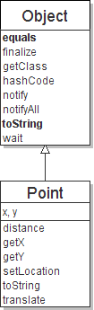
The class Object
The class Object forms the root of the
overall inheritance tree of all Java classes.
  Every class is implicitly a subclass of Object
The Object class defines several methods
that become part of every class you write.
For example:
  public String toString()
  Returns a text representation of the object,
  usually so that it can be printed.

Slide 84
Object methods
  What does this list of methods tell you about Java's design?
method | description
protected Object clone() | creates a copy of the object
public boolean equals(Object o) | returns whether two objects have the same state
protected void finalize() | used for garbage collection
public Class<?> getClass() | info about the object's type
public int hashCode() | a code suitable for putting this object into a hash collection
public String toString() | text representation of object
public void notify() public void notifyAll() public void wait() public void wait(...) | methods related to concurrency and locking (seen later)

Slide 85
Using the Object class
You can store any object in a variable of type Object.
  Object o1 = new Point(5, -3);
  Object o2 = "hello there";
You can write methods that accept an Object parameter.
  public void checkNotNull(Object o) {
  if (o != null) {
  throw new IllegalArgumentException();
  }
You can make arrays or collections of Objects.
  Object[] a = new Object[5];
  a[0] = "hello";
  a[1] = new Random();
  List<Object> list = new ArrayList<Object>();

Slide 86
Recall: comparing objects
The == operator does not work well with objects.
  It compares references, not objects' state.
  It produces true only when you compare an object to itself.
  Point p1 = new Point(5, 3);
  Point p2 = new Point(5, 3);
  Point p3 = p2;
  // p1 == p2 is false;
  // p1 == p3 is false;
  // p2 == p3 is true
  // p1.equals(p2)?
  // p2.equals(p3)?
...
p1
x | 5 | y | 3
p2
...
x | 5 | y | 3
p3

Slide 87
Default equals method
The Object class's equals implementation is very simple:
  public class Object {
  ...
  public boolean equals(Object o) {
  return this == o;
  }
  }
However:
  When we have used equals with various objects, it didn't behave like == . Why not? if (str1.equals(str2)) { ...
  The Java API documentation for equals is elaborate. Why?

Slide 88
Implementing equals
  public boolean equals(Object name) {
  statement(s) that return a boolean value ;
  }
  The parameter to equals must be of type Object.
  Having an Object parameter means any object can be passed.
    If we don't know what type it is, how can we compare it?

Slide 89
Casting references
  Object o1 = new Point(5, -3);
  Object o2 = "hello there";
  ((Point) o1).translate(6, 2); // ok
  int len = ((String) o2).length(); // ok
  Point p = (Point) o1;
  int x = p.getX(); // ok
Casting references is different than casting primitives.
  Really casting an Object reference into a Point reference.
  Doesn't actually change the object that is referred to.
  Tells the compiler to assume that o1 refers to a Point object.

Slide 90
The instanceof keyword
  if (variable instanceof type) {
  statement(s);
  }
Asks if a variable refers
to an object of a given type.
  Used as a boolean test.
  String s = "hello";
  Point p = new Point();
expression | result
s instanceof Point | false
s instanceof String | true
p instanceof Point | true
p instanceof String | false
p instanceof Object | true
s instanceof Object | true
null instanceof String | false
null instanceof Object | false

Slide 91
equals method for Points
  // Returns whether o refers to a Point object with
  // the same (x, y) coordinates as this Point.
  public boolean equals(Object o) {
  if (o instanceof Point) {
  // o is a Point; cast and compare it
  Point other = (Point) o;
  return x == other.x && y == other.y;
  } else {
  // o is not a Point; cannot be equal
  return false;
  }
  }

Slide 92
More about equals
Equality is expected to be reflexive, symmetric, and transitive:
  a.equals(a) is true for every object a
  a.equals(b) ↔ b.equals(a)
  (a.equals(b) && b.equals(c)) ↔ a.equals(c)
No non-null object is equal to null:
  a.equals(null) is false for every object a
Two sets are equal if they contain the same elements:
  Set<String> set1 = new HashSet<String>();
  Set<String> set2 = new TreeSet<String>();
  for (String s : "hi how are you".split(" ")) {
  set1.add(s); set2.add(s);
  }
  System.out.println(set1.equals(set2)); // true

Slide 93
The hashCode method
  public int hashCode()
  Returns an integer hash code for this object, indicating its preferred to place it in a hash table / hash set.
  Allows us to store non-int values in a hash set/map:
  public static int hashFunction(Object o) {
  return Math.abs(o.hashCode()) % elements.length;
  }
How is hashCode implemented?
  Depends on the type of object and its state.
    Example: a String's hashCode adds the ASCII values of its letters.
  You can write your own hashCode methods in classes you write.
    All classes come with a default version based on memory address.

Slide 94
Polymorphism
polymorphism: Ability for the same code to be used with different types of objects and behave differently with each.
A variable or parameter of type T can refer to any subclass of T.
  Employee ed = new Lawyer();
  Object otto = new Secretary();
  When a method is called on ed, it behaves as a Lawyer.
  You can call any Employee methods on ed.
  You can call any Object methods on otto.
    You can not call any Lawyer-only methods on ed (e.g. sue).
    You can not call any Employee methods on otto (e.g. getHours).

Slide 95
Polymorphism examples
You can use the object's extra functionality by casting.
  Employee ed = new Lawyer();
  ed.getVacationDays(); // ok
  ed.sue(); // compiler error
  ((Lawyer) ed).sue(); // ok
You can't cast an object into something that it is not.
  Object otto = new Secretary();
  System.out.println(otto.toString()); // ok
  otto.getVacationDays(); // compiler error
  ((Employee) otto).getVacationDays(); // ok
  ((Lawyer) otto).sue(); // runtime error

