Slide 1
CS 193A
Internationalization (i18n)
and Localization (L10n)
This document is copyright (C) Marty Stepp and Stanford Computer Science.
Licensed under Creative Commons Attribution 2.5 License. All rights reserved.

Slide 2



An app for the world
If you want your app to reach the widest possible audience, you may want to add support for other languages and cultures.
Many international users speak English, but many do not.
Users will of course prefer an app that reflects their own language and culture over one that doesn't.

Slide 3
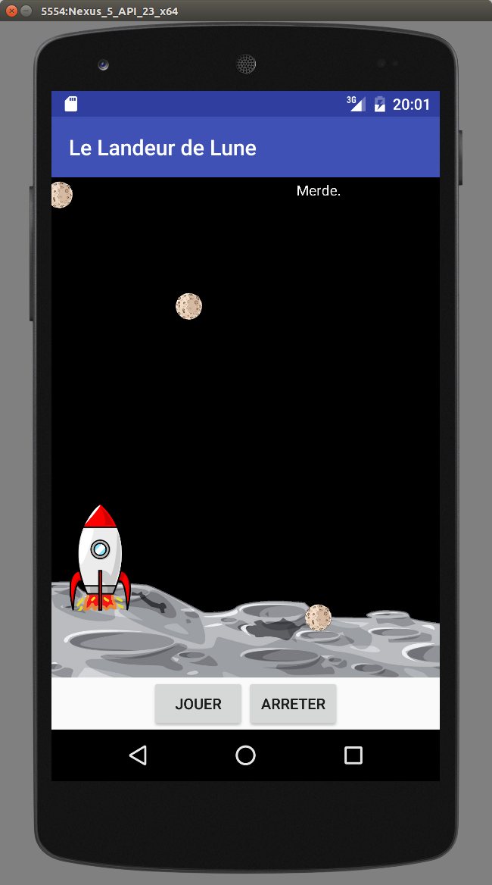
Goal of today's lecture
Let's create a Lunar Lander that also supports French language.
  Text strings in the app will appear in French.
  Any numbers shown will use the type of number
  formatting expected by French users.
  Some images in the app will change to
  new French-specific versions.

Slide 4
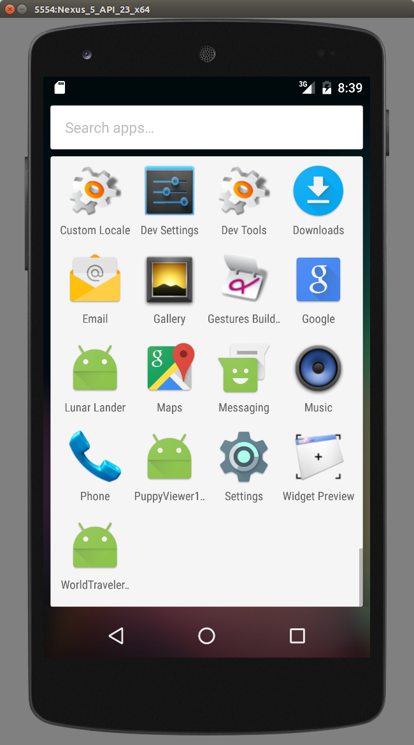
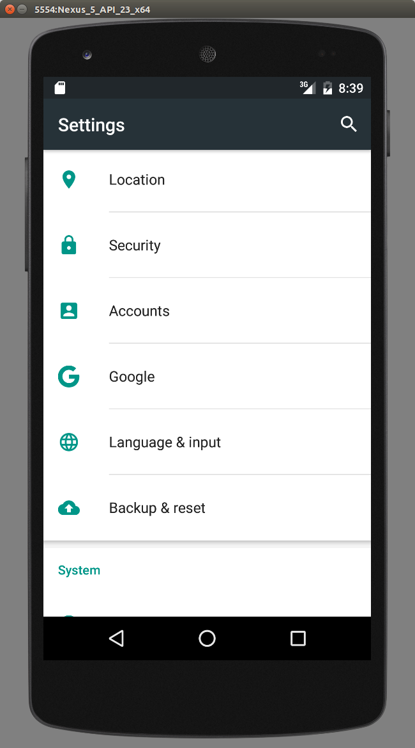
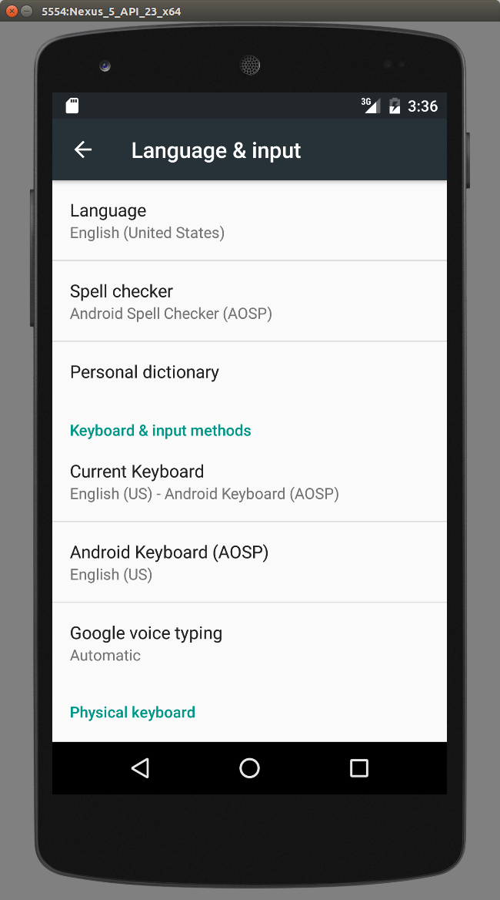
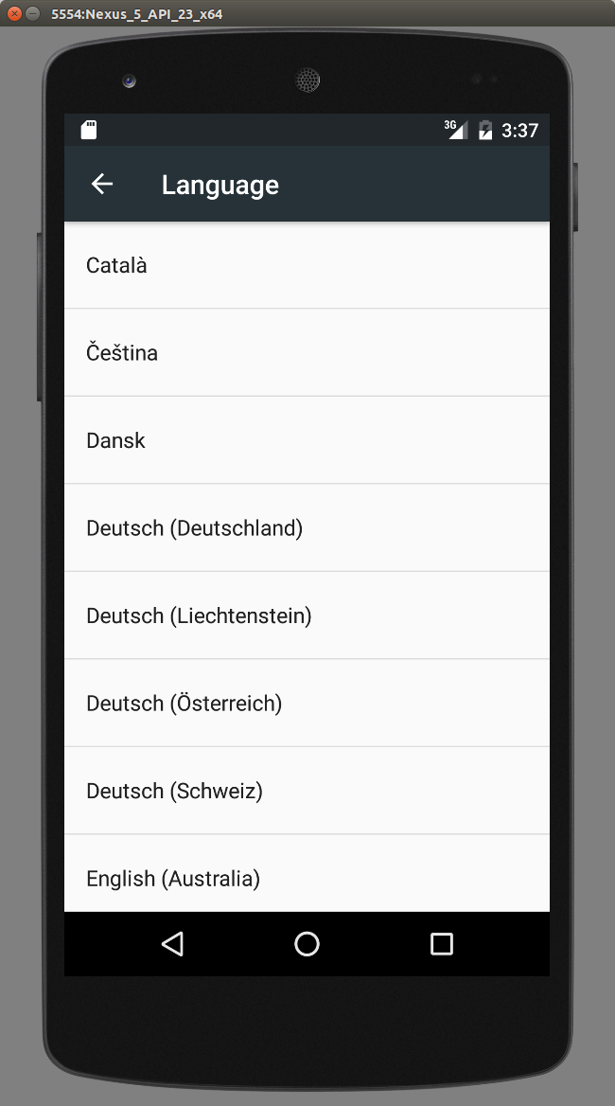
Changing device's locale
testing locales (on a real Android device, or emulator AVD)
  Settings → Language & Input → Select Language
    then launch the app of your choice

Slide 5
Localization
internationalization ("i18n"): Generalizing app's code so that it is not hard-coded to one language / region.
  done once per product (ideally); updated as code is added
localization ("L10n"): Translating internationalized software
for a specific region or language.
  done once per locale; each locale is updated as text is added
  globalization ("g11n"): i18n + L10n
English app
l10n Spanish
Spanish app
App code
(hard-coded
to English)
App code
(English-only,
but generalized
so we can add
other locales)
i18n
l10n French
French app
Chinese app
l10n Chinese
...

Slide 6
Locales
locale: A geographic/cultural location targeted for localization.
A locale is often written e.g. "en-US" which consists of:
  a language (e.g. English -> "en")
    often expressed as an ISO-639-1 code: de, en, fr, ja
  a location or variant (e.g. United States -> "US")
    often expressed as an ISO-3166-1 code: CA, US, GB, DE, ES, JP
Why isn't it enough to specify just the language?
  different locations may use different conventions, spelling, etc.
    "color" (US) vs. "colour" (UK)
    "localize" (US) vs. "localise" (UK)
  some locations use dialects of a given language
  other differences (dates, currency, numbers, time zone, etc.)

Slide 7
Differences between locales
language English vs. German
spelling color vs. colour
slang line vs. queue
numbers formatting 1,234.56 vs. 1234,56
telephone numbers (650)123-4567 vs. +1.650.123.4567
currency units/format $123.45 vs. 123,45€
date formatting 3/14/16 vs. 2016/Mar/14
text direction hello vs. שָׁלוֹם
keyboard shortcuts
spoken audio
video subtitles

Slide 8
How are i18n / l10n done?
developers internationalize the app's code
  pull all strings out of code and into separate resource files
  call methods that localize/format strings, numbers before printing
  use libraries to help localize messages
localizers (maybe not programmers) localize the app's text
  often hired to localize an app for a particular locale at a time
  desktop apps: possibly compile a different binary for each locale
  web app: look up localized strings when generating each page
  mobile app: different resource files depending on locale

Slide 9
Hard-coded Android text strings
Goal: Remove ALL text strings from your XML and Java code!
  That is, all strings that appear on the screen as part of the UI.
You may have hard-coded English strings in the XML:
  <Button ...
  android:text="Click me!" />
You may also have hard-coded strings in the Java code:
  TextView tv = (TextView) findViewById(R.id.foo);
  tv.setText("Welcome");

Slide 10
Internationalized strings.xml file
Declare constant string values in strings.xml file:
  res/values/strings.xml
  Each string is given a name which becomes its resource ID.
  <!-- res/values/strings.xml -->
  <resources>
  <string name="app_name">Shopping Cart</string>
  <string name="clickme">Click me!</string>
  <string name="welcome">Welcome</string>
  <string name="buy">Buy</string>
  <string name="sell">Sell</string>
  </resources>
  Must escape " and ' in strings as \" and \'

Slide 11
Internationalized XML/Java
Then refer to those constants in your XML and Java code.
  in XML: @string/name
  in Java: R.string.name
  <!-- activity_main.xml -->
  <Button ... android:text="Click me!" />
  <Button ... android:text="@string/clickme" />
  <TextView ... android:text="@string/app_name" />
  // MainActivity.java
  TextView tv = (TextView) findViewById(R.id.foo);
  tv.setText("Welcome");
  tv.setText(R.string.welcome);

Slide 12
Localizing strings
Now, to localize for a specific language:
  make a folder values-Language for each supported language
    res/values-es/strings.xml (Spanish)
    res/values-fr/strings.xml (French)
  add a translated copy of strings.xml to each folder
  no changes should need to be made to the app XML/Java code!

Slide 13
French strings.xml file
Example French strings file:
  <!-- res/values-fr/strings.xml -->
  <resources>
  <string name="app_name">Panier</string>
  <string name="clickme">Cliquez moi!</string>
  <string name="welcome">Bienvenue</string>
  <string name="buy">Acheter</string>
  <string name="sell">Vendre</string>
  </resources>

Slide 14
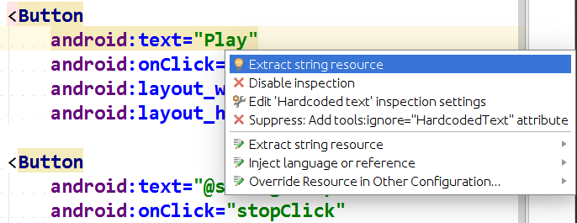
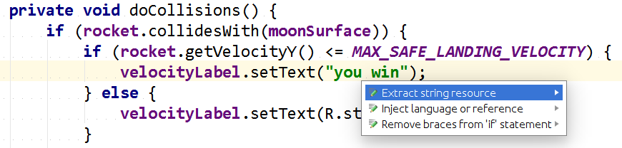
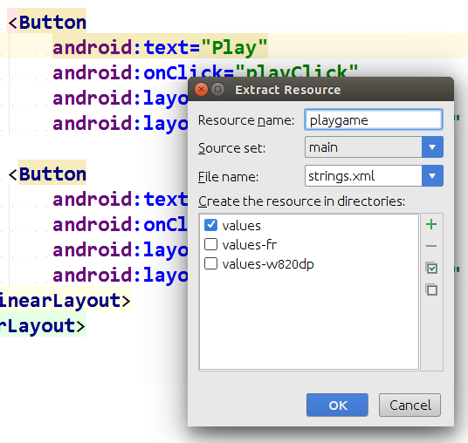
Android Studio string extraction
In Android Studio, press Alt-Enter on a hard-coded string to get a helpful popup for extracting that string's text as a resource
  can be done from XML or Java

Slide 15
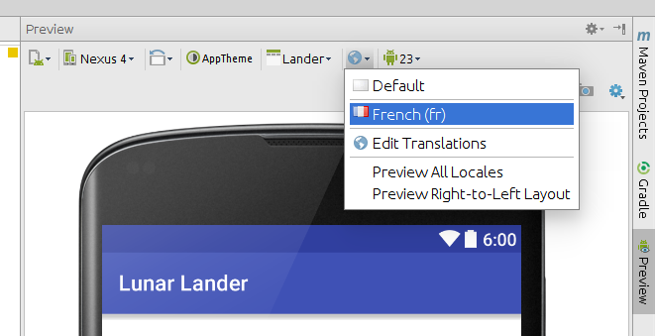
Android Studio locale preview
In Android Studio's XML Layout "Preview" pane, click the small globe icon to select a preview in a different locale
  any images, text, etc. that have been localized for that locale will show up without needing to run the app
  changes made in the Java code won't be seen here (need to run it)

Slide 16


Localized images
Images are in res/drawable
Create a folder res/drawable-Language
  res/drawable/companylogo.png (English)
  res/drawable-fr/companylogo.png (French)
  <!-- res/layout/activity_main.xml -->
  <ImageView
  android:layout_height="wrap_content"
  android:layout_width="wrap_content"
  android:src="@drawable/companylogo" />
  Automatically uses the right one for your locale if available
    falls back to default one in res/drawable if none available for your locale

Slide 17
Format strings
Sometimes your app wants to build a UI string based on a value that is not known until runtime.
  e.g. "You have 32 of 100 credits remaining."
  In these cases, use a format string to insert the value.
Example:
  <!-- res/values/strings.xml -->
  <resources> ...
  <string name="creditsleft">
  You have %1$d of %2$d credits remaining.</string>
  <!-- res/values-fr/strings.xml -->
  <resources> ...
  <string name="creditsleft">
  Il y a %1$d de %2$d crédits restant.</string>

Slide 18
Format string example
To fill in a format string, call getResources and getString
  Fill in template by passing values for each placeholder
  int credits = 32; // MainActivity.java
  int total = 100;
  // "You have %1$d of %2$d credits remaining."
  // "You have 32 of 100 credits remaining."
  String credStr = getResources().getString(
  R.string.creditsleft,
  credits, total);

Slide 19
Format string details (link)
Placeholder formatting: % NUMBER $ FORMAT TYPE
  $d an integer
  $0Nd an integer, 0-filled to N digits total
  $x an integer, in hexadecimal
  $s string
  $f float or double
  $.Nf float/double, with N digits after decimal point
  $b boolean
  $c character (char)
<string name="example">
Student name %1$s, ID #%2$04d has GPA %3$.2f!!
</string>
String out = getResources().getString(R.string.example,
"Marty", 35, 3.21786);
// "Student name Marty, ID #0035 has GPA 3.22!!"

Slide 20
Pluralization
Sometimes a string has a singular and plural form.
  e.g. "You are taking 1 class."
  e.g. "You are taking 2 classes."
  In these cases, use a quantity string to represent the message.
    Accepted quantities: zero, one, two, few, many, other
  <!-- res/values/strings.xml -->
  <resources> ...
  <plurals name="classestaken">
  <item quantity="one">You are taking %d class.</item>
  <item quantity="other">You are taking %d classes.</item>
  </plurals>
  <!-- res/values-fr/strings.xml -->
  <resources> ...
  <plurals name="classestaken">
  <item quantity="one">Vous avez pris une classe.</item>
  <item quantity="other">Vous avez pris %d classes.</item>
  </plurals>

Slide 21
Pluralization in Java code
To fill in a quantity string, use getQuantityString :
  getQuantityString(id, quantity, placeholders)
  int classes = 4; // MainActivity.java
  String classStr = getResources()
  .getQuantityString(R.string.classestaken,
  classes, classes);
  // "You have taken 4 classes."

Slide 22
Localizing numbers (link)
java.text.NumberFormat formats numbers for a locale
  Locale loc = Locale.getDefault(); // assume France
  NumberFormat fmt =
  NumberFormat.getInstance(loc);
  double gpa = 3.145;
  String result = fmt.format(gpa); // "3,145"
Related issue: If user types numbers into text fields in their locale's format, your app shouldn't crash!
  // don't use Double.parseDouble, etc.!
  String line = myEditText.getText().toString(); // "3,145"
  double gpa = fmt.parse(line); // 3.145
  throws ParseException if text is in invalid format

Slide 23
Localizing currencies $$$
currencies are represented by ISO-4217 currency identifiers
  examples: USD, GBP, EUR, JPY, CNY, INR, RUB
  programming languages don't know exchange rates between currencies (can't tell you how many Euros equals $100.00)
  but facilities exist for displaying a variable as a currency amount
java.text.NumberFormat and currency objects
  NumberFormat dollar =
  NumberFormat.getCurrencyInstance(Locale.US);
  NumberFormat euro =
  NumberFormat.getCurrencyInstance(Locale.GERMANY);
  euro.setCurrency(Currency.getInstance("EUR"));
  String s = euro.format(123456.78);

Slide 24
Localizing dates (link)
Differences in how to display dates across locales:
  names of the months/days (Monday vs. Lundi)
  ordering of days (what day does a week start/end)
  relative order of y/m/d (3/14/2016 vs. 2016/Mar/14)
  time zone (usually offset from UTC/GMT)
  12 vs. 24 hour time (5:00 PM vs. 17:00)
java.text.DateFormat formats dates
  styles: DateFormat.DEFAULT, FULL, LONG, MEDIUM, SHORT
  DateFormat fmt = DateFormat.getDateTimeInstance(
  DateFormat.LONG, DateFormat.SHORT, locale);
  String dateText = fmt.format(new Date());
  Date d = fmt.parse(dateText.trim()); // parse a date

Slide 25

SimpleLocalization
Method | Description
with(context) | get a SimpleLocalization instance
format(id, args) | format a resource string
get(id), get(id, args) | look up a resource string
isLTR(), isLTR(locale), isRTL(), isRTL(locale) | return whether locale is right-to-left
date(date), date(locale) | format a Date for this locale
currency(amount), currency(amount, locale) | format an amount of money for this locale
number(n), number(n, locale) | format a number for this locale
parseLocalizedInt/Long/ Double/Float(numStr) | parse string into a number
pluralize(id, n, args) | look up a quantity string

Slide 26
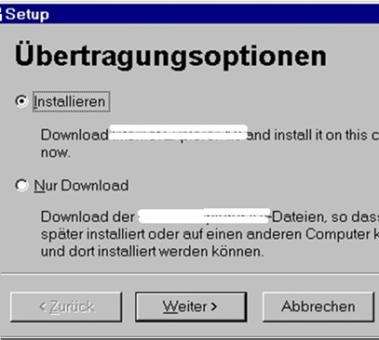
Localization gotchas
Some languages (e.g. German) use long words
  buttons/labels get too wide for space provided
some fonts don't have all characters
  but a smart OS can use font substitution
regular expressions / text searches
may not match i18n input
  ex. \w "word boundary" doesn't
  match Unicode word delimiters
databases / web servers / backends might return text that
has not been localized yet

Slide 27
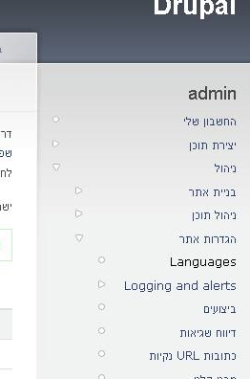
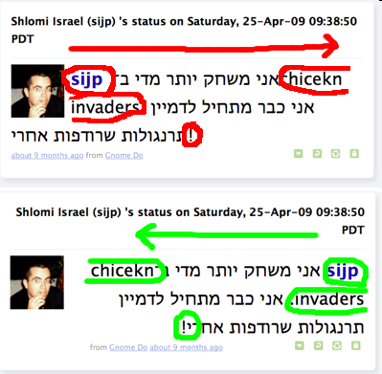
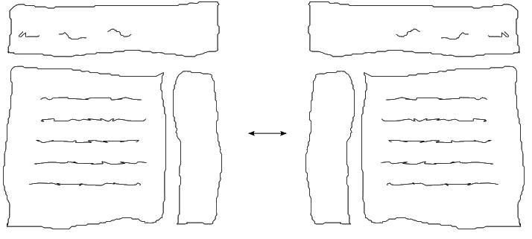
Right-to-left (RTL)
some languages begin lines on the right side and go left
  Arabic, Farsi/Persian, Hebrew, Kurdish, Punjabi, Somali, ...
  hello vs. שָׁלוֹם
often handled by separate style/layout files for RTL locales
RTL can lead to lots of subtle UI bugs
based on coders' LTR assumptions

Slide 28
Checking for RTL locales
In Android API 17 (4.2 Jelly Bean) or later:
  Configuration config =
  getResources().getConfiguration();
  if (config.getLayoutDirection() ==
  View.LAYOUT_DIRECTION_RTL) {
  // in Right To Left layout
  }
In older versions of Android:
  if (ViewCompat.getLayoutDirection(view) ==
  ViewCompat.LAYOUT_DIRECTION_RTL) {
  // the view has RTL layout
  } else {
  // the view has LTR layout
  }

Slide 29
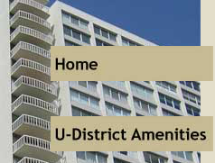


Things to avoid
Don't hard-code widths/heights in layout or GUI code
  e.g. myButton.setWidth(200);
Try to avoid images that look like text.
Avoid using symbols that have no meaning in other locales.
  USA "STOP sign"
  Hand up for "Wait"
(if localizing to RTL locales) Avoid hard-coding the notion that "left" means "start" and "right" means "end".
  example: Left for "Back", right for "Forward"
  example: Left for "less", right for "more"

Slide 30
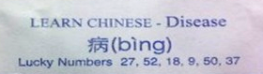
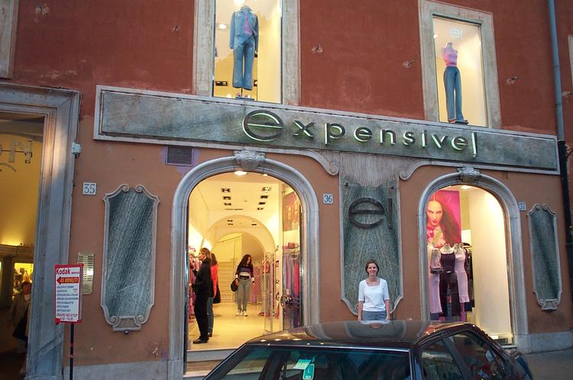
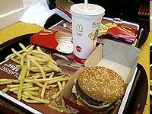
Perils of poor localization
English words may have different connotation in another language
  e.g. "Okay" could be translated as "so-so" or "mediocre"
<< and >> , when used as "arrows", can confuse some users whose languages use << and >> as quotation marks
product's name or ad could translate poorly
  Microsoft's "Bing" can translate to "disease" in Chinese
  McDonald's pictures-only billboard in Saudi Arabia
  ...
product could offend users from other countries
  an online dating site that allows users under 16 to register?
  an online auction site that has bidding end on a holy day?

Slide 31
Poorly localized messages
"Drop your pants here for best results." - dry cleaning, Tokyo
"We take your bags and send them in all directions." - Scandinavian airport
"Ladies may have a fit upstairs." - dry cleaning, Bangkok
"Teeth extracted by latest methodists." - dentist, Hong Kong
"Please leave your values at the front desk." - hotel, Paris
"No smoothen the lion." - zoo, Czech
"If you consider our help impolite, you should see the manager." - hotel, Athens
"Our wines leave you nothing to hope for." - Swiss restaurant
"It is forbidden to enter a woman, even if dressed as a man." - Bangkok temple
"Fur coats made for ladies from their own skin." - Swedish furrier
"Specialist in women and other diseases." - doctor, Rome
"Leave clothes here and spend afternoon having good time." - laundry, Rome
"We regret that you will be unbearable." - hotel, Bucharest
"When passenger of foot heave in sight, tootle the horn. Trumpet him melodiously at first, but if he still obstacles you then tootle him with vigor." - car rental, Tokyo

Slide 32

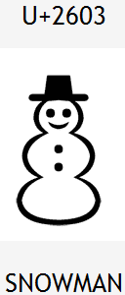
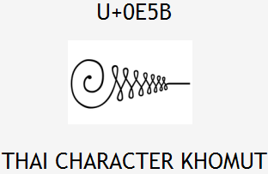
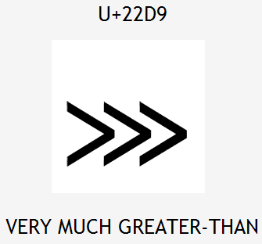

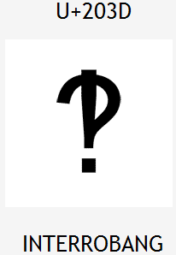

Unicode
Unicode: Standard for storing, encoding, numbering over 107,000 chars from > 90 languages.
  created in 1991 by non-profit Unicode Consortium
  standard character -> integer mappings
  Translation Formats (UTF-*) to store chars as bytes
  supported by languages (Java, .NET, Python), browsers
  important for localization because it defines int'l chars
  and encodings we will use to present localized text

Slide 33
Character encodings
ISO-8859-1: ANSI, 8-bit (extended ASCII)
  backward-compatible; simple; mostly English-only
UTF-8: 1 byte for all ANSI chars, which have the same code values as in standard ASCII; up to 4 bytes for other chars
UTF-16: uses 2 bytes for almost all characters, and 4 bytes to encode certain special characters
Code files, web pages may specify or be saved with an encoding:
<html>
<head>
<title>CS 142, Winter 2048</title>
<meta charset="utf-8" />

