Slide 1
CS 193A
What's Next?
(Other Topics We Didn't Cover)
This document is copyright (C) Marty Stepp and Stanford Computer Science.
Licensed under Creative Commons Attribution 2.5 License. All rights reserved.

Slide 2
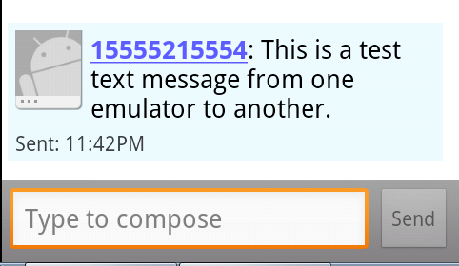
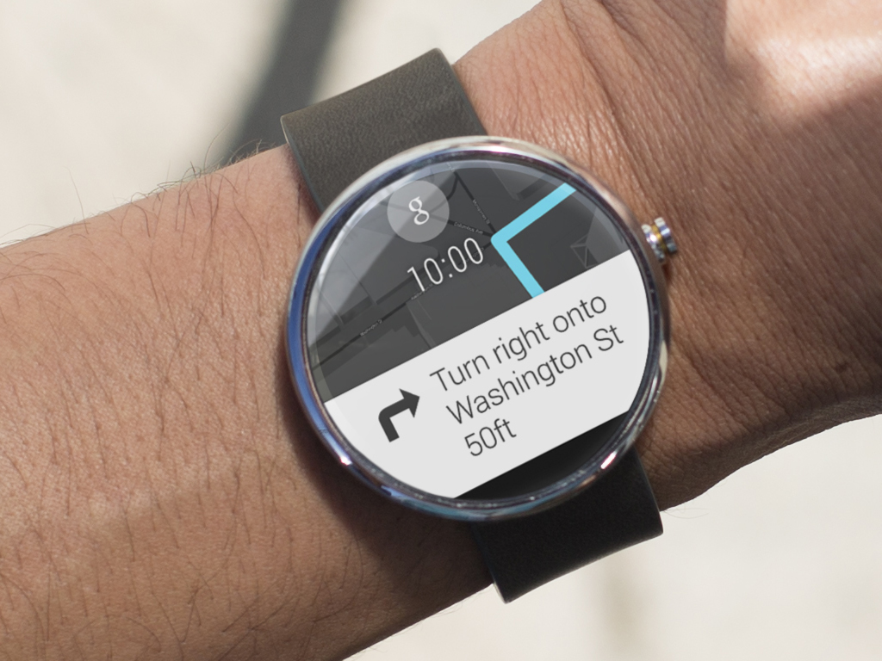
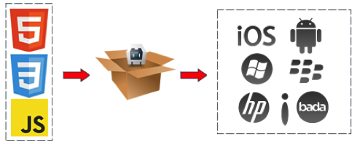
Outline
Sending and Receiving SMS messages
Testing
Games and Graphics
Android Wear
PhoneGap (multi-platform app development)

Slide 3
Sending and Receiving SMS
To send/receive SMS messages, need permissions:
  in AndroidManifest.xml:
  <uses permission
  android:name="android.permission.SEND_SMS" />
  <uses permission
  android:name="android.permission.RECEIVE_SMS" />
Sending an SMS message:
  SmsManager mgr = SmsManager.getDefault();
  mgr.sendTextMessage("phoneNumber", null,
  "msg text", null, null);
Receiving an SMS message:
  have to set up a broadcast receiver (see next slide)

Slide 4
Receiving SMS
Declare a broadcast receiver in AndroidManifest.xml:
  <receiver android:name=".SmsBroadcastReceiver" android:exported="true">
  <intent-filter android:priority="999" >
  <action android:name="android.provider.Telephony.SMS_RECEIVED" />
  </intent-filter>
  </receiver>
Write the code for your broadcast receiver:
  public class SmsBroadcastReceiver extends BroadcastReceiver {
  public void onReceive(Context context, Intent intent) {
  SmsMessage[] msgs =
  Telephony.Sms.Intents.getMessagesFromIntent(intent);
  String msgText = "";
  for (int i = 0; i < msgs.length; ++i) {
  String smsBody = msgs[i].getMessageBody().toString();
  String address = msgs[i].getOriginatingAddress();
  msgText += "SMS From: " + address + "\n" + smsBody + "\n";
  }
  Toast.makeText(context, msgText, Toast.LENGTH_SHORT).show();
  }
  }

Slide 5
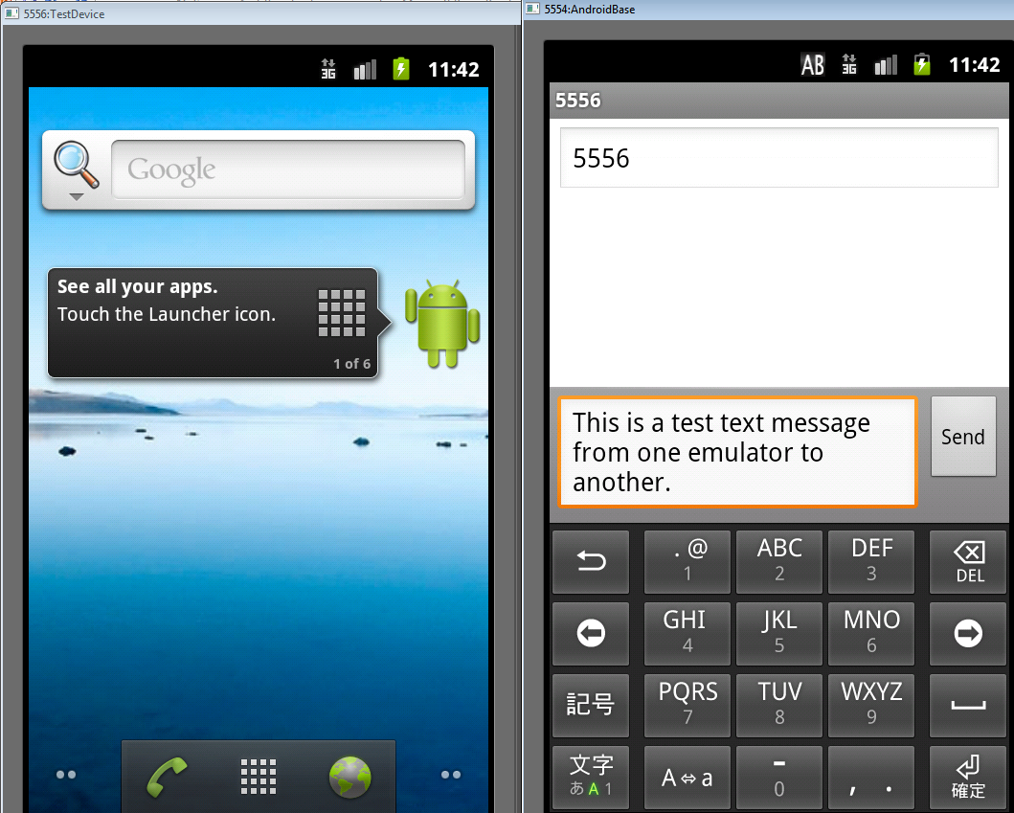
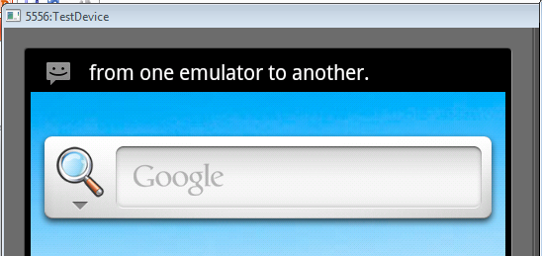
Testing SMS
need to set up two emulators to test it
  emulator's "phone number" is port number (e.g. 5556)

Slide 6
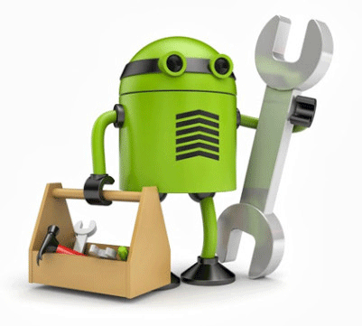
Testing an app
There are many kinds of testing you might want to do:
  unit testing: Small tests of individual classes and methods.
  functional / UI testing: Simulate running the entire app.
  load testing: See how the app handles many actions/requests.
  security testing: Check that the app cannot be compromised.
  ...
Luckily, Android has testing "baked in" as a core feature.
  Several classes, libraries, systems, etc. for testing out of the box.
  Many third-party libraries to add further testing features.

Slide 7
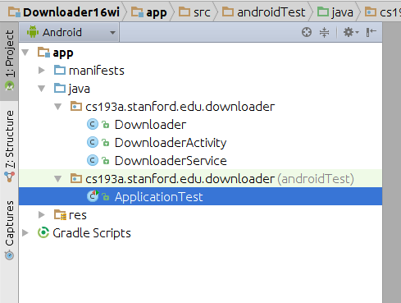

Unit testing
Every Android Studio app creates an androidTest src folder where you can put test cases.
JUnit: Popular library for unit testing Java apps.
public class EmailValidatorTest {
@Test
public void testEmailValidator() {
assertTrue(MyEmail.isValid("name@email.com"));
}
...
}

Slide 8

Mocks and Stubs
Testing parts of an app in isolation is hard.
  Use Mockito framework to make a fake "mock" version of other parts of the app.
  http://mockito.org/
@RunWith(MockitoJUnitRunner.class)
public class UnitTestSample {
private static final String FAKE_STRING = "HELLO WORLD";
@Mock Context mMockContext;
@Test
public void readStringFromContext_LocalizedString() {
when(mMockContext.getString(R.string.hello_word))
.thenReturn(FAKE_STRING);
ClassUnderTest myObjectUnderTest =
new ClassUnderTest(mMockContext);
String result = myObjectUnderTest.getHelloWorldString();
assertEquals(FAKE_STRING, result);
}
}

Slide 9
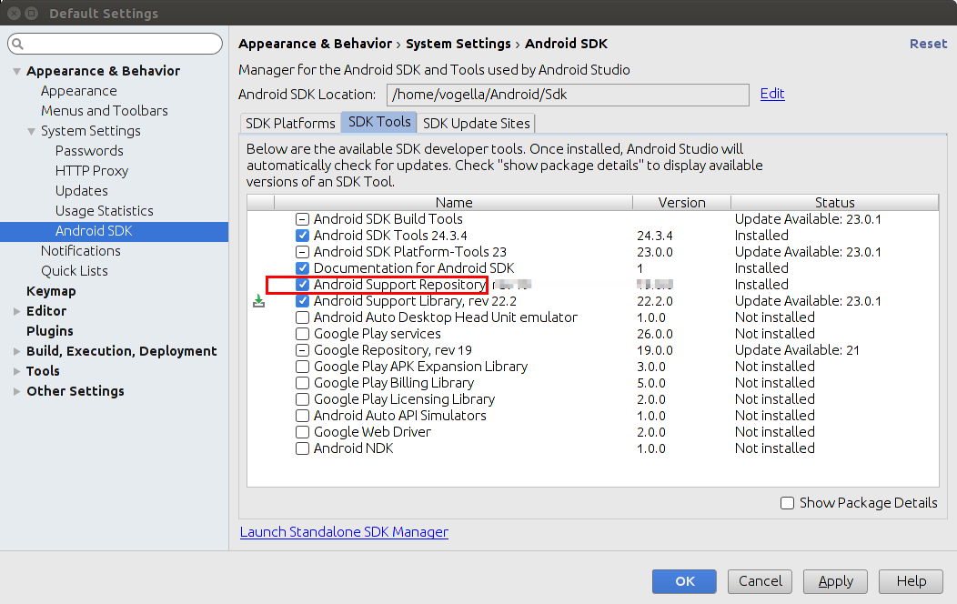
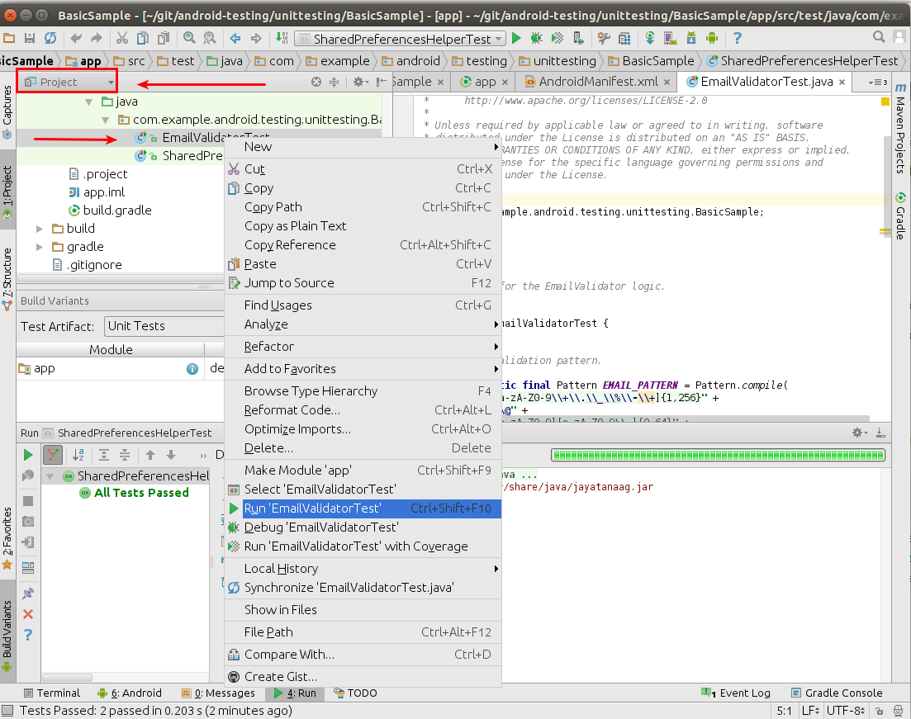
UI testing with Espresso
Espresso: Library for automated testing of an app's UI.
  http://developer.android.com/training/testing/ui-testing/espresso-testing.html
  Add to project's build.gradle:
  dependencies { ...
  androidTestCompile
  'com.android.support.test.espresso:espresso-core:2.2.1'
  }
  Install Android Support Repository / Library in Android Studio

Slide 10
An Espresso test class
@RunWith(AndroidJUnit4.class)
@LargeTest
public class ChangeTextBehaviorTest {
private String expected = "Espresso"; // string we expect
@Rule
public ActivityTestRule<MainActivity> mActivityRule =
new ActivityTestRule<>(MainActivity.class);
@Test
public void changeText_sameActivity() {
// type text and then press a button
Espresso.onView(withId(R.id.my_edit_text))
.perform(typeText(expected), closeSoftKeyboard());
Espresso.onView(withId(R.id.my_button)).perform(click());
// check that the text was changed
Espresso.onView(withId(R.id.my_text_view_output))
.check(matches(withText(expected)));
}
}

Slide 11

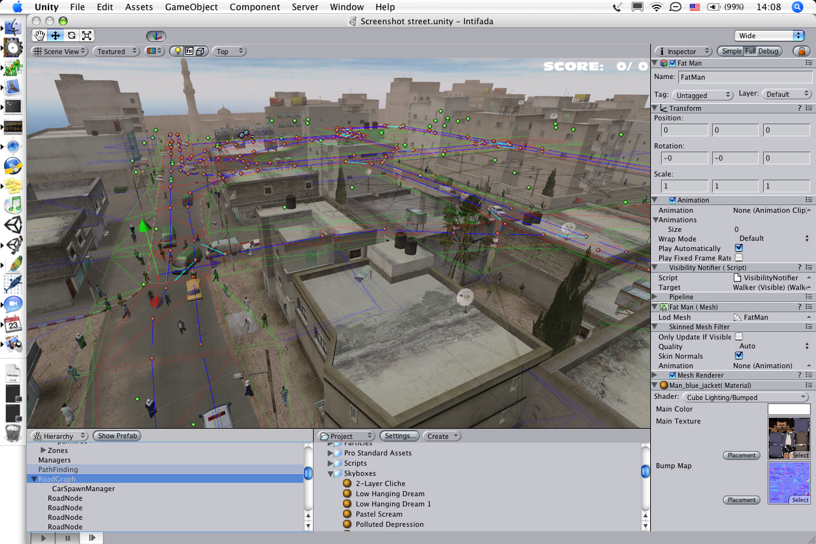

Making Games with Unity
https://unity3d.com/

Slide 12
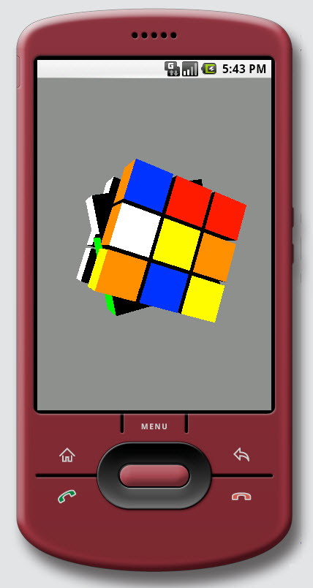
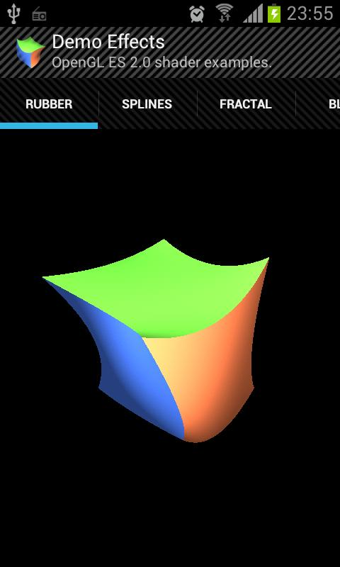
3D Graphics with OpenGL ES
http://developer.android.com/guide/topics/graphics/opengl.html

Slide 13
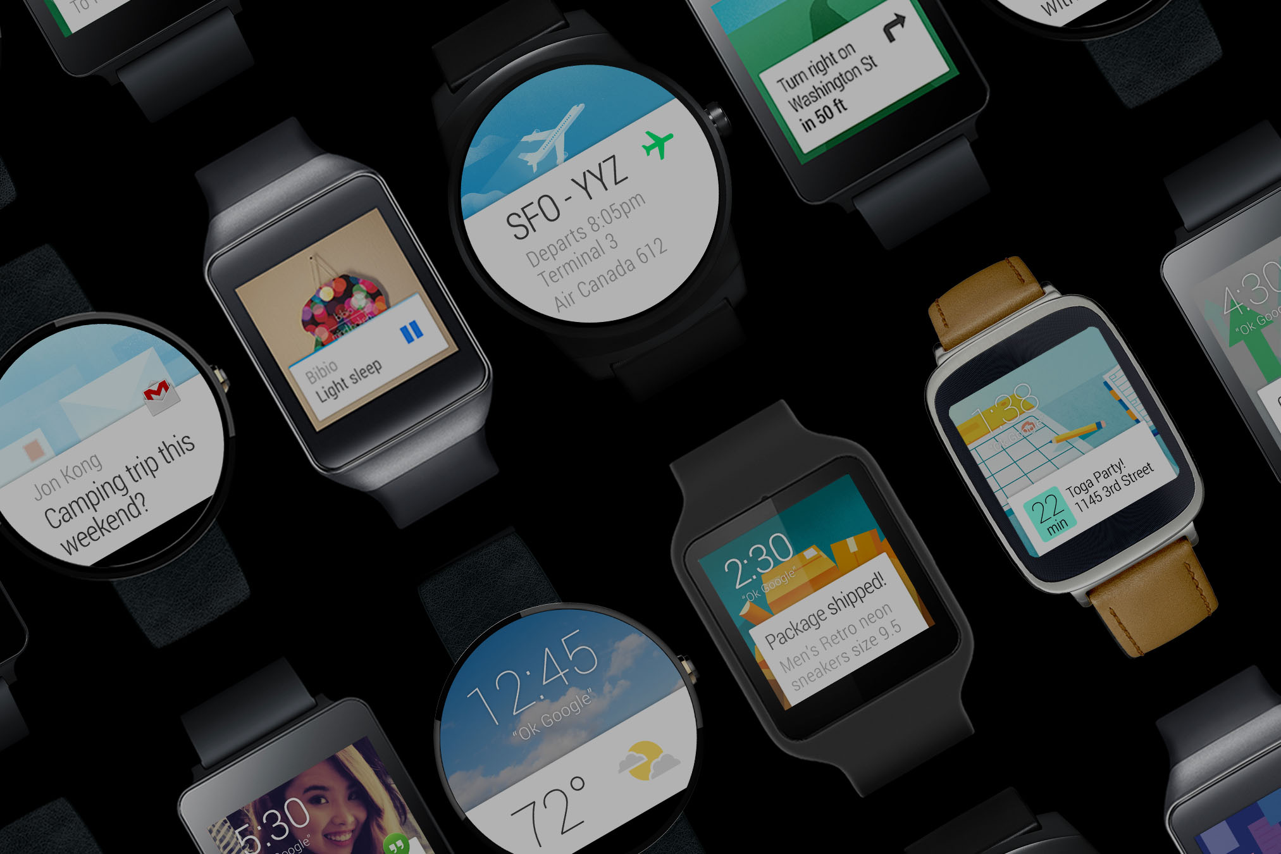
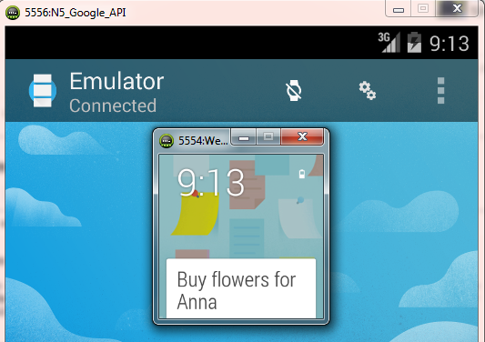
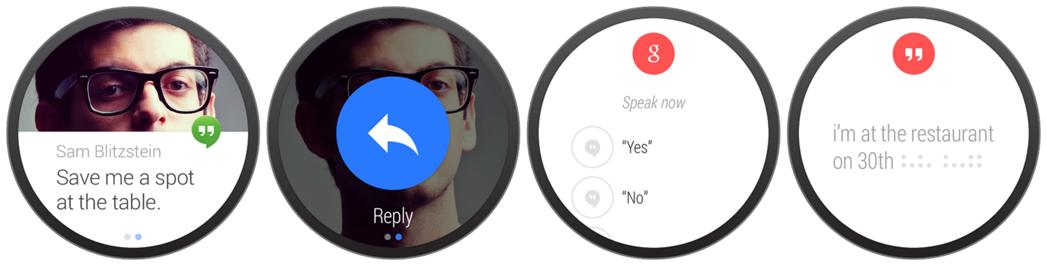
Android Wear (watches)
Android Wear: Version of Android that runs
on watches and other wearable devices.
  http://developer.android.com/training/building-wearables.html
Modifying an app to run on Wear
  Probably re-do your UI and layout
    new set of widgets specific to Wear
  Heavy emphasis on notifications
  Greater use of voice input over typing/clicking
  Testing: Create an emulator device to represent the watch
    tricky; must be paired with another device/emulator representing a phone

Slide 14
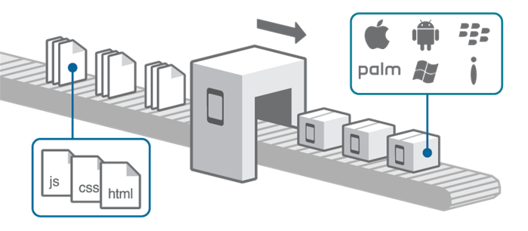
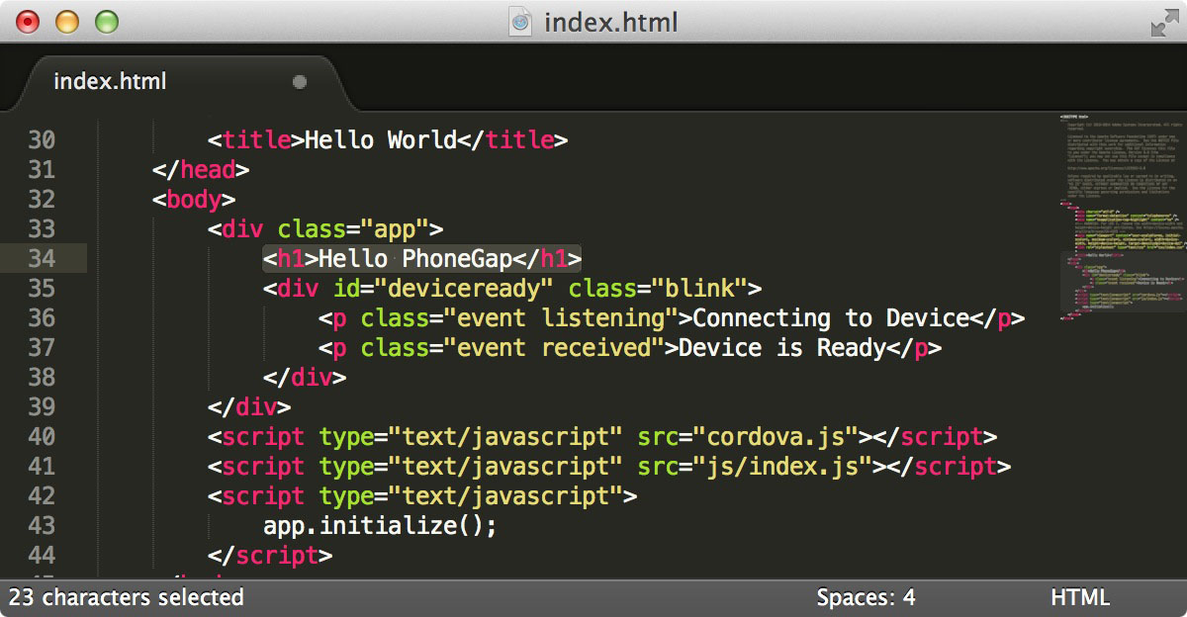
PhoneGap
PhoneGap: Cross-platform app development framework.
  based on HTML and JavaScript
  write code once, deploy to web app, Android, iOS, more
  http://phonegap.com/
Similar frameworks
  Xamarin, React Native, Qt,
  AppInventor, Appcelerator

Slide 15

Thank you!
Thanks for a great class!
  Special thanks to our TAs, May, Dae Hyun, and Senthilnathan!
Please give me your feedback about CS 193A:
  fill out our anonymous survey
  let me know what you'd like in future quarters
CS 193A will be offered again next year (Winter 2018)
  Tell your friends!
Coming soon: HW7

