Slide 1

Chat App (Android application)

Slide 2
Group 6
Nguyễn Văn Lượng
Lê Văn Luân
Vương Tùng Long
Nguyễn Hoàng Hào
Lê Đình Minh
Phạm Đức Duy

Slide 3
Outline
Main idea
Features
Project management
Testing
Modeling
Release

Slide 4
Main idea
An android application for communicating people
Instant messaging
Sharing status with others

Slide 5
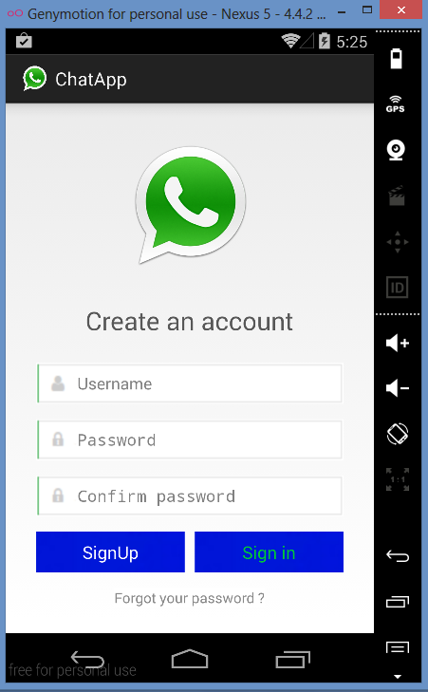
Feature : Sign Up
Create new account

Slide 6
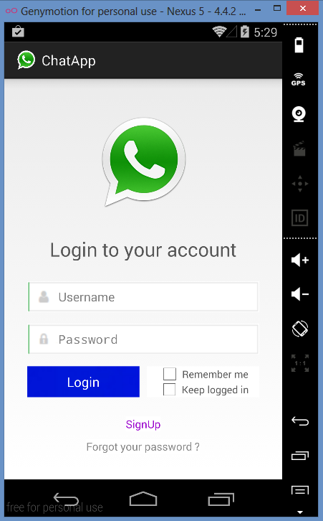
Feature : Login
Login to start connect with friends

Slide 7
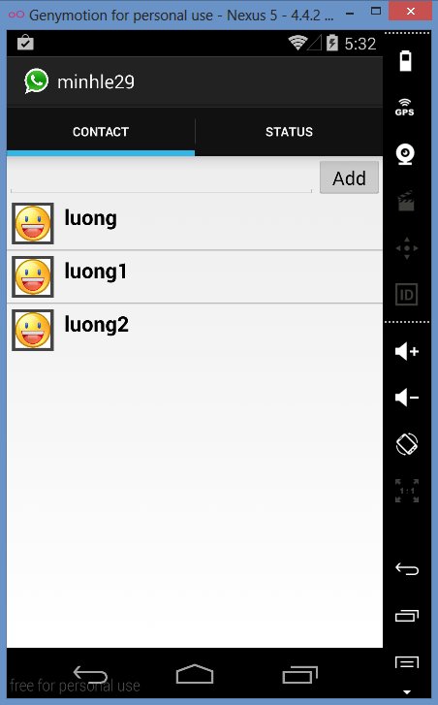
Feature : Main Screen
Main screen
2 tabs:
Contact : list all of your friend
Status : your friends’ status

Slide 8
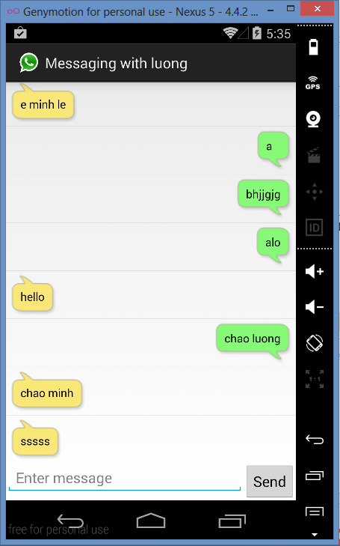
Feature : Chat
Chat with your friend

Slide 9
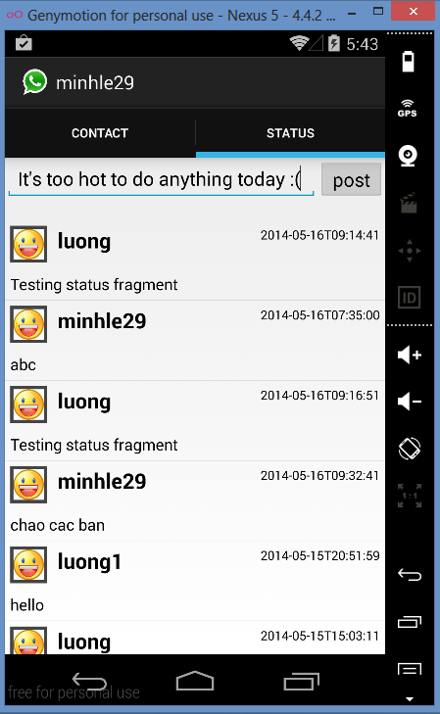
Feature : Status
Share your felling
See UML Diagram to know more about this project

Slide 10
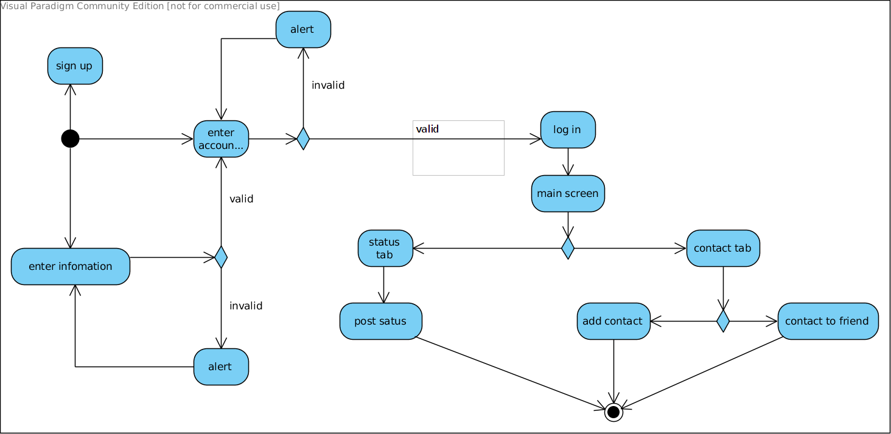
Modelling
Activity diagram

Slide 11
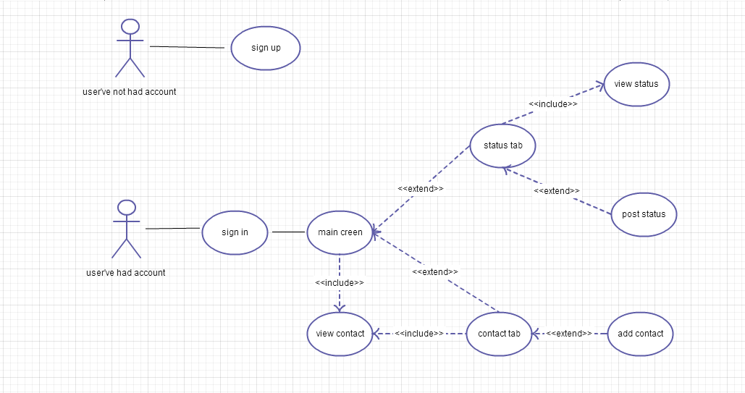
Modelling
Use Case diagram

Slide 12
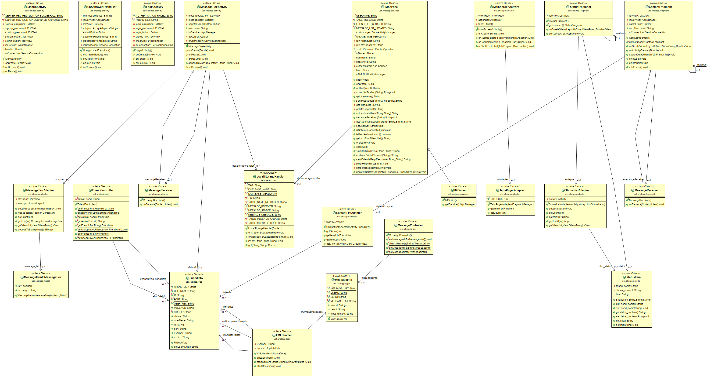
Modelling
Class diagram

Slide 13
Project management
Using:
Github
https://github.com/luongbs94/ChatApp
Pivotaltracker
https://www.pivotaltracker.com/s/projects/1031554

Slide 14
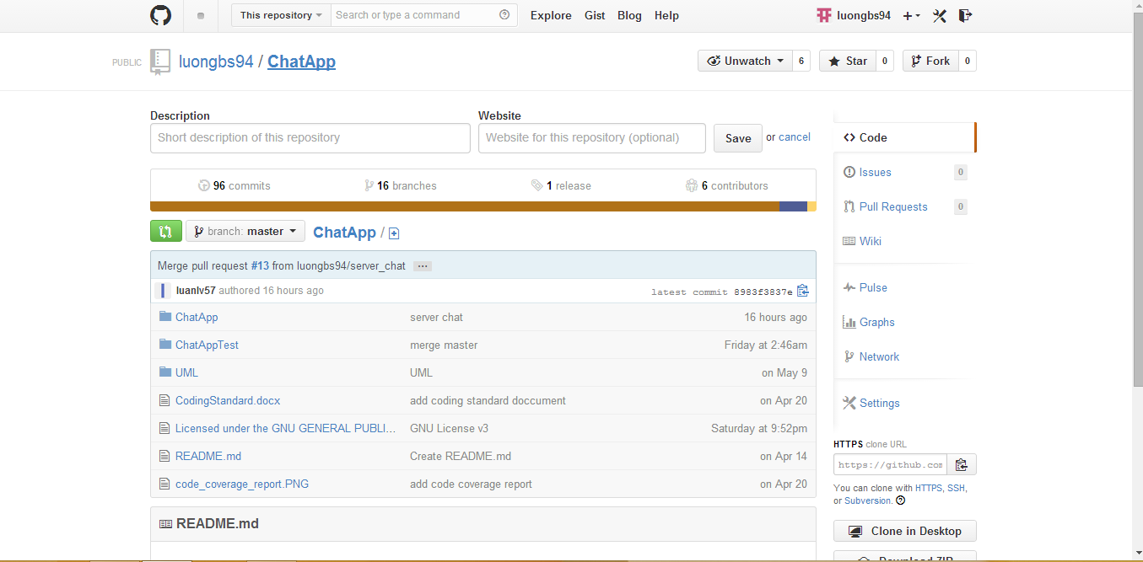
Github : Repository

Slide 15
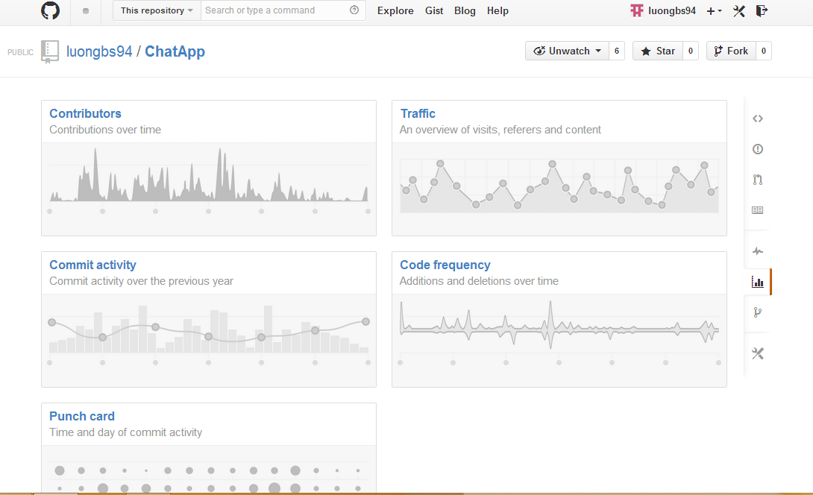
Github : Statistics

Slide 16
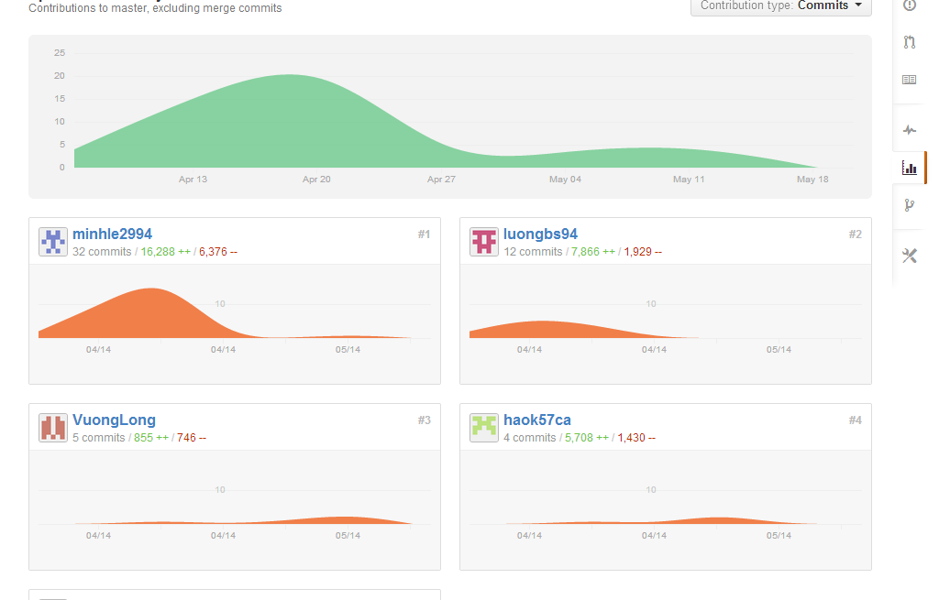
Github : Contributor

Slide 17
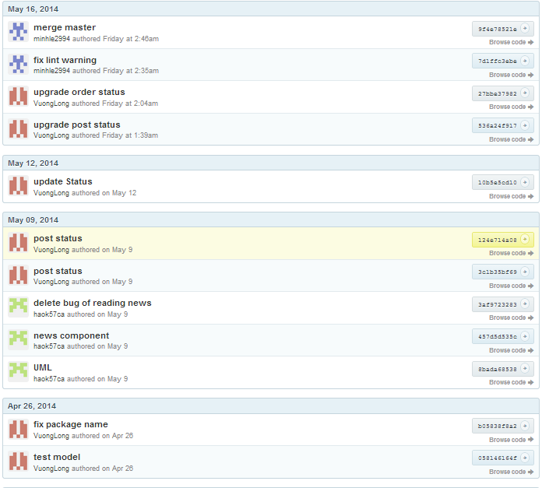
Github : Commit

Slide 18
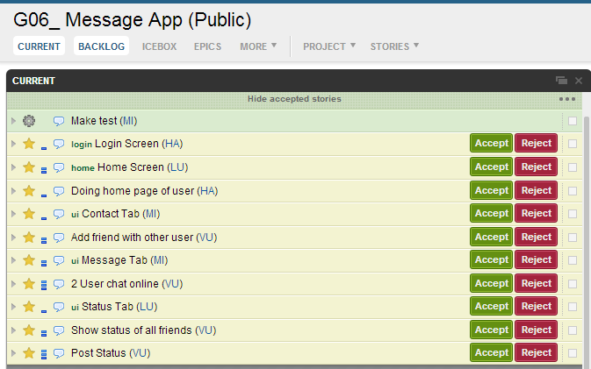
Pivoltal Tracker

Slide 19
Process implementation
Every week Group has discussion on Friday and Tuesday
For Friday:
*-Member tell about their work this week (done or not)
if not -> reason and need help ?
*-Members give comment, the project up to now is ok or need change something
-Decide what we do next week
-Divide work for all members
*- Do a discussion like Tuesday

Slide 20
Process implementation
Every week Group has discussion on Friday and Tuesday
For Tuesday:
-Members talk about their work in this week
+ tell progress of work do from last Friday
+ members comments each other about their work
+ plan work will do from now to Friday and consider
is there any thing hard to group find way to solve together

Slide 21
For a feature
Example: status
Discuss in group about
This feature
Write pivotal tracker
Write test
Code
Experience production

Slide 22
For a feature
Discuss in group about this feature
Purpose :
decide how to do this feature and how is main role
Find out there any troubler when do this feature and find way to solve it

Slide 23
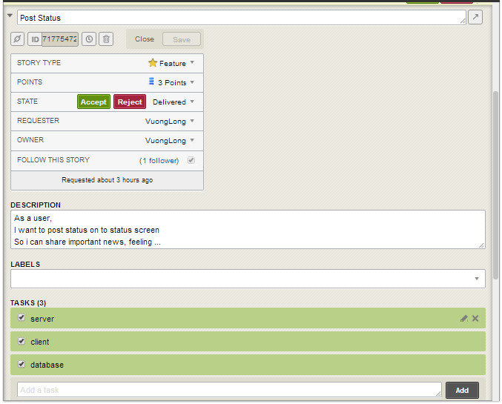
For a feature
Write pivotal tracker
Ex: status
The member who is divided
this feature will write this

Slide 24
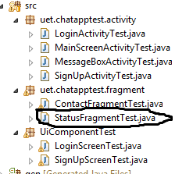
For a feature
Write test
Ex: status
Write test before code
for feature

Slide 25
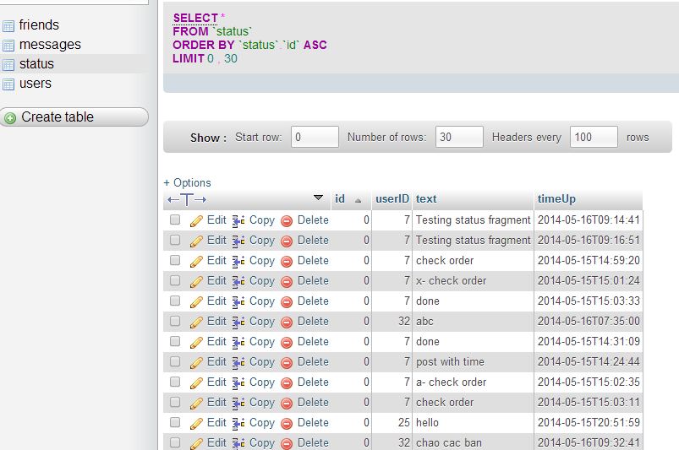
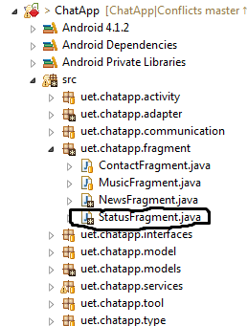
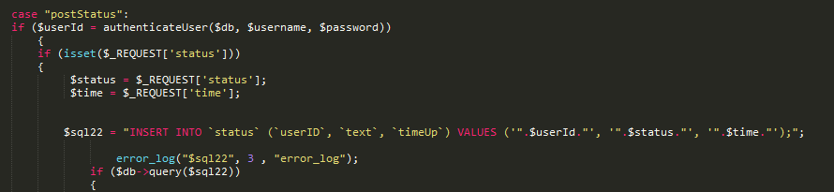
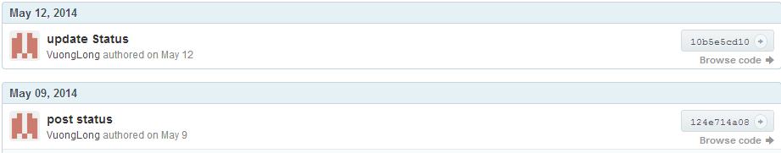
For a feature
Code
Ex: status
Prepare database
Code into project to do the feature
PHP
Commit
JAVA

Slide 26
For a feature
Experience production
Ex: status
All member have to use the
application to check there is
any problem in this feature

Slide 27
Testing
Android JUnit Test
Use Robotium framework to make UI test
Use Android Unit Test Case to make unit test

Slide 28
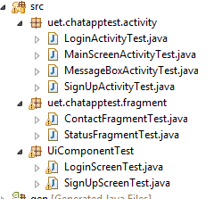
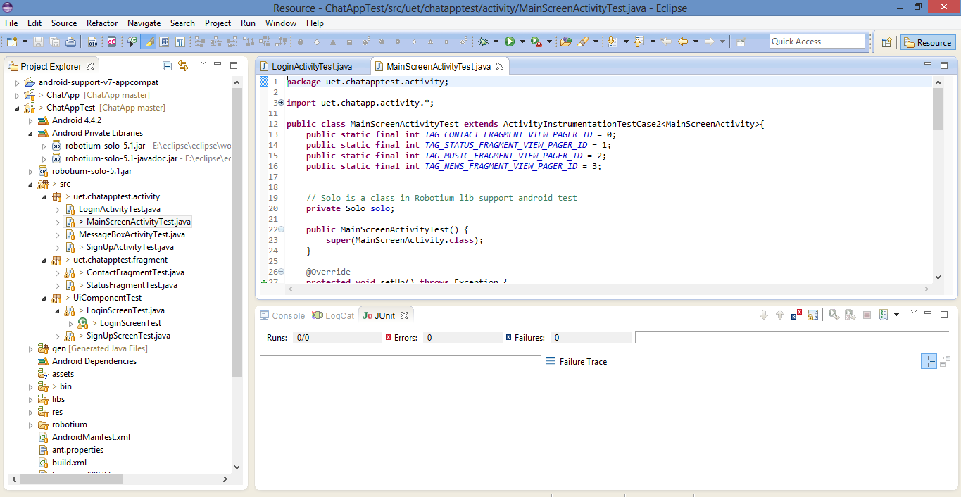
Testing

Slide 29
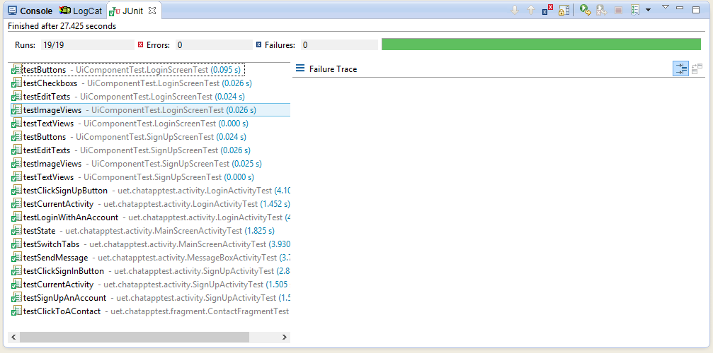
Testing

Slide 30
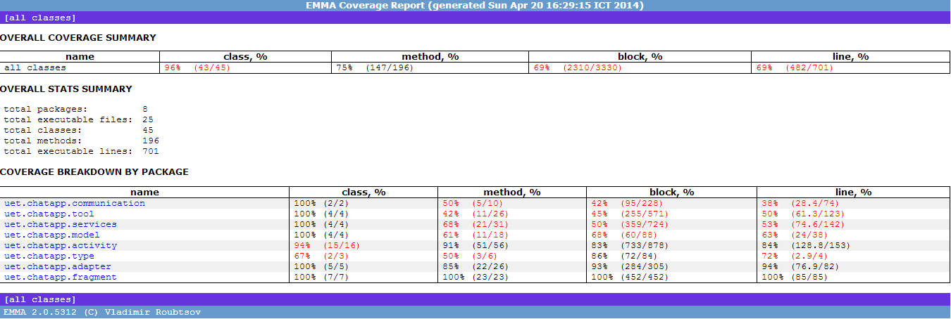
Test coverage

Slide 31
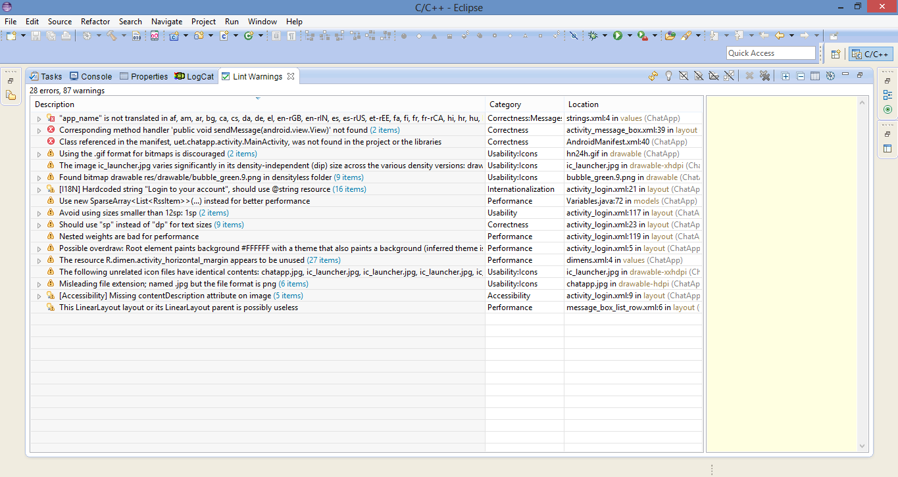
Lint
Before

Slide 32
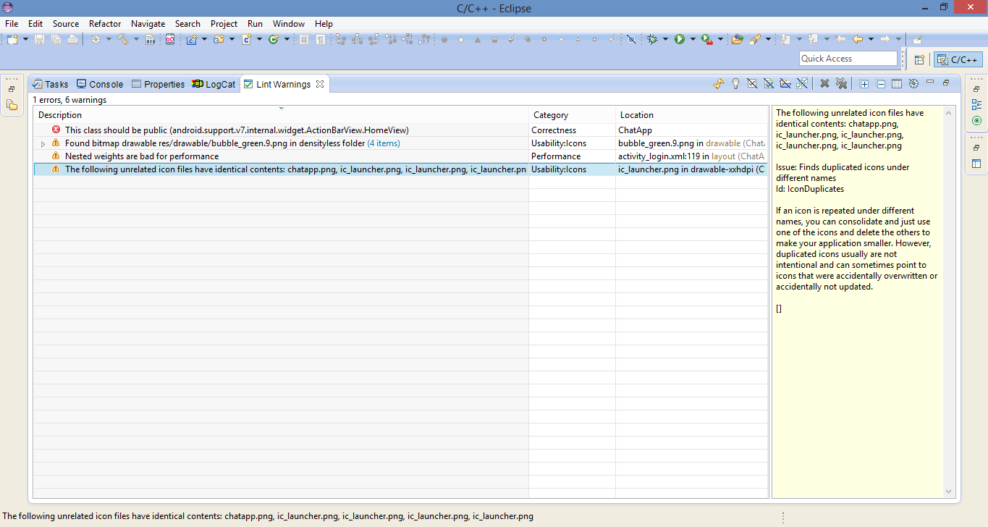
Lint
After fix

Slide 33
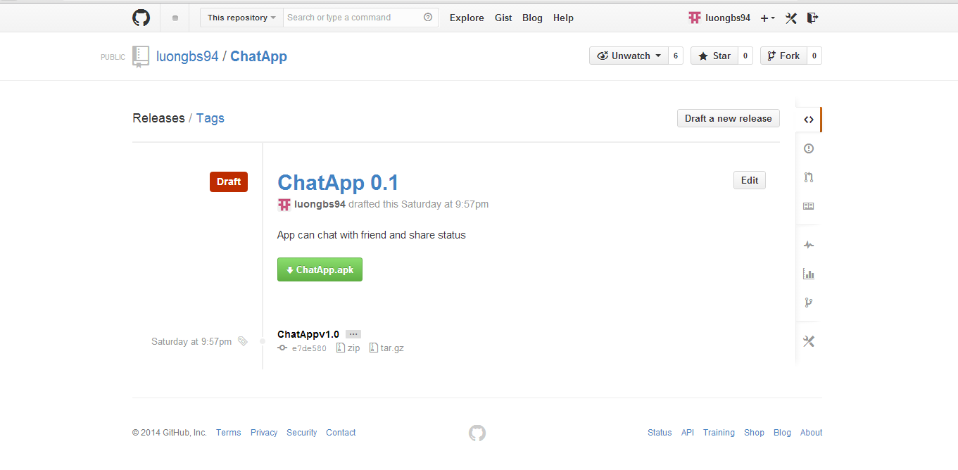
Release v 0.1

