Slide 1
DeRegistration

Slide 2
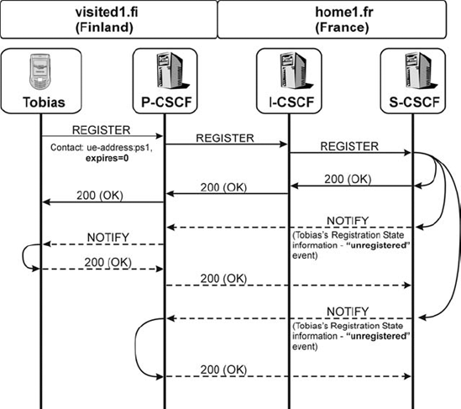
Quick access to commands
Notes:
- The S-CSCF will then clear all the information it has stored for Tobias, update the data in the HSS and send a 200 (OK)

Slide 3
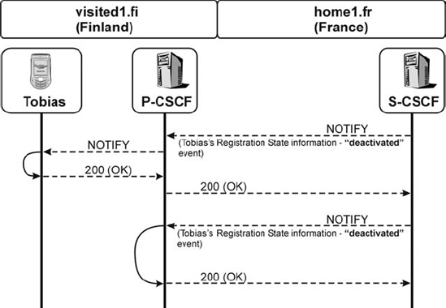
Quick access to commands
Notes:
maybe the S-CSCF needs to be shut down or maybe Tobias is using a pre-paid card and has ran out of money. In these cases the S-CSCF would simply send another NOTIFY message with registration-state information to Tobias's UE,

Slide 4
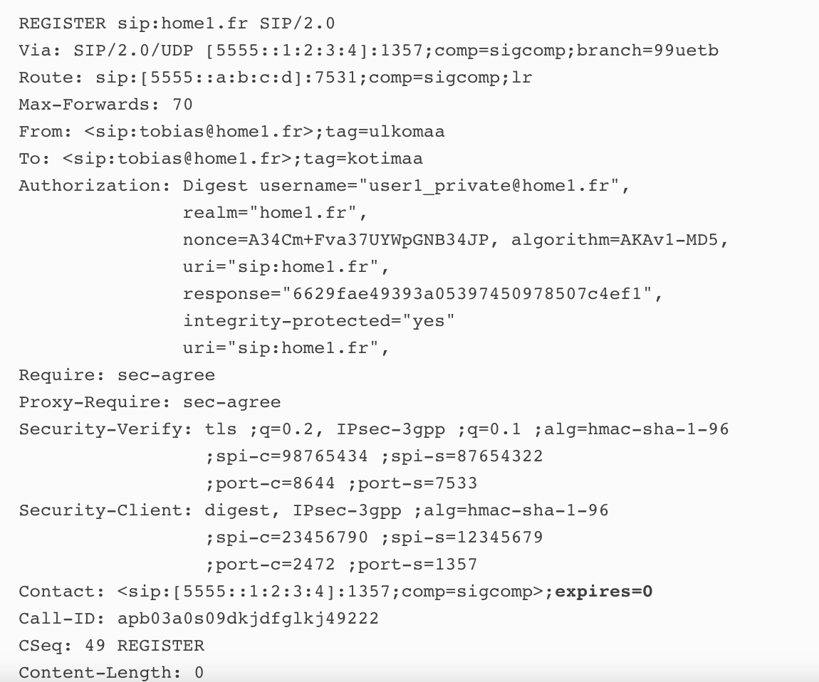
UE de-register
Notes:
This REGISTER request will be routed in exactly the same way as every other REGISTER request (i.e., it will not follow the stored Service-Route). Therefore, it will:
traverse the P-CSCF – which checks for integrity protection and adds the integrity-protected=yes flag to the Authorization header;
traverse the I-CSCF – which will ask the HSS for the S-CSCF address that was selected for the user; and
finally, be received at the S-CSCF – where de-registration will take place.
The S-CSCF will immediately send back a 200 (OK) response to the UE, which will also include the expires header set to the value 0.
Afterwards, the S-CSCF will generate NOTIFY requests to all subscribers of the registration-state information of Tobias, including Tobias's UE. Each of these NOTIFY requests will include the Subscription-State header set to the value "terminated", which indicates that the subscription to the registration-state information of that user has been terminated. For example:

Slide 5
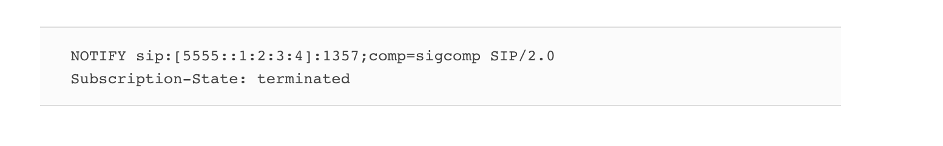
The S-CSCF will generate NOTIFY requests to all subscribers of the registration-state information of Tobias,

Slide 6

More questions about PowerPoint for Mac?
SELECT THE ARROW WHEN IN SLIDE SHOW MODE
Find out more at the PowerPoint for Mac Help Center.
Visit the PowerPoint team blog.
Notes:
In Slide Show mode, select the arrows to visit links.

