Slide 1
Project 1
Section 1 - Problem 1
Section 2 - Problem 1
Group 8 – Java:
Peter Boukhalil
Luong Dang
Kimberly Nivon
Julia Beatriz Ramos
Nhi Vu
Notes:
Kimberly

Slide 2
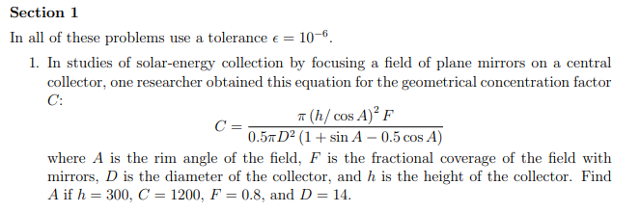
Section 1 - Problem 1
Notes:
Nhi

Slide 3
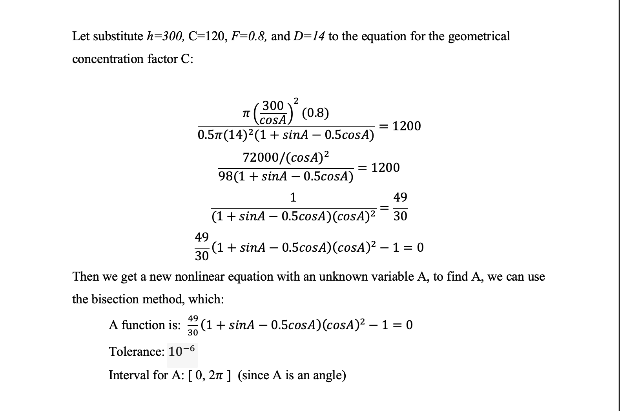
Section 1 - Problem 1
Notes:
Nhi

Slide 4
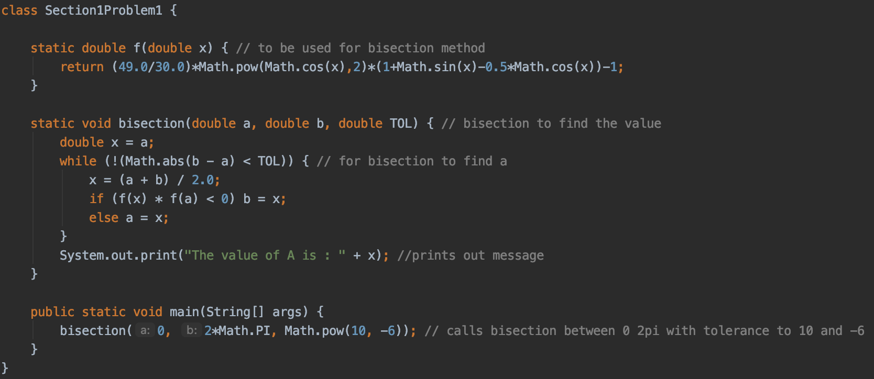
Section 1 - Problem 1 Solution
Notes:
Julia

Slide 5
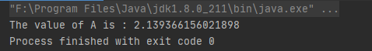
Section 1 - Problem 1 Solution Output
Notes:
Julia

Slide 6
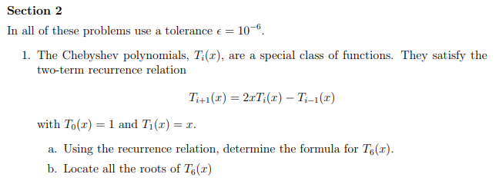
Section 2 - Problem 1
Notes:
Peter

Slide 7
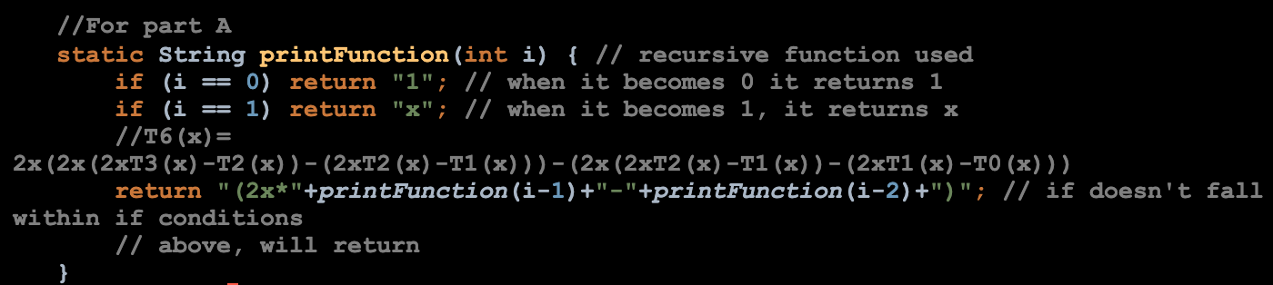
Section 2 - Problem 1 A Solution
Notes:
Peter

Slide 8
Section 2 - Problem 1 A Solution Output
Notes:
Peter

Slide 9
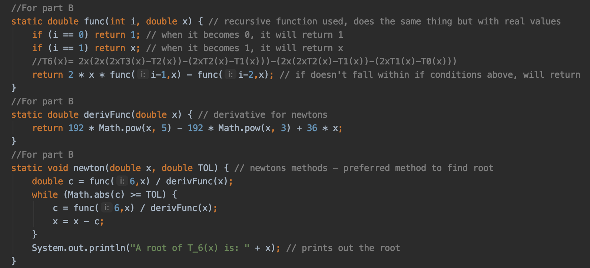
Section 2 - Problem 1 B Solution
Notes:
Kimberly

Slide 10
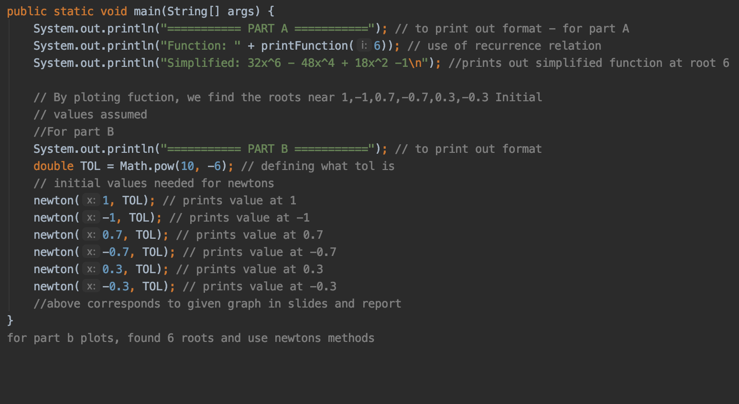
Section 2 - Problem 1 Solution
Notes:
Kimberly

Slide 11
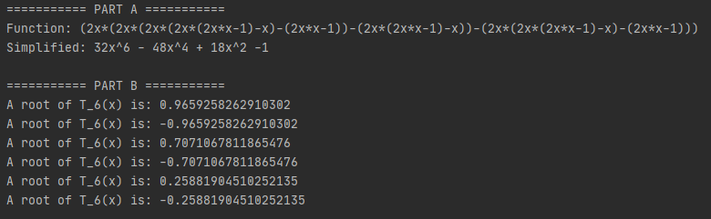
Section 2 - Problem 1 Solution Output
Notes:
Kimberly

Slide 12
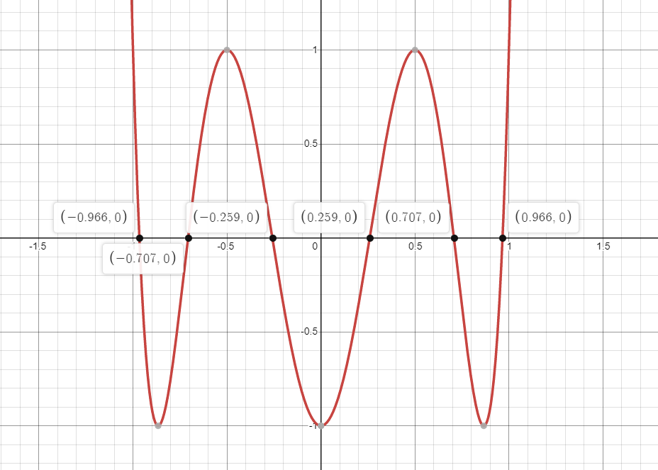
Section 2 - Problem 1 B Solution - Graph
Notes:
Kimberly

Slide 13
The End

