Slide 1
Training Front-end

Slide 2
Training Front-end
CSS Basic
CSS Trick
BEM (Naming convention - quy ước đặt tên class )
Jquery

Slide 3
CSS Basic
Padding and margin
Position
Max-width and max-height
Float
Display
Overflow
Media Screen

Slide 4
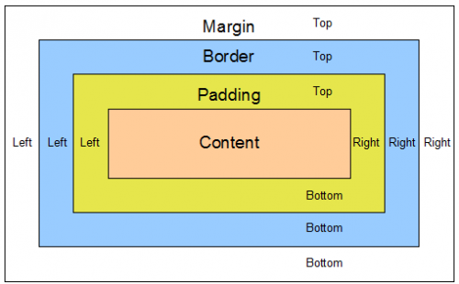
1.Padding and Margin

Slide 5
1.Padding and Margin
padding-top
padding-right
padding-bottom
padding-left
Value:
- length - specifies a padding in px, pt, cm, etc.
- % - specifies a padding in % of the width of the containing element
- inherit - specifies that the padding should be inherited from the parent element

Slide 6
1.Padding and Margin
margin-top
margin-right
margin-bottom
margin-left
Values:
- auto - the browser calculates the margin
- length - specifies a margin in px, pt, cm, etc.
- % - specifies a margin in % of the width of the containing element
- inherit - specifies that the margin should be inherited from the parent element

Slide 7
2.Position
static
relative
absolute
fixed
sticky

Slide 8
3.Max-width and max-height

Slide 9
4.Float
left - The element floats to the left of its container
right- The element floats to the right of its container
none - The element does not float (will be displayed just where it occurs in the text). This is default
inherit - The element inherits the float value of its parent
In its simplest use, the float property can be used to wrap text around images.
Clear: Both

Slide 10
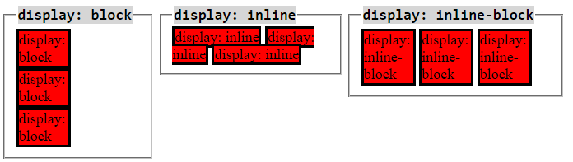
5. Display
Block
Inline-block
Inline
---------------------------
Inline elements:
respect left & right margins and padding, but not top & bottom
cannot have a width and height set
allow other elements to sit to their left and right.
see very important side notes on this here.
Block elements:
respect all of those
force a line break after the block element
Inline-block elements:
allow other elements to sit to their left and right
respect top & bottom margins and padding
respect height and width

Slide 11
6. Overflow
Overflow:
The overflow property has the following values:
visible - Default. The overflow is not clipped. It renders outside the element's box
hidden - The overflow is clipped, and the rest of the content will be invisible
scroll - The overflow is clipped, but a scrollbar is added to see the rest of the content
auto - If overflow is clipped, a scrollbar should be added to see the rest of the content
overflow-x
overflow-y

Slide 12
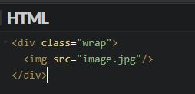
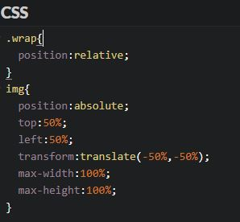
CSS Trick
Centered image
Image background
Other question???

Slide 13
JQUERY
Get/Set
Html()
Text()
Val()
Attr()
Add
Append()
Prepend()
Before()
After
addClass
Remove
Remove()
Empty()
removeClass()
Css
5. Dimensions
Width
Height
outerWidth
outerHeight
innerWidth
innerHeight
6. jQuery Traversing
Ancestors
Parent
Parents
Closest
Descendants
children
Find
Siblings
Siblings
Next
Prev
Filtering
eq

