Slide 1

Who Wants to Be a Millionaire
Network Programming Group: 07

Slide 2

Members
Nguyen Khanh Trung | 20205133
Luong Nam Khanh | 20205184
Pham Khanh Linh | 20205186

Slide 3
Table of Contents
01
03
04
Project Overview
Use-case diagram
Class diagram
05
06
07
Flow Charts
Message Diagram
State Machine
02
Application Architecture
08
Demo

Slide 4

Project Overview
01

Slide 5
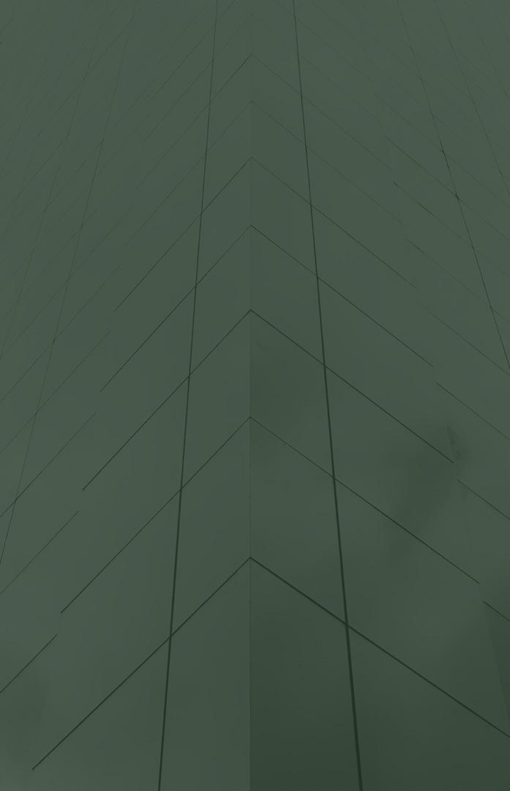
Who Wants to Be a Millionaire?
An overview of the game program being built, which is based on famous gameshow on TV.

Slide 6
1. About the rules of our project
Following the traditional rule
Objective: Answer a series of questions correctly to win the million-dollar prize.
Gameplay Structure: Multiple-choice questions, increasing difficulty.

Slide 7
Features
Support PvP mode, single mode
Support 3 type of lifeline: Ask the Audience, 50/50, Phone a Friend.
Surrendering

Slide 8

02
Application Architecture

Slide 9
Roles
Le Minh Duc | Front-end Leader
Nguyen Minh Huy | Front-end Developer
Nguyen Tuan Hiep | Front-end Developer, UI/UX
To Thai Duong | Front-end Developer, Tester
Pham Vuong Tu | Front-end Developer, Tester
Nguyen Phuong Quang | Back-end Leader
Luong Nam Khanh | Back-end Developer
Nguyen Hoang Hai | Back-end Developer, Tester
Do Tuan Minh | Back-end Developer, Tester

Slide 10

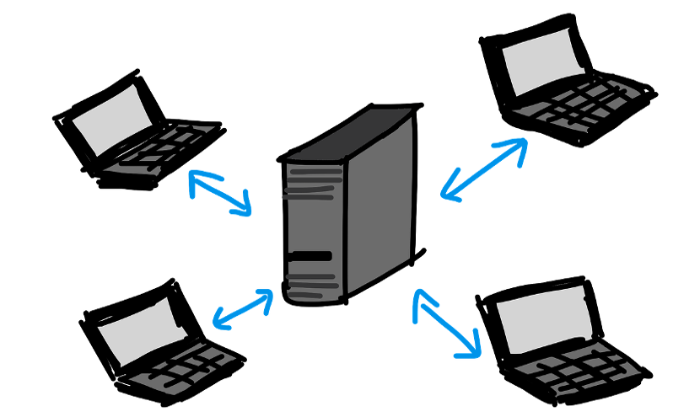
Client-server architecture

Slide 11
Task Assignments & Meetings
1 Week
Sprint
Team members assigned suitable tasks for each sprint
1 Meeting
Per Week
Meeting held weekly to keep things up to date
SCRUM METHODOLOGY
Teams
Meetings held and documented using Microsoft Teams
Github
Github is used as task management tools

Slide 12

Use-case Diagram
03

Slide 13
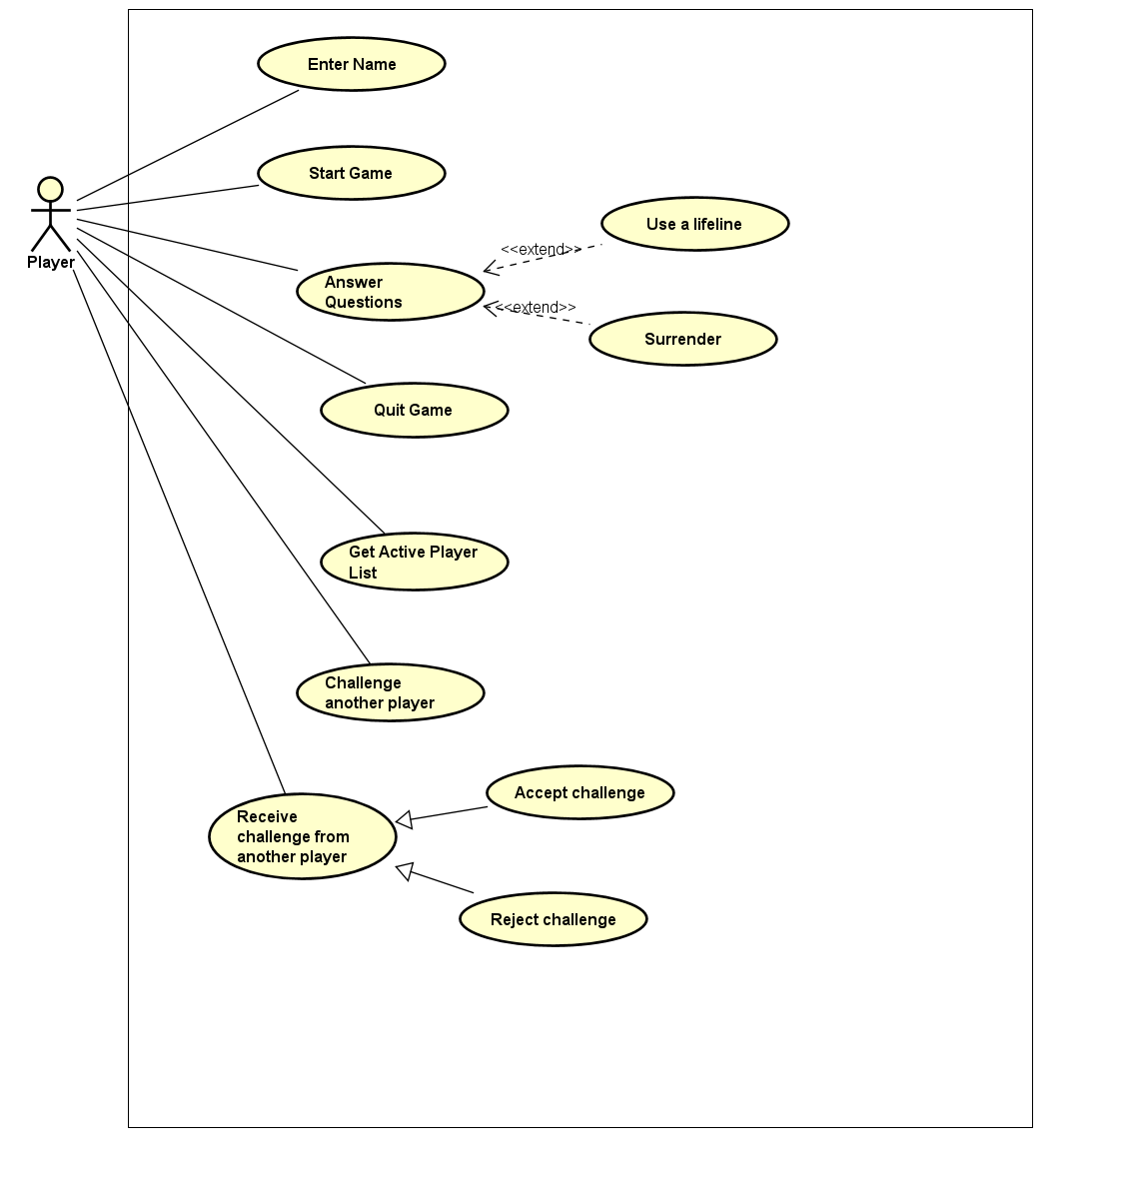
Use-case Diagram

Slide 14

Class Diagram
04

Slide 15
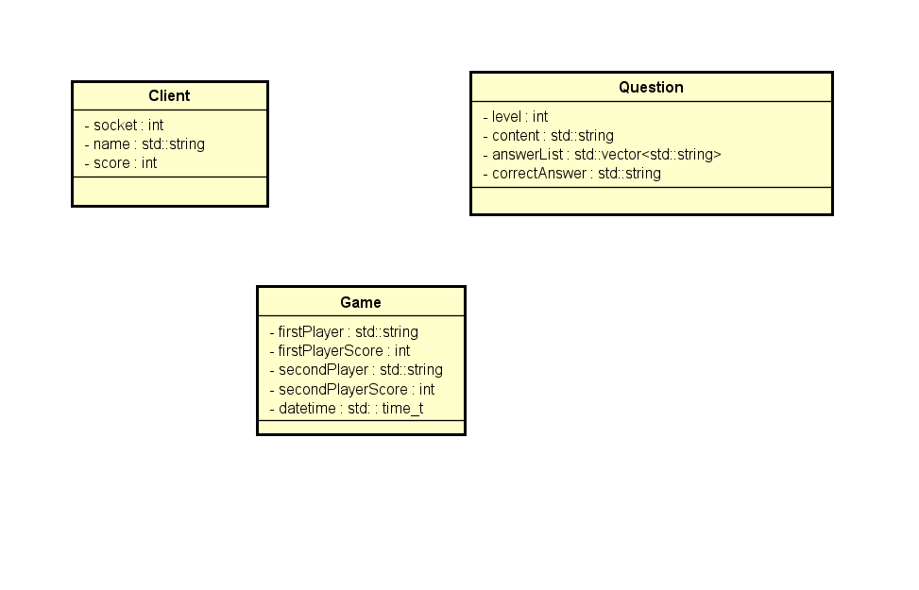
Timeline

Slide 16

Flow Chart
05

Slide 17
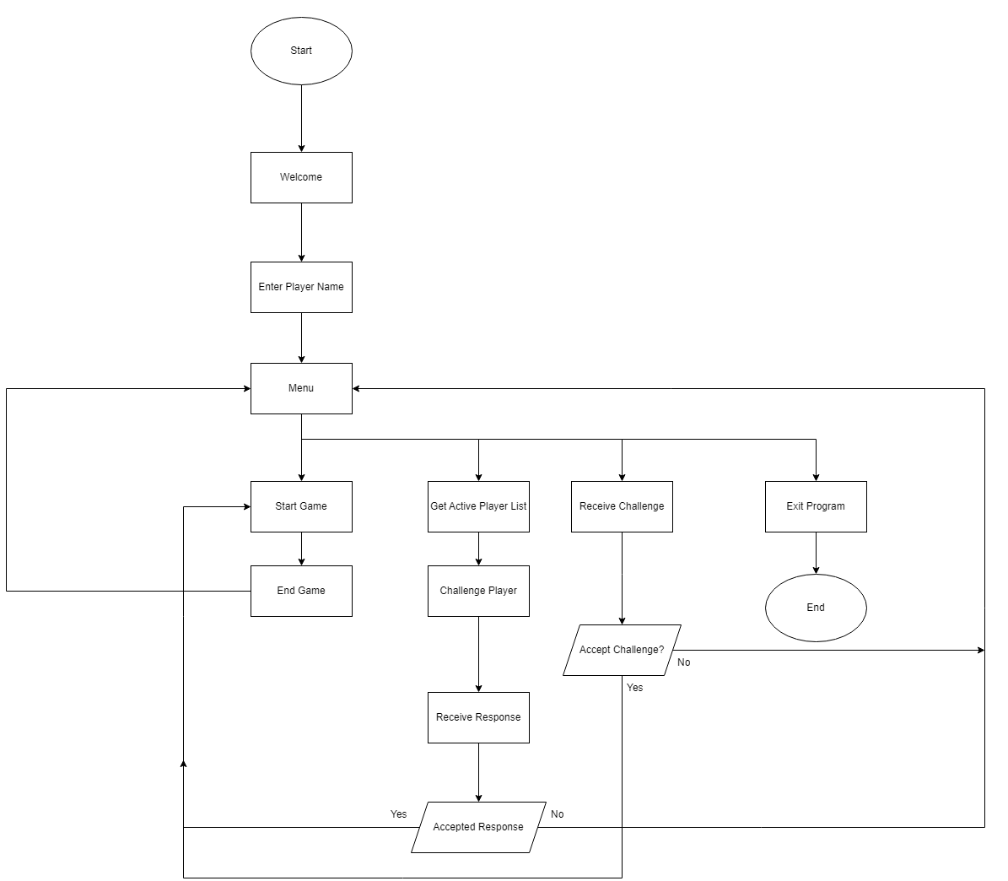
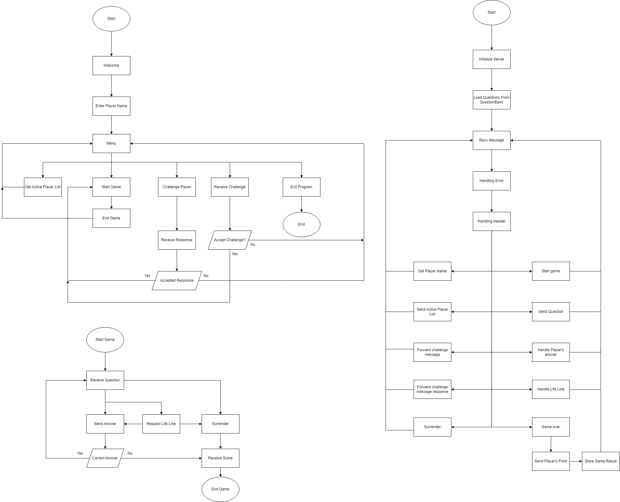
Client

Slide 18
Server

Slide 19
Message Diagram
06

Slide 20
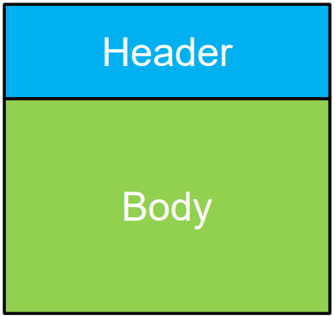
Message Format
Format: HEADER:BODY\n​
Name/Command
Values separate by “:”

Slide 21
 | Server to Client
 | Header | Body
1 | WELCOME
2 | RECEIVE_CHALLENGE | name
3 | CHALLENGE_ACCEPTED
4 | CHALLENGE_REJECTED
5 | QUESTION | question_level | question-content | question_answer
6 | GAME_OVER | your_score | opponent_score

Slide 22
 | Client to Server
 | Header | Body
1 | PLAYER | name
2 | GET_ACTIVE_PLAYER_LIST
3 | CHALLENGE_PLAYER | name
4 | ACCEPT_CHALLENGE
5 | REJECT_CHALLENGE
6 | START_GAME
7 | ANSWER | question_answer
8 | USE_LIFE_LINE | life_line_type
9 | SURRENDER

Slide 23
Finite State Machine
07

Slide 24
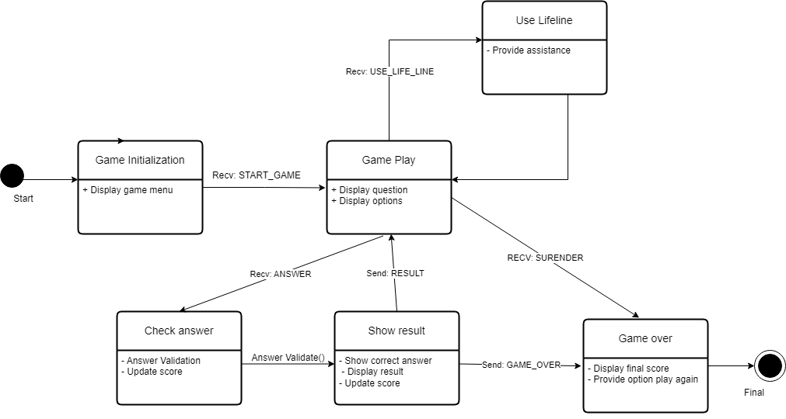
Finite State Machine

Slide 25

Demo
08

Slide 26
DEMO

