Slide 1

COMPANY COMPETENCY
NEU-PMC PTE LTD
Embedded Systems · Test & Measurement Solutions
Full-stack embedded system design — hardware, firmware and PC application software — with custom test, measurement and qualification tools for semiconductor and electronics manufacturing.
Company capability overview

Slide 2
What NEU-PMC PTE LTD Does
Full-stack embedded systems
Hardware, firmware and PC software — designed, built and validated by one team.
Flagship solutions
Hardware & PCB design
Multi-layer schematic capture, layout and test-fixture design, manufacturing-ready.
SmartDAC
Thermal-cycle data analysis software — JESD22-A104 profiling and one-click 9-point qualification reports.
Firmware development
Real-time embedded C for measurement, control and instrument communication.
Cable Jig Tester
116-pin cable continuity test system — full-stack embedded design with audit-ready Excel reporting.
PC & desktop applications
Data-acquisition, analysis and reporting tools with audit-ready outputs.
Test, measurement & qualification
Custom instruments and software for semiconductor / electronics QA.
One team delivering hardware, firmware and software — from concept to a validated, production-ready tool.

Slide 3
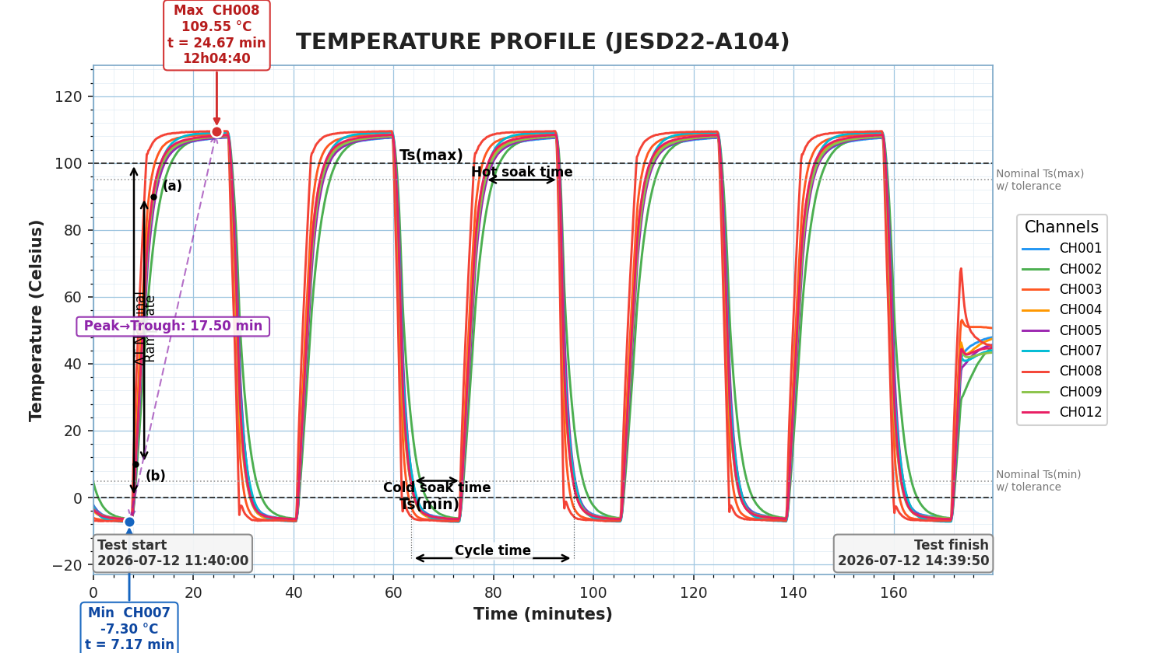
What SmartDAC Does
Reads FX1000 logs natively
Yokogawa binary .DAD and converted .xlsx; multi-file auto-merge; 9+ thermocouple channels.
JESD22-A104 profiling
Soak windows, 10–90% ramp rate, cycle time, peak-to-trough and hot/cold extremes — all annotated.
One-click 9-point report
Per-channel metrics with Pass/Fail against configurable acceptance limits.
Interactive Measure tool
Δtime, Δtemp, ramp rate (°C/min), region min/max/mean, multi-channel cursor.
Audit-ready Excel export
Standardized, reproducible deliverable for qualification records.
Annotated JESD22-A104 profile — real 9-channel FX1000 log

Slide 4
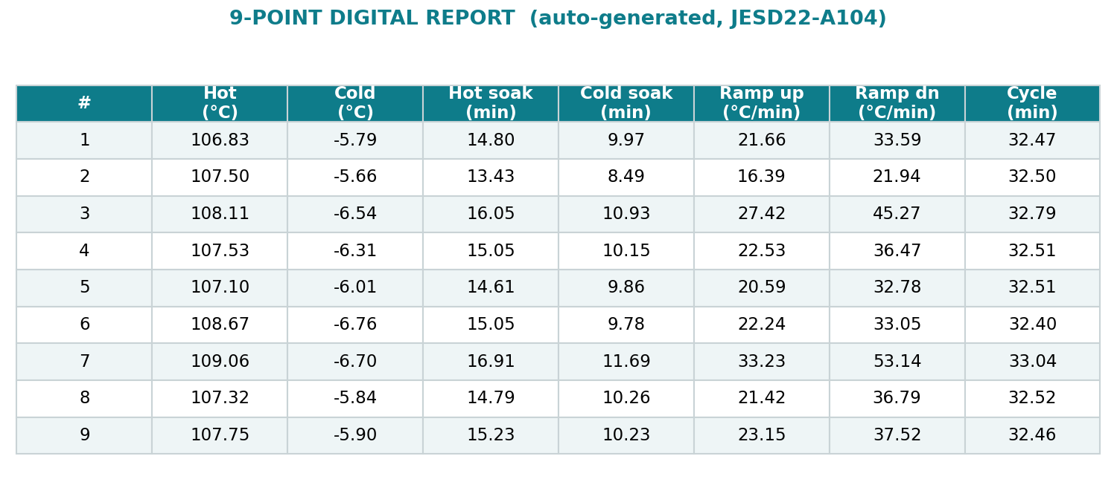
Standardized · Accurate · Fast
9
1-click
.DAD + .xlsx
4
sensor points / cycle
raw log → report
native input
measurement bases
From raw thermal-chamber logs to a signed-off, JESD22-A104-compliant report in minutes — consistent across every engineer and every run.

Slide 5
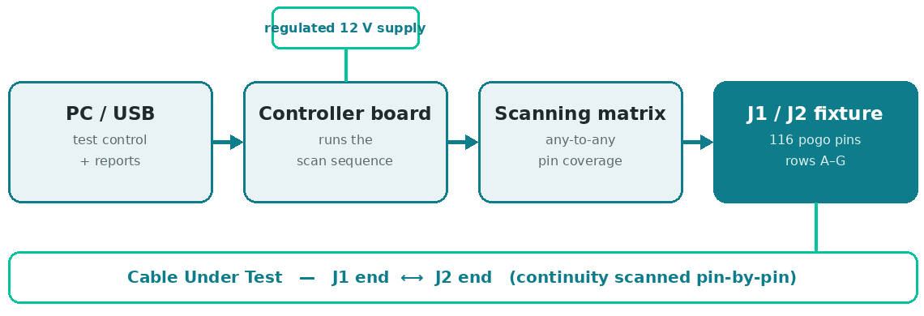
Cable Jig Tester — Hardware Design
Custom PCB design
Multi-layer schematic capture and layout for a compact, production-ready test board.
High-density test fixture
116-pin dual pogo-pin jig (J1/J2, rows A–G) for reliable, repeatable contact.
Power & signal integrity
Clean scanning paths and a regulated supply for stable, low-noise measurements.
Matrix scanning architecture
Any-to-any pin coverage engineered for fast, complete continuity checks.
Hardware architecture — PC ↔ controller ↔ scanning matrix ↔ J1/J2 fixture
Manufacturing-ready design
DFM-conscious layout with status indicators, controls and a single-cable PC link.

Slide 6
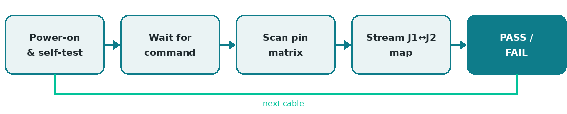
Cable Jig Tester — Firmware Development
Embedded C firmware
Bare-metal microcontroller firmware driving the entire test sequence.
Real-time pin-scan engine
Deterministic full-matrix scanning of every J1↔J2 pin pair.
Host command protocol
Lightweight serial protocol for test control, serial numbers and versioning.
On-board self-diagnostics
Built-in jig diagnostics isolate a fault to a pin, trace or contact.
Firmware sequence — self-test → command → scan → stream results
Robust & production-ready
Reliable low-level drivers and error handling for continuous line use.

Slide 7
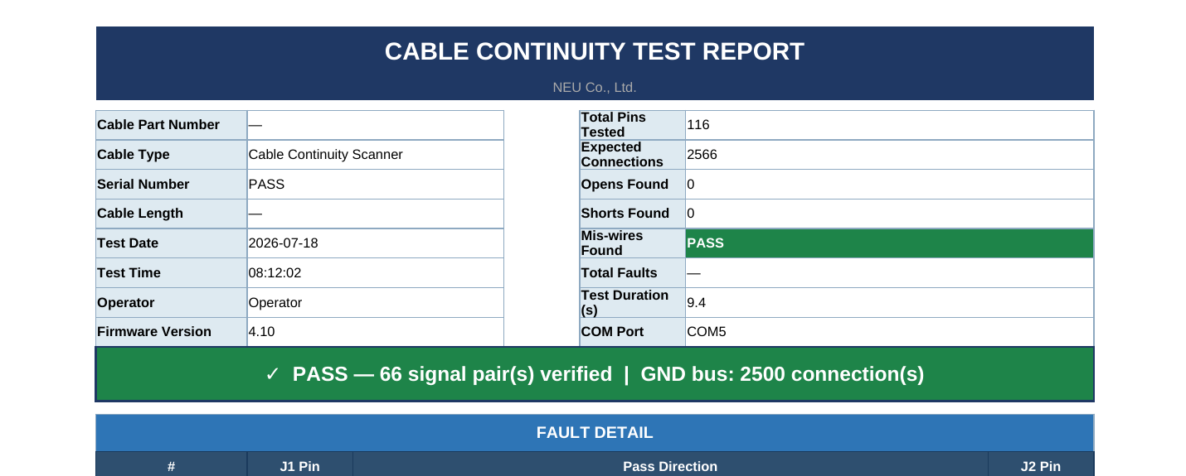
Cable Jig Tester — PC Application
Desktop test application
Live pass/fail view with per-pin status and auto serial-number increment.
Cable profiles — learn any cable
Save a golden netlist per cable type; auto-detects signal pairs and GND bus.
Orientation-independent testing
Passes whether the cable is inserted A→B or reversed B→A.
Raw capture mode
Inspect an unknown cable's netlist, auto-grouped by electrical net.
Template reports + one-click EXE
Audit-ready Excel reports (four sheets); packaged standalone build.
One-click PASS/FAIL report — template layout, four sheets

Slide 8
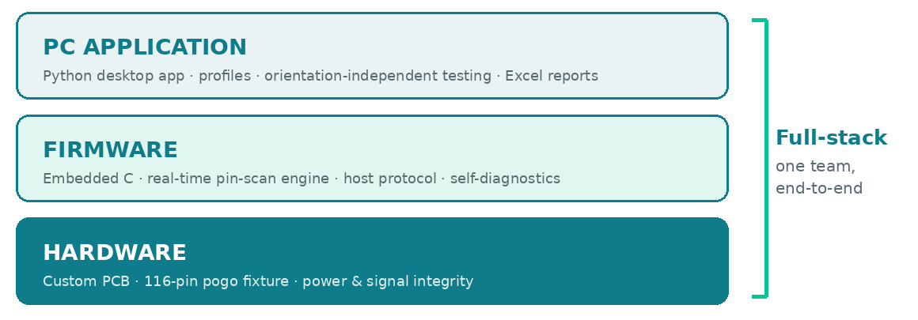
Cable Jig Tester — Full-Stack Embedded System Design
Hardware
Firmware
PC App
Full-stack
PCB · fixture · power
embedded C · real-time
Python · profiles · reports
one team, end-to-end
One workflow from board and firmware to the PC application and the signed-off report — designed, built and validated in-house.

