Slide 1
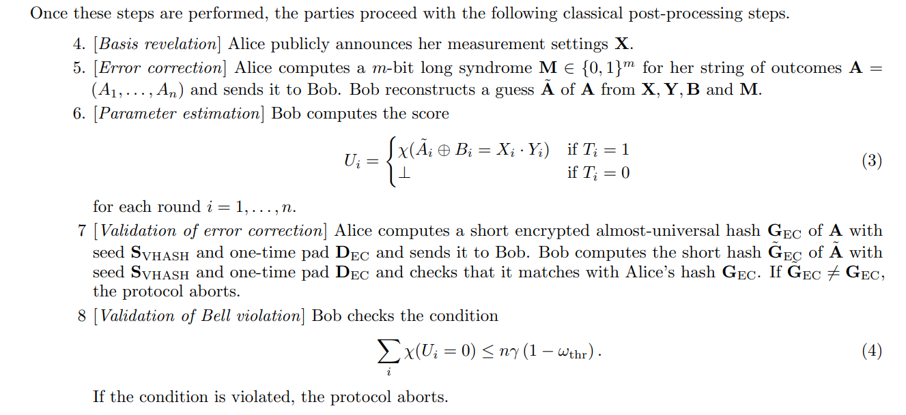
Key unification/verification in DIQKD

Slide 2
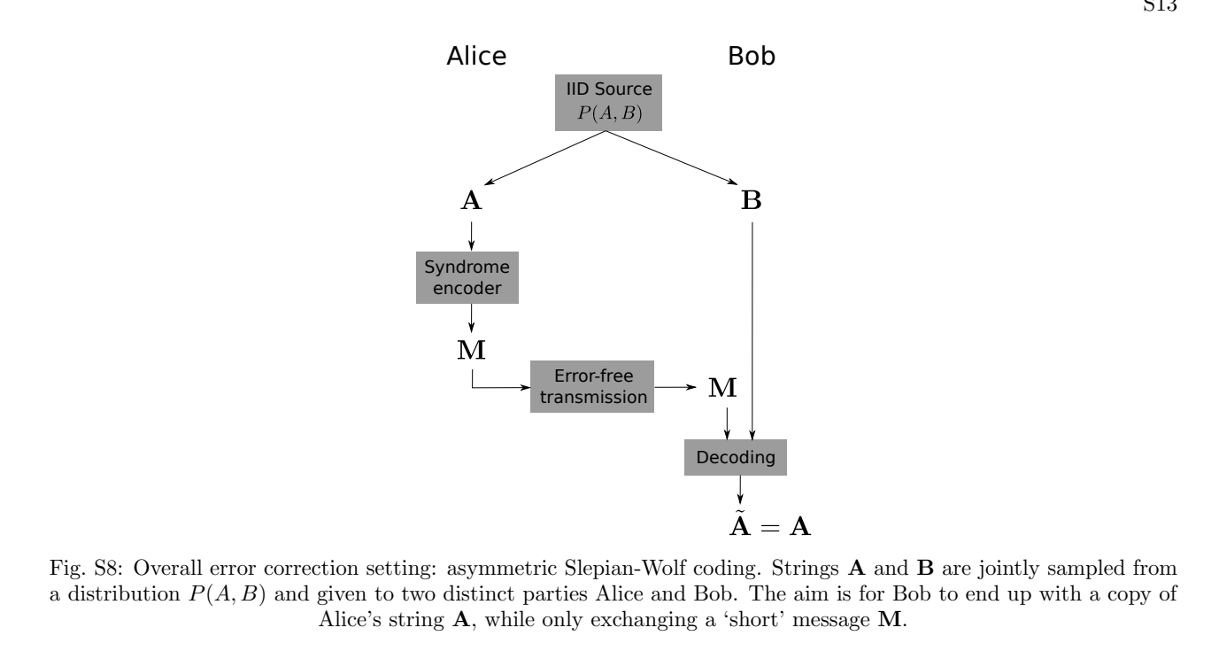
Key unification

Slide 3
Key Unification
4. One-way error correction and verification: In the first part, Alice computes a syndrome based on her raw key (denoted by L) and sends it to Bob via the public channel, who then uses the syndrome and his raw key to recover Alice’s key. In the second part, they perform an error verification by comparing the hash values of their raw keys. Alice and Bob proceed to privacy amplification if the hash values are identical, otherwise they abort the protocol.

Slide 4
Code
low-density parity-check (LDPC) codes, spatially-coupled LDPC (SC-LDPC) codes and polar codes
We will use the classical code: can correct only 50 bits, capacity of correcting is lower than LDPC code

