Slide 1
RECOMMENDER ENGINE OPTIMIZATION
STEVEN L TRUONG
Friday, 04/30/2021

Slide 2


Slide 3
Optimize the recommender engine
01

Slide 4
Optimize the recommender engine
02
Implement state-of-the-art algorithm

Slide 5
Optimize the recommender engine
03
Implement state-of-the-art algorithm
Reduce consumers from churning

Slide 6
WHY?
WHY DO WE NEED TO IMPROVE THE RECOMMENDER ENGINE?

Slide 7
According to Deloitte, among customers who cancel the services

Slide 8
According to Deloitte, among customers who cancel the services
62%
ONE SPECIFIC SHOW THEN CANCEL

Slide 9
According to Deloitte, among customers who cancel the services
62%
21%
ONE SPECIFIC SHOW THEN CANCEL
LACKS OF NEW CONTENT

Slide 10
According to Deloitte, among customers who cancel the services
62%
21%
27%
ONE SPECIFIC SHOW THEN CANCEL
LACKS OF NEW CONTENT
STAY IF MORE EXCLUSIVE CONTENT

Slide 11
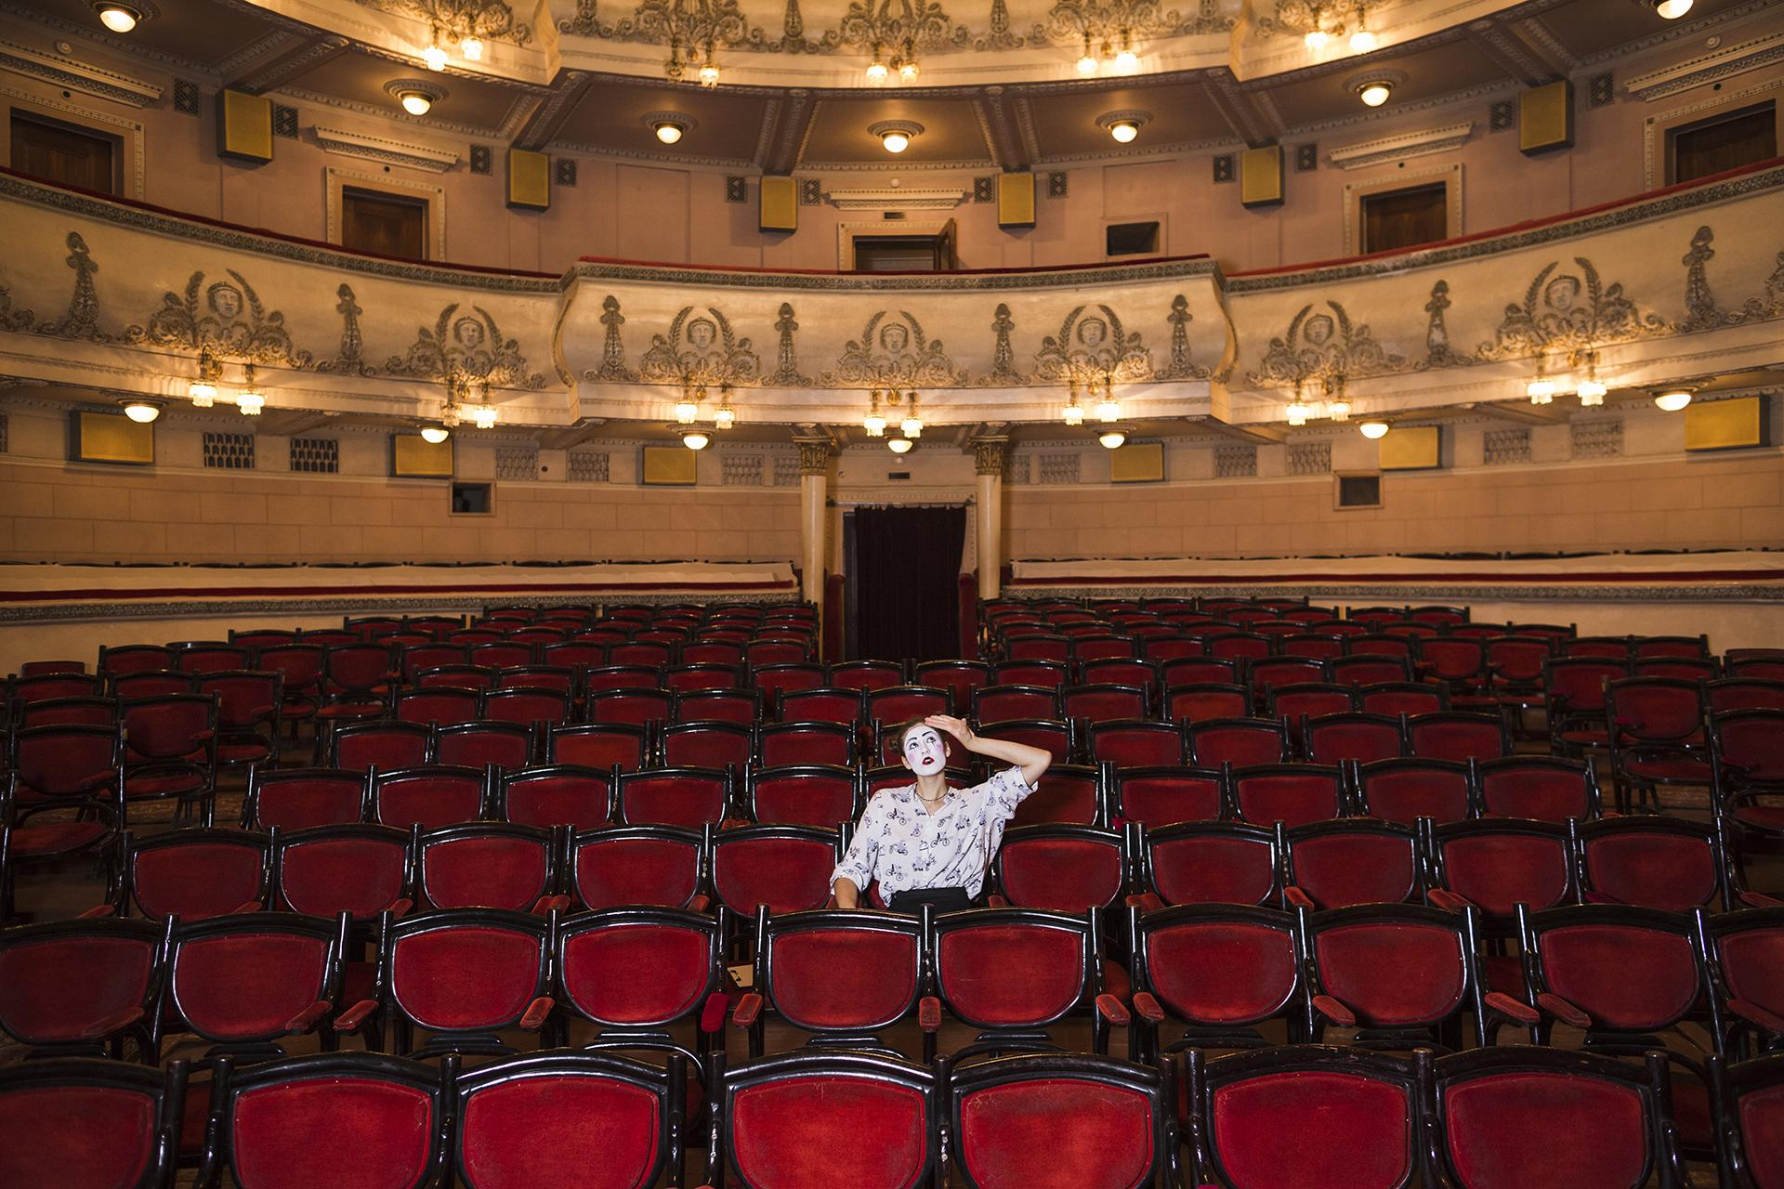
HOW DO WE APPROACH THE PROBLEM?

Slide 12
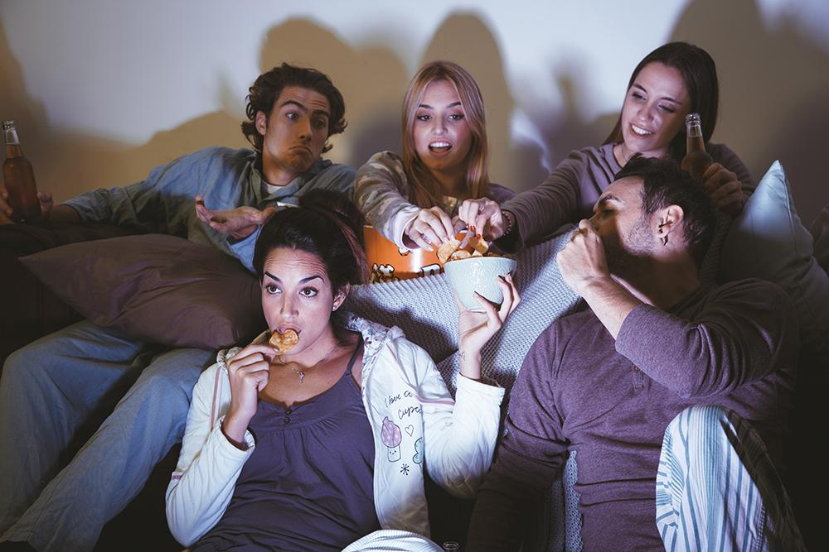
01
User-based collaborative filtering. Recommend similar movies based on user’s preference.

Slide 13

02
Item-based collaborative filtering. Recommend similar movies based on its characteristics.

Slide 14
Results

Slide 15
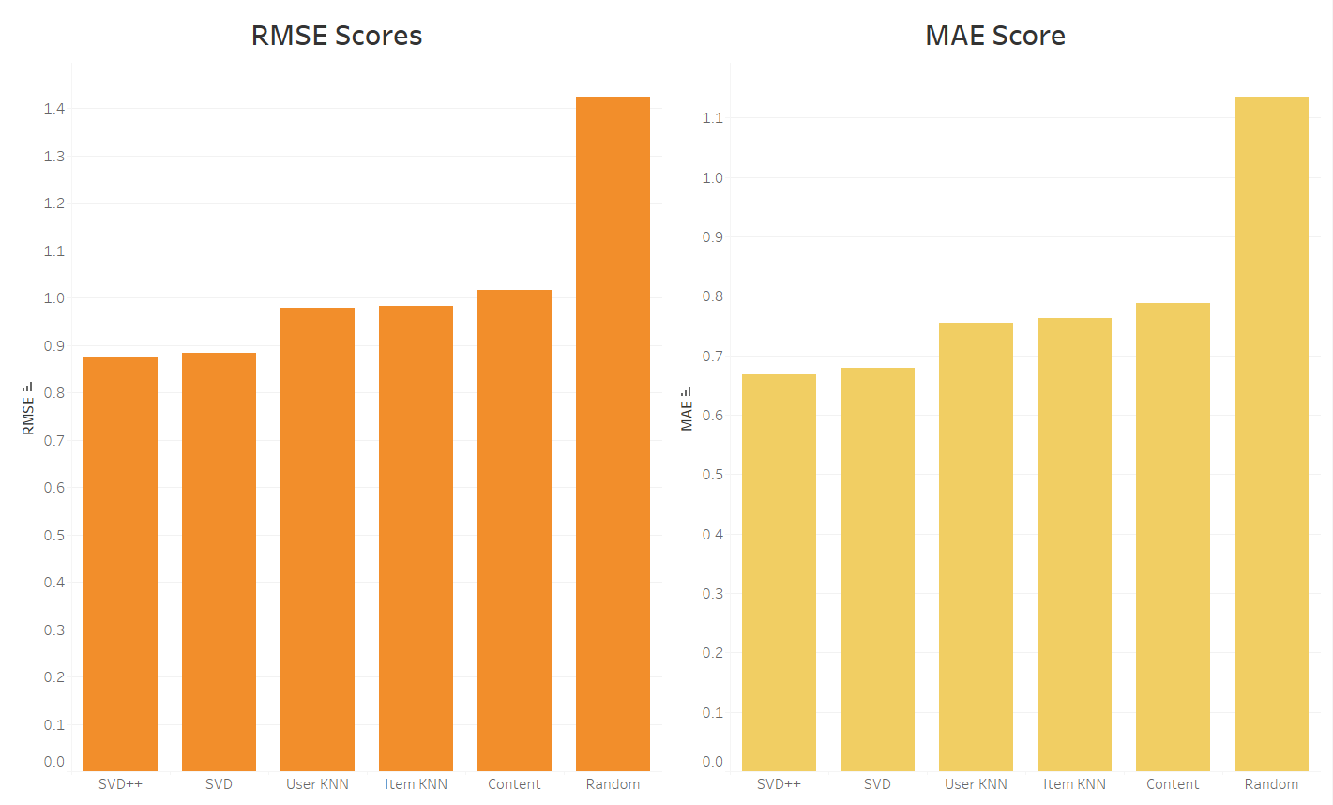
The lower the score, the better the algorithm performs

Slide 16
Demo

Slide 17
Future Work
Algorithm
Data
Restricted Boltzmann Machines (RBM’s) Deep Neural Networks (RNN) Tensorflow Recommenders (TFRS)
Scale it up using Apache Spark Amazon Deep Scalable Sparse Tensor Network Engine (DSSTNE)

Slide 18
Thank you
Questions?
https://github.com/luongtruong77
https://www.linkedin.com/in/luongtruong77/

