Slide 1

Default Risk
STEVEN L TRUONG
Friday, 05/14/2021

Slide 2
Motivation

Slide 3
Motivation
The Bank
Determine if potential clients are capable of repayment to prevent losing money on bad credit clients.

Slide 4
Motivation
The Bank
Clients
Determine if potential clients are capable of repayment to prevent losing money on bad credit clients.
Ensure that people who are capable of repayment are not rejected and help people to achieve their dreams.

Slide 5
Data and tools
Data
Language
Provided by Home Credit through Kaggle.
Python
Modeling
DataViz
Scikit-learn, xgboost, lightGBM, pandas, numpy.
Matplotlib, seaborn

Slide 6

Exploratory data analysis (EDA)

Slide 7
EDA and insights

Slide 8
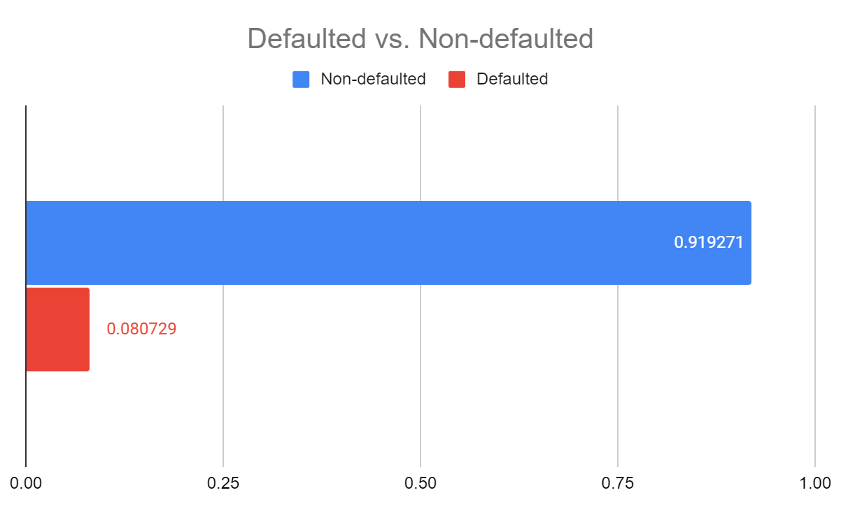
EDA and insights
91.9 %
NON-defaulted
Accounts that essentially have good credit.
8.1 %
Defaulted
People that have poor credit or non-existent credit histories.

Slide 9
EDA and insights
91.9 %
NON-defaulted
Accounts that essentially have good credit.
8.1 %
Defaulted
People that have poor credit or non-existent credit histories.
This is an imbalance class problem. The ratio is roughly 11:1

Slide 10
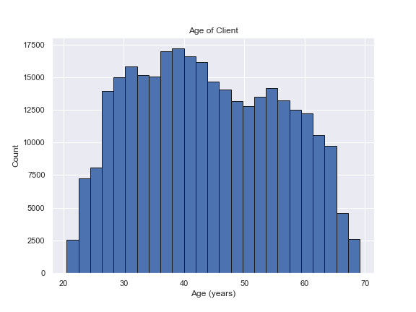
EDA and insights

Slide 11
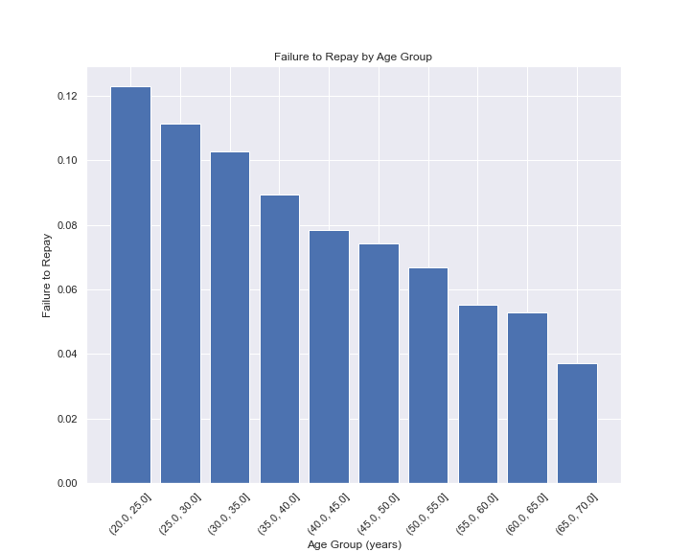
EDA and insights
The younger the client, the more likely to get defaulted.

Slide 12
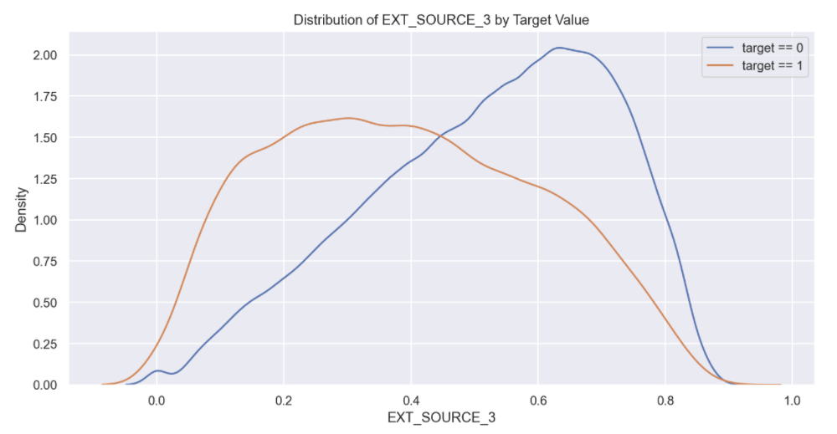
EDA and insights
External source of income displays the difference between the values of the target. Hence there is some relationship to the likelihood of an applicant to repay a loan.

Slide 13

Let’s build some models
Use the power of data science and machine learning.

Slide 14
Models comparison (ROC AUC)

Slide 15
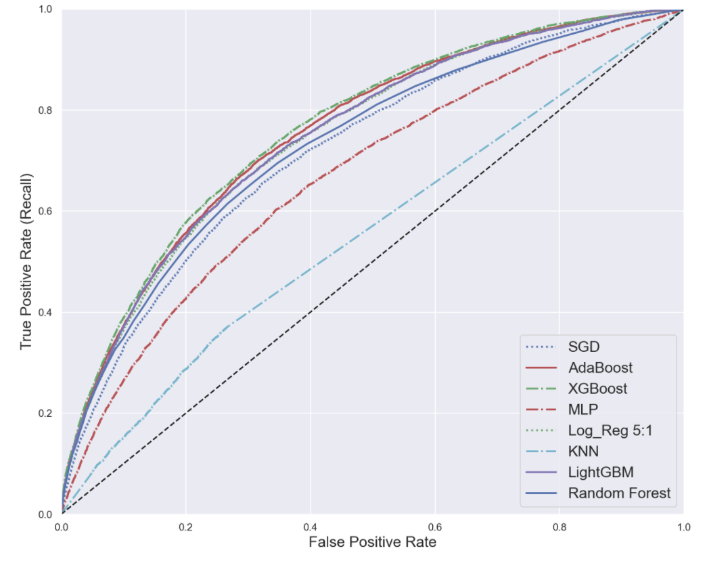
Models comparison (ROC AUC)

Slide 16
Models comparison (ROC AUC)
XGBoost wins.
(GBT on steroid)

Slide 17
Models comparison (F2 Score)

Slide 18
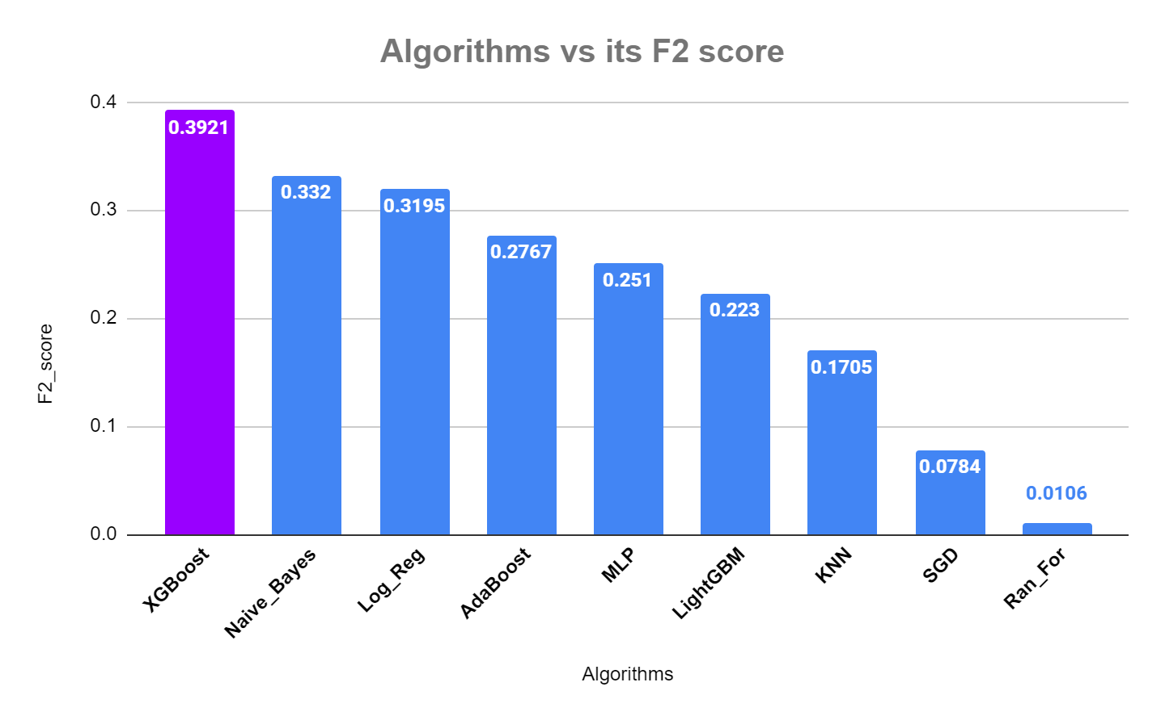
Models comparison (F2 Score)

Slide 19
Models comparison (F2 Score)
Metrics chosen: F_beta with beta = 2
Again, our good buddy XGBoost wins.

Slide 20

Model optimizaton
Now we have our chosen model, let’s tune and improve XGBoost.

Slide 21
Optimized XGBoost Model

Slide 22
Optimized XGBoost Model
Train Set
F2 Score
0.463
ROC AUC
0.804

Slide 23
Optimized XGBoost Model
Train Set
Test Set
F2 Score
F2 Score
0.463
0.432
ROC AUC
ROC AUC
0.804
0.768

Slide 24
Results

Slide 25
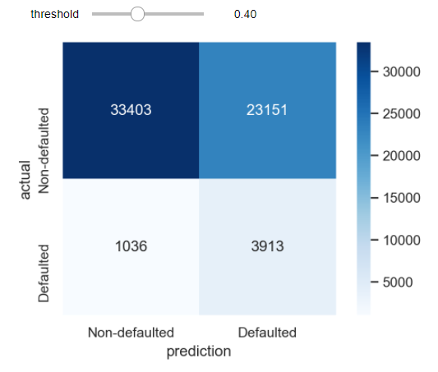
Results
We lean a little bit towards recall (not too strict on precision either)

Slide 26
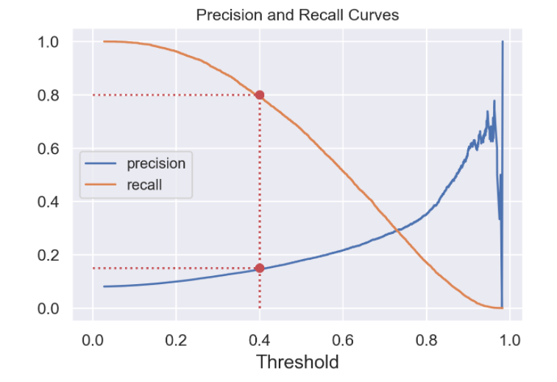
Results
We lean a little bit towards recall (not too strict on precision either)

Slide 27
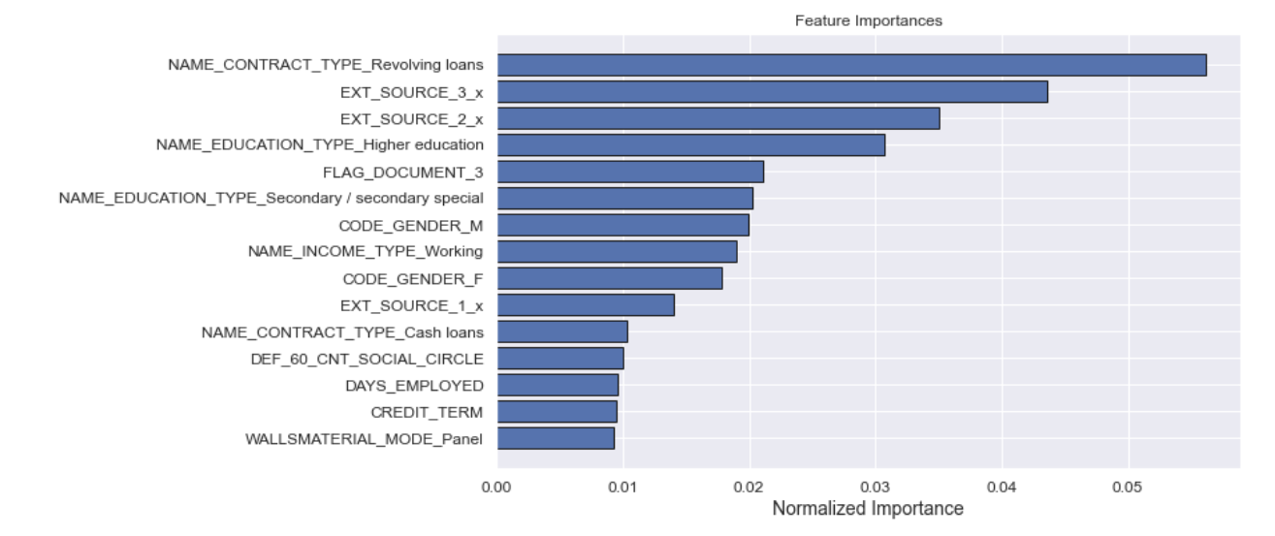
Features importance
Mainly external income sources, education, and type of loans determine the decision.

Slide 28
Recap

Slide 29
Recap
EDA/DataViz
Gather, clean, and explore data

Slide 30

Recap
Interactive features/ categorical features
EDA/DataViz
Feature Engineer
Gather, clean, and explore data

Slide 31

Recap
Interactive features/ categorical features
EDA/DataViz
Feature Engineer
Model seletion
Gather, clean, and explore data
Build, compare, and choose the best model

Slide 32
Recap
Interactive features/ categorical features
GridSearchCV, hyperparam tuning
EDA/DataViz
Feature Engineer
Model seletion
Optimization/ Deployment
Gather, clean, and explore data
Build, compare, and choose the best model

Slide 33
Future Work
Data
Algorithm
Deployment
Incorporate multiple datasets
Do better on XGBoost and LightGBM
Build interactive app and deploy to streamlit/AWS

Slide 34
Thank you
Steven L Truong
Questions?
Please reach out to me at https://www.linkedin.com/in/luongtruong77/

Slide 35
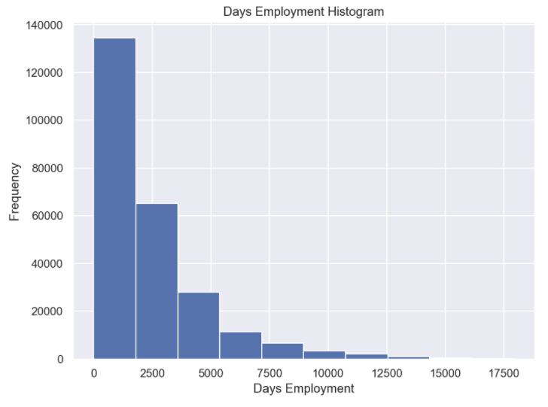
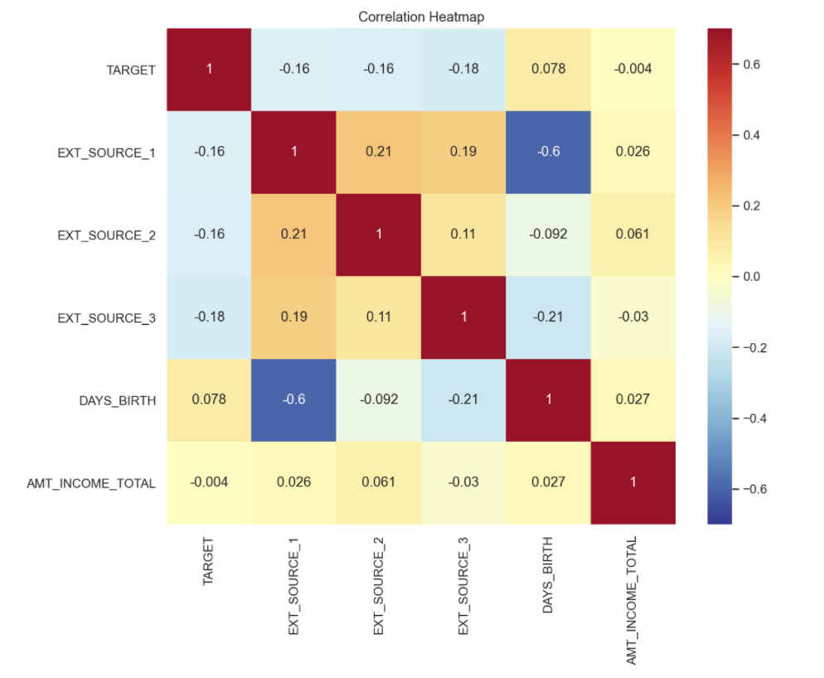
Appendix

Slide 36
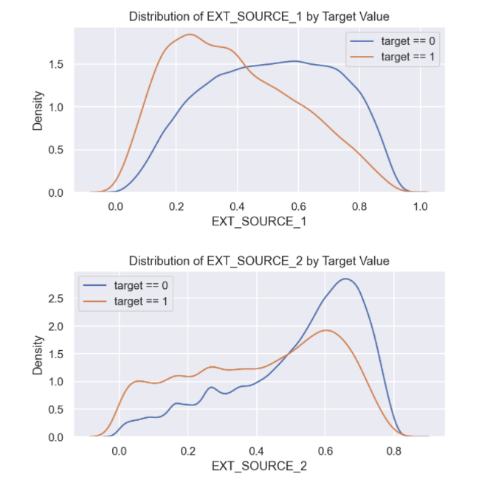
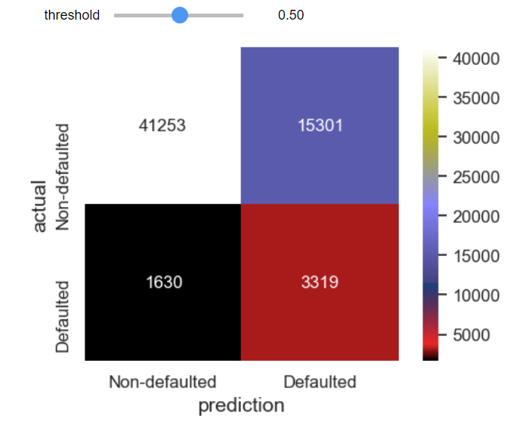
Appendix

