Slide 1

Default Risk
STEVEN L TRUONG
Friday, 05/14/2021

Slide 2
Motivation
The Bank
Clients
Determine if potential clients are capable of repayment to prevent losing money on bad credit clients.
Ensure that people who are capable of repayment are not rejected and help people to achieve their dreams.

Slide 3
Data and tools
Data
Language
Provided by Home Credit through Kaggle.
Python
Modeling
DataViz
Scikit-learn, xgboost, lightGBM, pandas, numpy.
Matplotlib, seaborn

Slide 4
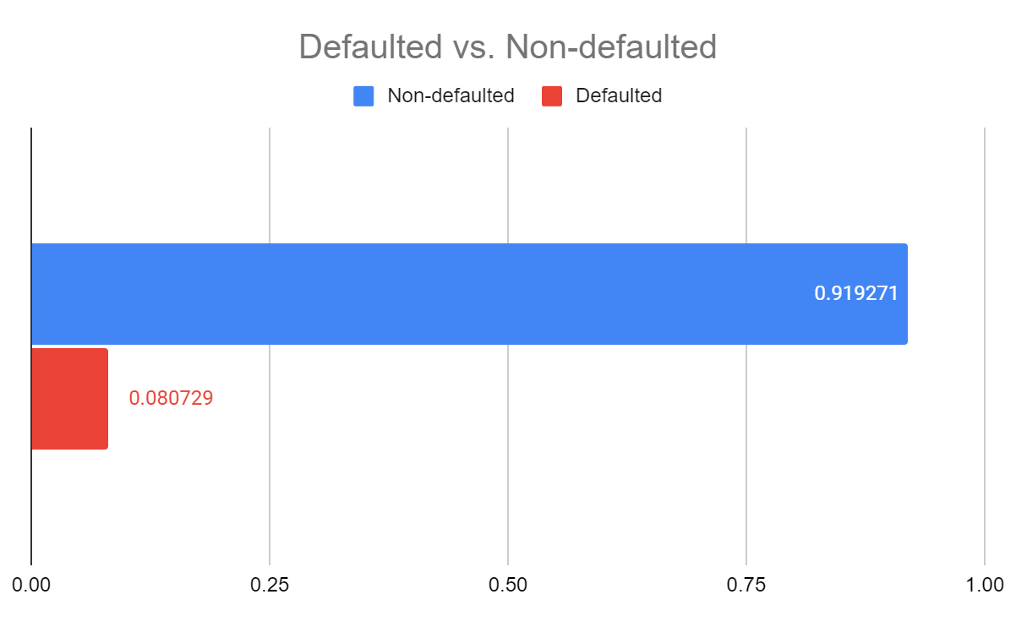
EDA and insights
91.9 %
NON-defaulted
Accounts that essentially have good credit.
8.1 %
Defaulted
People that have poor credit or non-existent credit histories.
This is an imbalance class problem. The ratio is roughly 11:1

Slide 5
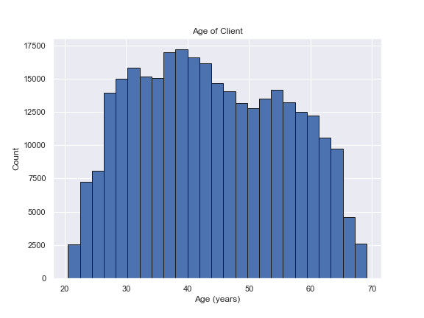
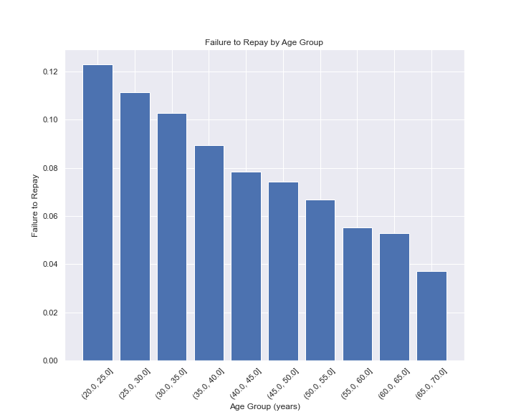
EDA and insights
The younger the client, the more likely to get defaulted.

Slide 6
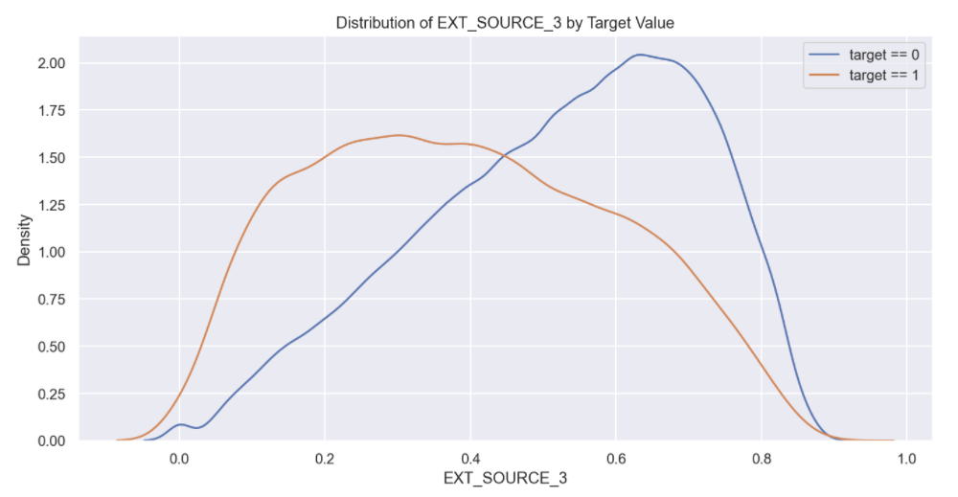
EDA and insights
External source of income displays the difference between the values of the target. Hence there is some relationship to the likelihood of an applicant to repay a loan.

Slide 7
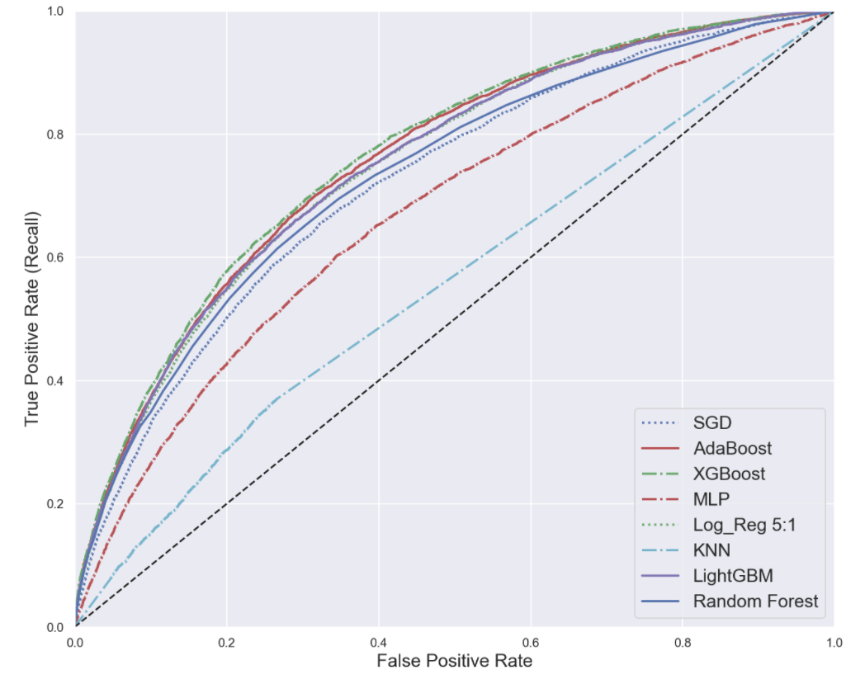
Models comparison
XGBoost wins.
(GBT on steroid)

Slide 8
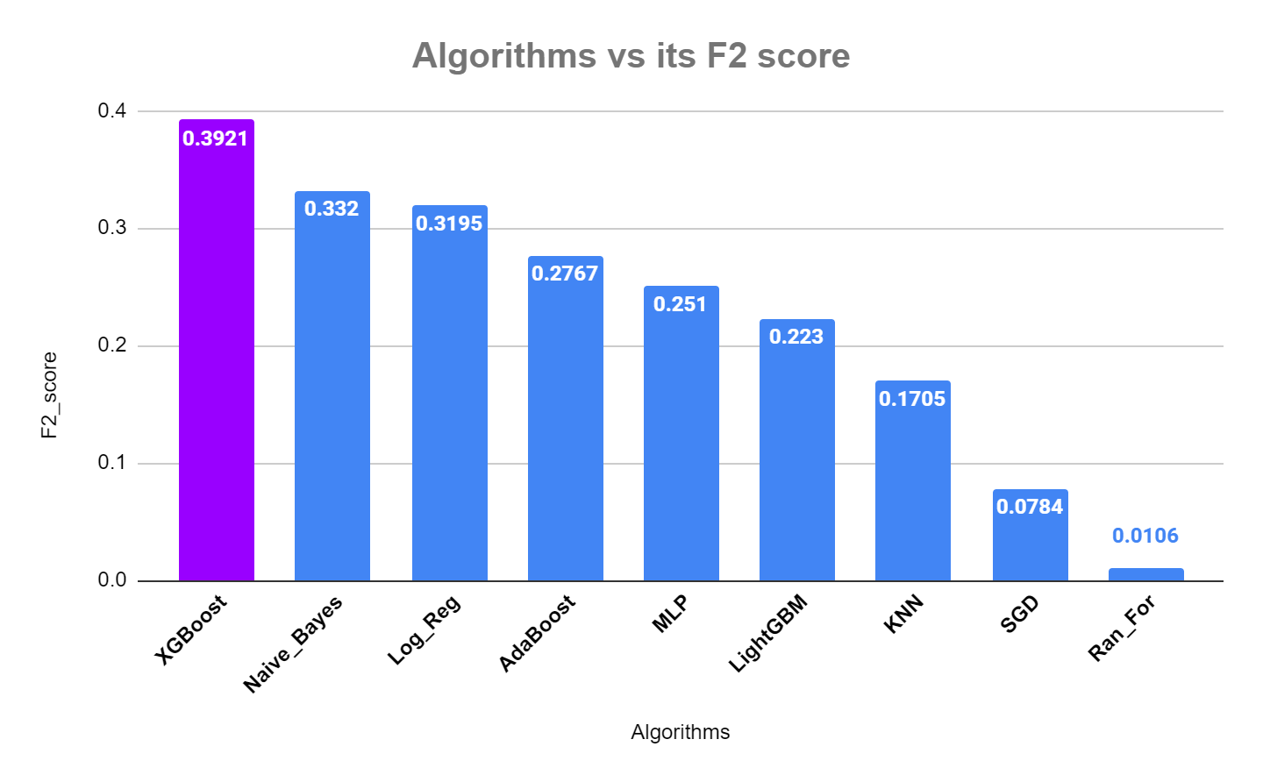
Models comparison
Metrics chosen: F_beta with beta = 2
Again, our good buddy XGBoost wins.

Slide 9

Model optimizaton
Now we have our chosen model, let’s tune and improve XGBoost.

Slide 10
Optimized XGBoost Model
Train Set
Test Set
F2 Score
F2 Score
0.463
0.432
ROC AUC
ROC AUC
0.804
0.768

Slide 11
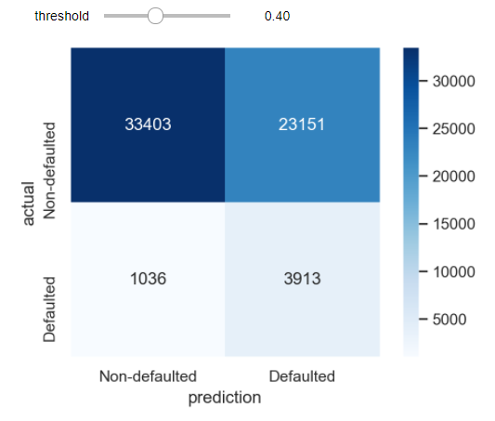
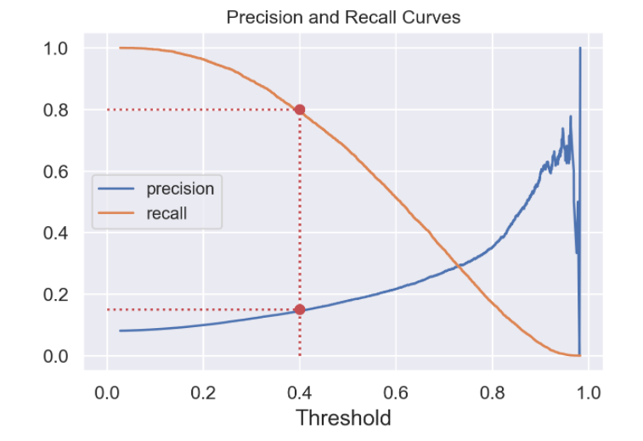
Results
We lean a little bit towards recall (not too strict on precision either)

Slide 12
Recap
Interactive features/ categorical features
GridSearchCV, hyperparam tuning
EDA/DataViz
Feature Engineer
Model seletion
Optimization/ Deployment
Gather, clean, and explore data
Build, compare, and choose the best model

Slide 13
Future Work
Goal 1
Goal 2
Goal 3
Goal 4
Venus is the second planet from the Sun
It’s the biggest planet in the Solar System
Saturn is a gas giant and has several rings
Despite being red, Mars is a cold place

Slide 15
Thank you
Steven L Truong
Questions?
Please reach out to me at https://www.linkedin.com/in/luongtruong77/

