Slide 1

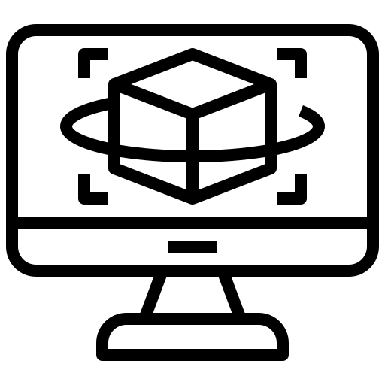
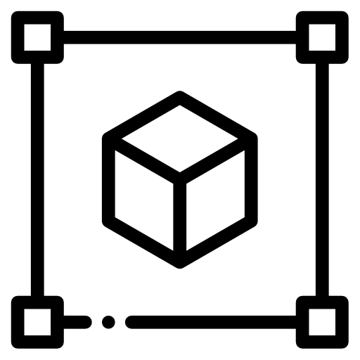

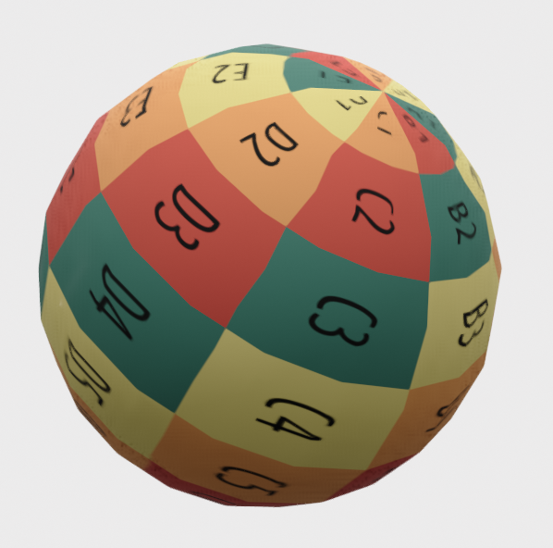

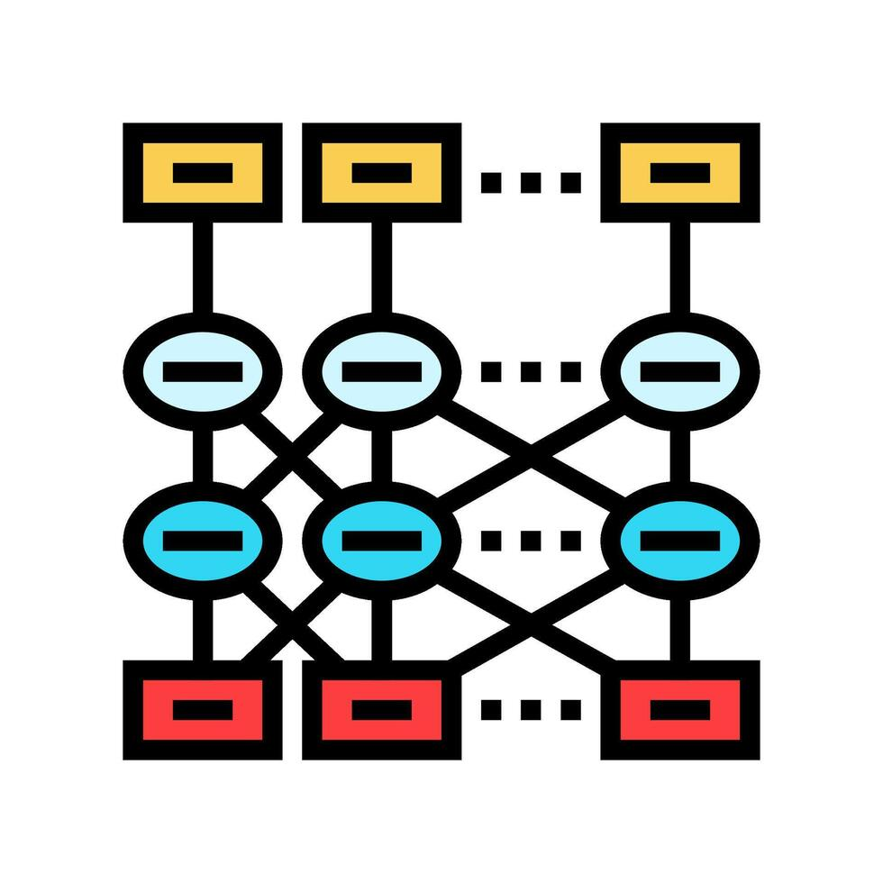

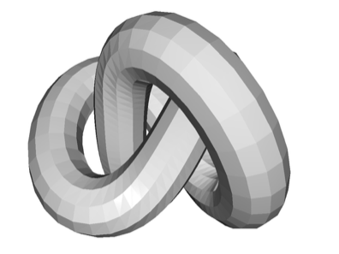
Rendering
Multiple 2D Images
3D Point Cloud Gen-Model
Texture Generation
Multi-view Shot From mobile Camera
Mesh
Generation
Colored 3D-PCL

