Slide 1
Zoo Planner
William Ansehl
Simon Benigeri
Renpin Luo
Luke Salamone

Slide 2



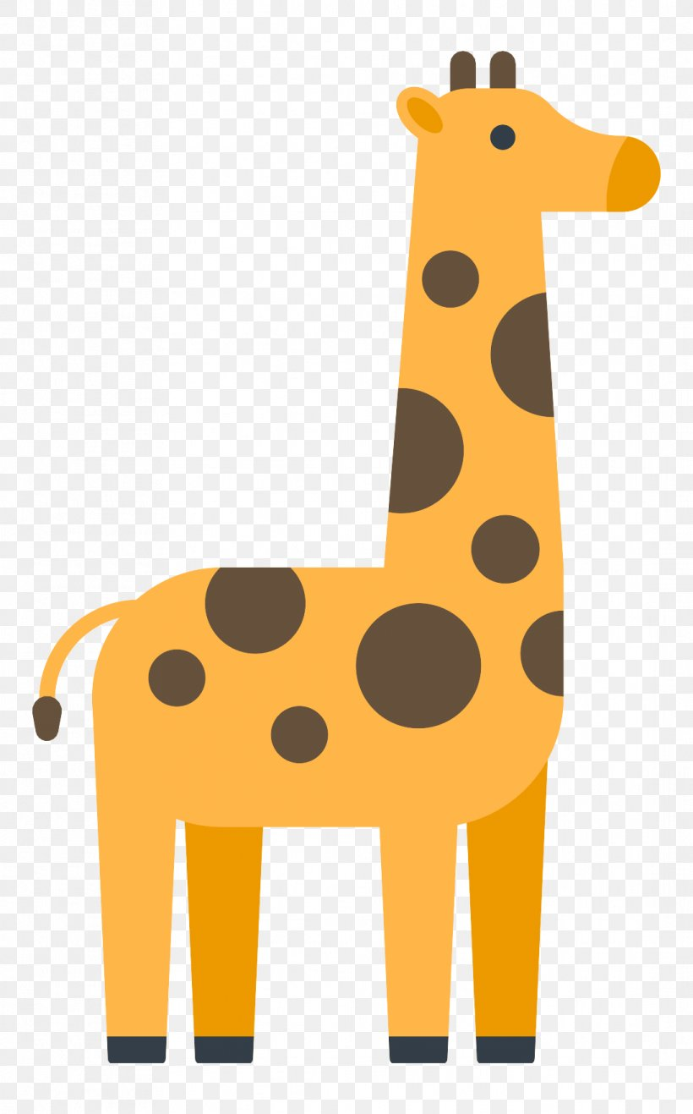


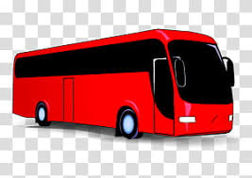
Scenario
Tiger Pen #1
Tiger Pen #2
Giraffe Pen #1

Slide 3
Objects
Animals: carnivore, herbivore, omnivore
Foods: meat, veggies
Moveable objects: robot, trolley
Locations: store, pantry, animal location, room
Tour bus

Slide 4
Actions (12)
Restrictions
Feed-herbivore
Feed-carnivore
Feed-omnivore
Free-move
Push-trolley
Grab-trolley
Drop-trolley
Pick-up-food
Visitors-move
Grab-animal
Move-animal
Release-animal
Dietary Restrictions
May need to buy food from store
Can’t feed animals in presence of visitors
An animal must be in its cage to be fed

