Slide 1
页面设计
2019.8.27

Slide 2


welcome to xxx
Enter

Slide 3
History/
Training
》
Tip: enter the interface of historical data and model training to perform data import, data cleaning, training model and other operations.
New test
Config

Slide 4
History/
Training
New test
Tip: after the model training, this operation can be performed, and new data can be predicted according to the model.
》
Config

Slide 5
History/
Training
New test
Config
Tip: go to the configuration screen and you'll find out more about what you want to know.
》

Slide 6
History/
Training
》
Import
空调数据采集1
空调数据采集2
空调数据采集3
空调数据采集4
New test
全选 全不选 Apply
Clean
Config
Splite
90/10 80/20 系统自定
Train
Socre ：0.83 Confusion_matrix ：[[201 1]
[1 2]]
Eval

Slide 7
History/
Training
Import
空调数据采集1
空调数据采集2
空调数据采集3
空调数据采集4
New test
全选 全不选 Apply
》
Pred
Config
xxx | xxx | xxx | xxx | xxx | xxx | xxx
xxx | xxx | xxx | xxx | xxx | xxx | xxx
xxx | xxx | xxx | xxx | xxx | xxx | xxx
xxx | xxx | xxx | xxx | xxx | xxx | xxx
xxx | xxx | xxx | xxx | xxx | xxx | xxx
Result

Slide 8
History/
Training
文件路径1
操作
文件路径2
文件路径3
…...
New test
SGDClassifier
DecisionTreeClassifier
AdaBoostClassifier
GaussianNB
……
算法
Config
》
confirm
xxx
其他

Slide 9
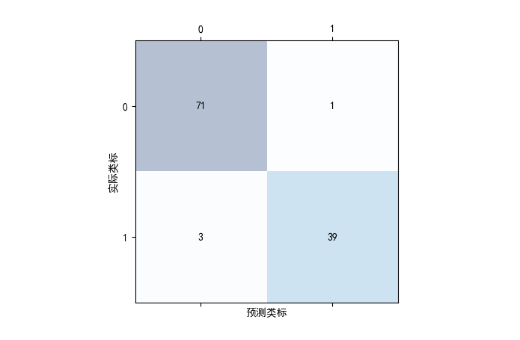
机器预测不吹
机器预测吹
人工标注不吹
人工标注吹

Slide 12


