Slide 1
01 | OPERATIONAL CHALLENGE
Anticipating Urban Bike Depletion & Dock Congestion
HSL City-Bike Rebalancing Insights Across 457 Stations & 4.98 Million Trips (2024–2025)
How can HSL city-bike operators anticipate where bikes deplete
and docks saturate across 457 stations in Helsinki and Espoo?
Macro Seasonality
14 operating months (2024–2025)
Unimodal summer peak & shoulder contraction
Commuter Tidal Swings
+78% evening rush surge
Opposing morning vs. evening tidal flows
Operational Triage
Identifying structural transit sinks
Same-month baseline for fleet sizing
Authors: Chenyu Wu · Jizhou Wang · Jussi Honkio
University of Helsinki · Introduction to Data Science · Canvas Mini-Project Spotlight Session
01 / 06
Notes:
Timing: 0:00-0:20 | Duration: 20 seconds | Word Count: 44 words
Good morning. City-bike operators in Helsinki face a daily rebalancing headache: docks run empty during morning commutes and overflow by evening. Across nearly five million cleaned trips in 2024 and 2025, our goal is helping HSL planners triage critical stations before service disruptions occur.

Slide 2
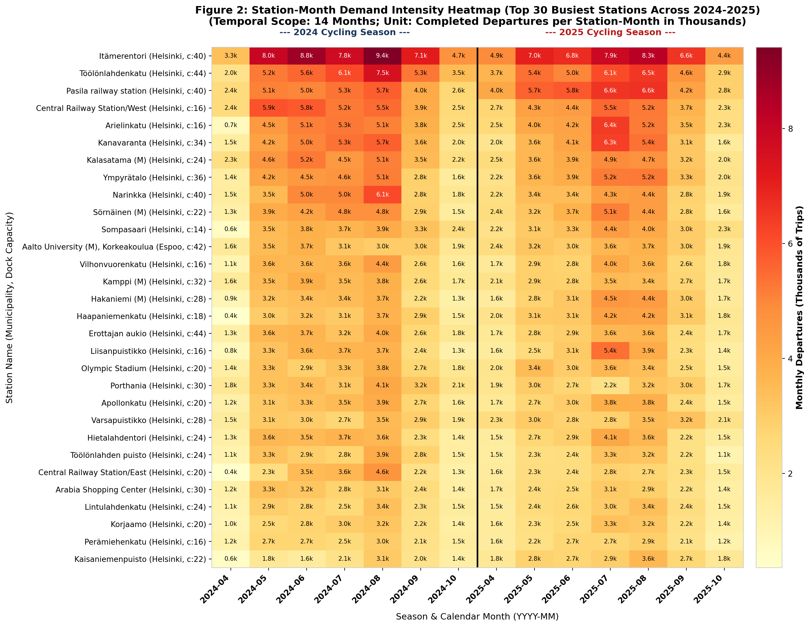
02 | SEASONAL CONCENTRATION
Summer Peaks at Nearly 500k Monthly Trips, Anchored by Major Rail Hubs
Station-Month Departures Across Two Full Seasons (April–October, 2024 & 2025)
Sharp Unimodal Summer Envelope
• Summer Peak: Monthly demand peaks in July/August at ~450k–492k trips, then contracts sharply by over 50% in shoulder months (April: 162k–243k; October: 198k–207k).
• Regional Share: Helsinki commands 88.8% of total ridership; Espoo accounts for 11.2% centered around metro stations and universities.
Transit Hub Sinks & Weather Context
• Transit Anchors: Top stations (Pasila station, Central Railway, Kalasatama, Itämerentori) sustain over 5,000–9,000 monthly departures throughout summer.
• Descriptive Weather: Daily ridership correlates with mean temperature (r = +0.74) and rain (r = -0.25). Reflects seasonal daylight (19h June vs. 9h Oct) and holidays; strictly non-causal.
02 / 06
Notes:
Timing: 0:20-0:55 | Duration: 35 seconds | Word Count: 73 words
Looking at the thirty busiest stations across fourteen operating months, ridership follows a steep summer peak in July and August, contracting by more than half in shoulder months. Helsinki accounts for eighty-nine percent of volume, anchored by major rail hubs like Pasila and Central Railway Station. Daily trips correlate with warm summer days, but this reflects holiday schedules and long Nordic daylight rather than direct causation. This volume profile informs seasonal fleet sizing.

Slide 3
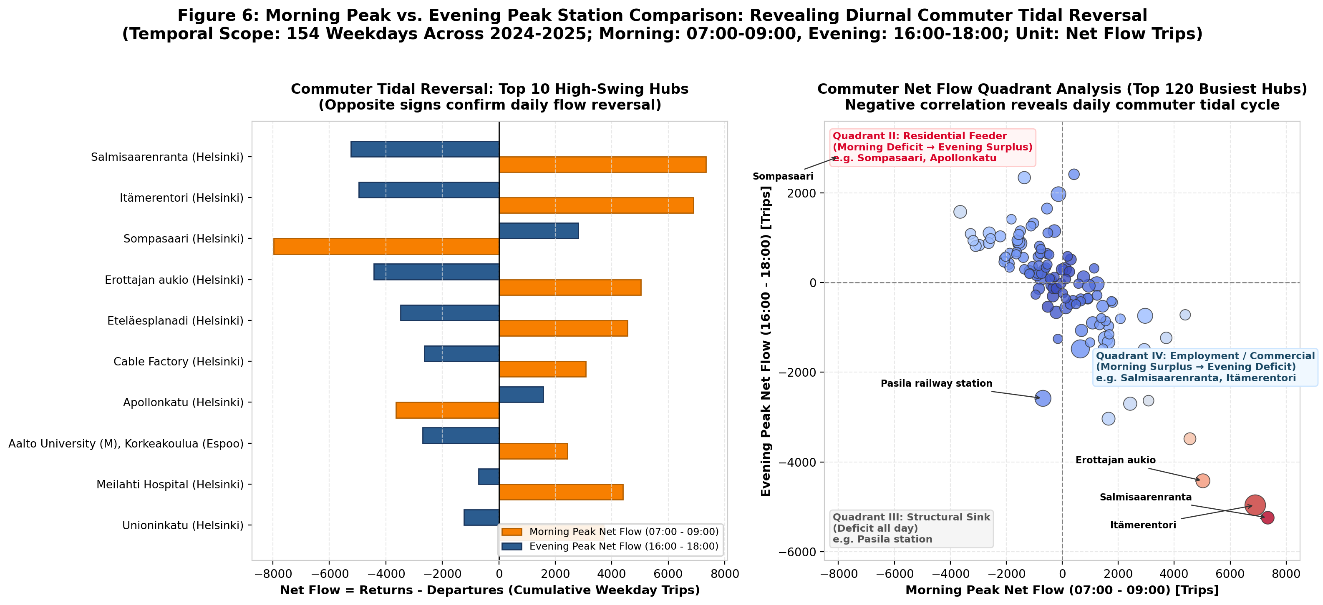
03 | INTRADAY COMMUTE DYNAMICS
Weekday Evening Demand Surges +78%, Reversing Station Net Flows
Standardized Peak Windows (07:00–09:00 vs. 16:00–18:00) Reveal Polarized Commuter Swings
Evening Rush Surge (+78% to +96%)
• Helsinki 2025: Morning 1,208 trips/day → Evening 2,154 trips/day (+78.4% surge).
• Espoo 2025: Morning 141 trips/day → Evening 276 trips/day (+95.9% surge).
• Behavioral Driver: Morning trips are utilitarian work commutes. Evening trips blend homeward travel with retail, dining, and recreation under evening daylight.
Diurnal Commuter Tidal Reversals
• Residential Feeders: Sompasaari empties in the morning (-7,973 net flow) and fills up in the evening (+2,808 net flow).
• Workplace Centers: Salmisaarenranta fills in the morning (+7,343 net flow) and empties in the evening (-5,244 net flow).
• Transit Interchanges: Pasila rail station remains in deficit all day (-2.6k morning, -2.6k evening).
03 / 06
Notes:
Timing: 0:55-1:30 | Duration: 35 seconds | Word Count: 76 words
Intraday patterns show that weekday evening peaks generate seventy-eight to ninety-six percent more trips than morning peaks. Simultaneously, stations undergo sharp tidal reversals. Residential docks like Sompasaari experience severe morning deficits as commuters leave, but accumulate heavy surpluses by evening. Conversely, workplace centers like Salmisaarenranta fill up in the morning and empty out after work. Meanwhile, Pasila rail station operates in continuous deficit throughout the entire day. These commuter swings dictate where rebalancing vans should stage.

Slide 4
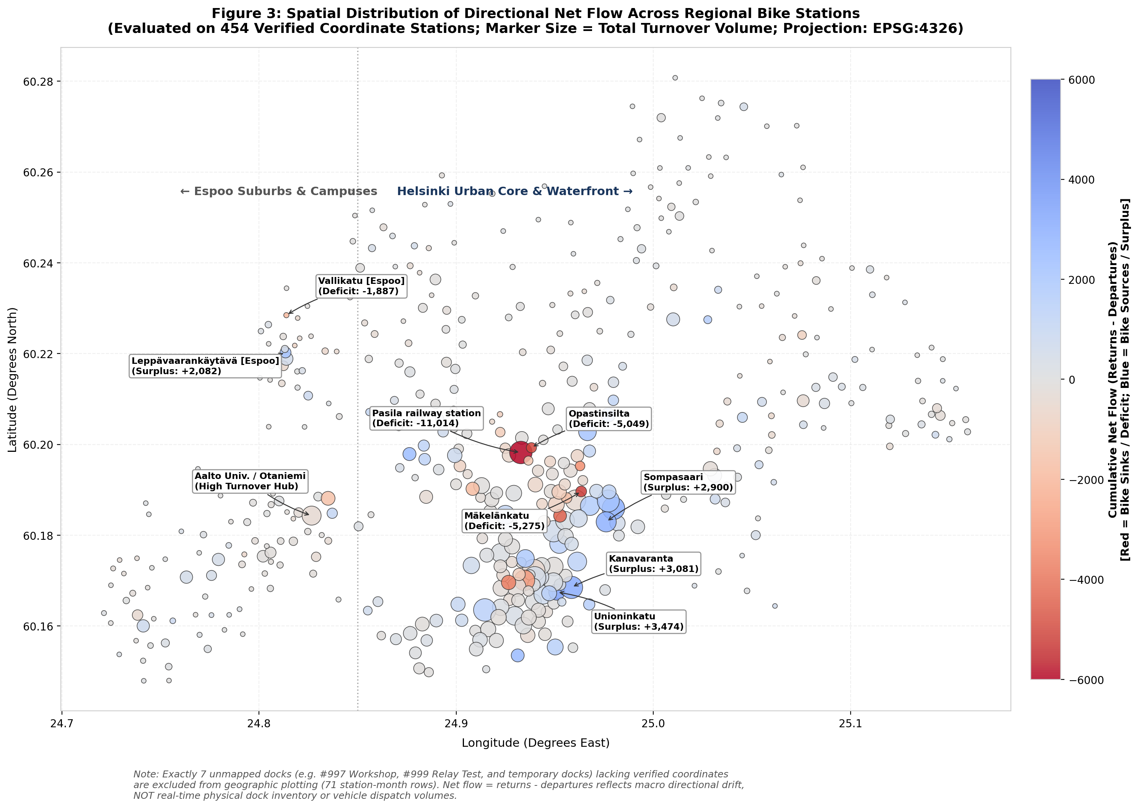
04 | REBALANCING TRIAGE
Directional Net Flow Pinpoints Systemic Rebalancing Bottlenecks
Cumulative Net Flow (Returns - Departures) Across 454 Coordinate Stations (2024–2025)
Deficit Sinks (Red, Bike Depletion)
• Pasila Rail Interchange: Chronic primary sink with -11,014 net trips (capacity: 40); disembarking train commuters bike to offices.
• Radial Arterials: Mäkelänkatu (-5,275), Opastinsilta (-5,049), and Karhupuisto (-4,421) suffer rapid bicycle exhaustion.
• Operational Implication: Priority candidates for pre-staging bicycle supplies before morning rush.
Surplus Sources (Blue, Dock Congestion)
• Destination Accumulators: Waterfront and dining clusters: Unioninkatu (+3,474), Kanavaranta (+3,081), Kalasatama (+2,140).
• Dock Saturation Risk: High risk of return blocking where riders cannot find open slots to terminate trips.
• Triage Distinction: Net flow measures passenger drift, NOT exact truck loads. Van dispatch requires live dock occupancy telemetry.
04 / 06
Notes:
Timing: 1:30-2:05 | Duration: 35 seconds | Word Count: 59 words
Mapping cumulative net flow across the network highlights structural rebalancing sinks in red and surplus sources in blue. Pasila railway station is the primary deficit bottleneck, accumulating an eleven-thousand trip deficit over two seasons. While this macro drift identifies priority candidates for rebalancing attention, it reflects passenger flow rather than exact physical bike inventory or rigid truck dispatch orders.

Slide 5
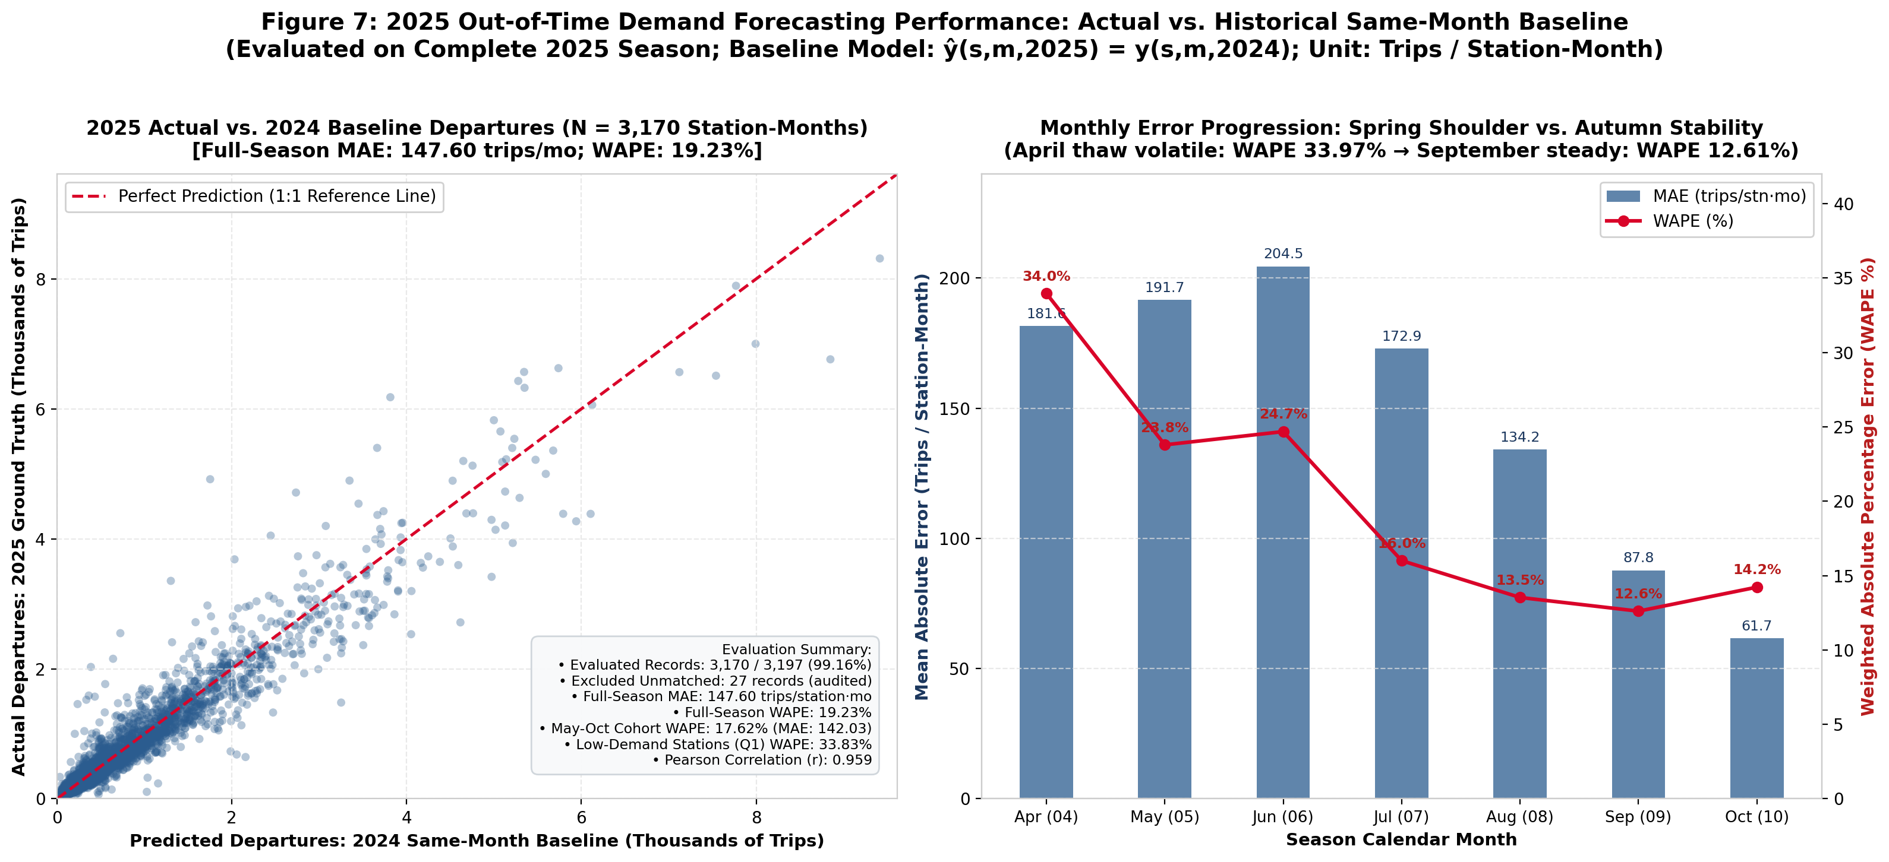
05 | DEMAND FORECASTING
Previous-Year Same-Month Baseline Minimizes Demand Forecast Error
2025 Out-of-Time Backtest (N=2,718 Matched Station-Months; Unit: Trips / Station-Month)
Baseline Lowest Volume Error (17.6%)
• Historical Baseline: Same-month previous-year achieves 17.58% WAPE (MAE: 141.9 trips/month).
• Absorbs Nordic Shifts: Naturally aligns with solar daylight and academic calendars without transitional lag delay, beating Decision Trees (24.7%) and Ridge (28.0%).
• Macro Sizing Role: Highly effective for seasonal fleet sizing and monthly station quotas.
Complementary Tools & Methodological Unit
• Ridge for Deficit Ranks: Ridge regression captures 65%–80% of Top-20 deficit stations in May–August (Spearman ρ = 0.76).
• Metric Definition: MAE is measured in completed trips/month, NOT physical bicycle stock.
• Preliminary Benchmark: Evaluated on a single 2025 backtest season; serves as an empirical reference, not definitive proof.
05 / 06
Notes:
Timing: 2:05-2:35 | Duration: 30 seconds | Word Count: 54 words
When forecasting 2025 monthly demand, using the previous year's same month achieved the lowest volume error at 17.6% WAPE. The baseline naturally absorbs Nordic seasonal shifts without transitional delay. Meanwhile, Ridge regression helps screen high-deficit stations. This single-season test provides an empirical benchmark for fleet sizing, measured in monthly trip events, not missing bicycles.

Slide 6
06 | OPERATIONAL CONCLUSIONS
Actionable Guidelines & Methodological Guardrails for Operators
Empirical Recommendations for Seasonal Fleet Sizing, Triage & Future Telemetry
1. Seasonal Fleet Sizing
Historical Baseline for Procurement
Use the previous-year same-month baseline (17.6% WAPE) to establish macro seasonal bike fleet contracts and monthly depot allocations. It naturally captures northern climate shifts without lag error.
2. Rebalancing Route Triage
Pre-Stage Prior to 16:00 Rush
Target chronic transit sinks (Pasila rail hub, -11k net flow). Explore pre-staging bicycle redistribution prior to the afternoon peak (e.g. before 15:30) to absorb the +78% evening surge.
3. Connect Live Telemetry
Integrate Real-Time Dock Sensors
Pair monthly triage screening with real-time 15-minute dock occupancy feeds before issuing physical van dispatch orders. Net flow reflects macro passenger drift, not live dock fullness.
Essential Methodological Boundaries (What the Data Does and Does Not Show):
• Weather = Retrospective FMI observations, strictly excluded from 2025 predictions; correlations reflect seasonal co-movement, not direct causality.
• MAE Unit = Trips per station-month, not missing bicycles. Bicycles circulate across multiple trips throughout each day.
• Net Flow ≠ Van Dispatch Workloads. Reflects 30-day directional passenger drift; diurnal reversals partially offset daytime flows.
• Single Test Cycle = 2025 represents an exploratory out-of-time benchmark; no claims of statistical significance or long-term superiority.
06 / 06
Notes:
Timing: 2:35-3:00 | Duration: 25 seconds | Word Count: 47 words
To conclude, operators should use the historical baseline for seasonal fleet sizing and net-flow rankings to prioritize rebalancing routes, such as pre-staging before the 16:00 evening surge. Connecting real-time dock telemetry is the essential next step before dispatching redistribution vans. Thank you, and we welcome your questions.

