Slide 1

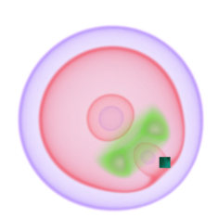
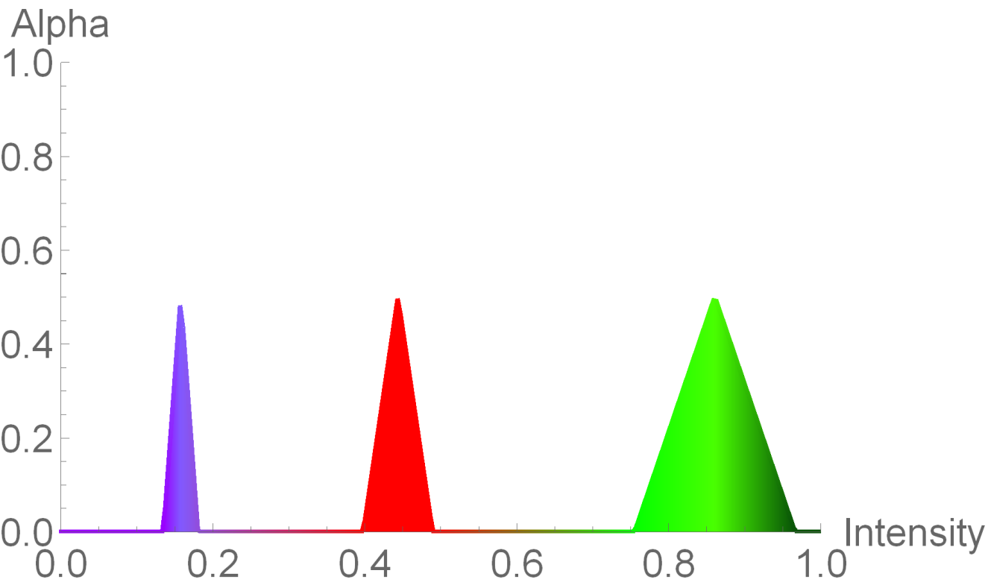
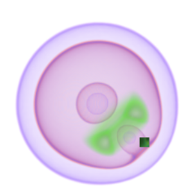
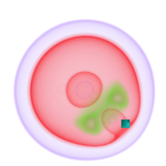
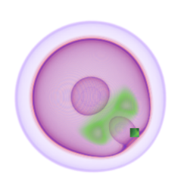
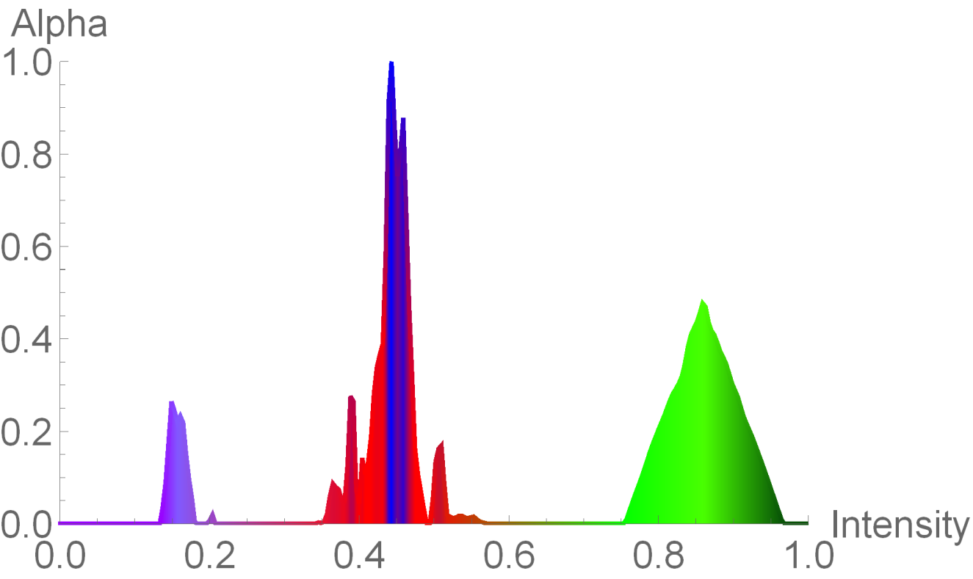
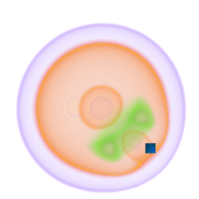
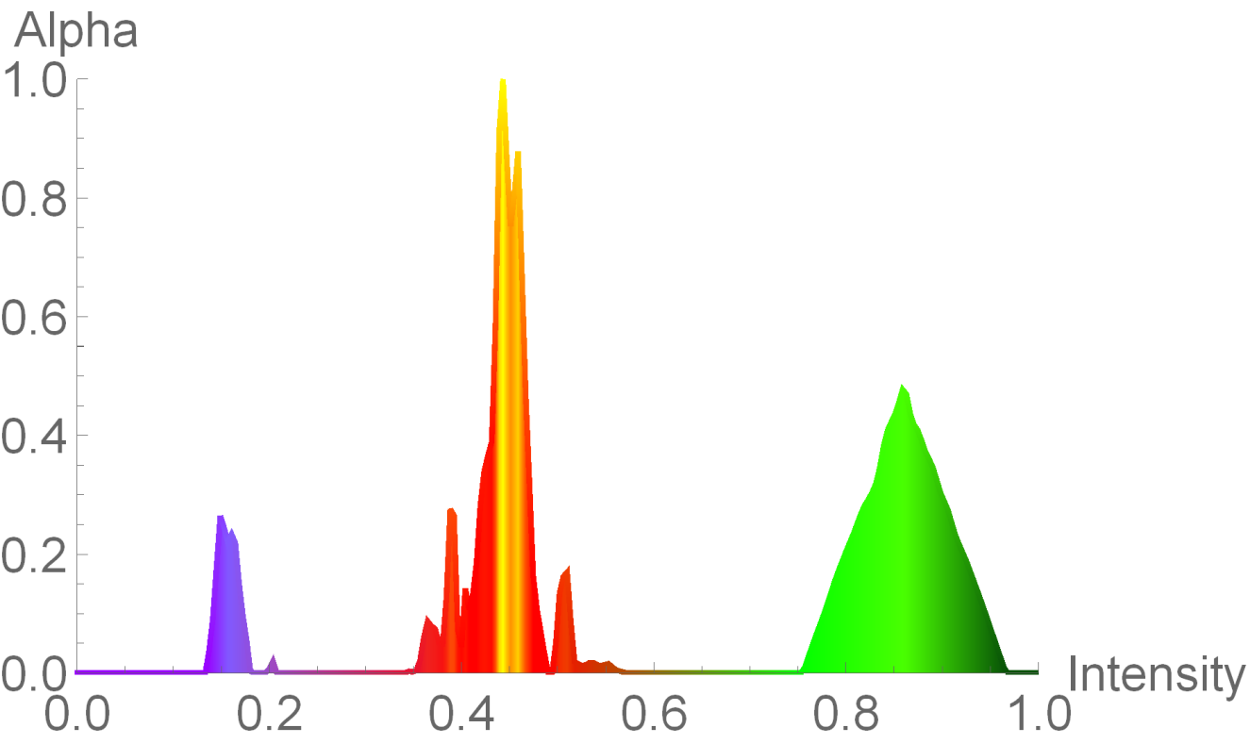
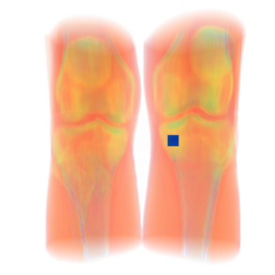
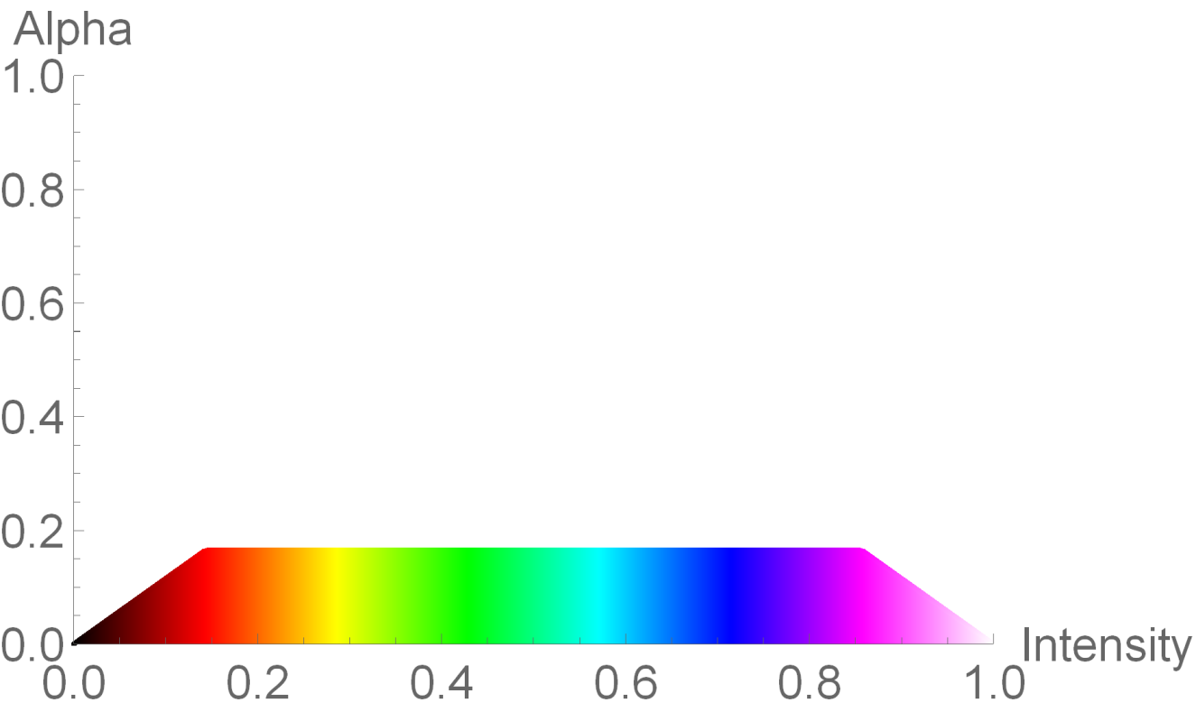
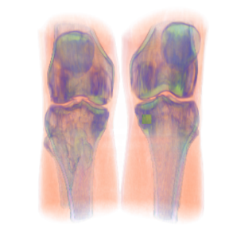
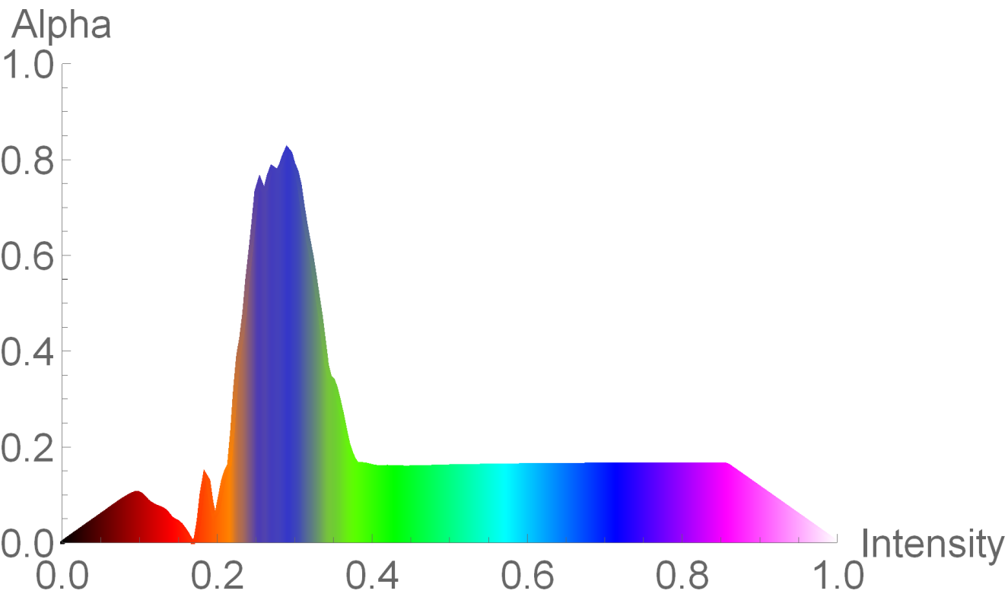
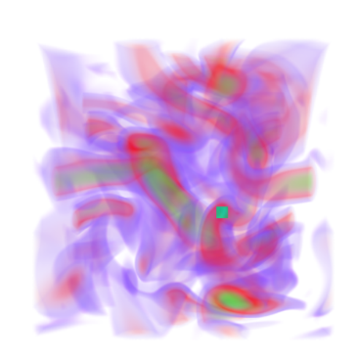
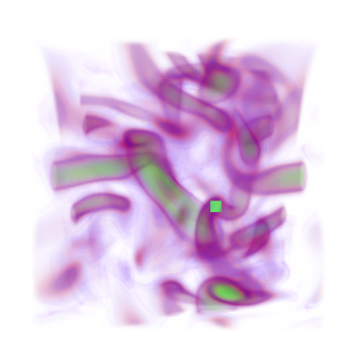
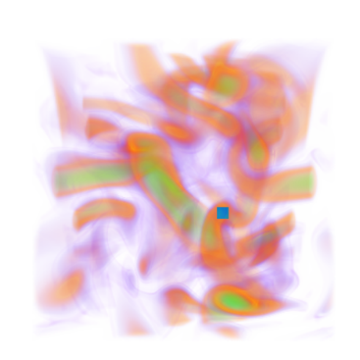
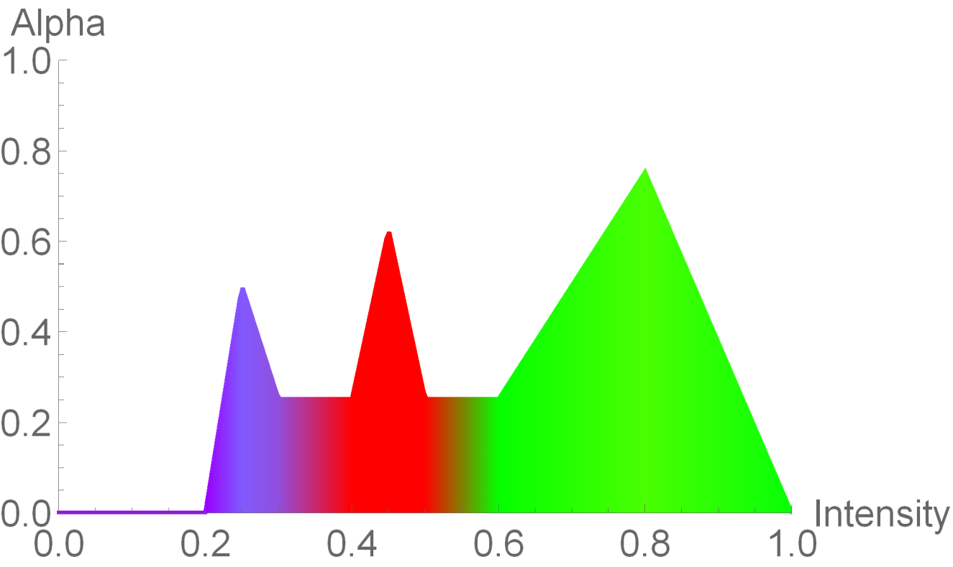
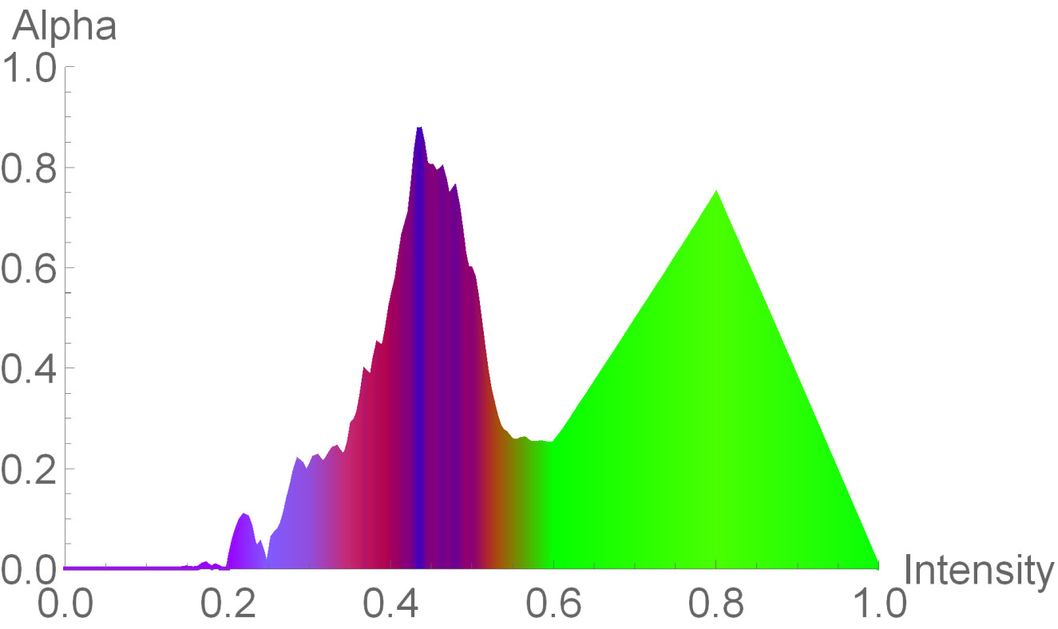
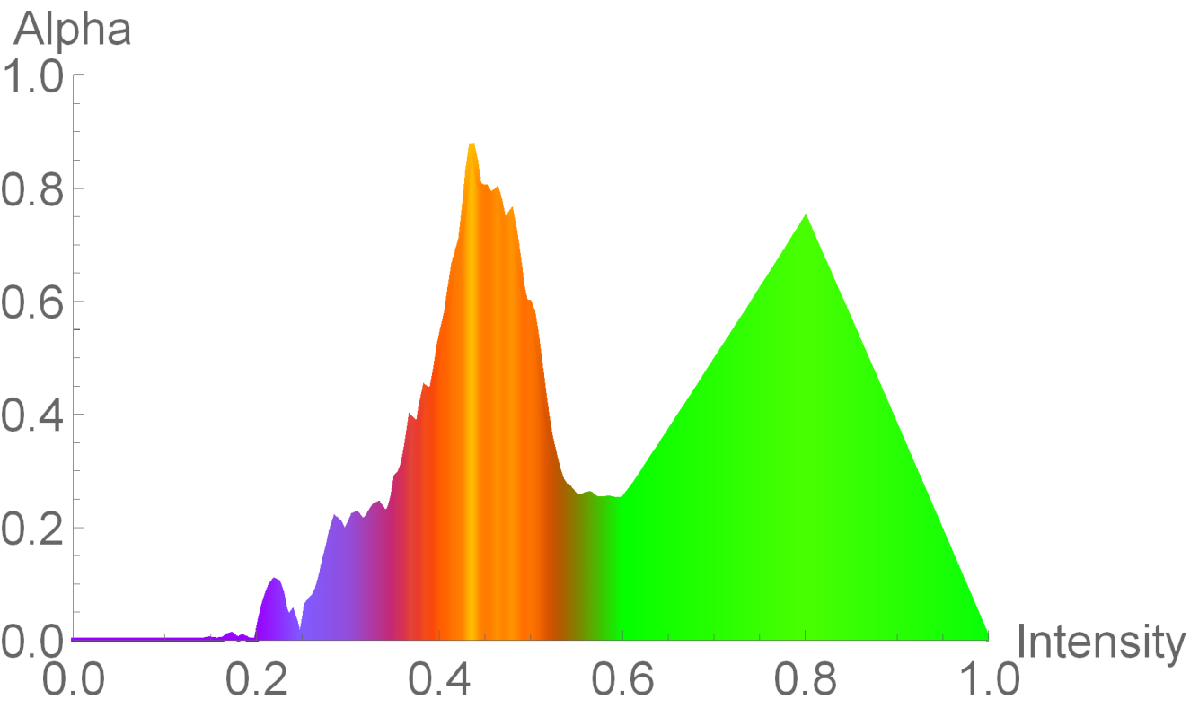
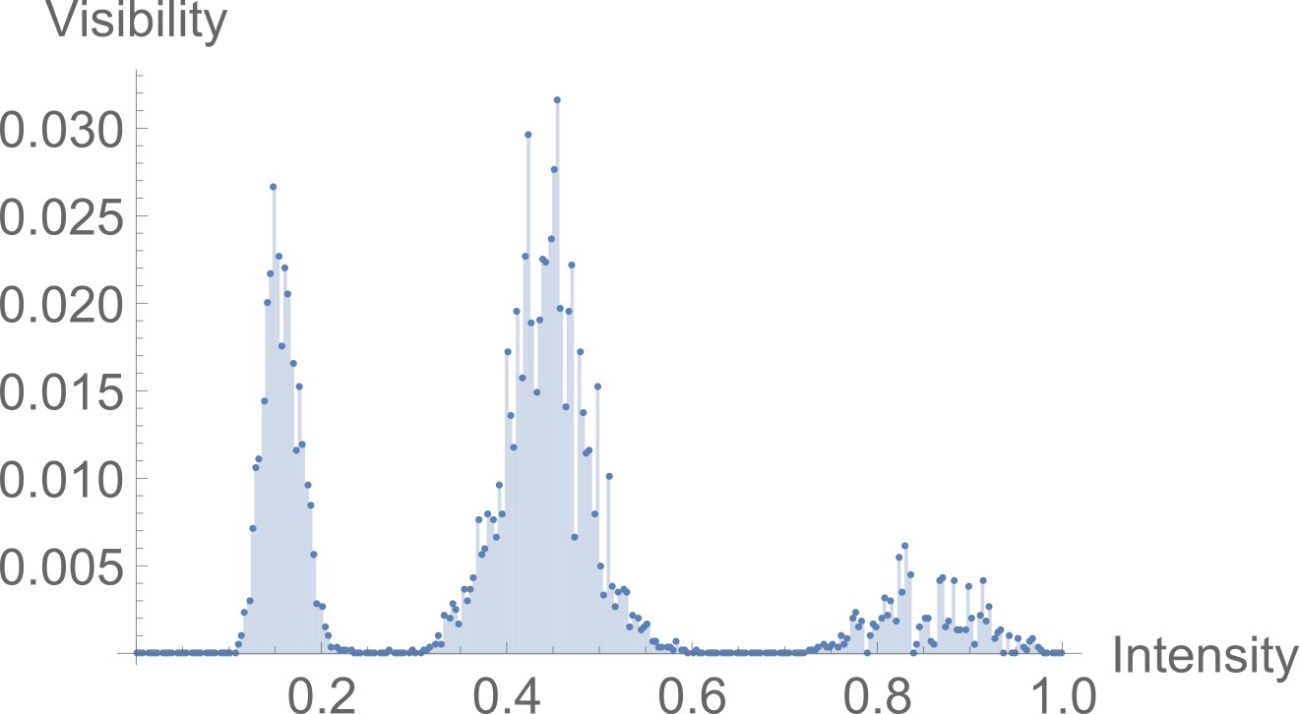
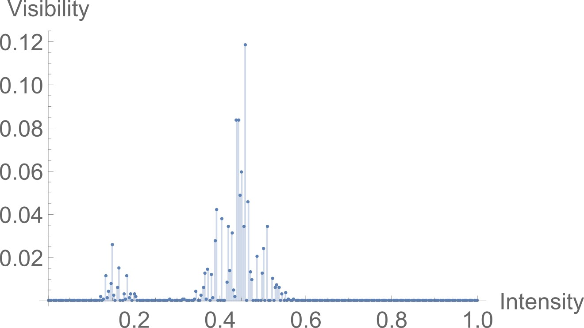
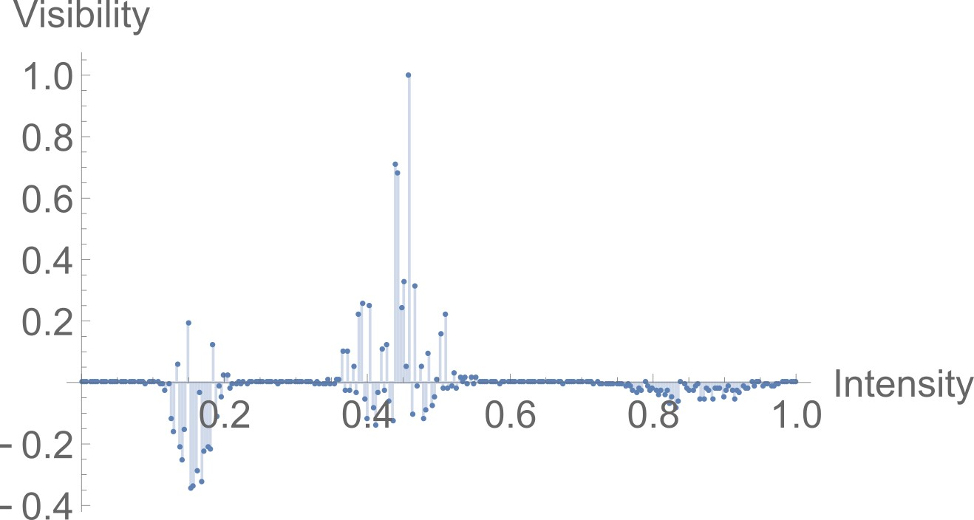
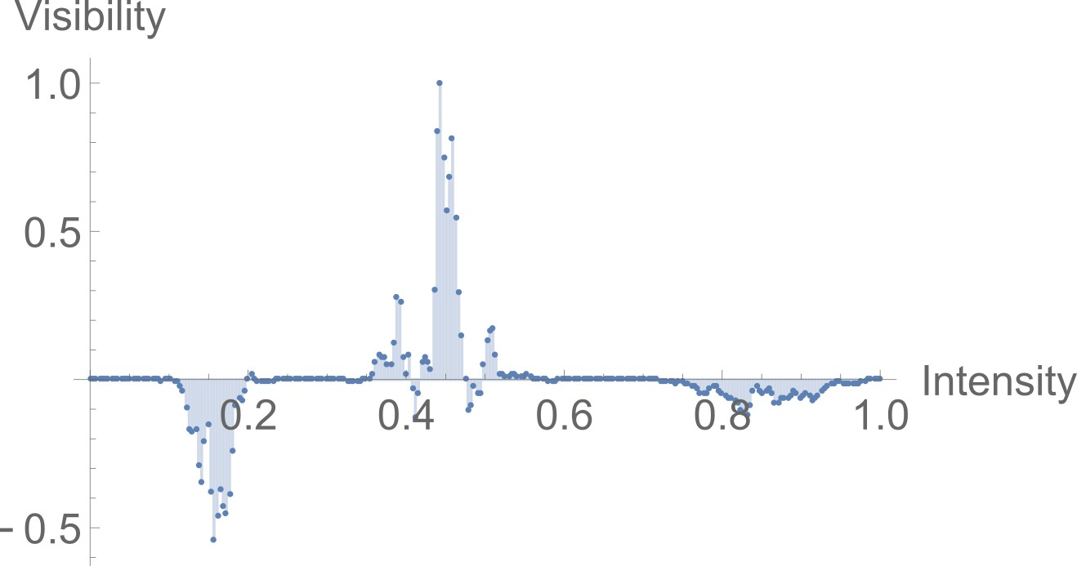

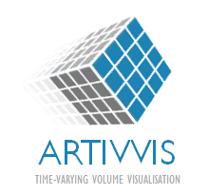




Intuitive Transfer Function Editing Using Relative Visibility Histograms
Shengzhou Luo and John Dingliana Contact: luos@tcd.ie | john.Dingliana@scss.tcd.ie
Graphics Vision and Visualisation Group (GV2), School of Computer Science and Statistics, Trinity College Dublin (Ireland)
Main Contributions
Color and Alpha Editing
We present a technique which enables a user to modify the visualization of a 3D volume dataset by clicking on a 2D region of the rendered image and applying image operations such as changing the color or opacity of the materials in the region
Our main contribution is a means by which, we can infer, from a selected 2D region, what parts of the 3D dataset the user wishes to change.
This is done be weighting the data in the selected region based on the proportion of materials visible to the user within the region. Specifically, this is represented by what we call the Relative Visibility Histogram, derived from the relationship between global visibility and local visibility of features in the selected region.
Compared to other similar techniques, our approach is relatively lightweight, requiring only intermediate information about visibility of data samples. It is thus simple to implement and performs in real-time.
A single pass of volume ray casting is done to calculate the global visibility histogram for the whole volume and the local visibility histogram for the selected region in the view-port. From this we calculate the relative visibility histogram, $H_{G}$, which is used to infer features that the user intends to edit in the visualization.
For instance, the user-selected target color is blended with the original transfer function for intensity ranges that have positive values in the relative visibility histogram as below:
$$C_{i}=\left\{\begin{aligned}C_{i}+H_{G}\left(i\right)\left(C_{s}−C_{i}\right), if H_{G}>0 \\ C_{i} ,else\end{aligned}\right.$$
Similarly, the alpha of the transfer function can be increased in intensity ranges that have positive relative visibility values, and decreased for ranges with negative relative visibility values, as follows:
$$A_{i}=\left\{\begin{aligned}A_{i}+H_{G}\left(1−A_{i}\right), if H_{G}>0 \\ A_{i}−H_{G}\left(0−A_{i}\right), else\end{aligned}\right.$$
Results
(a) (b) (c) (d)
(a) Nucleon with a selected region; (b) TF of (a); (c) Blue applied to selected material; (d) opacity of selected material enhanced
Background and Motivations
Left: Blue applied to selected region of above TF and opacity enhanced; Right: Yellow applied and opacity enhanced. The modified TF is shown for each case alongside the rendering
A recurring challenge in volume visualization, is defining effective transfer functions, which assign optical properties such as color and opacity to specific data ranges for visualization. Due to the non-linear relationship between the transfer function and the resultant rendering, the process of editing transfer functions is often un-intuitive, typically necessitating a trial-and-error process.
It is desirable to have an output sensitive approach where the user can more directly control the appearance of the visualization, without explicit knowledge of the transfer function.
However, directly manipulating 3D data based on the output image is challenging due to the inherent ambiguity of what 3D feature is visible at a particular point in a 2D image (the classic picking problem in 3D computer graphics) and this is exacerbated in volume data where several translucent features may be simultaneously visible under any pixel.
We address this by using voxel visibility information to infer what the user intends to select in a selected region.
Left: CT-Knee dataset and basic TF; Right: Blue applied and opacity enhanced for selected region
Relative Visibility Histograms
Given a global visibility histogram, $H$, representing the visibility distribution of all the voxels in the viewport, and a local visibility histogram, $H_{L}$, representing the visibility distribution for the subset of voxels that contribute to a given region of interest in the final image (for a rectangular region, this comprises voxels within a frustum extended from the rectangular region in the viewport), we can define the relative visibility of voxels in the region as:
$$H_{r}=H_{L} − H$$
  (note: $H$, $H_{L}$ are normalized by dividing each value by the sum of all values in each histogram)
In practice due to the reduced number of samples within a local region, the histogram will exhibit a number of discontinuities compared to the global distribution. Thus, we smooth the histogram by applying a Gaussian, and then normalizing the result as follows:
$H_{G}=H_{g}/max⁡(abs(H_{g}))$, where $H_{g}=Gaussian(H_{r},n,σ)$
$H_{G}$ is referred to as the relative visibility histogram
(a) (b) (c)
(a)Turbulent vortex dataset and initial TF; (b)Blue applied to selected material and opacity enhanced; (c) Yellow applied and opacity enhanced.
This approach is implemented with a GPU-Raycast volume renderer with the visibility computation and rendering implemented on a GPU using CUDA. The implementation is quite lightweight, and achieves real-time performance (over 36 frames per second) for the datasets tested on a computer equipped with an Intel Xeon E3-1246 v3 CPU and a NVIDIA Quadro K4200 graphics card.
The examples show that the technique can be applied effectively to a range of different datasets and transfer functions. Although we only show single step examples here for illustration, it can be used for iterative editing akin to a progressive fill tool for a large number successive of operations.
(a) (b)
References
(c) (d)
[1] C. D. Correa and K.-L. Ma, “Visibility Histograms and Visibility-Driven Transfer Functions,” IEEE Transactions on Visualization and Computer Graphics, vol. 17, no. 2, pp. 192–204, Feb. 2011.
[2] G. Emsenhuber, “Visibility Histograms in Direct Volume Rendering,” Master’s Thesis, Institute of Computer Graphics and Algorithms, Vienna University of Technology, Favoritenstrasse 9-11/186, A-1040 Vienna, Austria, 2008.
[3] H. Guo, N. Mao, and X. Yuan, “WYSIWYG (What You See is What You Get) Volume Visualization,” IEEE Transactions on Visualization and Computer Graphics, vol. 17, no. 12, pp. 2106–2114, 2011.
[4] H. Guo and X. Yuan, “Local WYSIWYG volume visualization,” in Visualization Symposium (PacificVis), 2013 IEEE Pacific, 2013, pp. 65–72.
[5] A. Wiebel, F. M. Vos, D. Foerster, and H. C. Hege, “WYSIWYP: What You See Is What You Pick,” IEEE Transactions on Visualization and Computer Graphics, vol. 18, no. 12, pp. 2236–2244, Dec. 2012.
(a) Global Visibility Histogram of dataset shown above; (b) Local Visibility Histogram of selected region; (c) Relative Visibility Histogram; (d) Relative visibility histogram after smoothing
This research has been conducted with the financial support of Science Foundation Ireland (SFI) under Grant Number 13/IA/1895.

