Slide 2
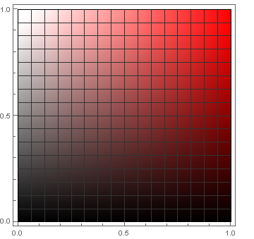
Brightness
Saturation

Slide 3
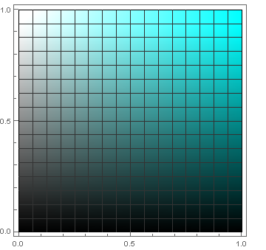
Brightness
Saturation

