Slide 2
opacity
opacity
opacity
opacity
0
intensity
0
intensity
0
intensity
0
intensity
trapezoid
tent
box
ramp

Slide 3
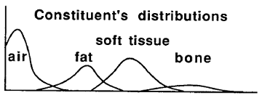
intensity

