Slide 1
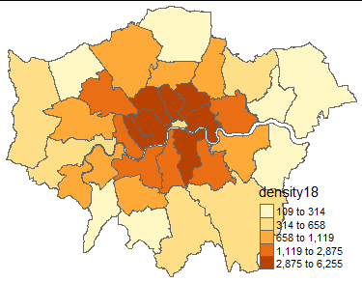
The Prevailing of the New-form Rental Market:
Potential links Between Airbnb And the Rental System in London
About the research
The online rental market such as Airbnb is impacting the traditional rental system and drawing widespread concern. In order to prevent the mainstream housing market from potential threat posted by this trend in the future, the development of the online housing rental market must be under supervision. Meanwhile, this impact on the local rental market should be assessed quantitatively as well.
Based on data provided by third-party “Inside Airbnb”, this research analyses all active Airbnb listings in London to get the distribution pattern in “borough” scale. Then, the listings are modelled with the local rental market data obtained from gov.uk to reveal the connection between the two types of rental market.
Key findings
● Except for the “city of London”, the number of Airbnb listings decrease radially from the central of London.
● Even though the online rental industry is developing rapidly, the highest market share Airbnb taken up in Westminster just reaches at 6.52%.
● The extremely high correlation coefficient, 0.949 (maximum 1), indicates the online rental market is strongly and positively related to the local rental market, in other words, the more prevent the Airbnb is in a
Distribution Pattern of Airbnb Listings

Slide 2
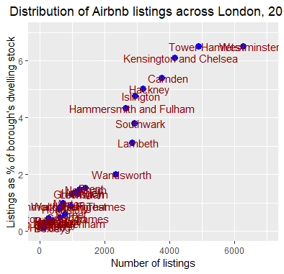
region, the bigger the local rental market might be.
● The impact of Airbnb on the local housing rental market is significant. Each rental housing published on Airbnb will bring additional 22.7% growth in the number of rented houses. That is to say, in theory, every 5 new housing rentals posted on Airbnb can motivates one potential property to be listed on the local rental market.
Policy Implication
● The Monitoring on the online rental market is indispensable. Because the online rental market does have an impact on the traditional rental market.
● Although the online rental market size is far less than mainstream market, as its scale is keeping expanding, the relevant policy needs to be properly formulated in time, especially in terms of taxation.
● Under the current size of the online rental market, it is quite helpful to promote the performance of the local housing rental market, in other words, online rentals can be appropriately encouraged in areas where it is not popular yet.
The correlation between Airbnb listings and local rental market
Key references and resources:
Wachsmuth, D. and Weisler, A. (2018) ‘Airbnb and the rent gap: Gentrification through the sharing economy’, Environment and Planning A: Economy and Space, 50(6), pp. 1147–1170. doi: 10.1177/0308518X18778038.

