Slide 1

Notes:
Good morning everyone. My name is Luo Zhou, from Donghua University.
Today I will present our work, **Baro2Talk: Reconstructing Spectrograms from Ear Canal Pressure for Voice-free Communication**. This work is a collaboration between Donghua University, the UESTC, and Shanghai Jiao Tong University.
The central idea is to enable silent, voice-free communication using a small pressure sensor inside an earbud, without recording spoken audio.

Slide 2
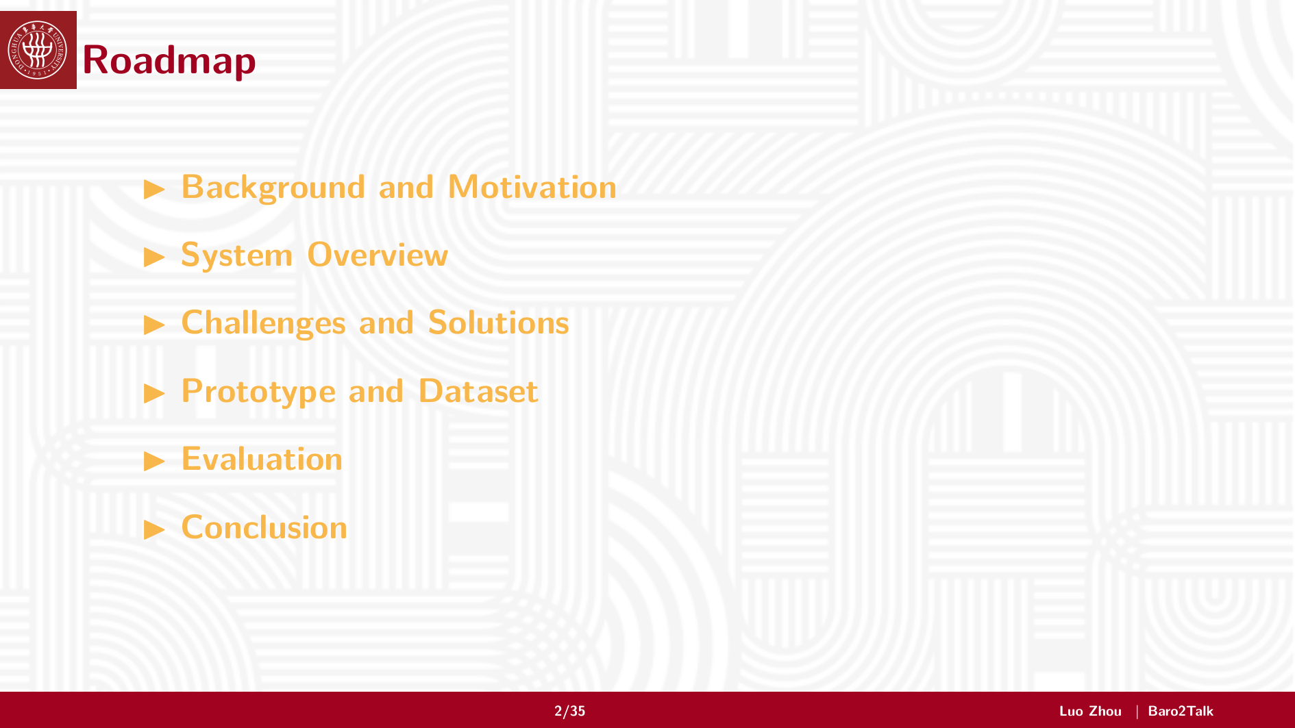
Notes:
I will first introduce the motivation and sensing opportunity. Then I will give the system overview, walk through the three main challenges and our solutions, and finally present the prototype, dataset, evaluation, and conclusion.

Slide 3
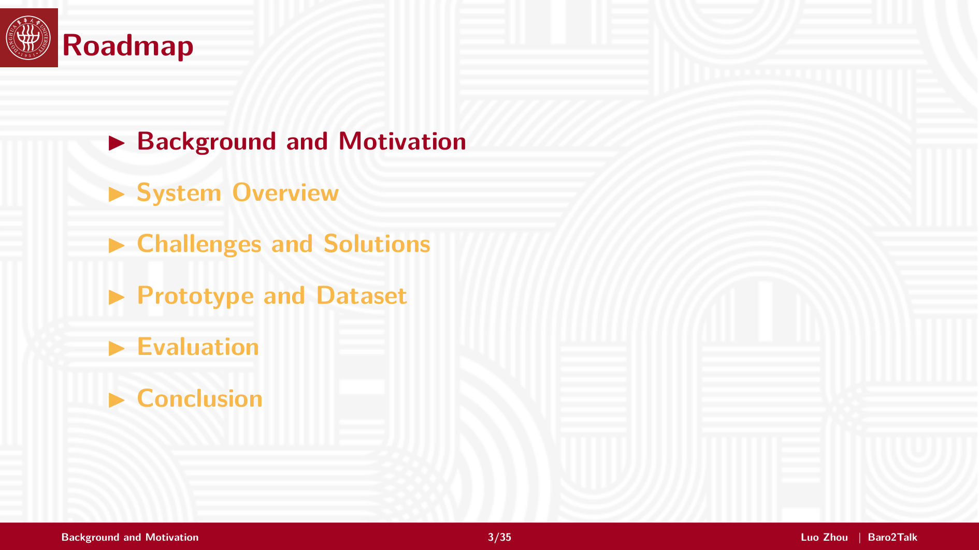
Notes:
Let us start with the background.
The key question is: how can we support speech-like interaction when speaking aloud is inconvenient, unreliable, or impossible?

Slide 4
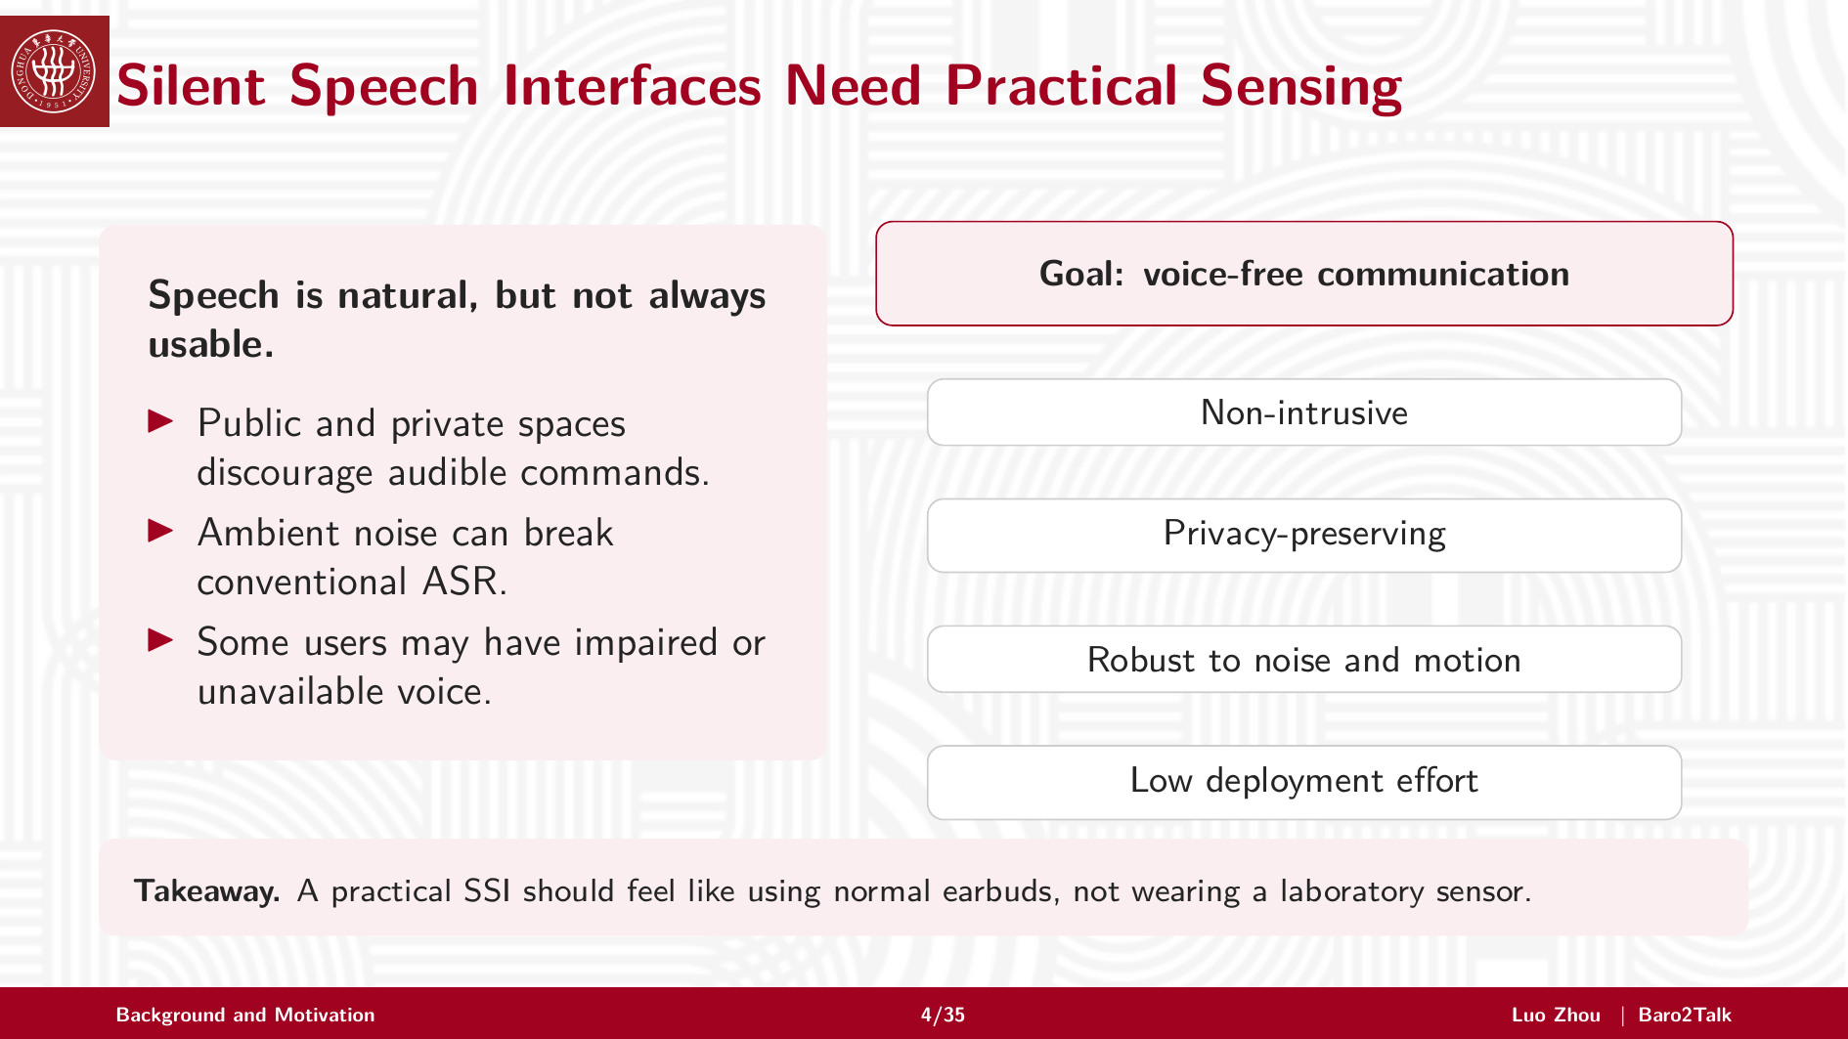
Notes:
Speech is natural, but it is not always usable.
In public or private spaces, audible commands may be socially awkward or privacy-sensitive. In noisy environments, conventional ASR can fail. Some users may also have impaired or unavailable voice.
So a practical silent speech interface should be non-intrusive, privacy-preserving, robust to noise and motion, and easy to deploy. Our target is not a laboratory sensor. We want something close to ordinary earbuds.

Slide 5
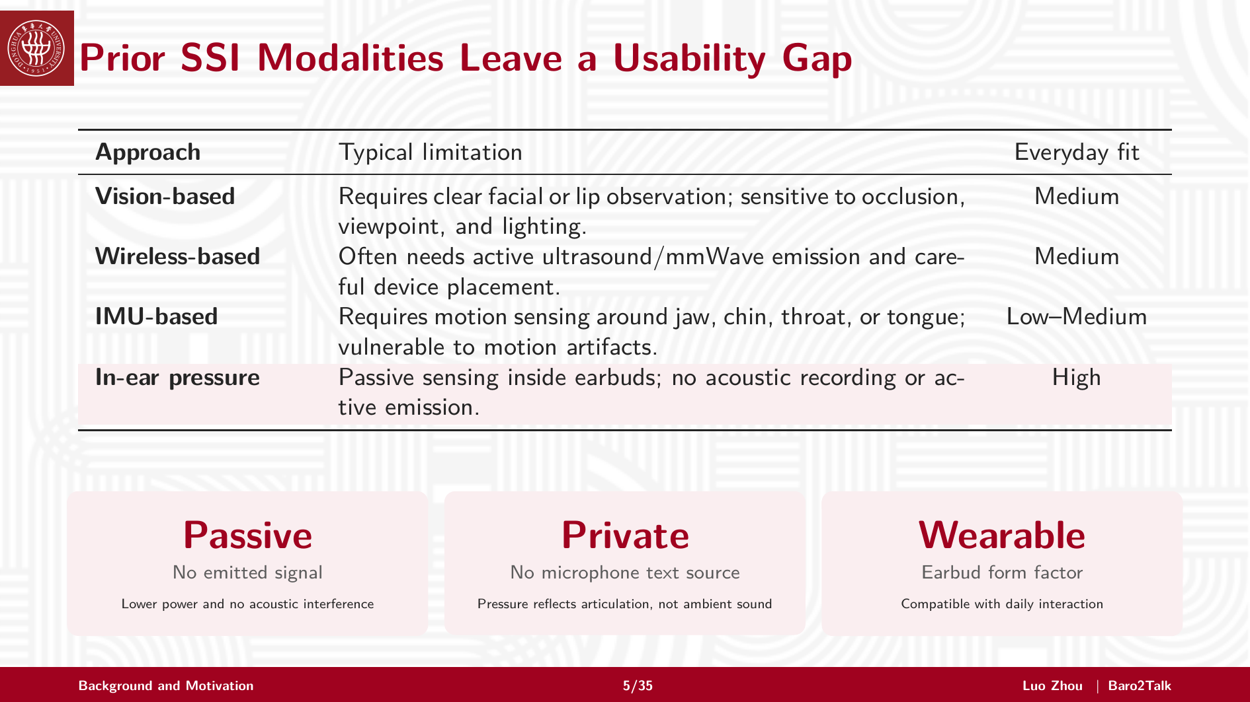
Notes:
Existing SSI modalities each have limitations.
Vision-based systems need a clear view of the face. Wireless-based systems may require active signal emission and careful placement. IMU-based systems can be sensitive to motion artifacts and often require extra sensing locations.
In-ear pressure sensing offers a different tradeoff. It is passive, private, and compatible with earbuds. It captures articulation-related pressure changes instead of acoustic speech. This makes it attractive for daily silent interaction.

Slide 6
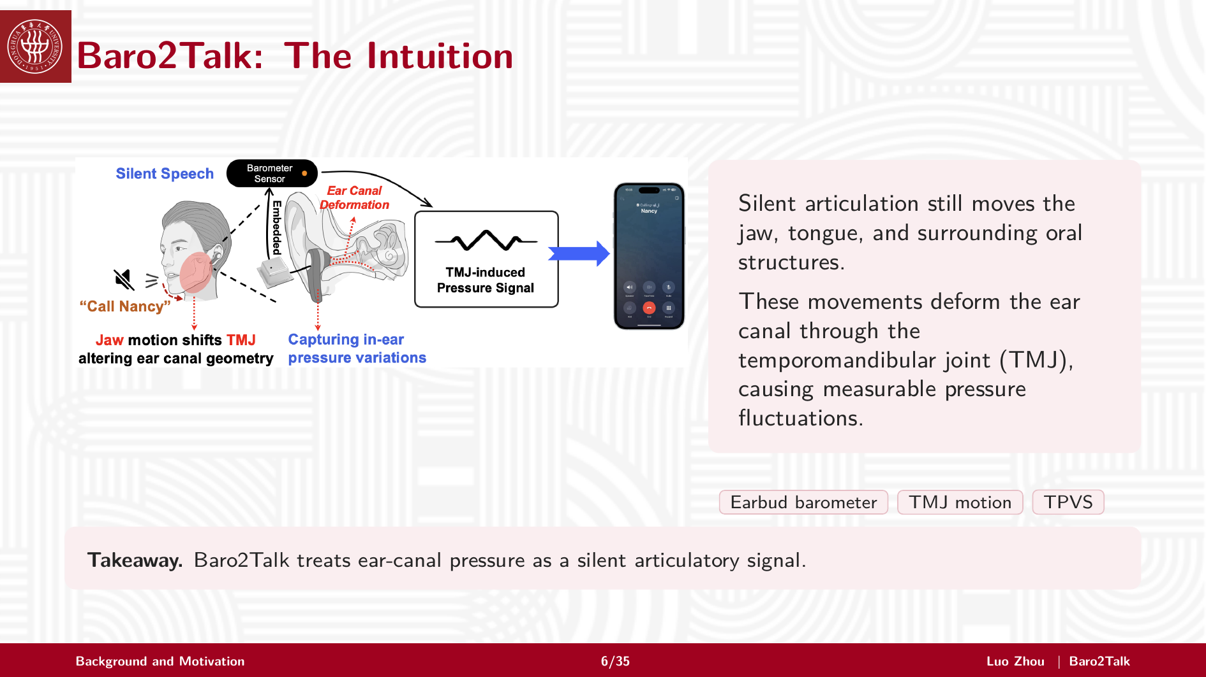
Notes:
The intuition is physiological.
Even during silent articulation, the jaw, tongue, and surrounding oral structures still move. These movements are coupled with the temporomandibular joint, or TMJ, and can deform the ear canal.
With a miniature barometer inside the earbud, this deformation appears as a pressure variation sequence. We call it TPVS: TMJ-dominated Pressure Variation Sequence.
Baro2Talk treats this pressure signal as a silent articulatory signal.

Slide 7
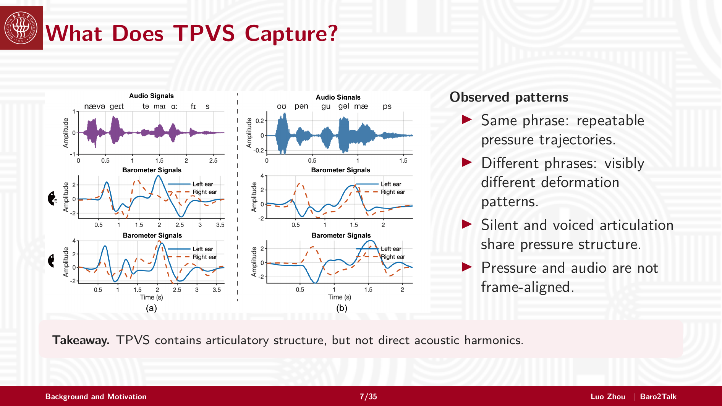
Notes:
TPVS has useful structure.
For the same phrase, pressure trajectories are repeatable. For different phrases, the patterns are visibly different. Silent and voiced articulation share pressure structure, because both are driven by articulatory motion.
But TPVS is not audio. It is not perfectly frame-aligned with speech, and it does not directly contain acoustic harmonics. This distinction motivates the modeling design.

Slide 8
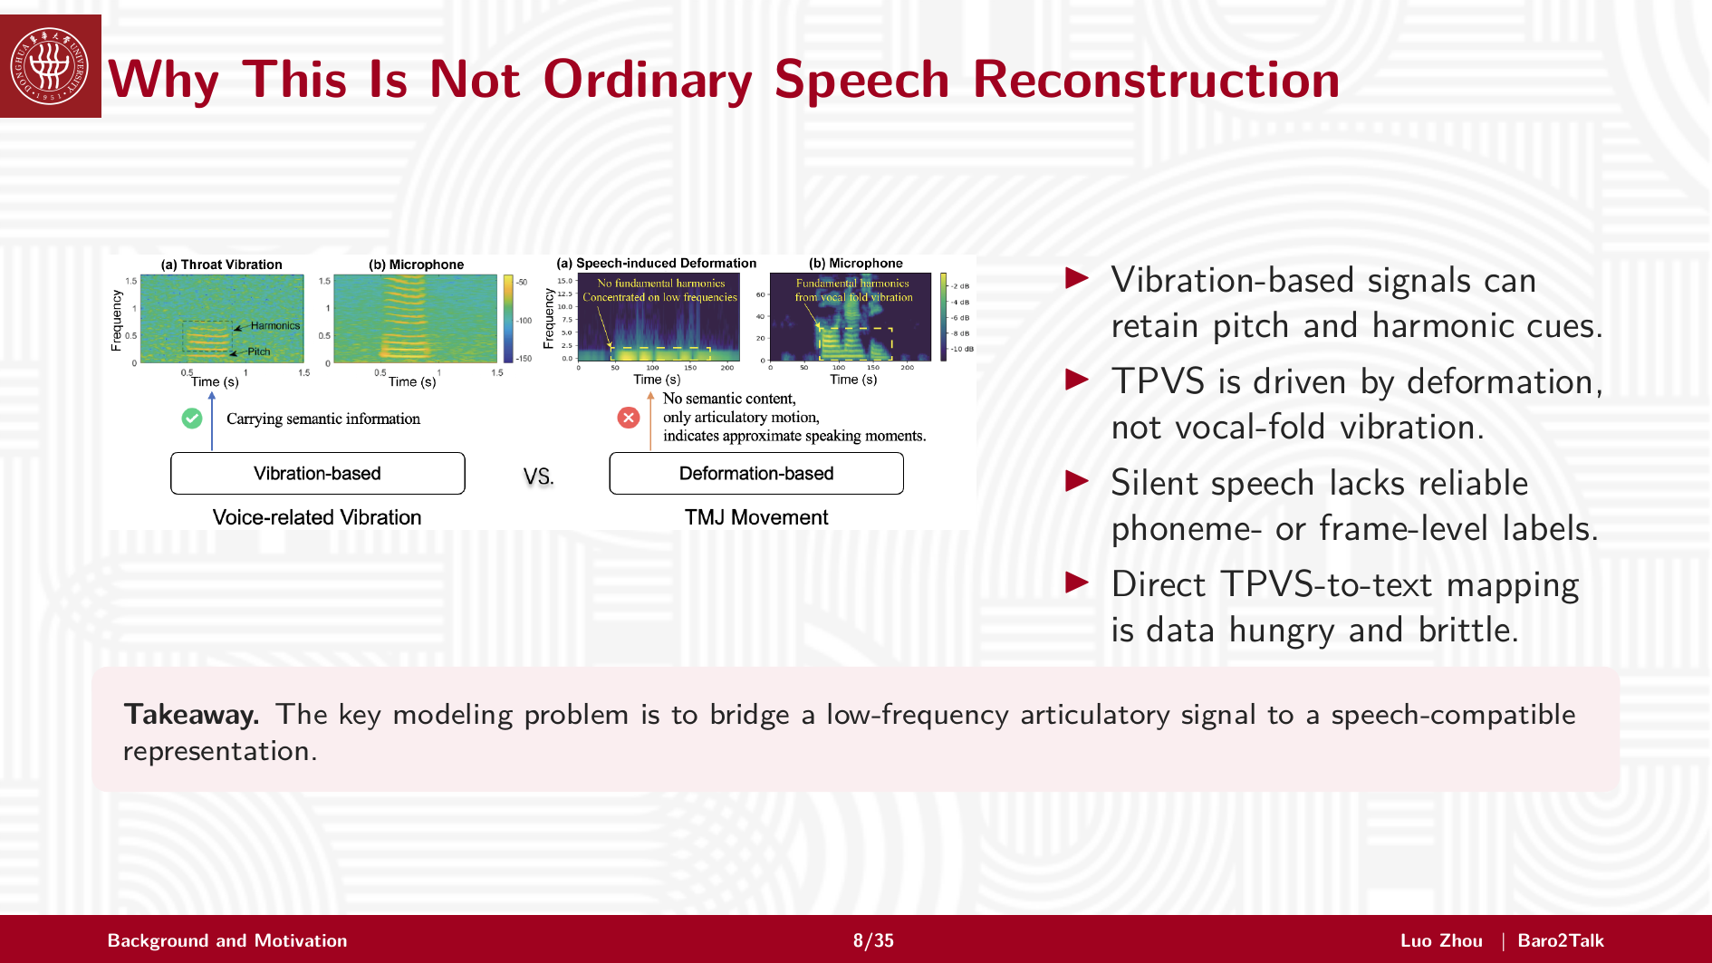
Notes:
This is not ordinary speech reconstruction.
Vibration-based signals may retain pitch and harmonic cues, but TPVS is driven by deformation, not vocal-fold vibration. Silent speech also lacks reliable frame-level phoneme labels.
Therefore, a direct TPVS-to-text mapping is data-hungry and brittle. The real problem is to bridge a low-frequency articulatory signal to a speech-compatible representation.

Slide 9
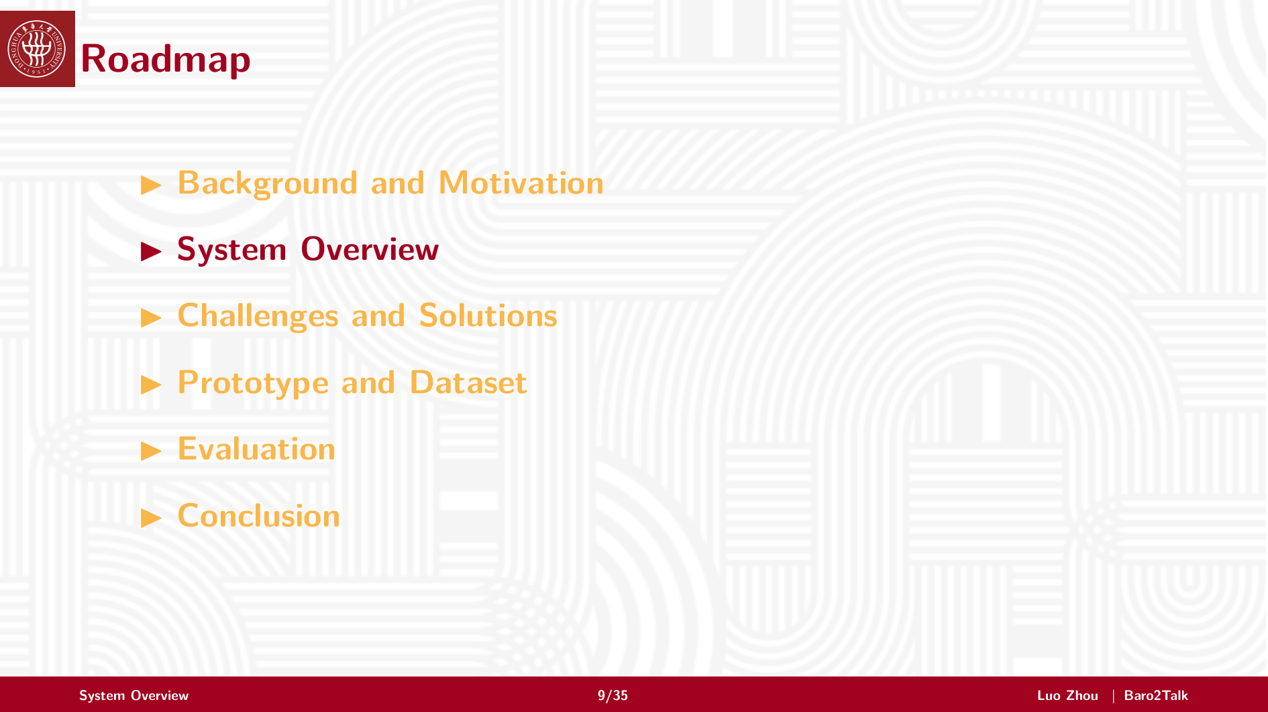
Notes:
Now I will introduce the system.
The key design choice is to reconstruct Mel-spectrograms from pressure, instead of directly predicting text.

Slide 10
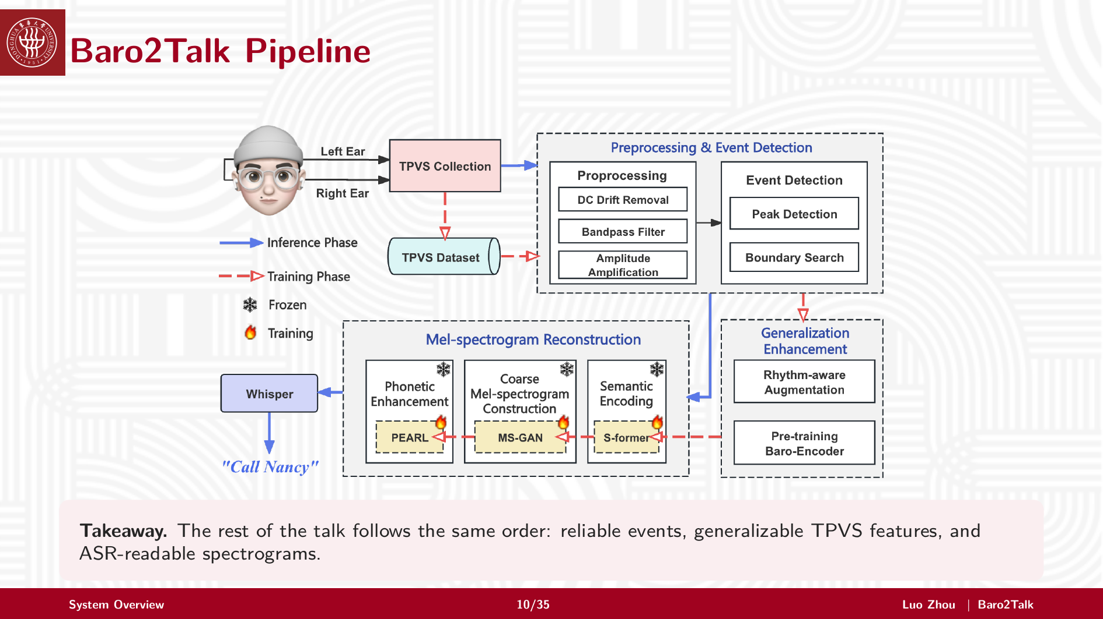
Notes:
The pipeline has three major parts.
First, the earbud collects left and right pressure signals. Preprocessing and event detection remove drift and extract meaningful deformation segments.
Second, a generalization module handles speaking rhythm, user anatomy, and earbud fit.
Third, the reconstruction pipeline maps pressure to a Mel-spectrogram. S-Former aligns pressure with text semantics, MS-GAN builds a coarse spectrogram, and PEARL refines phonetic details. The reconstructed spectrogram is then decoded by an existing ASR backend such as Whisper.

Slide 11

Notes:
Next I will explain the design through three challenges.
Each challenge corresponds to one conversion in the pipeline.

Slide 12
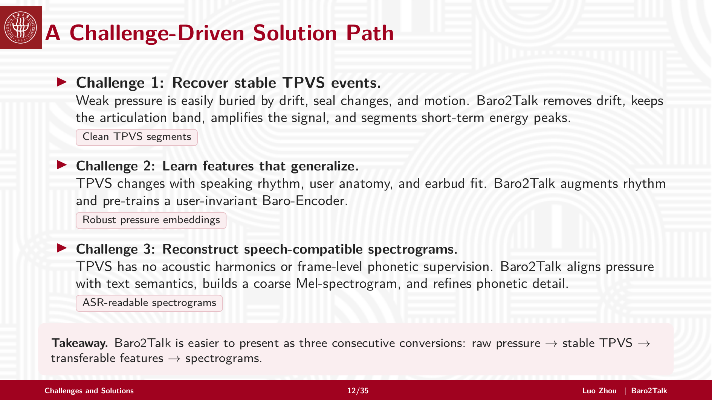
Notes:
The first challenge is to recover stable TPVS events from weak pressure. We solve this with drift removal, band-pass filtering, signal amplification, and energy-based segmentation.
The second challenge is generalization. TPVS varies across rhythm, users, and earbud fit. We use rhythm-aware augmentation and a user-invariant Baro-Encoder.
The third challenge is reconstruction. TPVS has no acoustic harmonics or frame-level phonetic supervision. We therefore align pressure with semantics, generate a coarse Mel-spectrogram, and refine phonetic details.

Slide 13
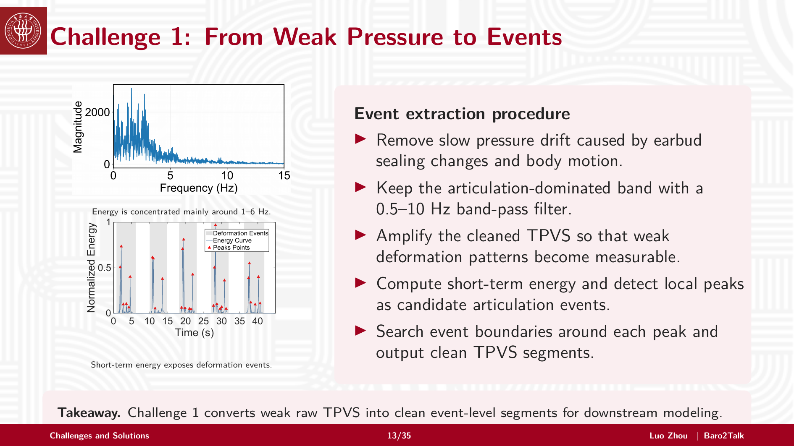
Notes:
Challenge 1 is event extraction.
The left figures show two observations. Silent articulation energy is mainly concentrated in the low-frequency range, around one to six hertz. Also, deformation events appear as peaks in the short-term energy curve.
Based on this, we process raw TPVS in five steps: remove slow drift, keep the 0.5 to 10 hertz articulation band, amplify weak deformation patterns, detect local energy peaks, and search event boundaries.
The output is clean event-level TPVS segments for downstream modeling.

Slide 14
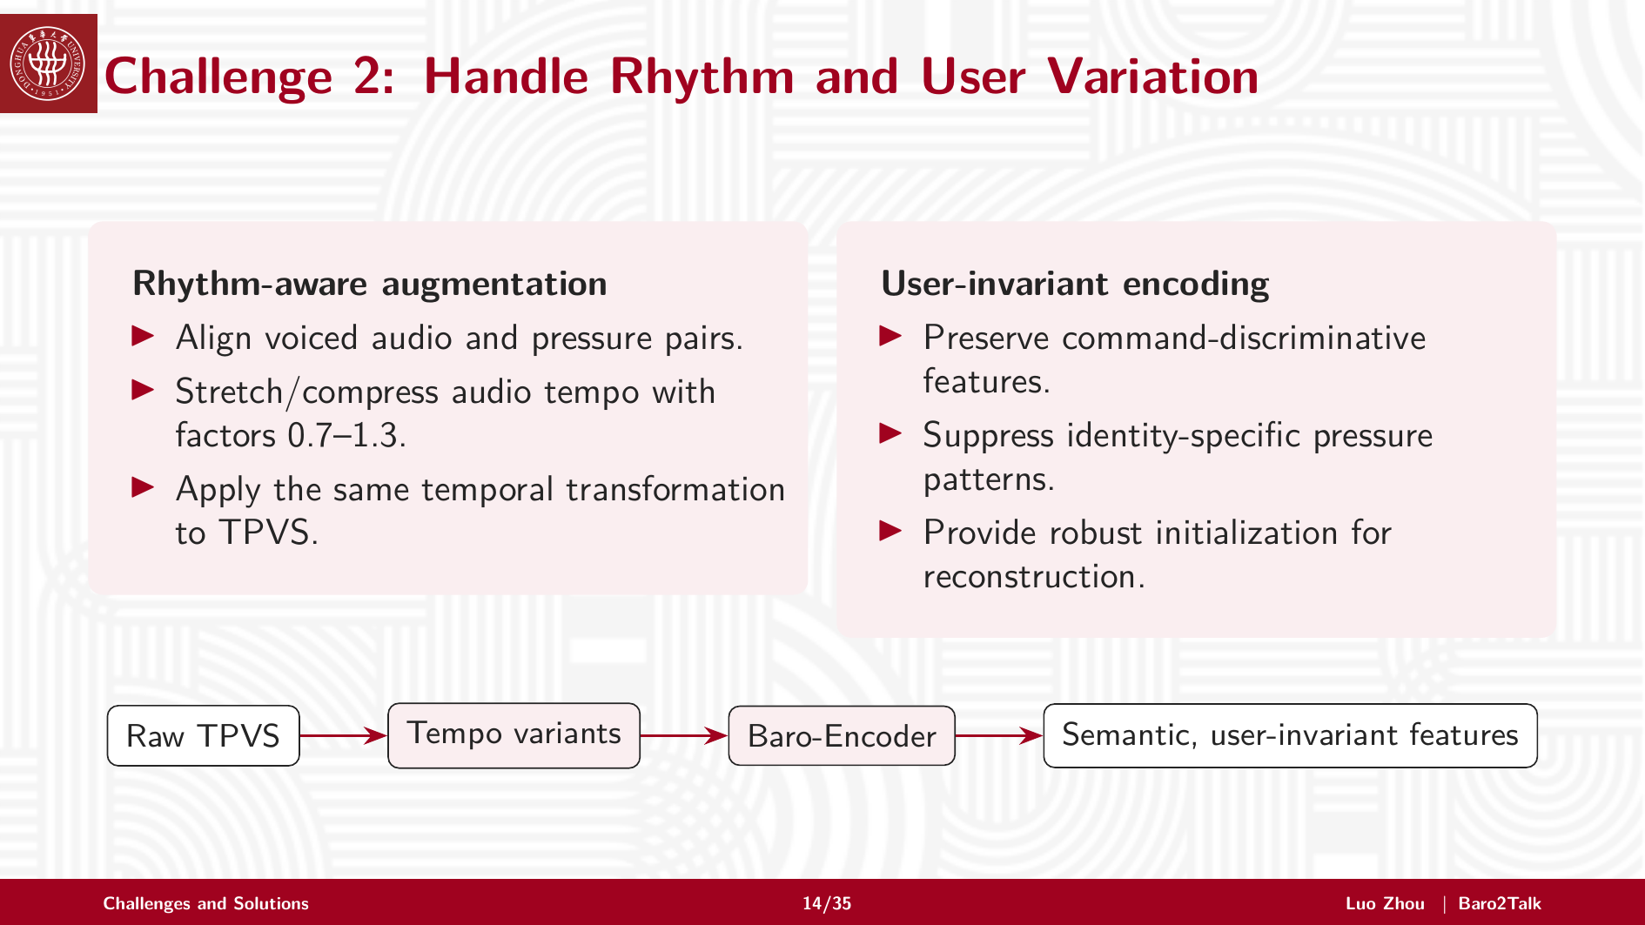
Notes:
Challenge 2 is variation.
The same command can have different rhythms, and different users produce different pressure patterns. Baro2Talk handles this in two ways.
First, rhythm-aware augmentation stretches or compresses paired audio and TPVS, so the model sees different speaking speeds. Second, user-invariant encoding preserves command-related features while suppressing identity-specific pressure cues.
This gives a more transferable pressure representation.

Slide 15
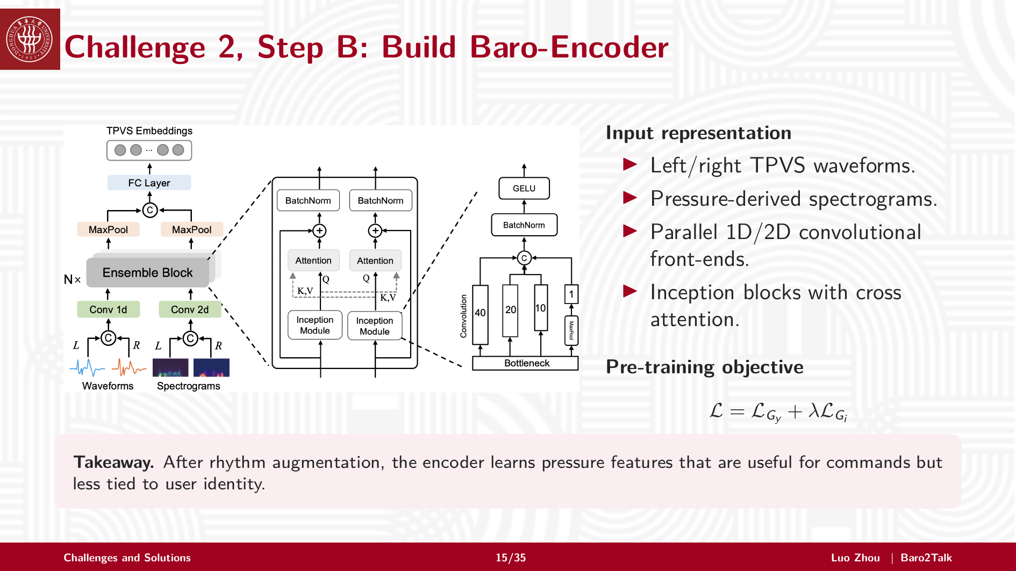
Notes:
The Baro-Encoder takes both waveform-level TPVS and pressure-derived spectrograms.
It uses parallel 1D and 2D convolutional front-ends, Inception blocks, and cross attention. The objective combines command-related learning with identity-aware regularization.
The goal is not only command classification. The goal is to learn pressure features that are useful for commands but less tied to a specific user.

Slide 16
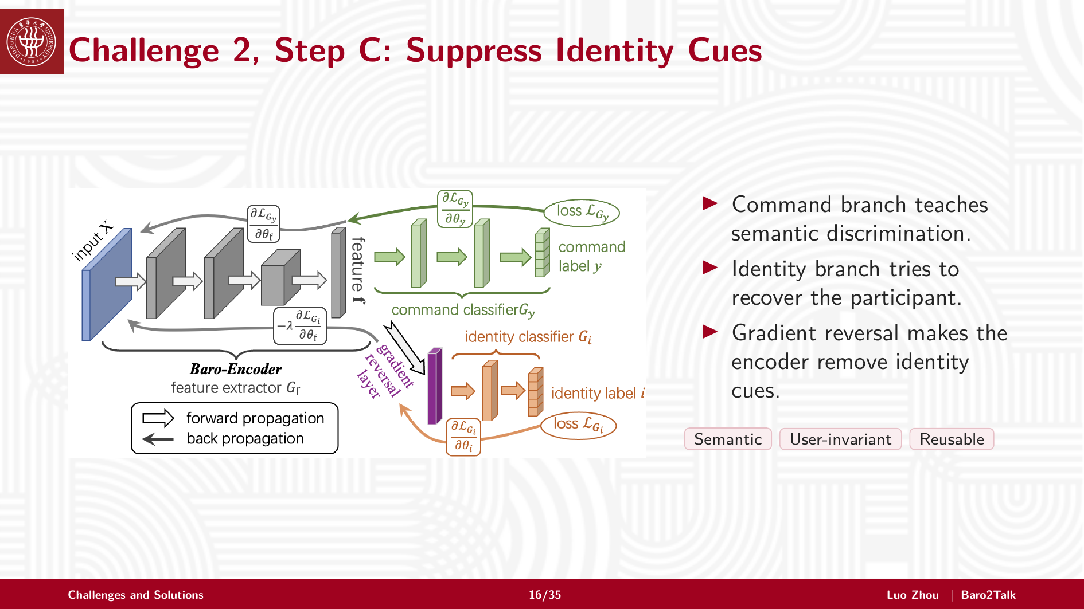
Notes:
Here, the command branch teaches semantic discrimination, while the identity branch tries to recover the participant.
With gradient reversal, the encoder learns to make identity prediction difficult. In other words, it removes participant-specific cues while keeping command-relevant information.
This makes the representation semantic, user-invariant, and reusable.

Slide 17
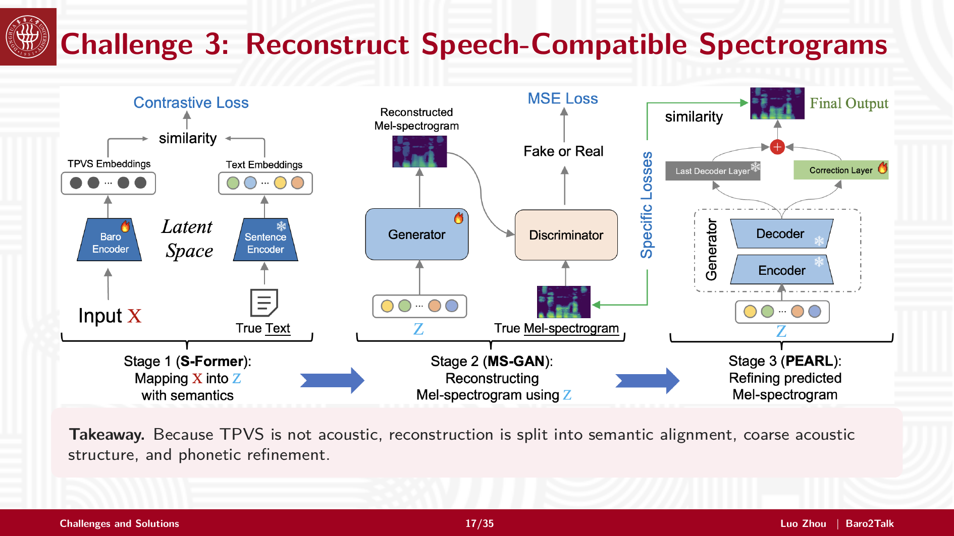
Notes:
Challenge 3 is the core reconstruction problem.
Because TPVS is not acoustic, we do not reconstruct the spectrogram in one step. Instead, we split the task into semantic alignment, coarse acoustic structure generation, and phonetic refinement.
This staged design avoids relying on unreliable frame-level alignment.

Slide 18
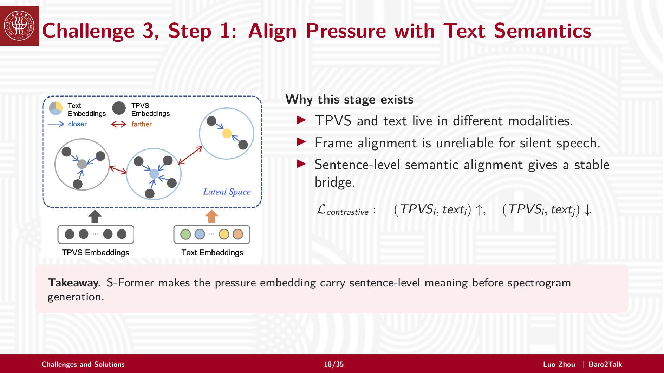
Notes:
The first stage is semantic alignment.
TPVS and text are different modalities. Frame alignment is unreliable for silent speech, so we align them at the sentence level.
The contrastive objective pulls matched pressure-text pairs closer and pushes mismatched pairs apart. As a result, S-Former makes the pressure embedding carry sentence-level meaning before spectrogram generation.

Slide 19
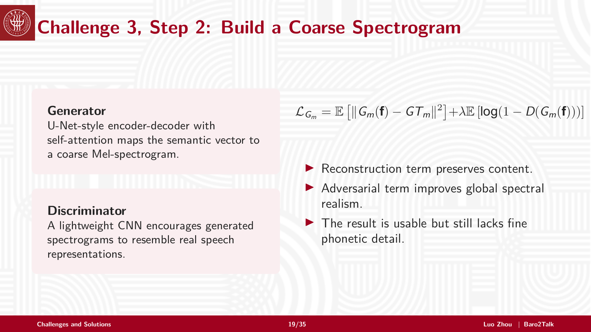
Notes:
The second stage builds a coarse Mel-spectrogram.
The generator is a U-Net-style encoder-decoder with self-attention. It maps the semantic pressure feature to a spectrogram. The reconstruction term preserves content, and the adversarial term encourages global spectral realism.
The output is already usable, but it still lacks fine phonetic details.

Slide 20
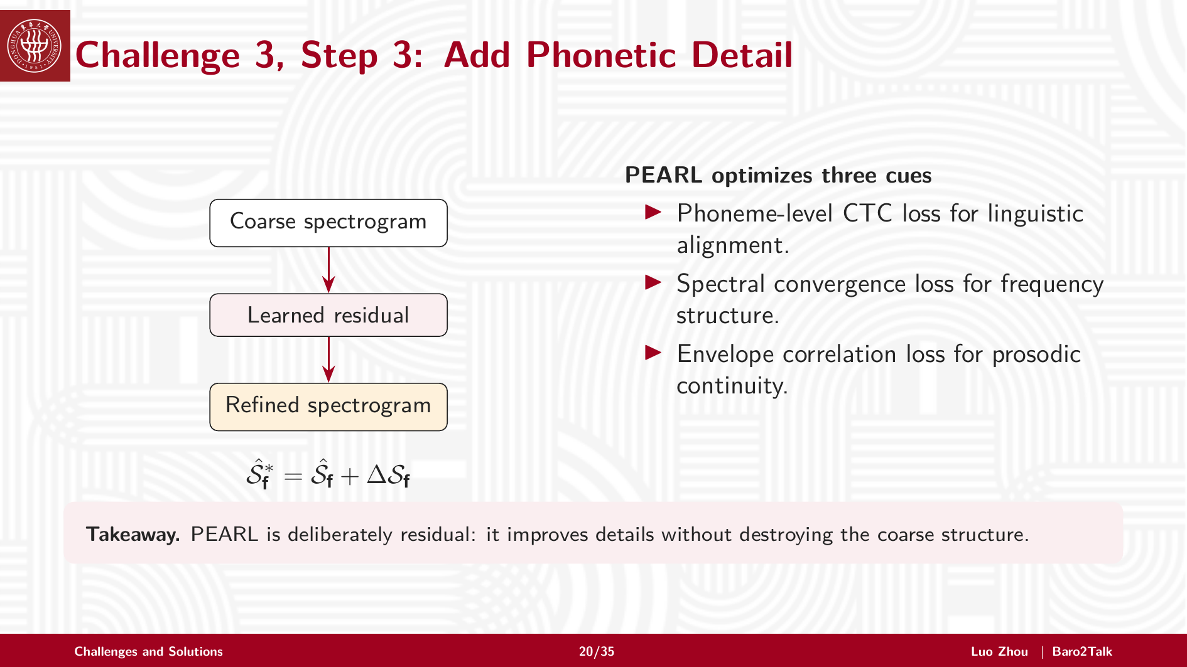
Notes:
The third stage is PEARL, a residual phonetic enhancement module.
Instead of regenerating the whole spectrogram, PEARL learns a residual correction. This improves details while preserving the coarse structure.
It uses phoneme-level CTC loss for linguistic alignment, spectral convergence for frequency structure, and envelope correlation for prosodic continuity.

Slide 21
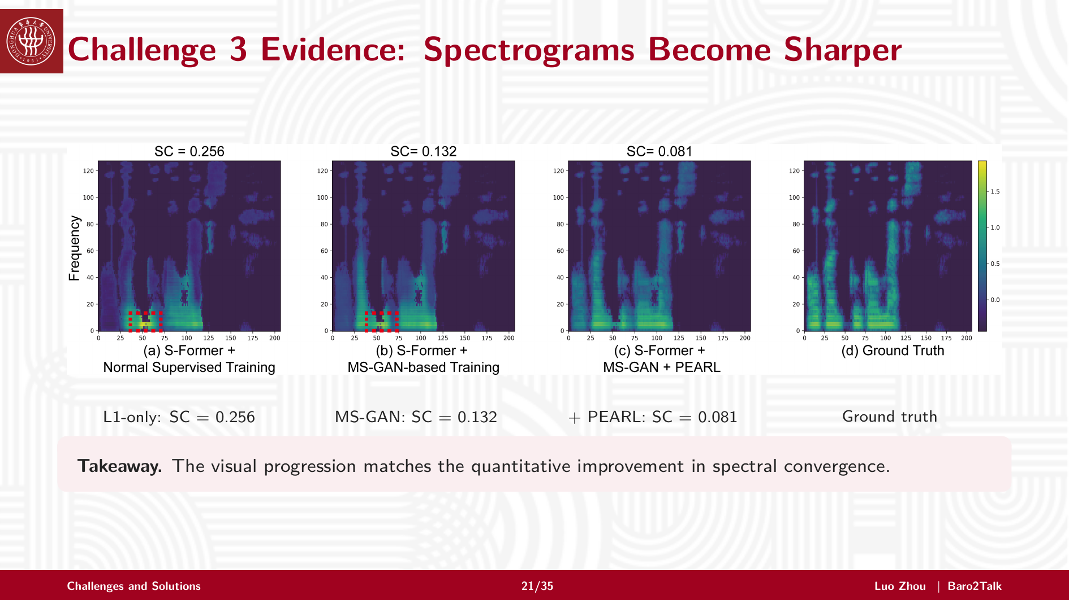
Notes:
This slide gives a visual explanation of why the reconstruction is designed in stages.
With only the L1 objective, the model can roughly place the spectral energy, but the result is over-smoothed and many speech-like details are missing.
After adding MS-GAN, the spectrogram becomes more structured and closer to real speech, because the adversarial loss encourages global spectral realism.
Finally, PEARL adds residual phonetic details. The local patterns become sharper and more consistent with the ground truth, which makes the spectrogram easier for ASR to interpret.
So the key message is not only that SC becomes lower. More importantly, each stage fixes a different failure mode: L1 gives the rough shape, MS-GAN improves speech-like structure, and PEARL restores fine phonetic detail.

Slide 22
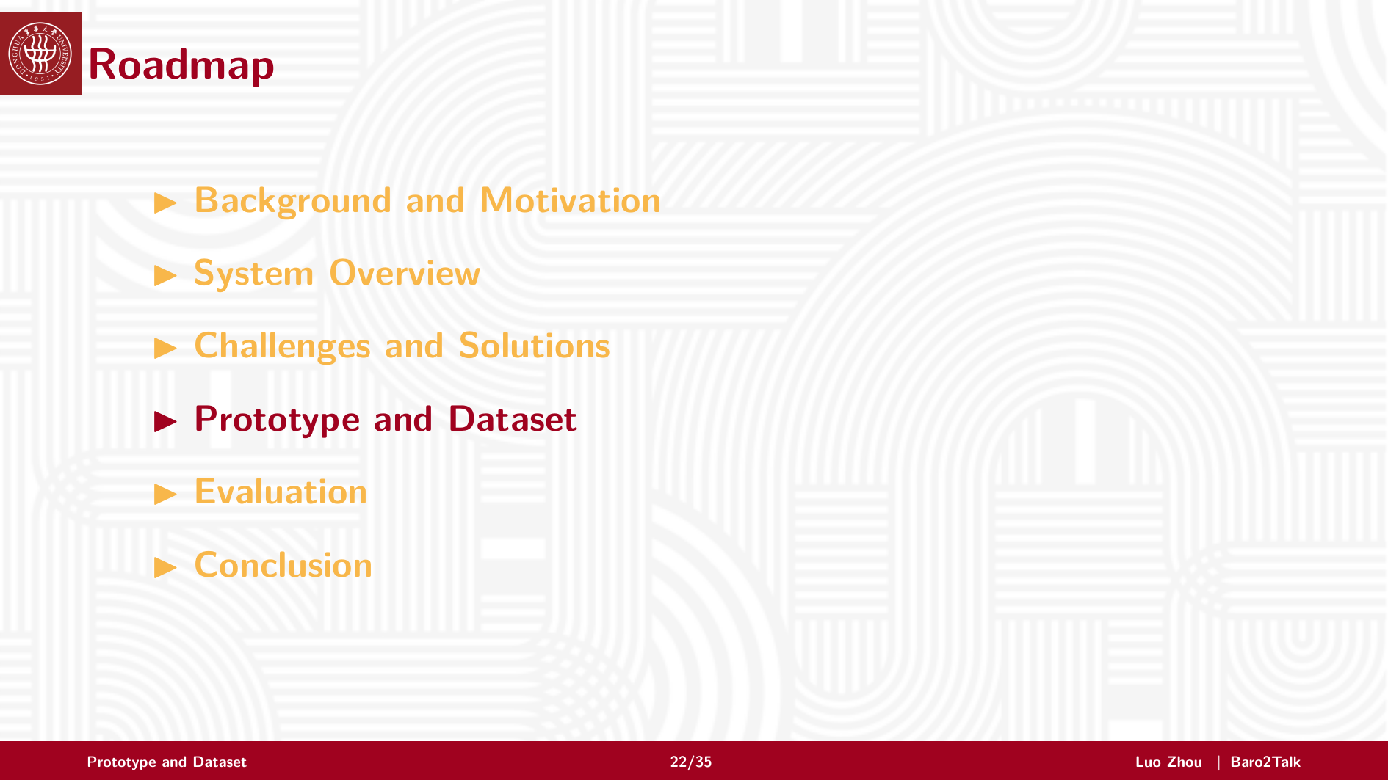
Notes:
Next I will introduce the prototype and dataset.
This part verifies whether the idea works in a practical wearable setting.

Slide 23
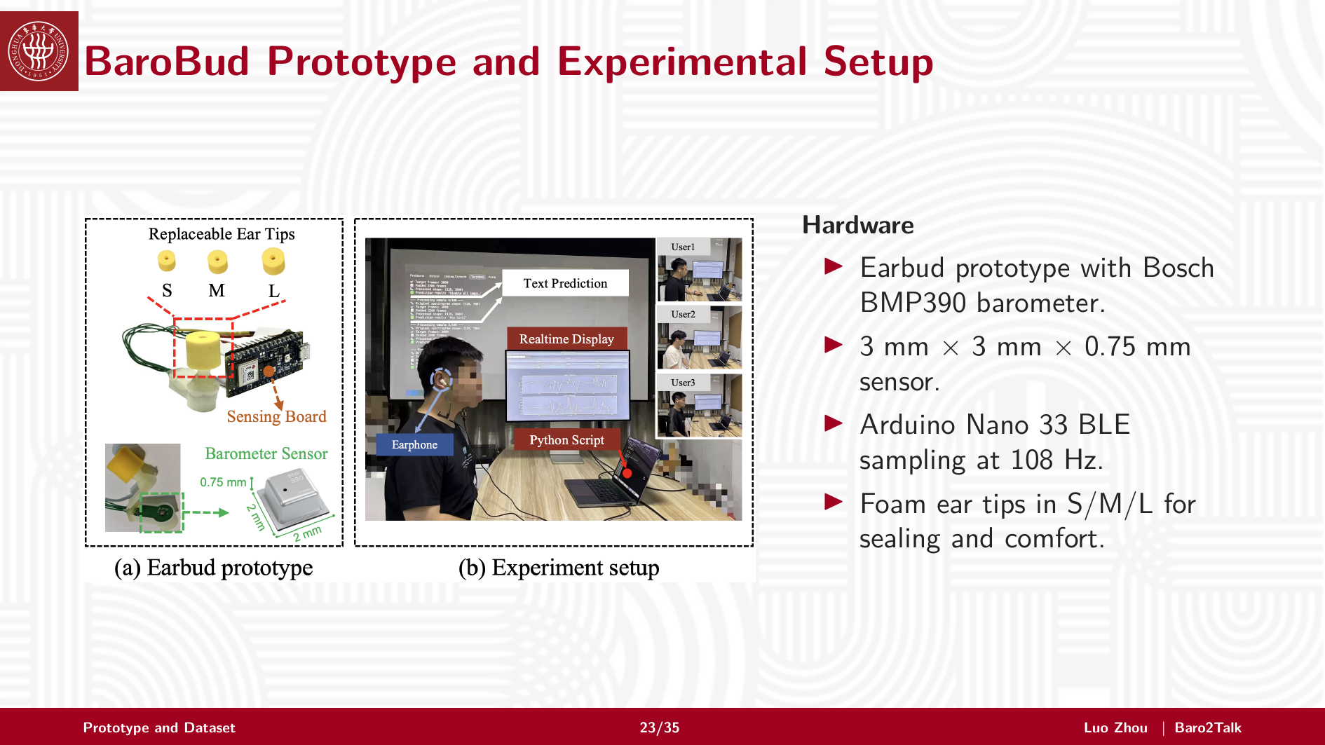
Notes:
We built an earbud prototype called BaroBud.
It uses a Bosch BMP390 barometer, which is only 3 millimeters by 3 millimeters by 0.75 millimeters. Data is collected with an Arduino Nano 33 BLE at 108 hertz.
We also use foam ear tips in different sizes to improve sealing and comfort, because pressure sensing depends strongly on earbud fit.

Slide 24
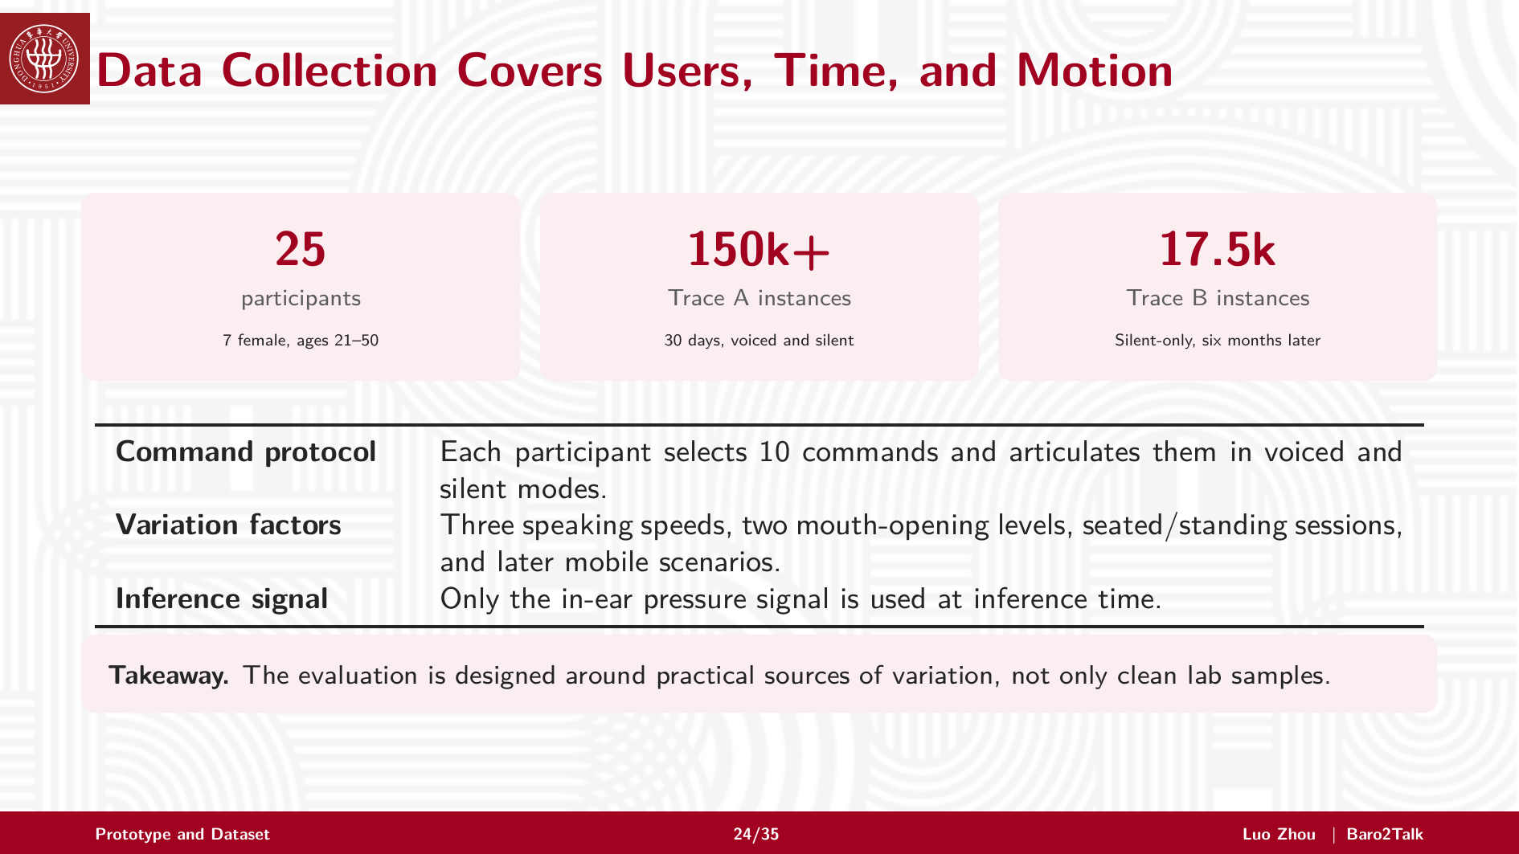
Notes:
The dataset covers practical variation.
We recruited 25 participants. Trace A contains more than 150,000 instances collected over 30 days, including voiced and silent articulation. Trace B contains 17,500 silent-only instances collected six months later.
Participants selected commands and articulated them under different speeds, mouth-opening levels, postures, and mobile scenarios. During inference, only in-ear pressure is used.

Slide 25
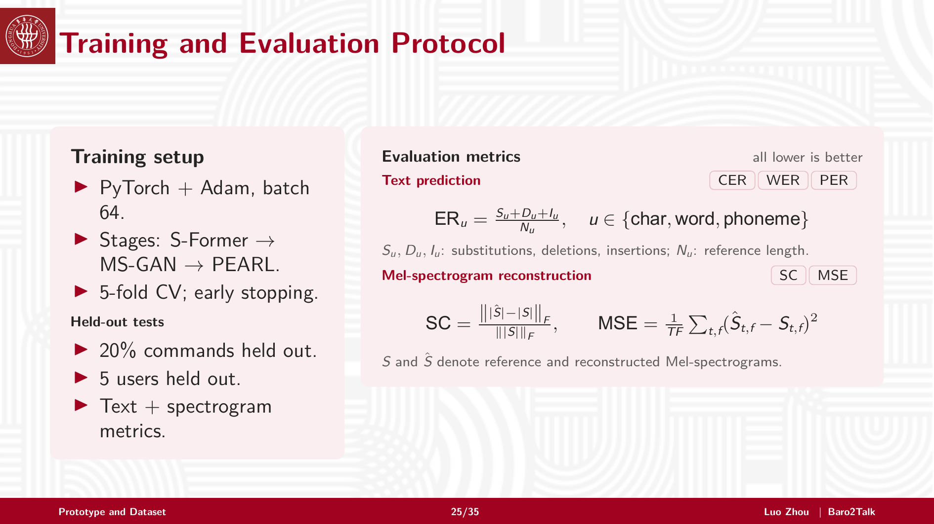
Notes:
Training follows the three-stage pipeline: S-Former, MS-GAN, and PEARL. We use PyTorch, Adam, five-fold cross-validation, and early stopping.
For held-out tests, 20 percent of commands and five users are excluded.
We evaluate text prediction with CER, WER, and PER, which are normalized edit-distance metrics. We evaluate spectrogram reconstruction with SC and MSE. For all these metrics, lower is better.

Slide 26

Notes:
Now I will present the evaluation results.
The main question is whether Baro2Talk can produce ASR-readable spectrograms and remain robust in practical conditions.

Slide 27
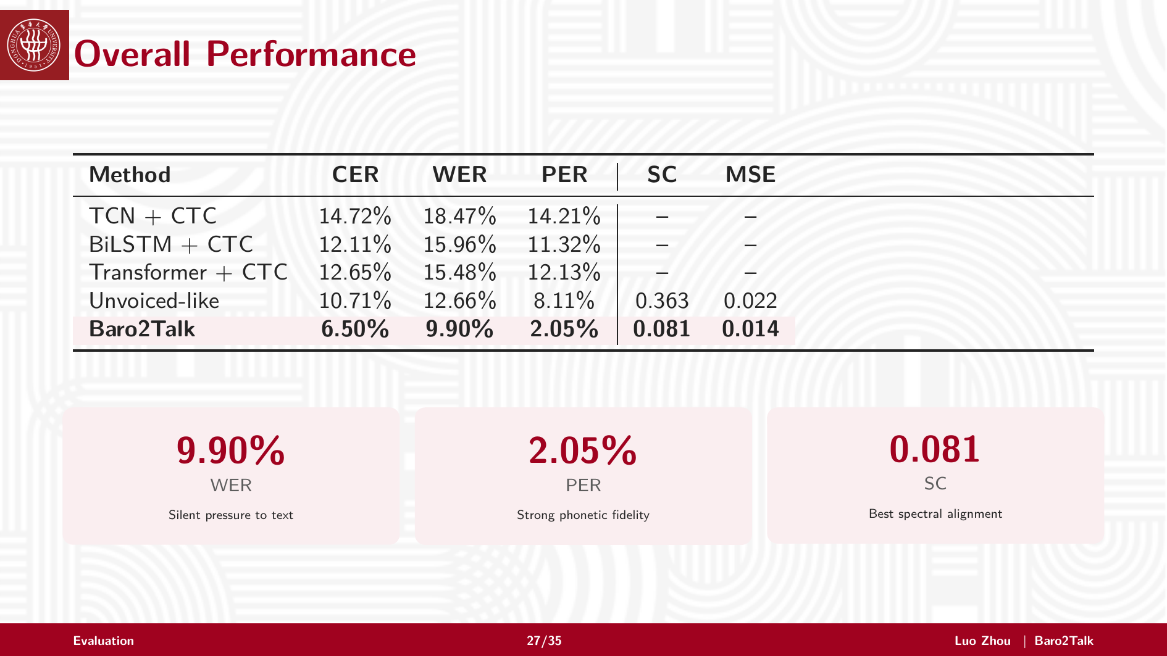
Notes:
Baro2Talk consistently outperforms all baselines in both recognition accuracy and spectrogram quality.
The most important result is that the word error rate is below 10 percent, while the reconstructed spectrogram also shows the best spectral alignment.
This means that in-ear pressure is not only classifiable, but can be converted into a speech-compatible representation for reliable ASR decoding.

Slide 28
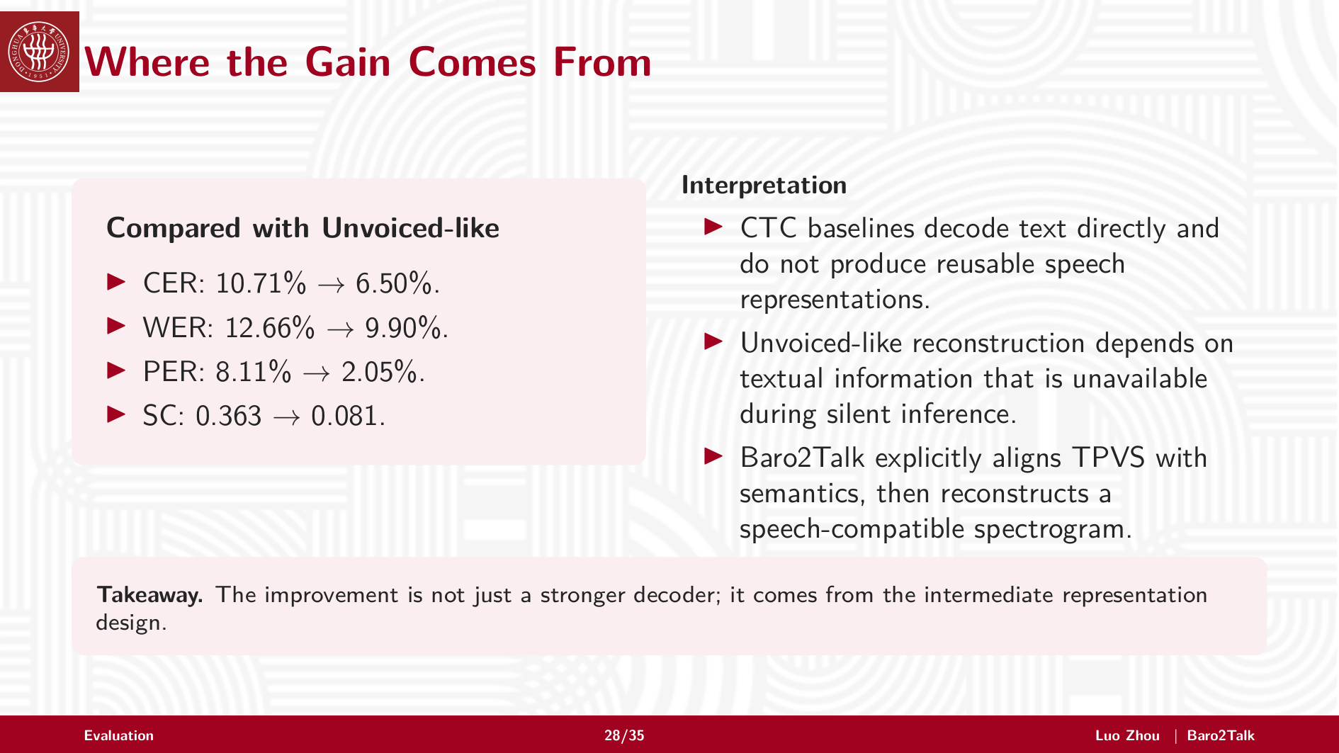
Notes:
The main gain is consistent across both sides of the task: text errors go down, and the reconstructed spectrogram becomes much closer to real speech. For example, WER drops below 10 percent, and spectral convergence improves substantially.
The reason is the intermediate representation design. Baro2Talk does not directly decode text from pressure. It first aligns TPVS with sentence-level semantics, and then reconstructs a Mel-spectrogram that existing ASR models can read.

Slide 29
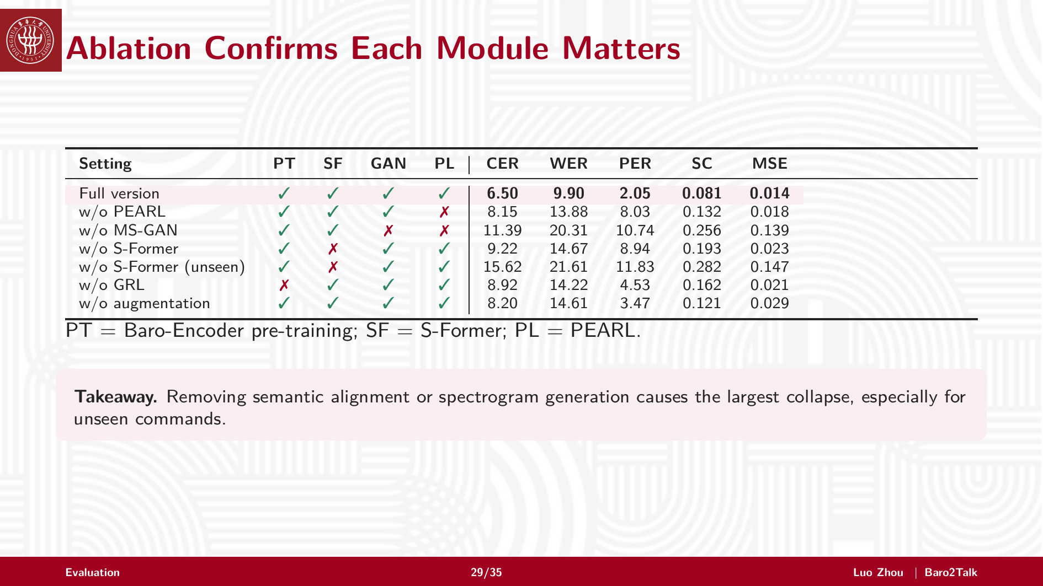
Notes:
The ablation study confirms that each module matters.
Without S-Former, semantic alignment becomes weaker, and unseen commands degrade significantly. Without MS-GAN, spectrogram quality drops sharply. Without PEARL, phonetic detail is worse, especially in PER.
Augmentation and gradient reversal also improve robustness. Overall, the staged reconstruction pipeline is necessary, not just optional engineering.

Slide 30
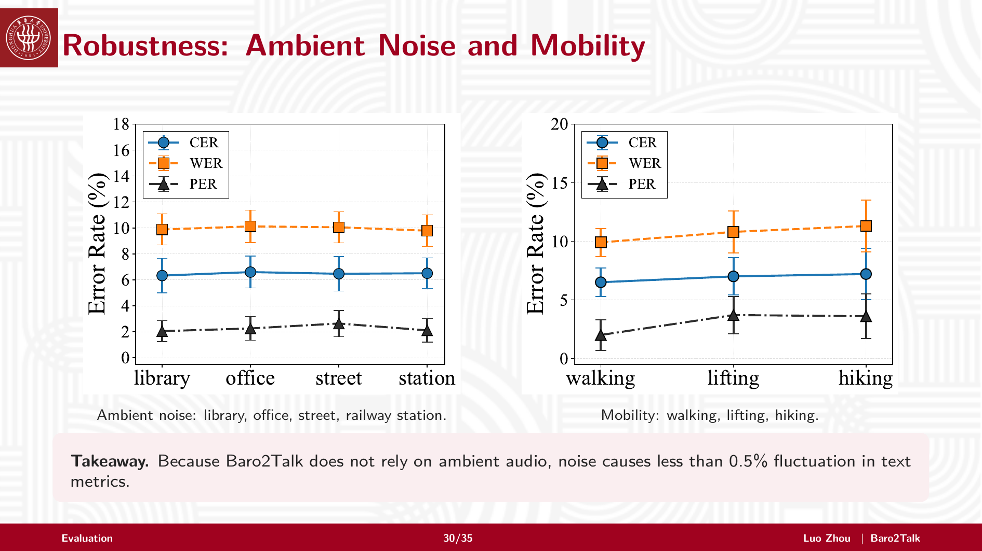
Notes:
We next test robustness.
Under ambient noise, including library, office, street, and railway station, text metrics fluctuate by less than 0.5 percent. This is because the system does not rely on acoustic audio.
Under mobility, including walking, lifting, and hiking, performance remains stable. This shows the benefit of passive pressure sensing in daily scenarios.

Slide 31
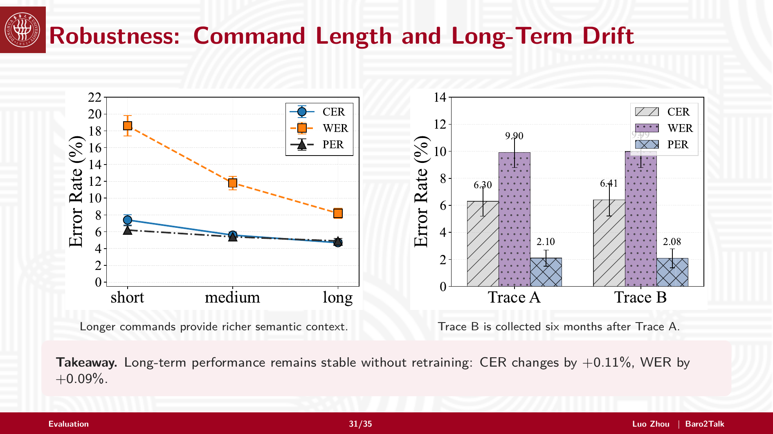
Notes:
For command length, longer commands perform better because they provide richer semantic context.
For long-term stability, Trace B is collected six months after Trace A. Without retraining, CER changes by only 0.11 percent and WER by only 0.09 percent.
This suggests that Baro2Talk can remain stable over time.

Slide 32
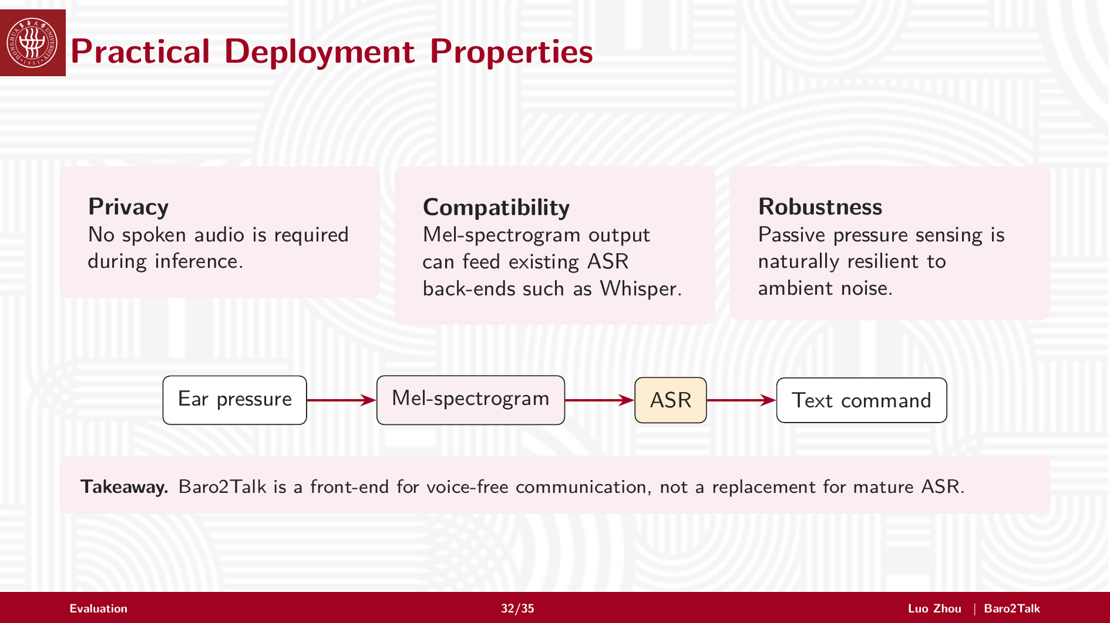
Notes:
Baro2Talk has three practical properties.
First, it is privacy-preserving because no spoken audio is required during inference. Second, it is compatible with existing ASR backends because it outputs Mel-spectrograms. Third, it is robust to ambient noise because the signal is pressure caused by articulation.
So Baro2Talk is a front-end for voice-free communication, not a replacement for mature ASR.

Slide 33
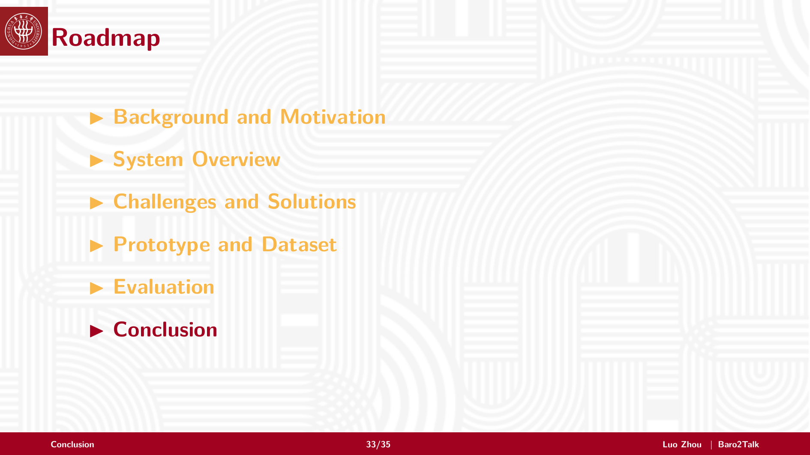
Notes:
Let me conclude the talk with the main takeaways.

Slide 34
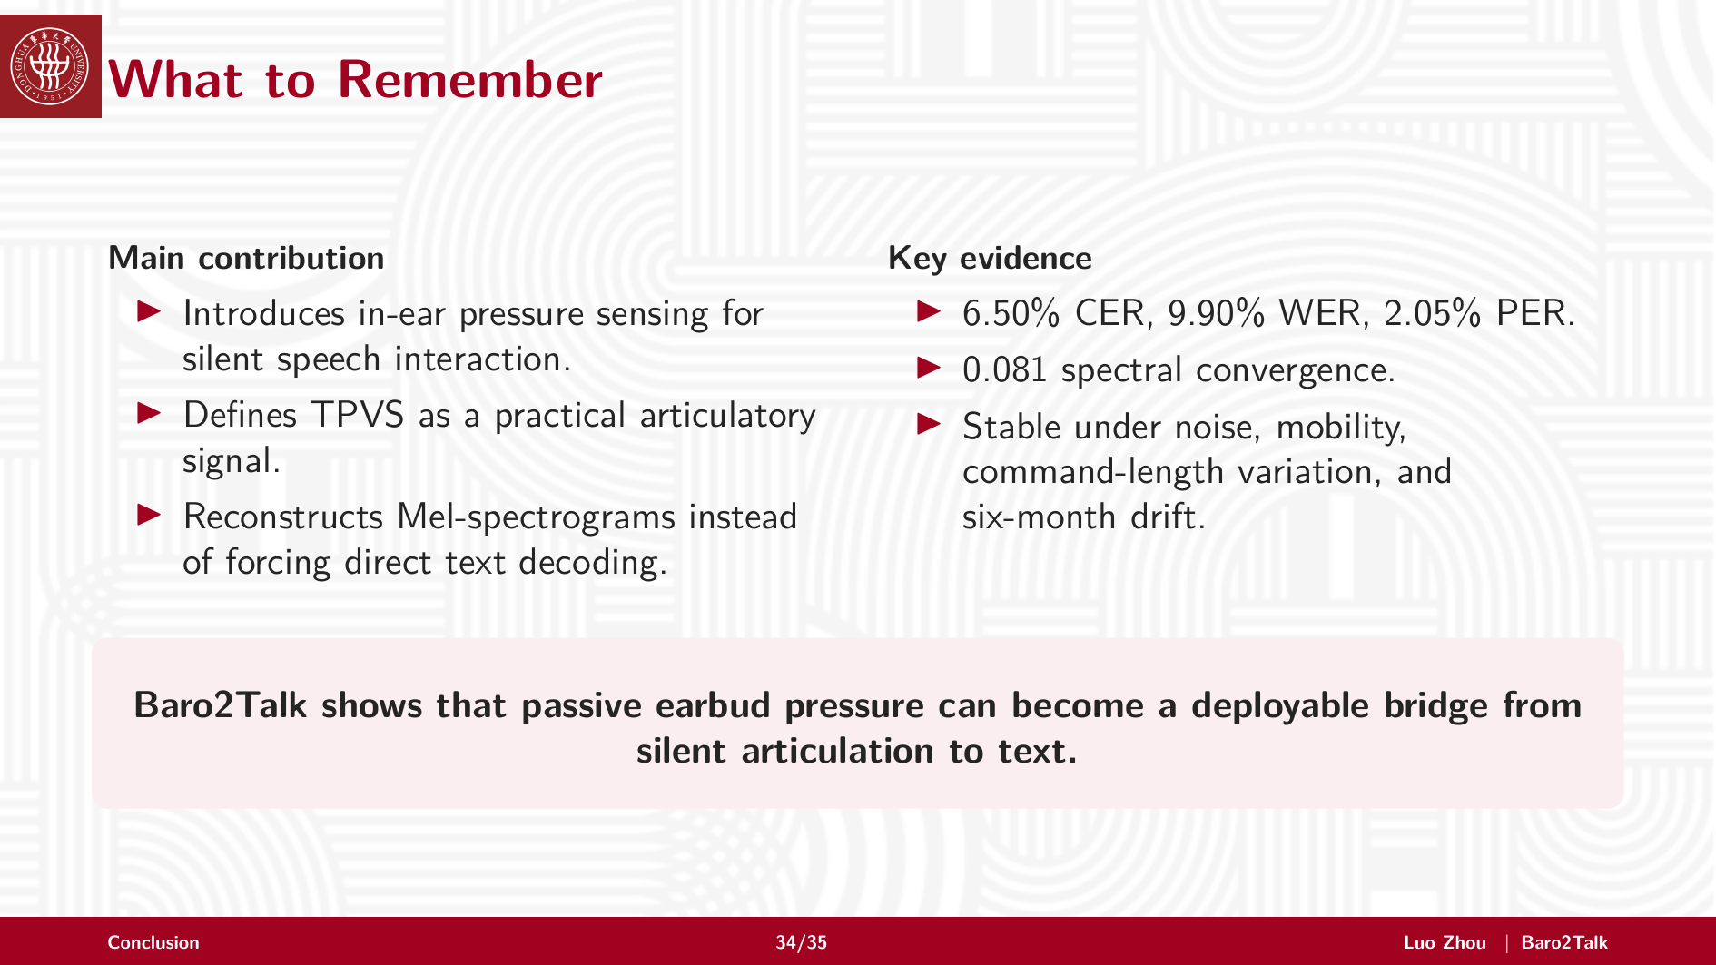
Notes:
To summarize, Baro2Talk makes three main contributions.
First, it introduces in-ear pressure sensing as a practical modality for silent speech interaction. Second, it defines TPVS as an articulatory signal that can be captured inside ordinary earbuds. Third, it reconstructs Mel-spectrograms, rather than forcing direct text decoding from pressure.
Across the evaluation, Baro2Talk achieves strong recognition and spectrogram quality, and remains stable under noise, mobility, command-length variation, and six-month drift.
Overall, this work shows that passive earbud pressure can serve as a deployable bridge from silent articulation to text.

Slide 35

Notes:
Thank you for listening.
I would be happy to take your questions.

