Slide 1





BaroAuth
Harnessing Ear Canal Deformation for
Speaking User Authentication on Earbuds
Presented by : Luo Zhou
Co-authors: Shan Chang, Jiusong Luo, Huixiang Wen, Li Lu
Luo Zhou et al.
Donghua University
2025.07.21
1/35
Notes:
Hi everyone, my name Luo Zhou, from Donghua University. It’s happy to be here to present our work - BaroAuth, which explores a novel way to authenticate users by leveraging ear canal deformation caused by speaking.

Slide 2
Contents
1
Background
2
Feasibility Study
3
Threat Model
4
Challenges
5
Design of BaroAuth
6
Evaluation
7
Conclusion
Luo Zhou et al.
Donghua University
2025.07.21
2/35
Notes:
Here's a brief outline of today’s presentation.

Slide 3
Background
1
Luo Zhou et al.
Donghua University
2025.07.21
3/35
Notes:
So, first, let’s see the background and motivation behind our work.

Slide 4
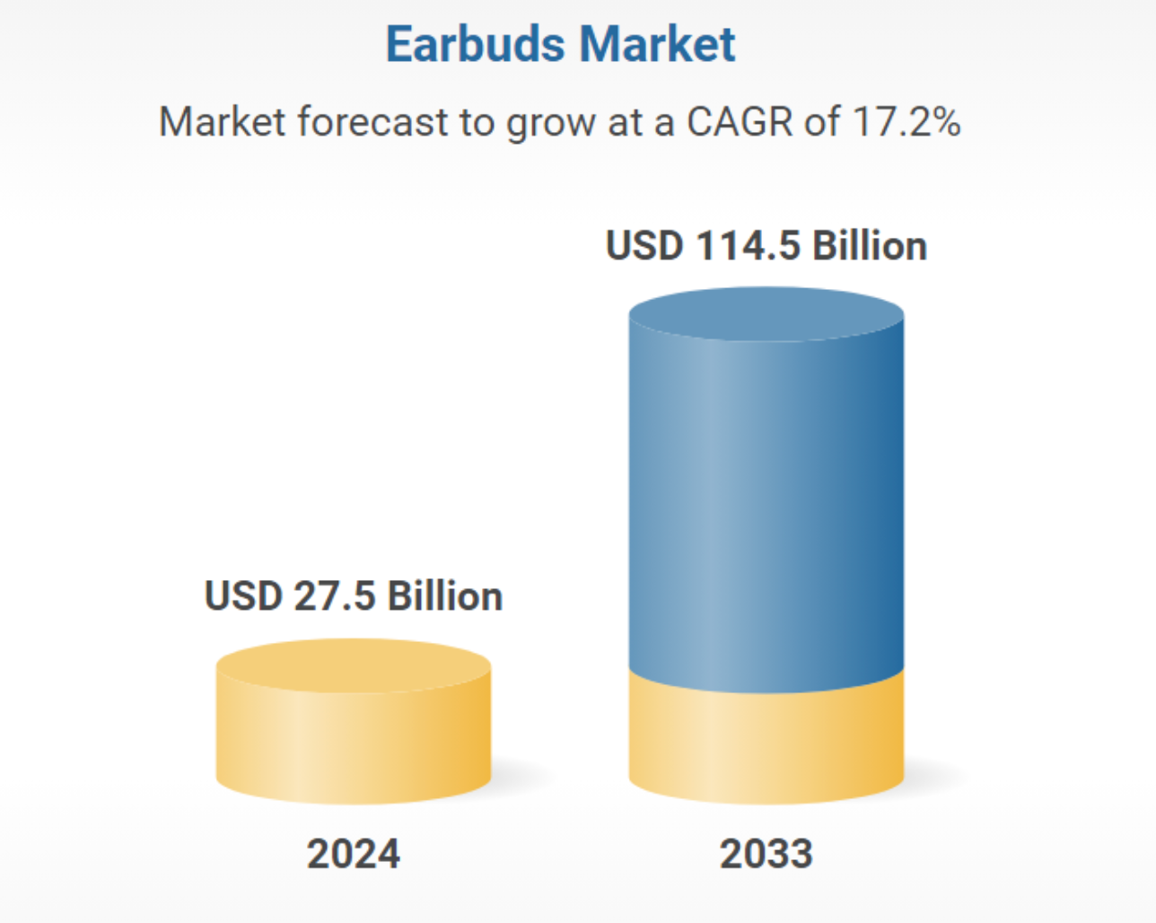

Background
The Growing Era of Smart Wearables
$114B Market by 2033
17% Annual Growth Rate
From Audio Devices to
IoT Gateways
Smart Home
Voice AI
Payments
Authentication
Luo Zhou et al.
Donghua University
2025.07.21
4/35
Notes:
Today, we are in an era where smart devices are ubiquitous. And the earbuds we wear every day are evolving. They are no longer just for music, now they are becoming critical gateways to our digital lives, like controlling smart homes, communicating with AI assistants. This fundamental shift in function is fueling incredible market growth. As you can see, the global earbud market is projected to skyrocket to nearly 114 billion dollars by 2033, reflecting just how integral these devices are becoming. And as these devices handle more sensitive tasks, the need for a secure and effortless way to authenticate the user becomes paramount. So, this brings us to the central question: how to secure these new gateways? Let’s look at the current landscape.

Slide 5
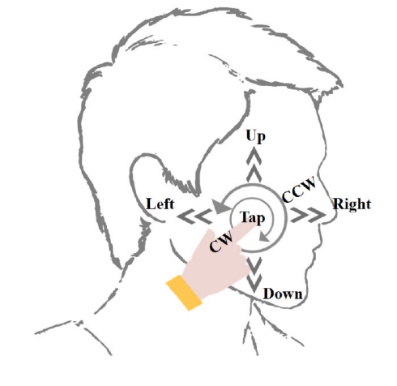
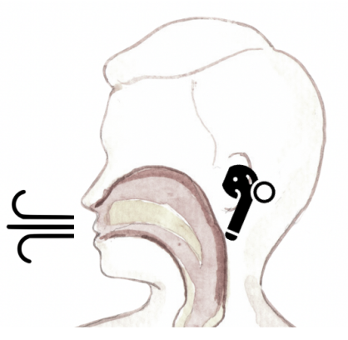
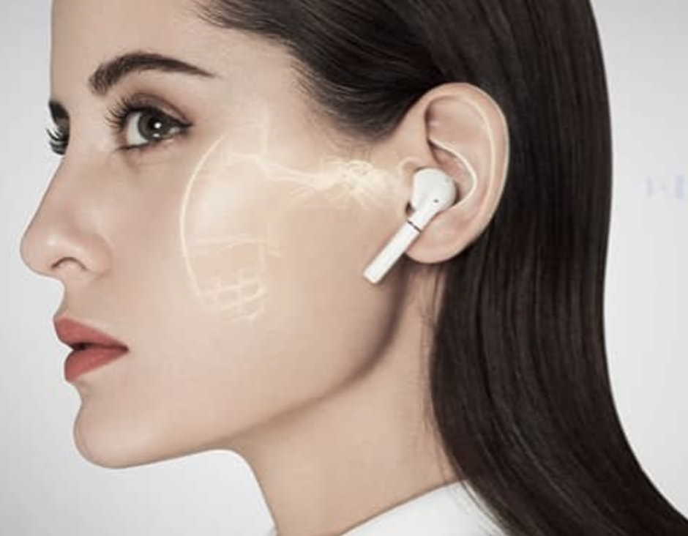
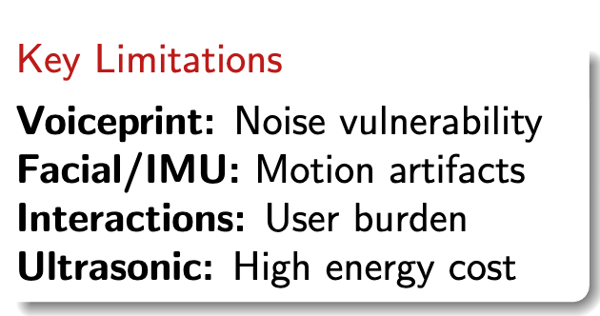
Background
Current Authentication Methods: Limitations
Activity-based
Interaction-based
Biometric-based
Voiceprint
Facial muscle motions
Acoustic resonance
Dental occlusion
Sliding fingers
Breathing
Heartbeat
Ear canal deformation
Luo Zhou et al.
Donghua University
2025.07.21
5/35
Notes:
Existing Methods generally fall into three categories.
First, activity-based methods, like using your voiceprint or analyzing facial muscle movements. The problem is that they are vulnerable to background noise, motion artifacts, and can be fooled by mimicry attacks;
Second, interaction-based methods require the user to perform a specific action, like a dental occlusion or a specific finger-sliding gesture. While these can be secure, they place a burden on the user and are not practical for frequent, seamless authentication;
Finally, we have other biometric-based approaches, like measuring your heartbeat or using ultrasonic signals to map the ear canal. These are promising because they use a person’s unique physiology. However, they often rely on weak signals that difficult to extract reliably, and some of them also require produce ultrasonic signals, which can be power-hungry and interfere with the primary audio function of the earbuds.

Slide 6
Background
Current Authentication Methods: Limitations
Our Goal
Activity-based
Interaction-based
Biometric-based
Secure
+
Breathing
Heartbeat
Ear canal deformation
Voiceprint
Facial muscle motions
Acoustic resonance
Dental occlusion
Sliding fingers
Seamless
+
Intuitive
Luo Zhou et al.
Donghua University
2025.07.21
6/35
Notes:
So, our goal is to propose a secure, seamless and intuitive authentication methods via earbuds.

Slide 7
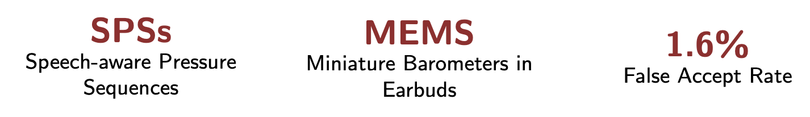
Background
Our Solution: BaroAuth
Luo Zhou et al.
Donghua University
2025.07.21
7/35
Notes:
This is precisely where our solution, BaroAuth, comes in.
The intuition behind BaroAuth is simple yet powerful. Instead of analyzing the sound of your voice, we capture something much more fundamental: the physical deformation of your ear canal as you speak.
As this illustration shows, when you speak, your jaw movements cause subtle but distinct pressure changes inside the sealed ear canal. We capture these unique signals using a miniature, low-power MEMS barometer embedded directly into the earbud. We call this rich biometric signal a Speech-aware Pressure Sequence, or SPS.

Slide 8
Feasibility Study
2
Luo Zhou et al.
Donghua University
2025.07.21
8/35
Notes:
In this section, we’ll explore the scientific foundation and the empirical evidence that validates our method.

Slide 9
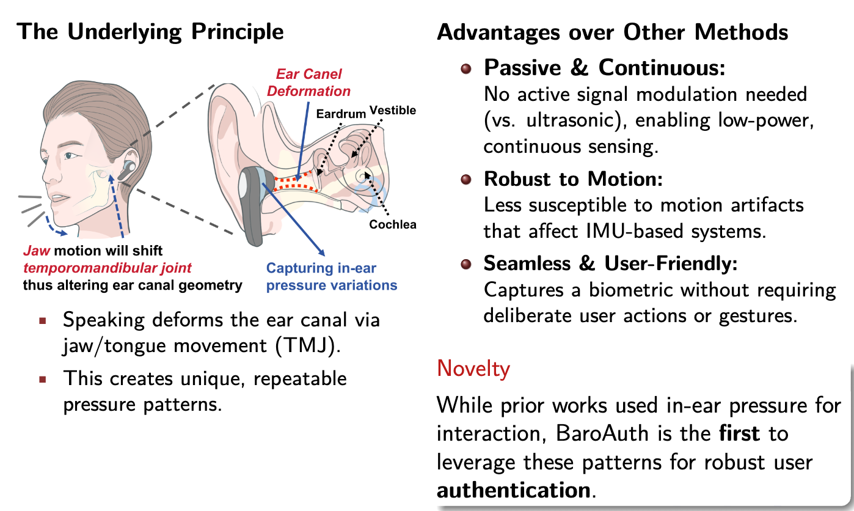
Feasibility Study
Physiological Foundation
Luo Zhou et al.
Donghua University
2025.07.21
9/35
Notes:
The feasibility of BaroAuth rests on a fascinating physiological phenomenon. When we speak, we make complex movements with our jaw and tongue. These movements are controlled by the temporomandibular joint, or TMJ. Because the TMJ is directly connected to the auditory canal, these movements cause the ear canal to physically deform—it slightly changes its shape and volume. In a sealed earbud environment, this deformation generates subtle, yet measurable, pressure variations.
This principle is the heart of our system. But why is using a barometer to measure this better than other methods?
This brings several key advantages. First, it's Passive and Continuous. Unlike ultrasonic methods, we don't need to generate any signals, which makes our system extremely low-power. Second, it's Robust to Motion. These internal pressure changes are far less susceptible to the body motion artifacts that plague IMU-based systems. And third, it's completely User-Friendly, as it captures this biometric from a natural action—speaking—without requiring any deliberate gestures from the user.
And here lies our key novelty. While some prior works have explored in-ear pressure for simple interactions, we are the first to recognize and leverage the richness of these speech-induced patterns for the purpose of robust user authentication.
So, Let’s see what do these signals look like in practice, and whether they are useful for authentication.

Slide 10
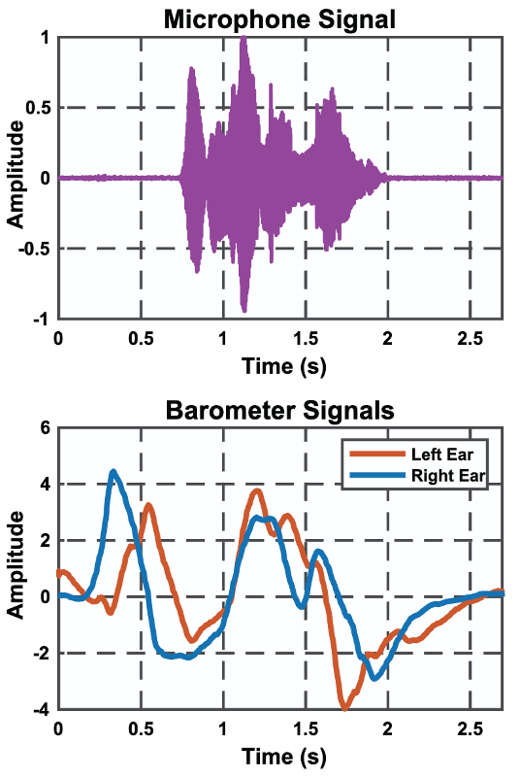
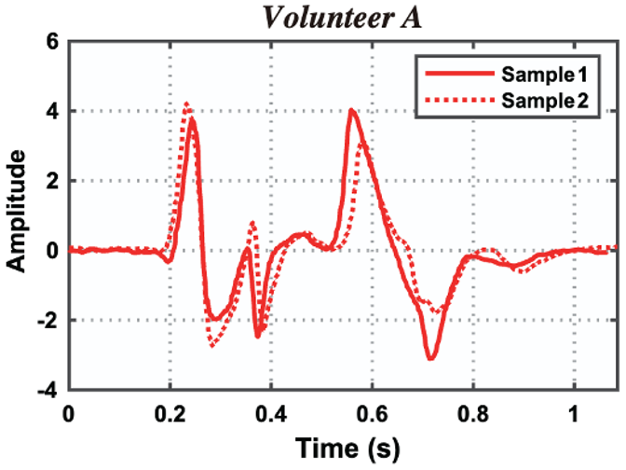

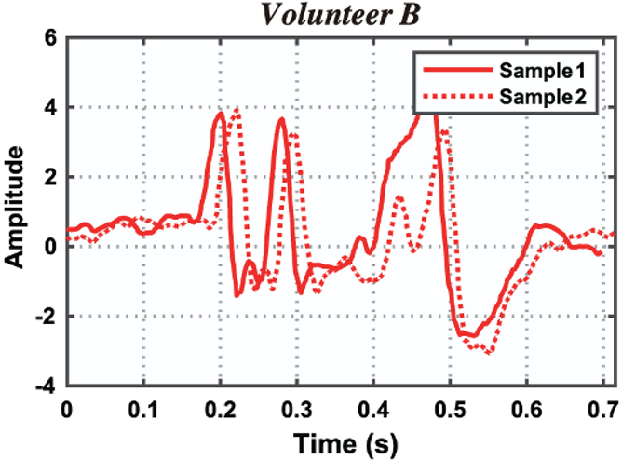


Feasibility Study
Speech-aware Pressure Sequences (SPSs)
Navigate to my office
Video my mom
Detectable
Different
Luo Zhou et al.
Donghua University
2025.07.21
10/35
Notes:
On the left, when a volunteer says “Navigate to my office”, the barometer signal clearly captures the event. And more importantly, on the right, we see two volunteers speaking the same phrase “Video my mom”. The patterns are highly consistent for the same user, but clearly different between users. This confirms that these SPSs have the two hallmarks of a strong biometric: high consistency for the same person, and high variability between different people.

Slide 11
Threat Model
3
Luo Zhou et al.
Donghua University
2025.07.21
11/35
Notes:
And we also define the threat model to evaluate the security of BaroAuth.

Slide 12
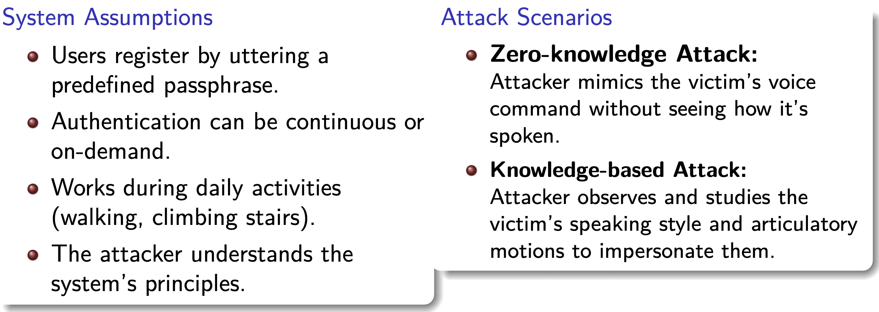
Threat Model
Threat Model
Luo Zhou et al.
Donghua University
2025.07.21
12/35
Notes:
The threat model is built on a few practical assumptions: users enroll with a passphrase, the system works during daily activities, and more importantly, we assume a strong attacker who understands our system’s principles.
Against this system, we test two primary attack scenarios:
First: a Zero-knowledge attack, where the impersonator only knows the victim’s passphrase and tries to mimic their voice;
And second, a more sophisticated Knowledge-based attack. Here, the attacker has studied how the victim utters by watching secret shotting videos. Then, the attacker attempts to replicate not just their voice, but their specific articulatory motions. Successfully defending against this stronger, knowledge-based attacker is crucial for proving the real-world security of our system.

Slide 13
Challenges
4
Luo Zhou et al.
Donghua University
2025.07.21
13/35
Notes:
But, to make BaroAuth become a robust and real-world system, we still face three key challenges.

Slide 14

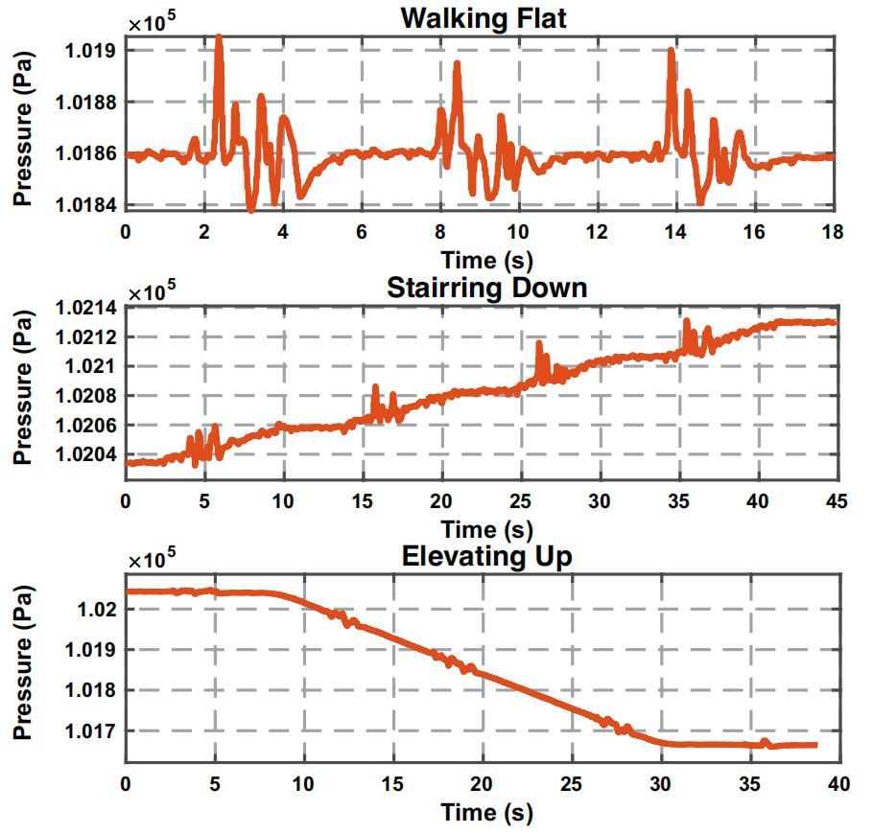


Challenges
Challenge 1:
How to eliminate the baseline drift of SPS ?
SPSs under 3 classical moving scenarios
Luo Zhou et al.
Donghua University
2025.07.21
14/35
Notes:
The first major challenge is dealing with environmental interference, specifically baseline drift. Barometer sensor is sensitive enough to detect SPS, but this also means it detects changes in altitude. As you can see from the graphs, when a user is walking on a flat surface, the signal is stable. However, when climbing stairs or riding an elevator, the baseline of the pressure signal drifts significantly. This drift can completely overwhelm the subtle biometric patterns from speech. So, our first critical question is: How can we eliminate this baseline drift while perfectly preserving the user’s unique signature?

Slide 15
Challenges
Challenge 1:
How to eliminate the baseline drift of SPS ?
Challenge 2
How to adapt to various speaking rhythms ?
Challenge 3
How to extract stable identity features from SPS ?
Luo Zhou et al.
Donghua University
2025.07.21
15/35
Notes:
The second challenge is saying that we might speak faster when we’re in a hurry, or slower when we’re tired. This variation stretches and compresses the signal in the time domain. A model trained only on a normal speaking pace would likely fail in these common, real-world scenarios. So, BaroAuth needs to figure out how to adapt to various speaking rhythms.

Slide 16
Challenges
Challenge 1:
How to eliminate the baseline drift of SPS ?
Challenge 2
How to adapt to various speaking rhythms ?
Challenge 3
How to extract stable identity features from SPS ?
Luo Zhou et al.
Donghua University
2025.07.21
16/35
Notes:
Finally, even with a clean and rhythm-adjusted signal, we face our third and most fundamental challenge: how to extract stable identity features. This is because the SPS signal is complex, it contains complementary information in both the time domain, reflecting large-scale jaw movements, and the frequency domain, which captures finer details from vocal resonance. A simple model might fail to capture the full picture.

Slide 17
Design of BaroAuth
5
Luo Zhou et al.
Donghua University
2025.07.21
17/35
Notes:
Next, Let’s move to the design of our BaroAuth, and explaining how we engineered our solution to address each of these problems.

Slide 18
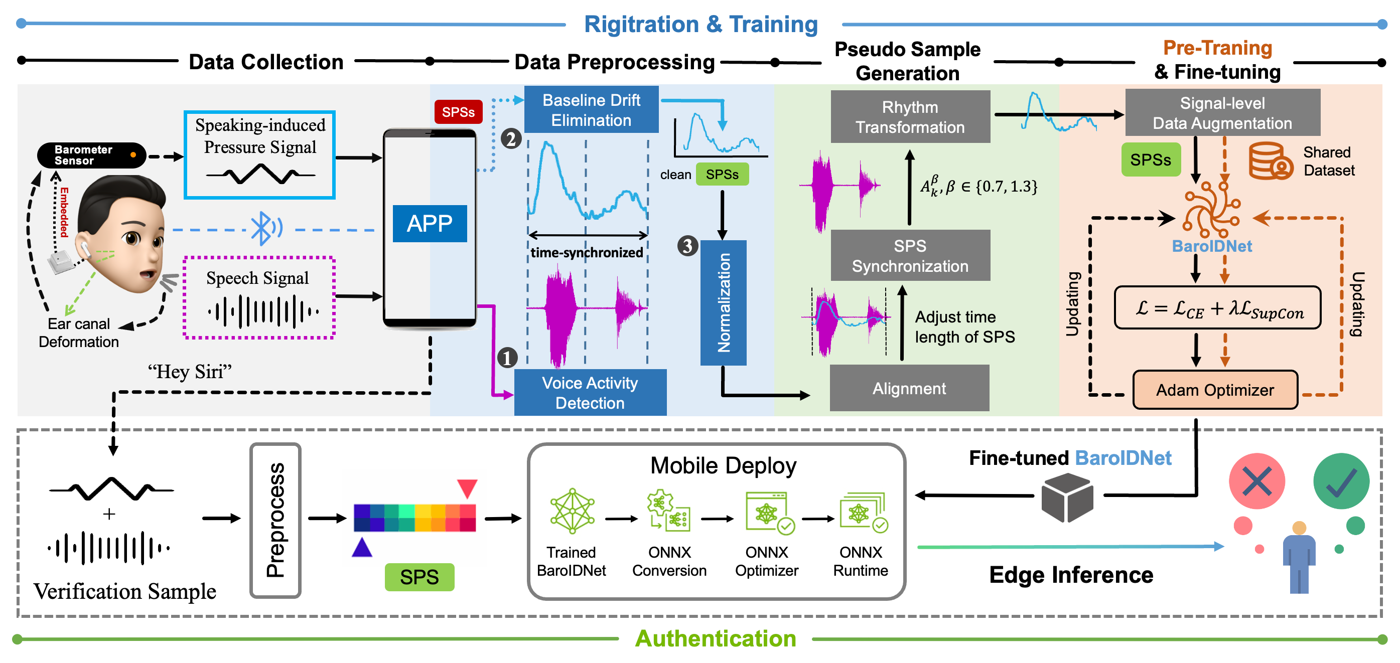
Design of BaroAuth
Overview of BaroAuth
Luo Zhou et al.
Donghua University
2025.07.21
18/35
Notes:
BaroAuth mainly includes four modules: Data Collection, Data Preprocessing, Pseudo Sample Generation and Training of our end-to-end Authentication model – BaroIDNet

Slide 19
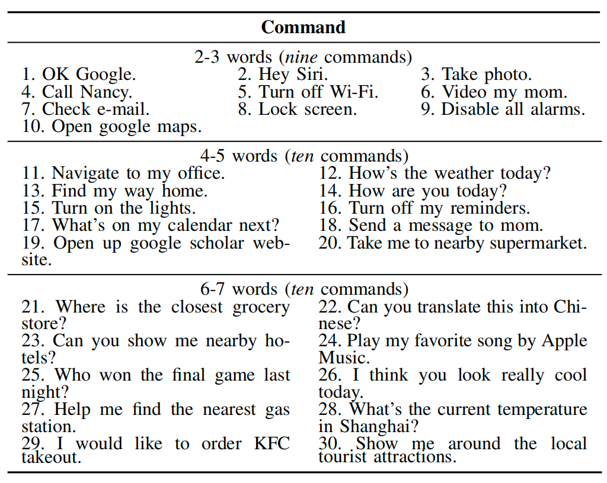
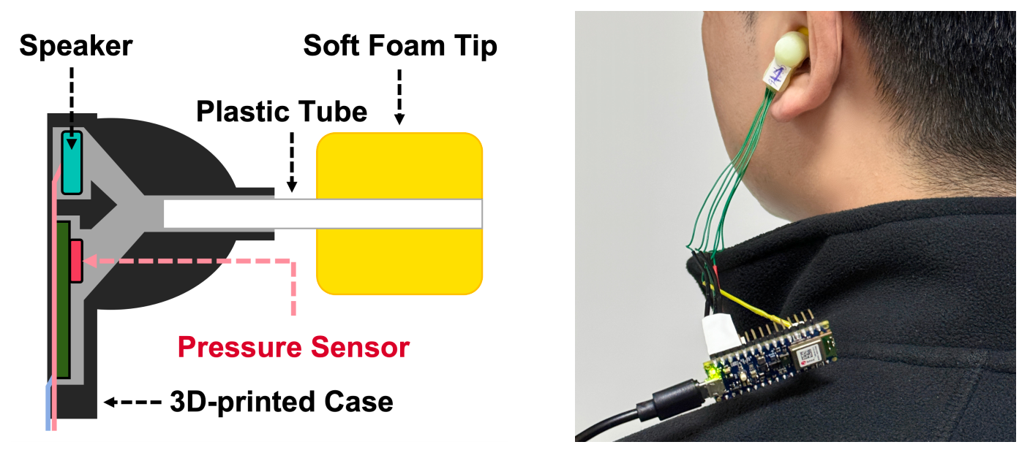
Design of BaroAuth
Hardware Prototype & Data Collection
Data Collection
Command List
Trace A (30 days)
Collect 300 pieces of microphone signals, as well as corresponding pressure signals, per volunteer
Record the process of data collection using a video camera
Trace B (100 times)
Launch zero-knowledge impersonation Attack
Launch Snooping and Impersonation Attack
Trace C (10 times per day for 1week)
Each volunteer speaks every selected command at a normal speaking volume and pace for one week after 6 months.
Hardware Schematic
Data Collection Setup
Luo Zhou et al.
Donghua University
2025.07.21
19/35
Notes:
Of course, we develop a custom hardware prototype by embedding a miniature Bosch BMP390 pressure sensor into 3D-printed earbud housing, which allows us to capture the necessary data.
To train our authentication model and comprehensively evaluate BaroAuth, we also conduct an extensive data collection study over 30 days, involving multiple volunteers and a list of 30 different voice commands.
Crucially, we collect three distinct traces of data: Trace A for general training, Trace B specifically to simulate zero-knowledge and knowledge-based attacks, and Trace C to evaluate the system’s stability after a period of six months.

Slide 20
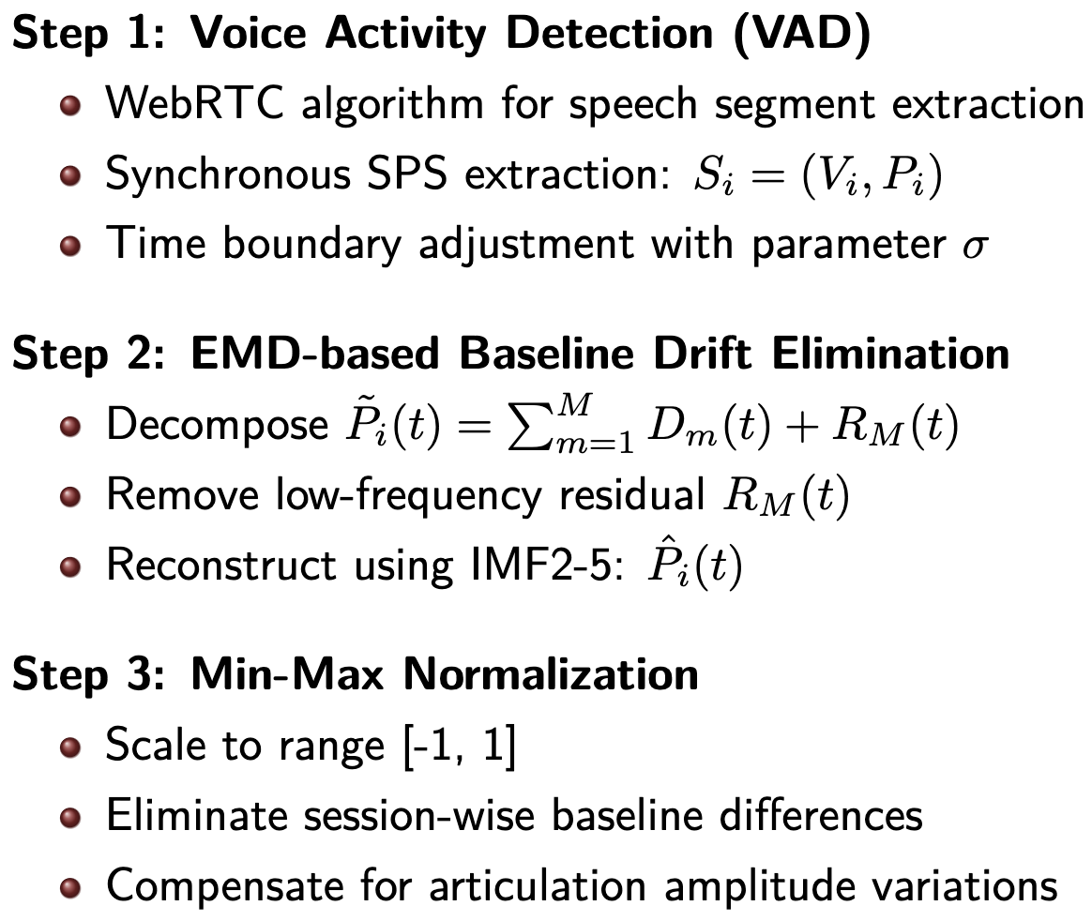
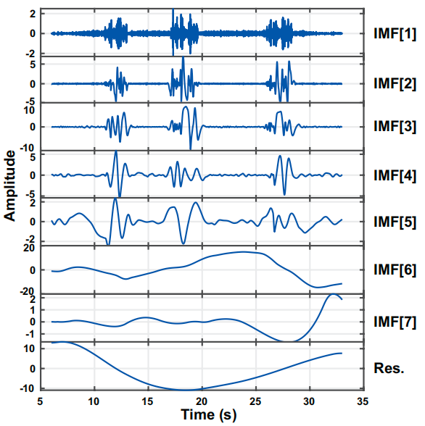
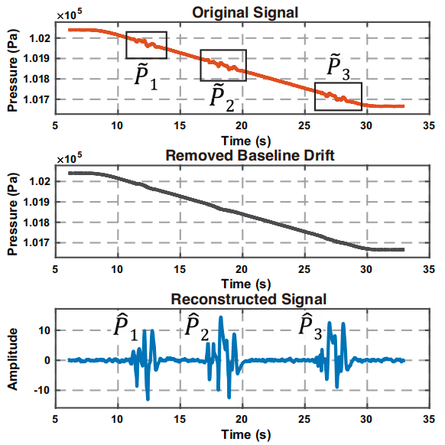
Design of BaroAuth
Data Preprocessing Pipeline
Challenge 1
An example of EMD decomposition
An example of removed baseline
drift and reconstructed SPSs
Luo Zhou et al.
Donghua University
2025.07.21
20/35
Notes:
Our preprocessing pipeline has three main steps:
First, we use Voice Activity Detection algorithm to accurately segment the speech-related portions from the continuous signal.
Second, to eliminate drift, we apply Empirical Mode Decomposition, or EMD. As you can see in the figures on the right, EMD adaptively decomposes the signal into different frequency components, allowing us to isolate and remove the low-frequency drift while perfectly preserving the high-frequency biometric details.
Finally, we apply Min-Max Normalization to standardize the signal, compensating for any amplitude variations. The result is a clean, stable SPS signal, ready for feature extraction.

Slide 21
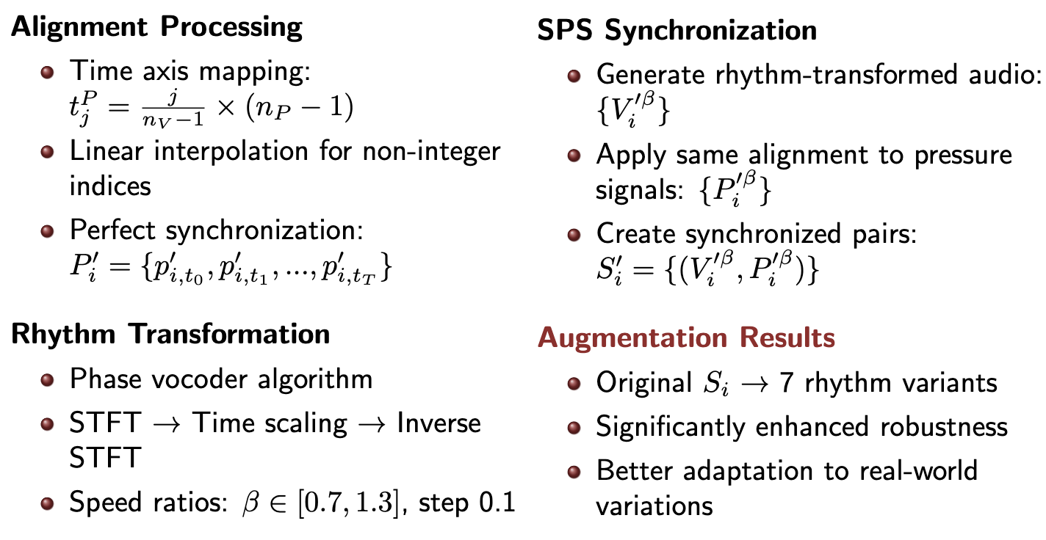
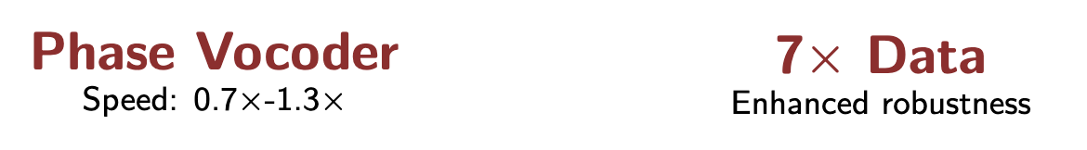
Design of BaroAuth
Pseudo Sample Generation
Challenge 2
Luo Zhou et al.
Donghua University
2025.07.21
21/35
Notes:
Next, to tackle Challenge 2: Rhythm Variations, we developed a data augmentation pipeline."
The process is straightforward. We first align the pressure signal with the audio signal. Then, using a Phase Vocoder, we perform time-scaling on the audio to simulate faster and slower speaking rhythms. We apply these same transformations to the synchronized pressure signals."
This process effectively multiplies our training data by a factor of seven, creating a diverse dataset that makes our final model significantly more robust to the natural variations in a user's speaking pace.

Slide 22
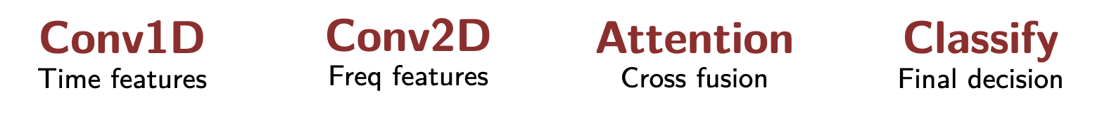
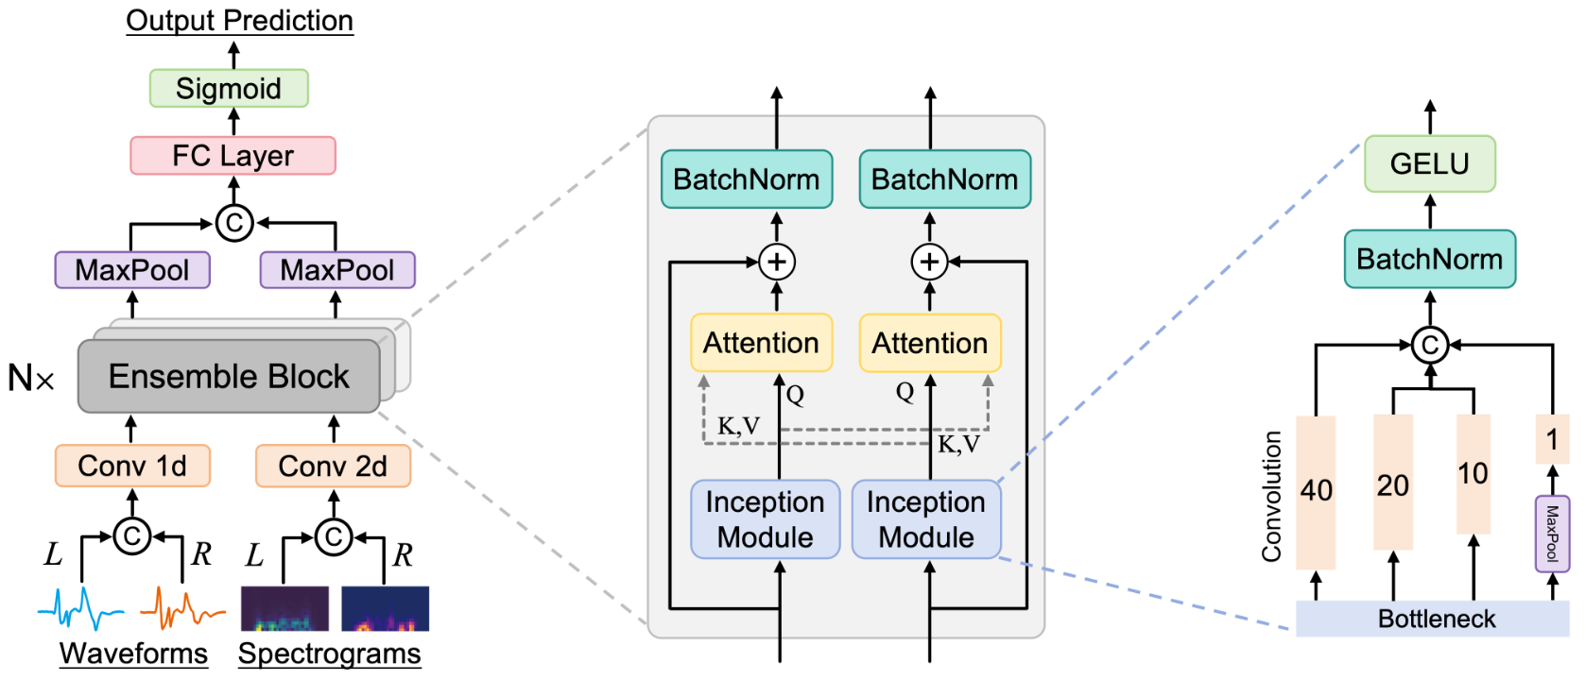
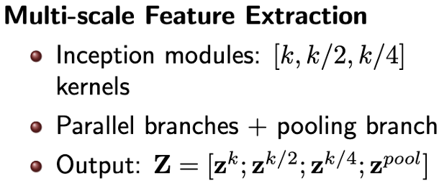
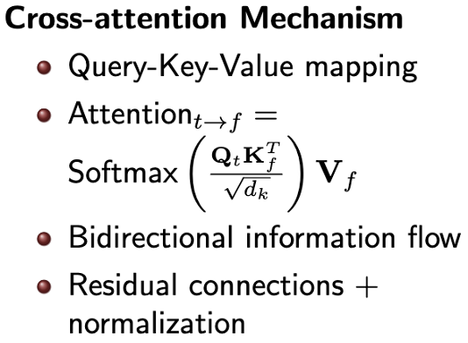
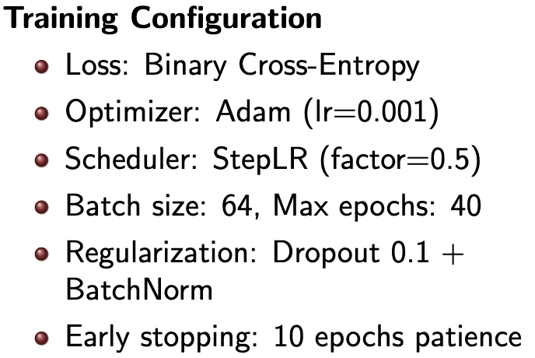
Design of BaroAuth
Authentication Model - BaroIDNet
Challenge 3
Luo Zhou et al.
Donghua University
2025.07.21
22/35
Notes:
Finally, to solve Challenge 3: Extracting Stable Features, we designed our novel end-to-end authentication model, BaroIDNet."
The architecture is designed to fuse information from multiple domains. It starts by using parallel 1D and 2D convolutions to separately extract features from the time-domain waveforms and the frequency-domain spectrograms."
To capture features at different temporal scales, we use Multi-scale Inception modules. But the most critical component is our Cross-Attention Mechanism. This allows the time and frequency branches to dynamically interact and fuse their complementary information, creating a much richer and more discriminative feature representation than either could alone.
The resulting fused vector is then passed through a final classification head to make the authentication decision.

Slide 23
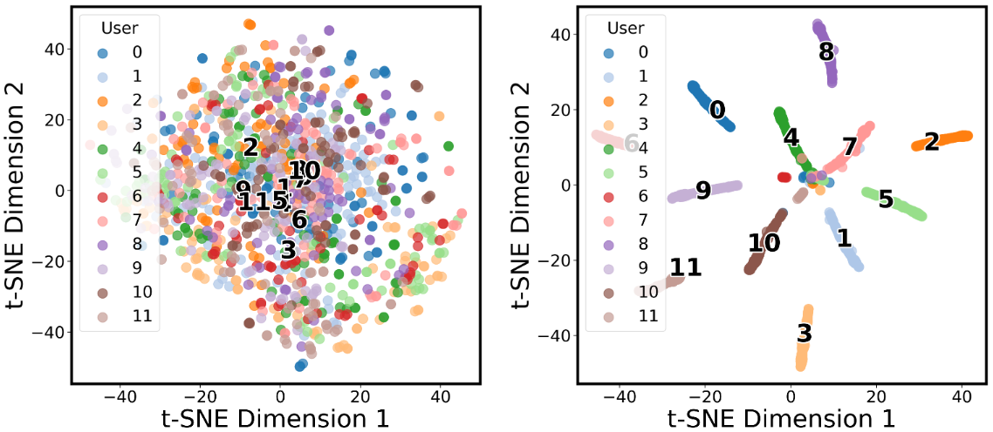
Design of BaroAuth
Feature Visualization: t-SNE Analysis
The visualization of features extracted by
raw data (left) and FC output from BaroAuth
Raw Data Features:
VS.
Extracted Features:
Mixed user patterns
Poor separability
Overlapping clusters
Clear user clusters
Excellent separability
Distinct boundaries
Luo Zhou et al.
Donghua University
2025.07.21
23/35
Notes:
To evaluate the ability of BaroAuth to extract user discriminative features, we visualize both raw input data and model-extracted features using t-SNE.
The left figure shows the t-SNE visualization of raw input data, where samples from
different users are intermixed, indicating a lack of discriminative properties.
In contrast, after feature extraction, the right figure illustrates the model-extracted features, where samples from the same user form distinct, compact clusters. These results demonstrate the effectiveness of BaroAuth in transforming ambiguous raw inputs into a structured feature space with clear user-specific separability.

Slide 24
Evaluation
6
Luo Zhou et al.
Donghua University
2025.07.21
24/35

Slide 25
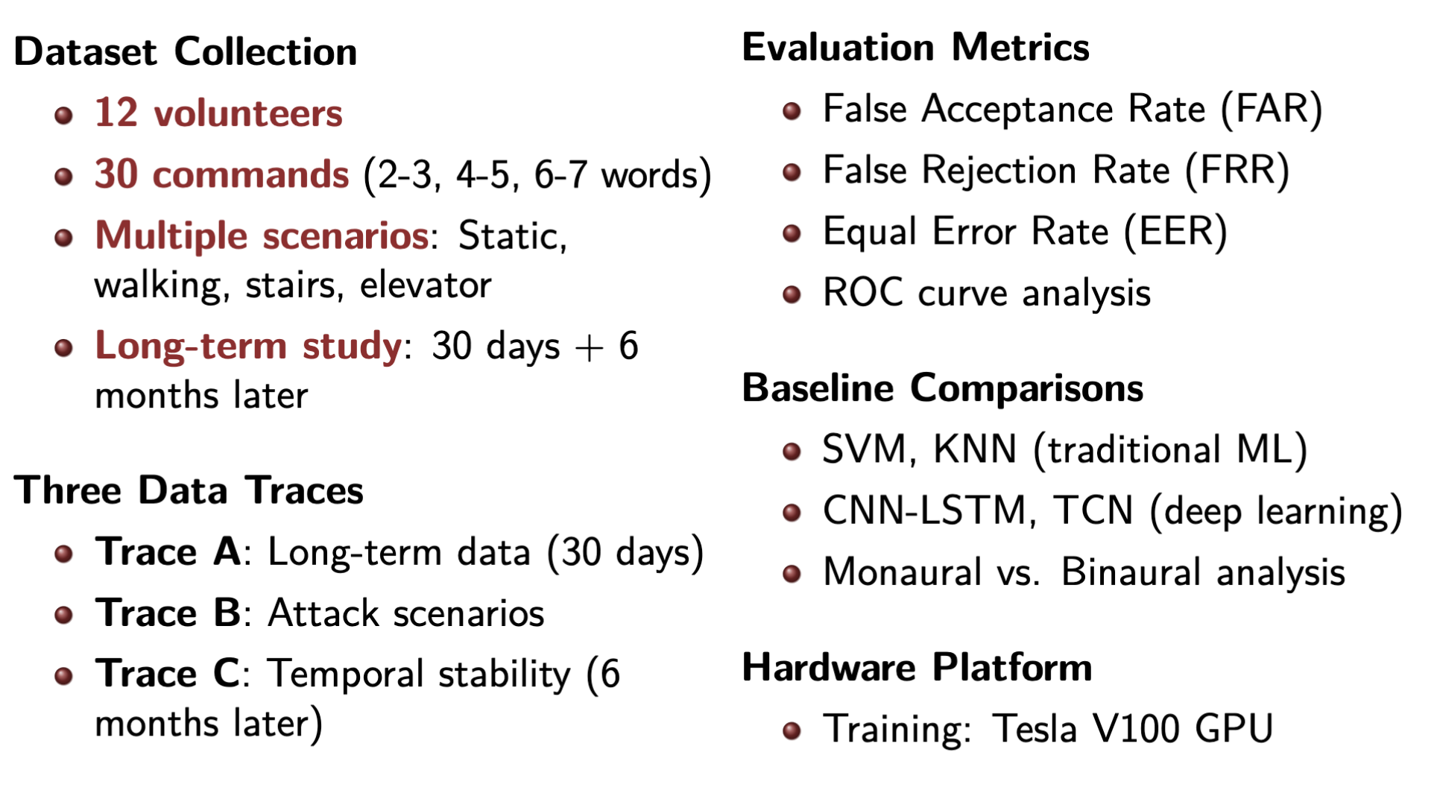
Evaluation
Comprehensive Experimental Evaluation
Luo Zhou et al.
Donghua University
2025.07.21
25/57
Notes:
To measure performance, we use three standard metrics for biometric systems: the False Acceptance Rate, which is the probability of an imposter being incorrectly accepted; the False Rejection Rate, the probability of a genuine user being incorrectly rejected; and the Equal Error Rate, where these two are equal."
And finally, we will be comparing our results against several key baselines, including both traditional and deep learning approaches."
So, let's dive into the results.

Slide 26
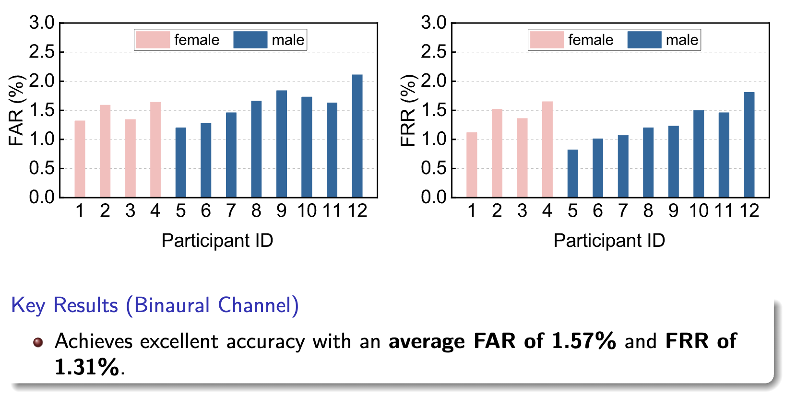
Evaluation
Overall Performance Results
Luo Zhou et al.
Donghua University
2025.07.21
26/35
Notes:
We first evaluate the overall performance of BaroAuth in the static scenario. During the experiment, we consider each participant as a valid user, and remaining participants as attackers. The experiment simulates the zero-knowledge attack where attackers expect their SPSs can fool the system. Overall, the average FAR and FRR over 12 participants are 1.57% and 1.31%, respectively.

Slide 27
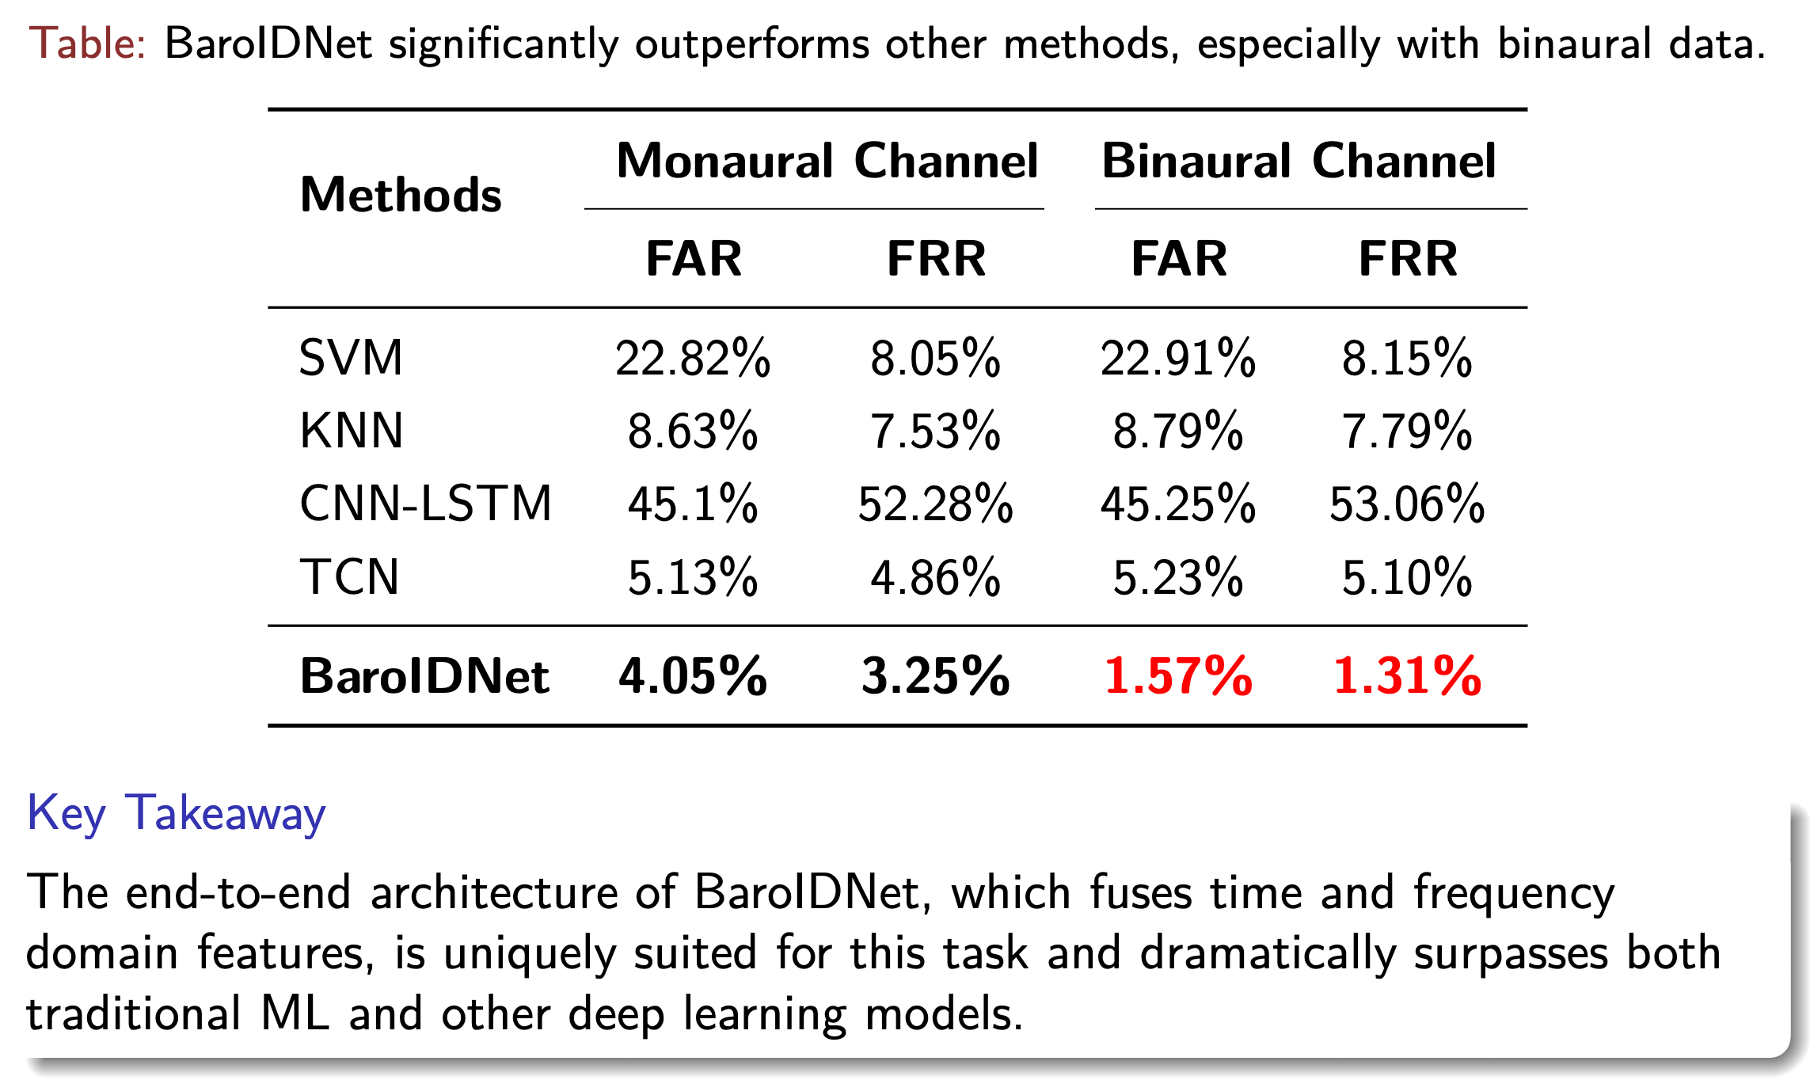
Evaluation
Comparison with Baselines
Luo Zhou et al.
Donghua University
2025.07.21
27/35
Notes:
Compared to the four baseline methods, our BaroIDNet achieves lower FAR and FRR in both monaural and binaural channel, as shown in this table. In the monaural channel, BaroIDNet achieves a FAR of 4.05% and FRR of 3.25%, while in the binaural channel, these values drop to 1.57% and 1.31%, respectively. Notably, the significant performance improvement in the binaural channel is due to BaroIDNet’s ability to extract and fuse complementary features from left and right ear signals using convolution operations in both time and frequency domains.

Slide 28
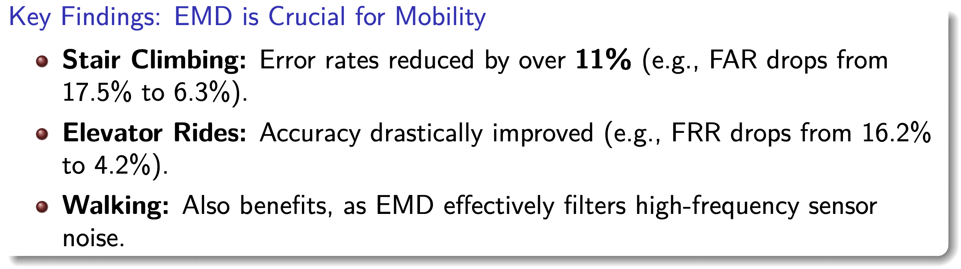
Evaluation
Impact of Mobile Scenarios
Luo Zhou et al.
Donghua University
2025.07.21
28/35
Notes:
Next, we evaluated the system's robustness in mobile scenarios. As the graph clearly shows, without drift elimination, the error rates during activities like stair climbing are very high. However, with our EMD-based processing enabled, the performance is drastically improved. For instance, when climbing stairs, the error rate is reduced by over eleven percent. This confirms that our EMD-based approach is crucial for making BaroAuth a practical and reliable system in real-world mobile environments.

Slide 29
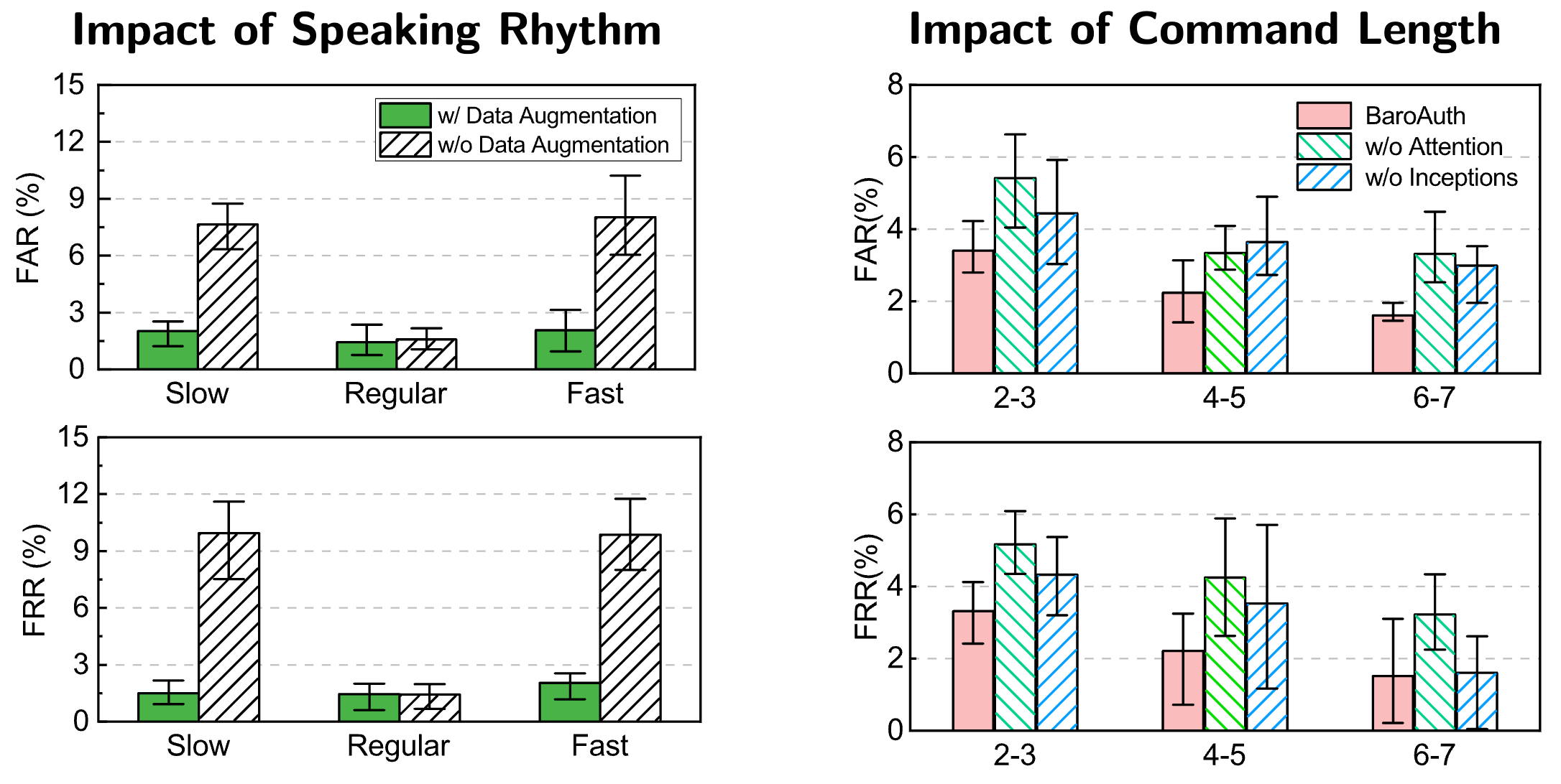
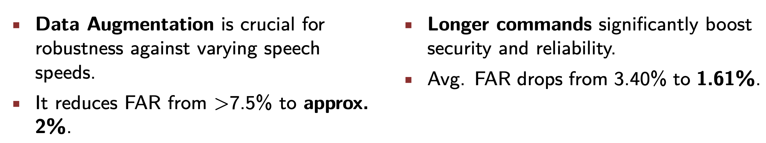
Evaluation
Impact of Speaking Rhythm & Command Length
Luo Zhou et al.
Donghua University
2025.07.21
29/35
Notes:
We also analyzed the impact of speaking style.
On the left, you can see that without our rhythm-based data augmentation, the system is brittle, with error rates spiking for fast or slow speech. With augmentation, however, the performance becomes stable and robust across all speeds.
On the right, we see a clear trend: longer commands boost security. As the command length increases, the error rates for both false accepts and false rejects drop significantly, providing an easy way to tune the system for higher-security applications.

Slide 30
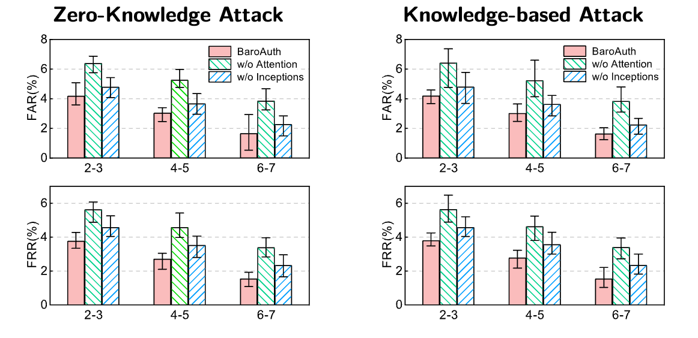
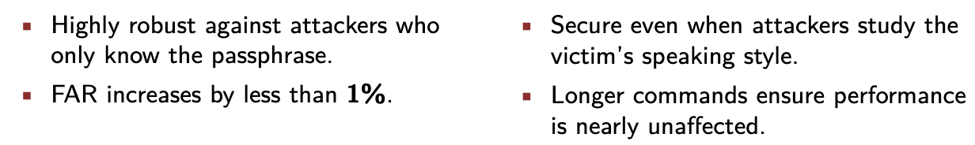
Evaluation
Attack Resistance Evaluation
Luo Zhou et al.
Donghua University
2025.07.21
30/35
Notes:
Of course, a key measure of any authentication system is its resistance to attacks.
On the left, we tested a Zero-Knowledge Attack, where an attacker mimics the passphrase. The results are excellent—the FAR increases by less than one percent, showing that voice alone is not enough to fool the system.
On the right, we evaluated a tougher Knowledge-based Attack, where the attacker studies how the victim speaks. Even in this more sophisticated scenario, BaroAuth remains secure, especially with longer passphrases.

Slide 31
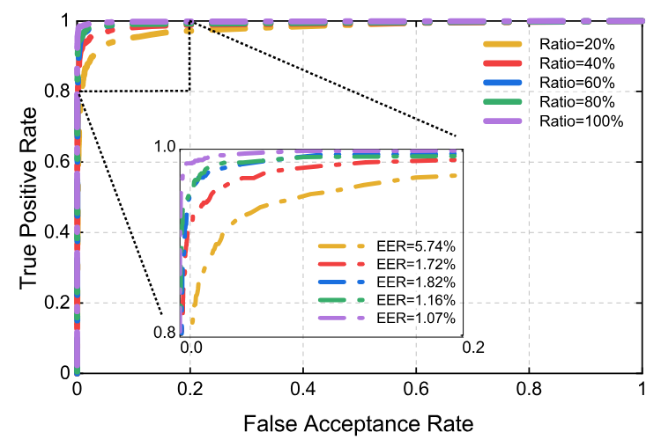
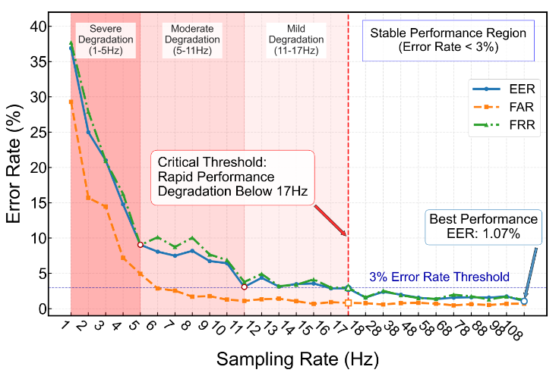
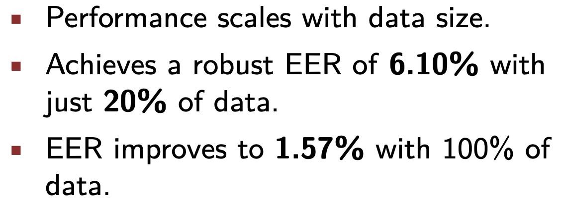
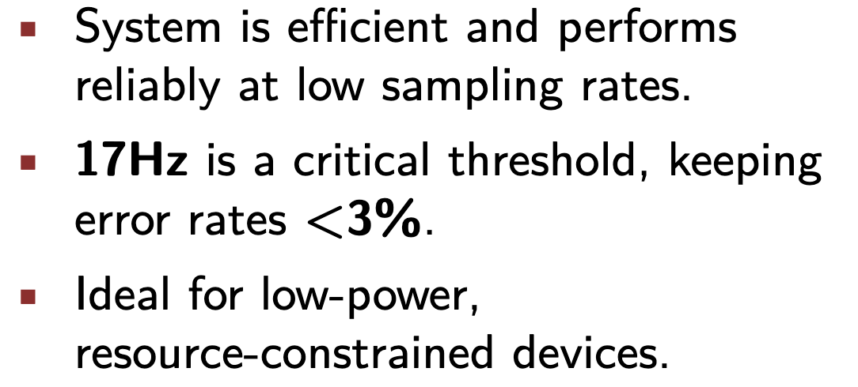
Evaluation
Ablation Study
Luo Zhou et al.
Donghua University
2025.07.21
31/35
Notes:
To better understand what drives this performance, we conducted an ablation study.
The results on the left show that performance scales predictably with data size. Even with just 20% of the data, the system achieves a respectable EER, which improves steadily as more data becomes available.
On the right, we analyzed the impact of sampling rate. We found that we can reduce the sampling rate all the way down to 17 Hertz while keeping error rates below three percent. This is a critical finding, as it proves that BaroAuth is extremely efficient and perfectly suited for low-power, resource-constrained devices.

Slide 32
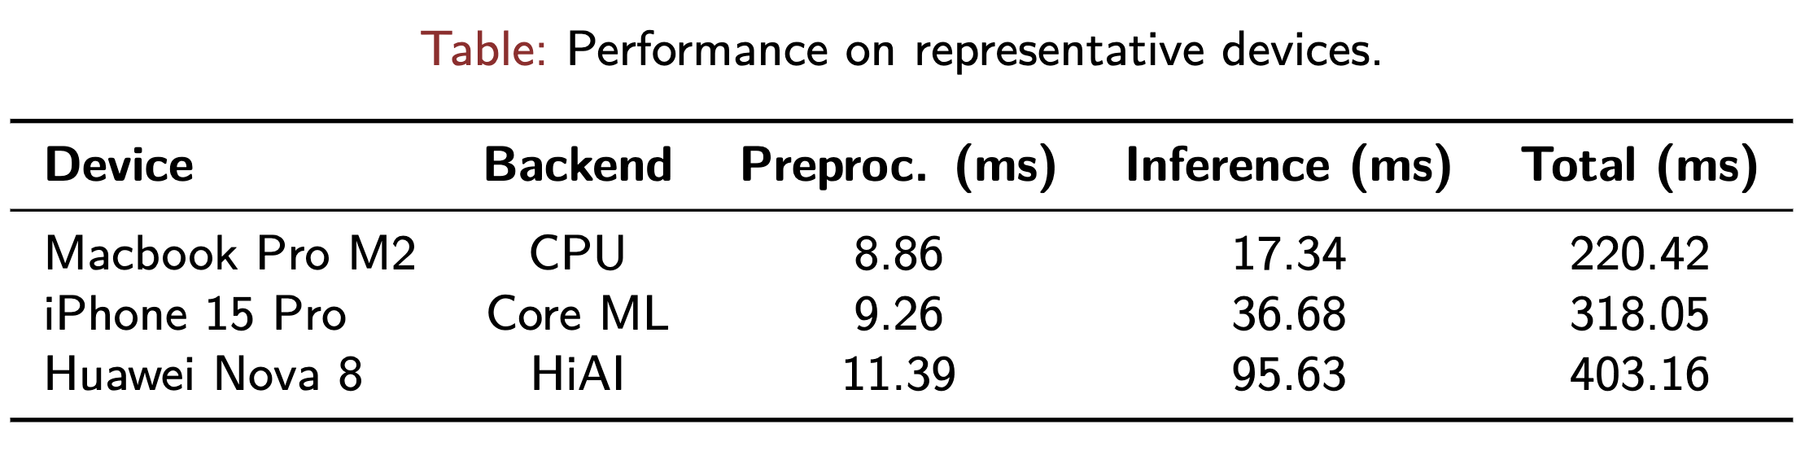
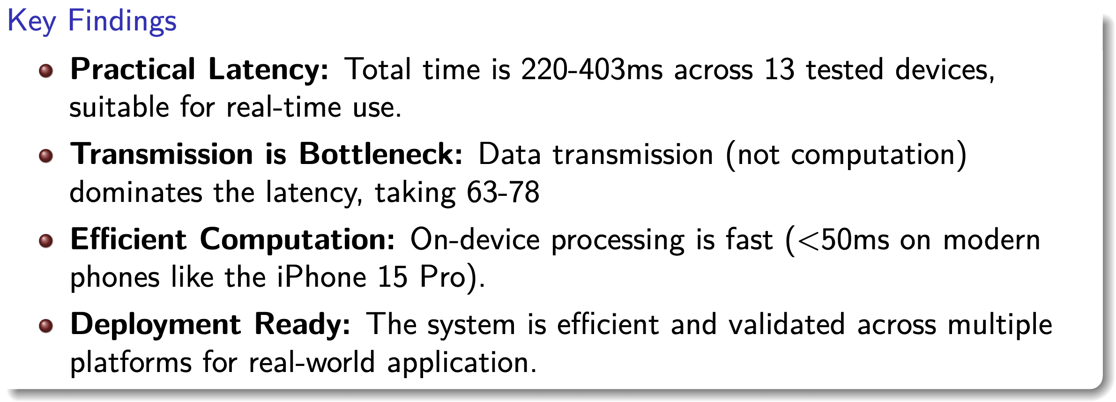
Evaluation
Computational Overhead
Luo Zhou et al.
Donghua University
2025.07.21
32/35
Notes:
Finally, we evaluated the computational overhead on a wide range of real-world devices.
As the summary table shows, the total authentication latency is well within a practical range, typically between 200 and 400 milliseconds.
Our key finding here is that the primary bottleneck is not computation, but data transmission. The actual on-device processing on modern phones is incredibly fast—often less than 50 milliseconds.

Slide 33
Conclusion
7
Luo Zhou et al.
Donghua University
2025.07.21
33/35
Notes:
So, generally...

Slide 34
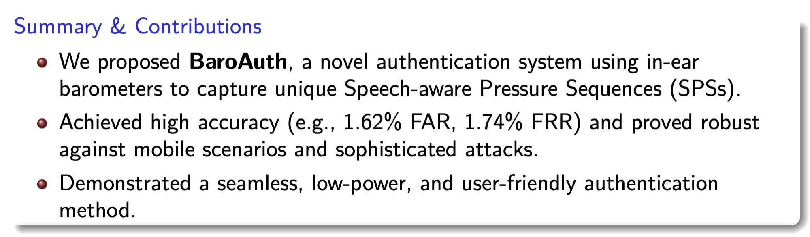
Conclusion
Conclusion
Luo Zhou et al.
Donghua University
2025.07.21
34/35
Notes:
We propose BaroAuth, a novel biometric authentication system that utilizes SPSs captured by MEMS barometers in earbuds to extract dynamic and static physiological features, enabling efficient, robust, and accurate user authentication. By leveraging unique in-ear pressure signals, BaroAuth adapts to diverse mobile scenarios, with stands environmental noise, and resists both zero-knowledge and knowledge-based attacks. Extensive experiments demonstrate its effectiveness and robustness.

Slide 35

The End
Luo Zhou et al.
Donghua University
2025.07.21
35/35

Slide 36
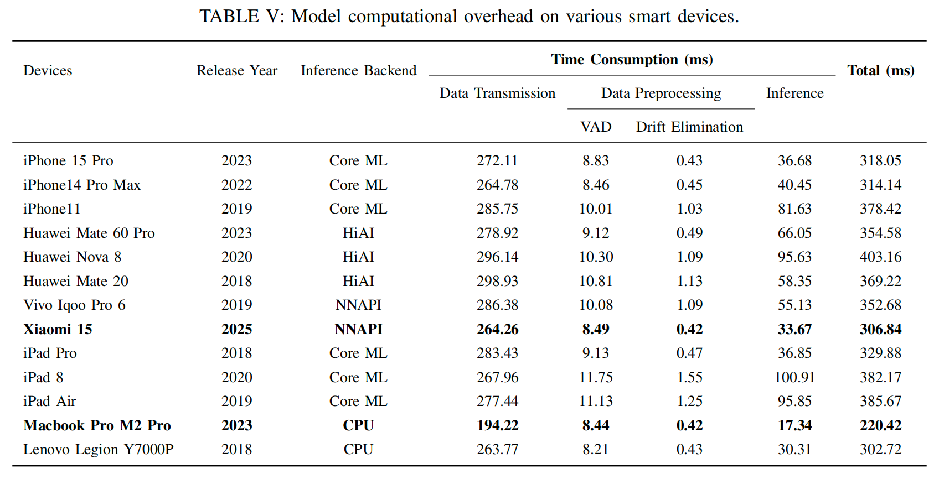

Slide 37
