Slide 1
Vanilla Mask RCNN
1. inference (end-to-end)
feature extraction
rpn
rcnn
mask
image
mask prediction
roi
feature
2. inference (two stages)
rewrite the code and run as two stages. Feature extraction is run twice
feature extraction
rpn
rcnn
image
roi (store to disk)
feature extraction
mask
roi (load from disk)
image
mask prediction
feature

Slide 2
Ensemble Mask RCNN
feature extraction
rpn
rcnn
image1
roi1 (store to disk)
roi2
augment2
roi3
augment3
...
....
feature extraction
*can do MNS here to reduce roi
mask
roi1,roi2, roi3 ... (load from disk)
image
mask prediction
feature
feature extraction
mask
roi1,roi2, roi3 ... (load from disk)
augment2
mask prediction
feature
feature extraction
mask
roi1,roi2, roi3 ... (load from disk)
augment3
mask prediction
feature

Slide 3
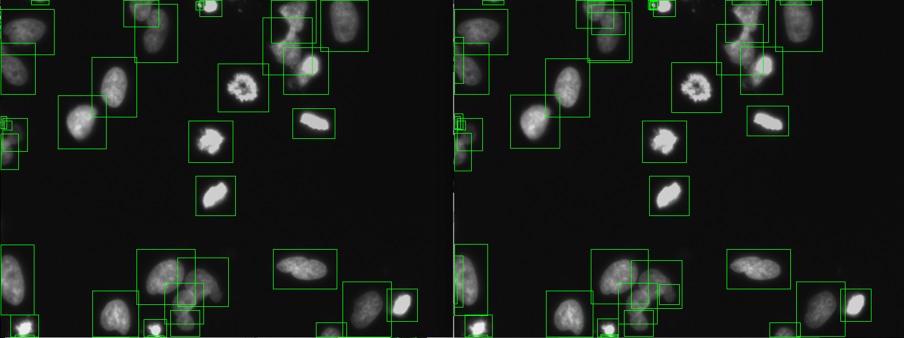
roi1
roi1,roi2, roi3 ...

Slide 4
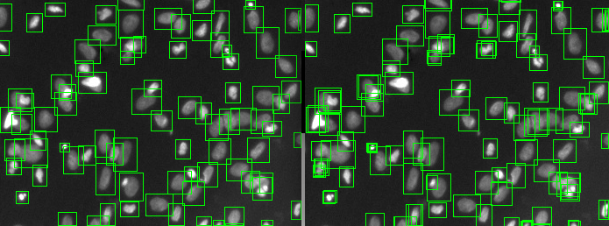

Slide 5
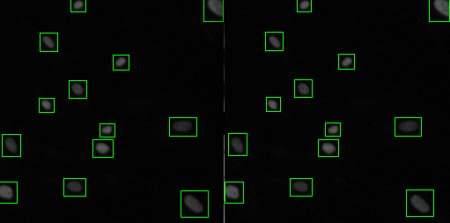
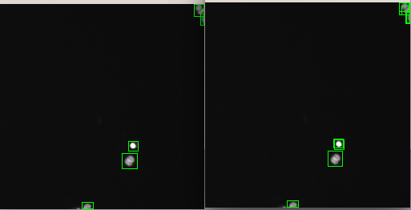

Slide 6
