Slide 1
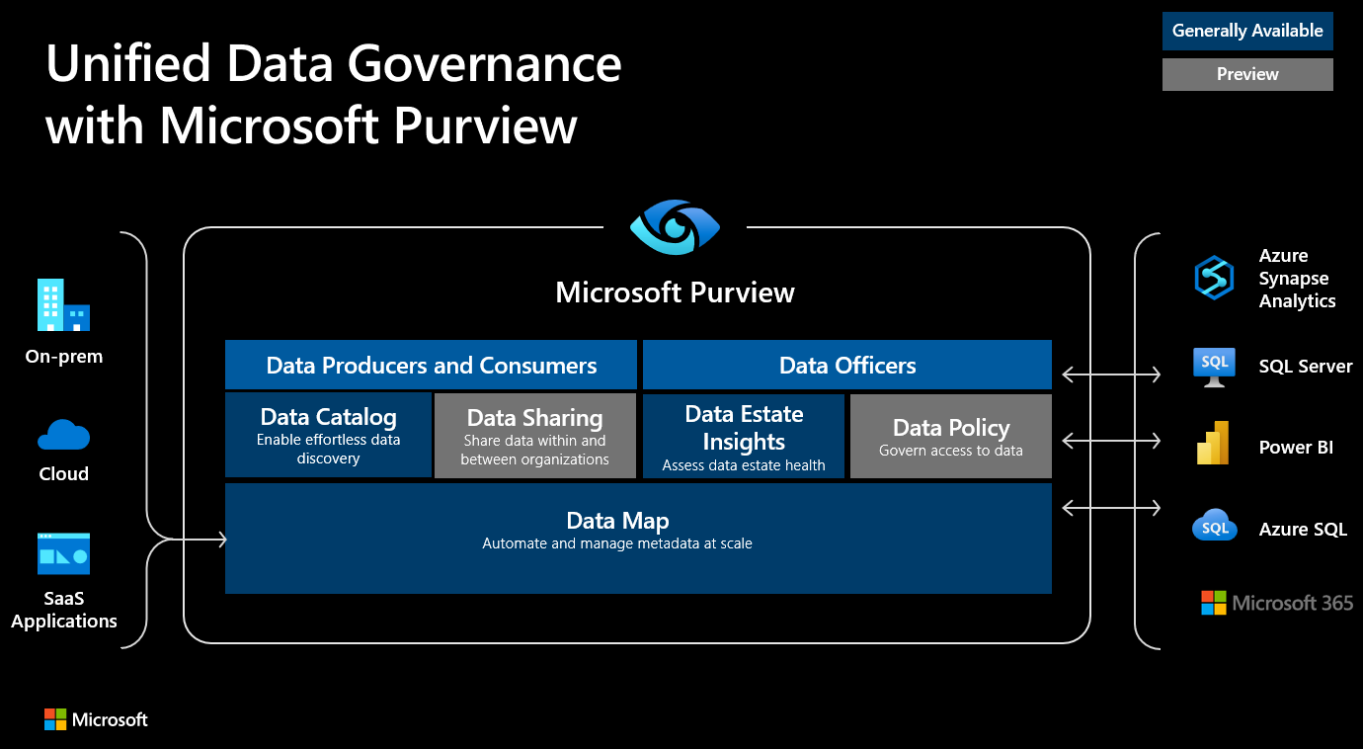


Empowering data consumers leveraging Microsoft Purview as a data marketplace
Prashant Atri
Jorge Gonzalez
Cloud Solution Architect
Cloud Solution Architect

Slide 2
Agenda
Data Access challenges
Self-service data access – Demo
Data Consumption Journey
Empowering data consumers leveraging Microsoft Purview as a Data Marketplace

Slide 3
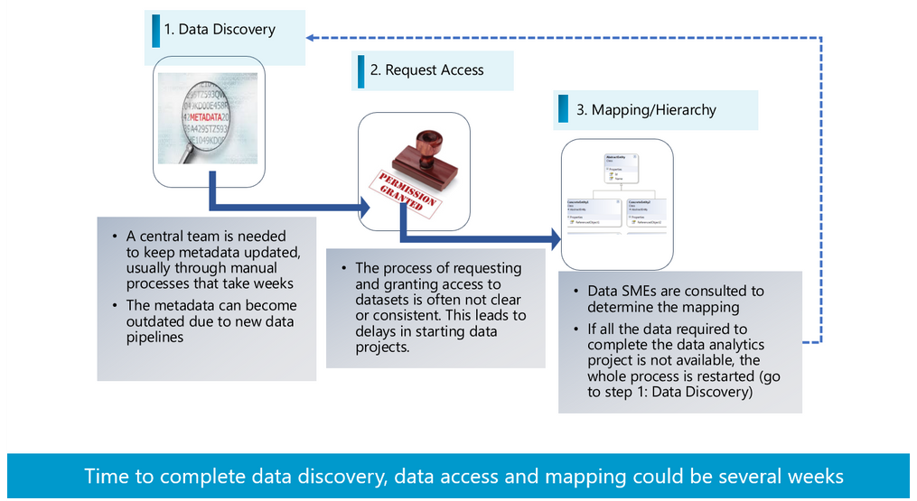
User Journey When Data Projects Are Initiated

Slide 4
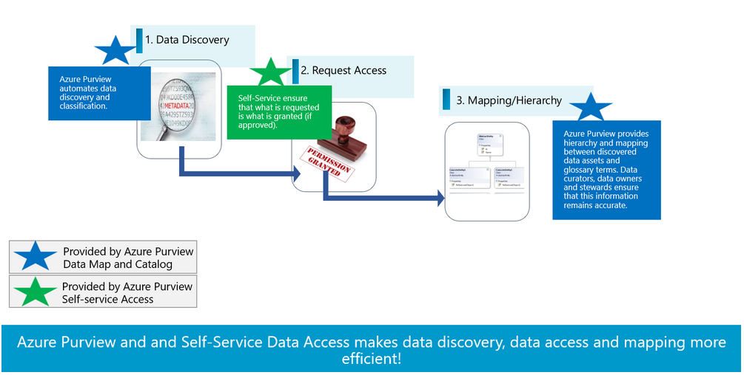
Revised User Journey

Slide 5
Agenda
Data Access challenges
Self-service data access – Demo
Data Consumption Journey
Empowering data consumers leveraging Microsoft Purview as a Data Marketplace

Slide 6
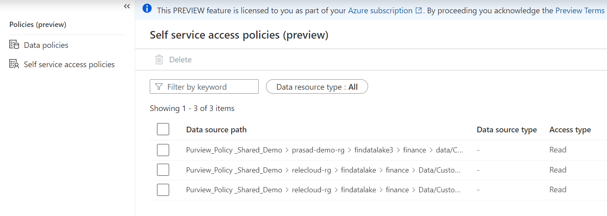
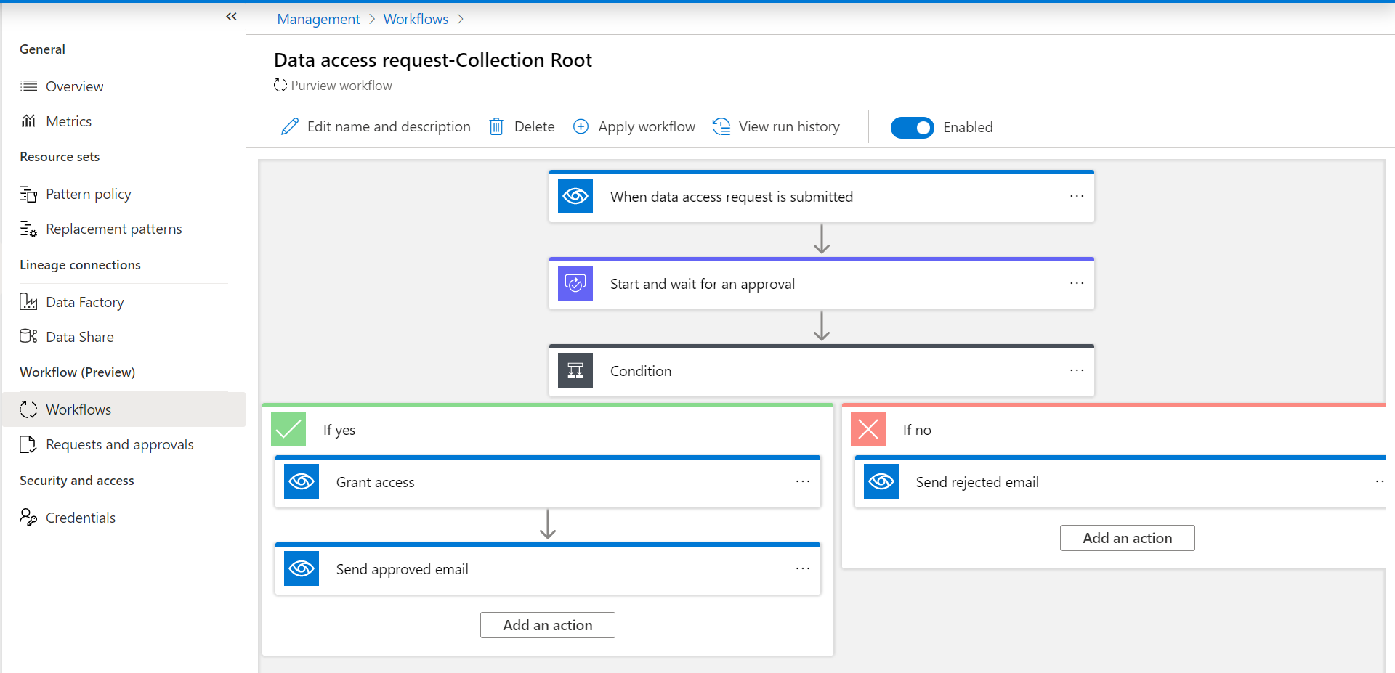
Self-service data access Automated enforcement for Microsoft Data stores
In Preview

Slide 7
Microsoft Purview - How to setup Self-service data access workflow
Pre-requisites and Steps
Check supported data sources for data access policy
Data sources (For example - Azure Data Lake Storage Gen2, Azure SQL Database) registered in purview data map and setup scanning
Setup appropriate permissions and enable Data Use Management (DUM)
Setup self-service data access workflow
Apply workflow at collection level
Enable consumers do the self-service data discovery and request access to the datasets

Slide 8
Agenda
Data Access challenges
Self-service data access policy – Demo
Data Consumption Journey
Empowering data consumers leveraging Microsoft Purview as a Data Marketplace

Slide 9
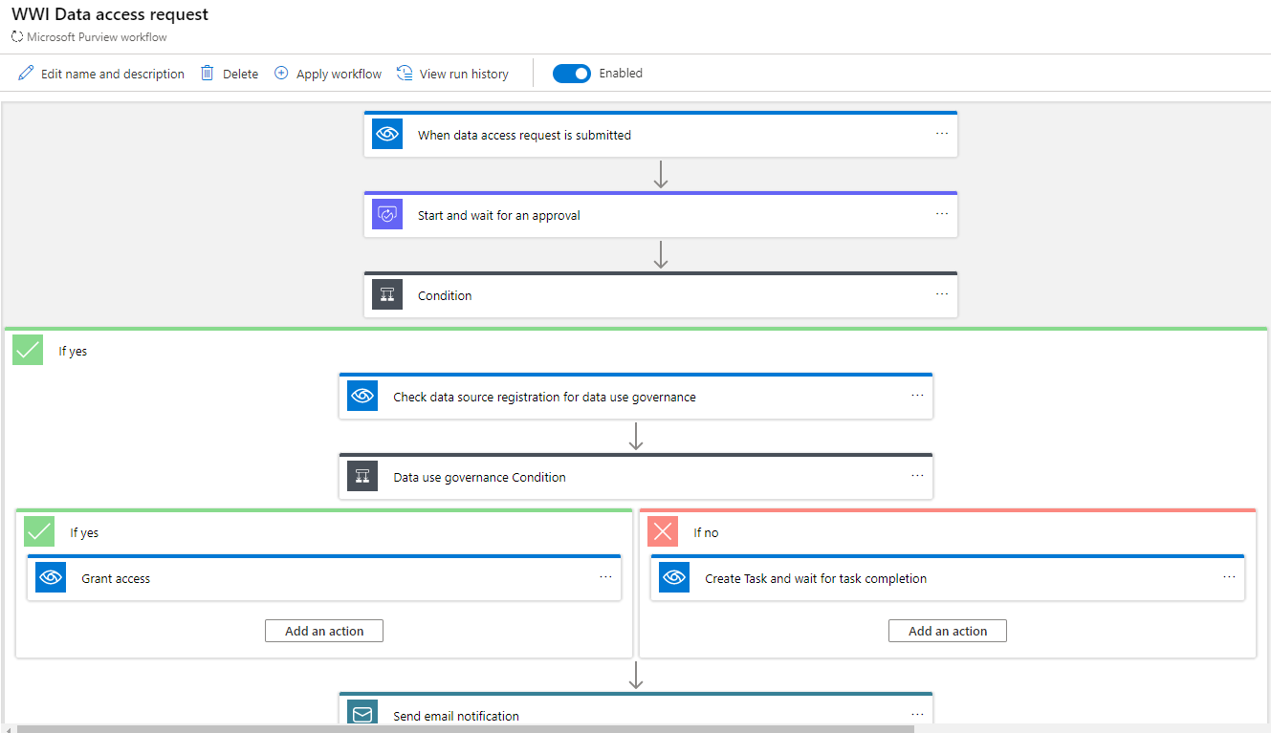
Data Consumption Automated data set access provisioning
Self-service data access
Users can do self-service search & discovery of data assets
Users can request access to data set and get approved from within the catalog
Users can use Microsoft purview catalog or Azure Synapse Analytics workspace for discovering and requesting data set access

Slide 10


Jorge
Browses catalog
Data Consumer
Discover Data
Request Access
Gets Notified
Analyze data using his own tools
Prashant
Gets notified
Data Owner
Approves request
Self service data policy – Grant access

Slide 11
Data Consumption
Pre-requisites and Steps
Data Readers role at purview collection level
Demo Example…
Consumption for ADLS file, folder using PowerBI and Synapse

Slide 12
References
Microsoft Purview Data Map supported data sources and file types - Microsoft Purview | Microsoft Docs
https://docs.microsoft.com/en-us/azure/purview/concept-self-service-data-access-policy
Connect Synapse workspace to Microsoft Purview - Azure Synapse Analytics | Microsoft Docs

Slide 13

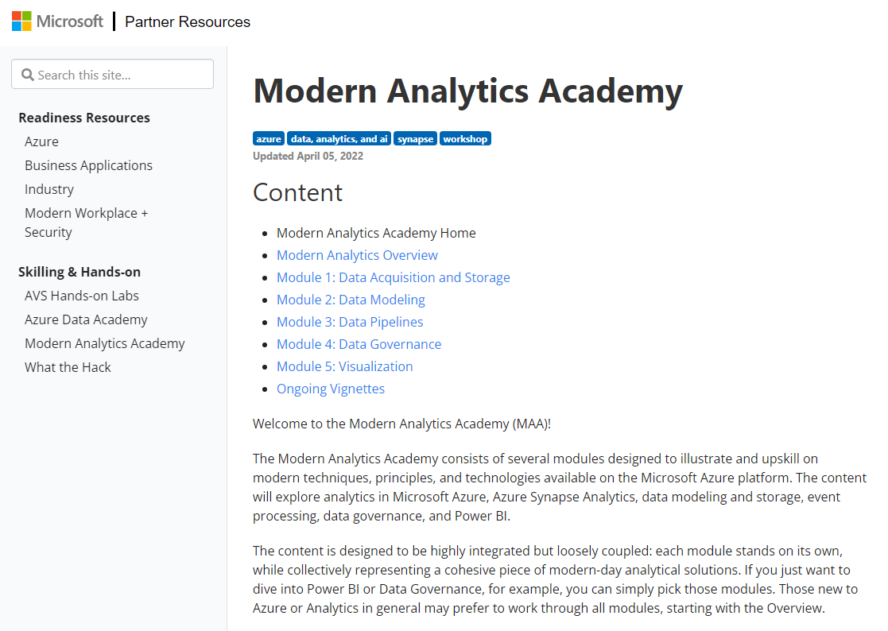
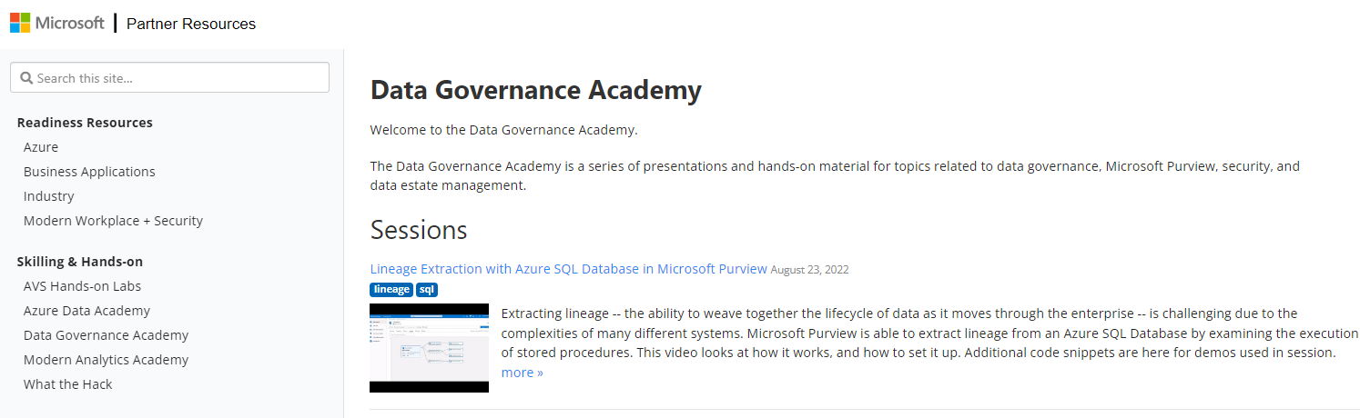
Want to learn more?
https://aka.ms/dga
Sessions on governance
https://aka.ms/maa
Sessions on analytics
https://aka.ms/EnablePurview
Event calendar
https://aka.ms/maa-feedback
Suggestions for topics, workshops

