Slide 1
DATA ANAYSIS ESSENTIALS
WEEK-6
GETTING STARTED WITH PANDAS
P.Srilatha
Assistant Professor
Department of IT&DS
Aditya University

Slide 2
Introduction to Pandas
pandas contains data structures and data manipulation tools designed to make data cleaning and analysis fast and easy in Python.
Pandas used in numerical computing tools like NumPy and SciPy, analytical libraries like statsmodels and scikit-learn, and data visualization libraries like matplotlib.
pandas is designed for working with tabular or heterogeneous data.
Numpy is best suited for working with homogeneous numerical array data.

Slide 3
Features
Handling of data
Alignment and indexing
Handling missing data
Cleaning up data
Multiple file formats supported
A lot of time series
Optimized performance
Python support
Visualize
Grouping
Mask data
Unique data
Perform mathematical operations on the data

Slide 4
Applications
Economics
Recommendation Systems
Stock Prediction
Neuroscience
Statistics
Advertising
Analytics
Natural Language Processing
Big Data
Data Science

Slide 5
Dataset
A dataset is a structured collection of related data organized in rows and columns for storage, analysis, and processing. Each row represents an individual record (or observation), and each column represents a specific attribute (or feature) of that record.
In Pandas, a dataset is typically stored in a DataFrame, making it easy to manipulate, analyze, and visualize the data.
Ex:
Rows (Records): Each row contains information about one student.
Columns (Attributes): RollNo, Name, Department, and Marks describe each student.
RollNo | Name | Department | Marks
101 | Alice | CSE | 85
102 | Bob | AIML | 90
103 | Charlie | ECE | 78

Slide 6
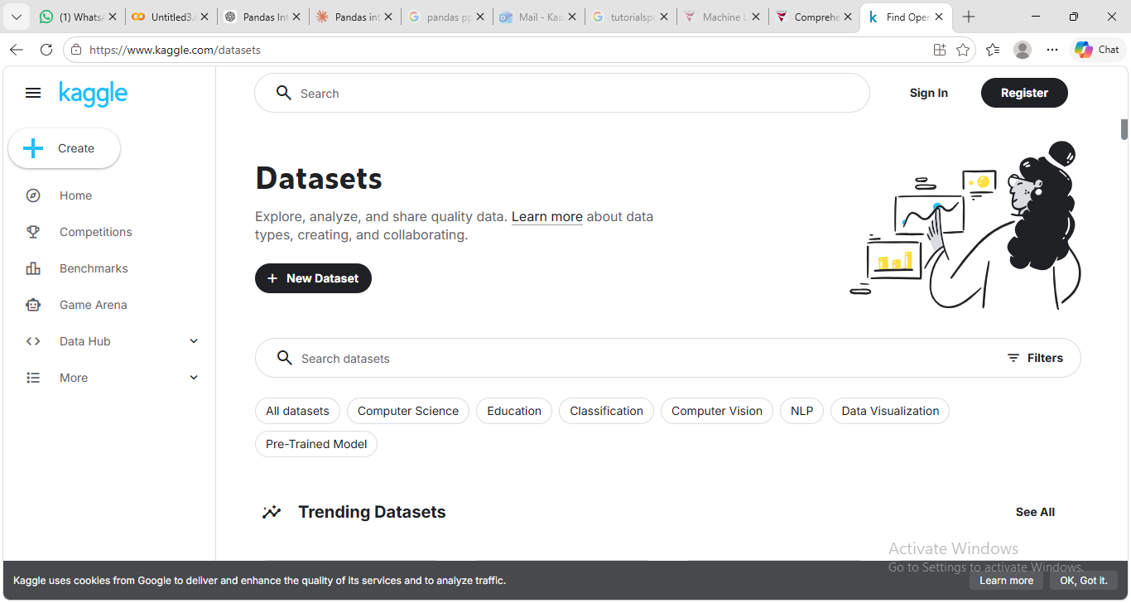
Kaggle Dataset

Slide 7
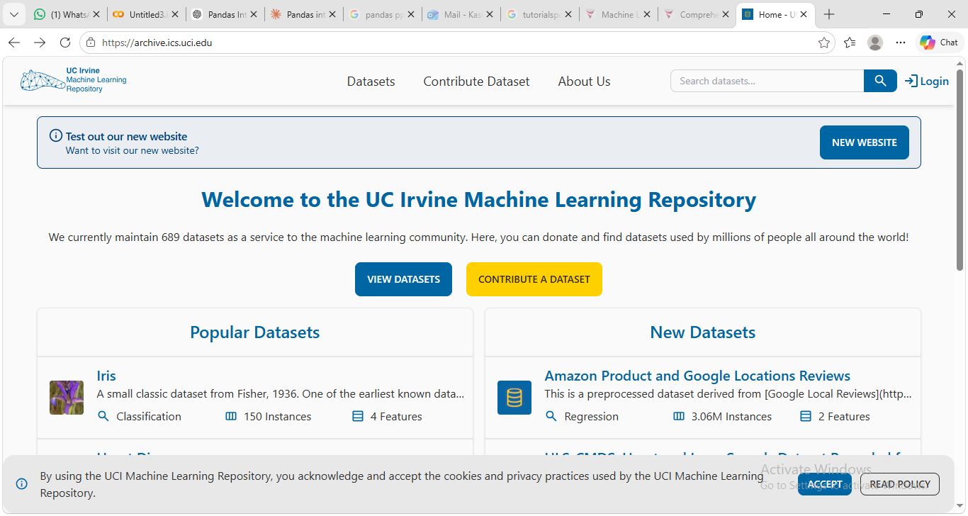
UCI Machine Learning Repository

Slide 8
Series
Series
A Series is a one-dimensional array-like object containing a sequence of values of the same type and an associated array of data labels, called its index. The simplest Series is formed from only an array of data:
import pandas as pd
obj=pd.Series([4, 7, -5, 3])
print(obj)
0 4
1 7
2 -5
3 3
dtype: int64

Slide 9

Mount your Google drive

Slide 10
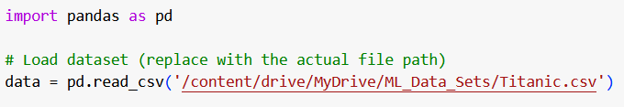
Read you file using full absolute path

Slide 11
Display first five and last five records
data.head()
data.tail()
Detect missing values
Print(data.isnull().sum())

Slide 12
Data Frame
Data Frame
A Data Frame represents a rectangular table of data and contains an ordered collection of columns, each of which can be different type(string,numeric,boolean)
The DataFrame has both a row and column index; it can be thought of as a dict of Series all sharing the same index.
There are many ways to construct a DataFrame, though one of the most common is
from a dict of equal-length lists or NumPy arrays:
import pandas as pd
data = {'state': ['Ohio', 'Ohio', 'Ohio', 'Nevada', 'Nevada', 'Nevada'],
'year': [2000, 2001, 2002, 2001, 2002, 2003],
'pop': [1.5, 1.7, 3.6, 2.4, 2.9, 3.2]}
frame = pd.DataFrame(data)
print(frame)
State year pop
0 Ohio 2000 1.5
Ohio 2001 1.7
Ohio 2002 3.6
Nevada 2001 2.4
Nevada 2002 2.9
Nevada 2003 3.2

Slide 13
The head selects first five rows
frame.head()
If you specify a sequence of columns, the DataFrame’s columns will be arranged in that order:
pd.DataFrame(data, columns=['year', 'state', 'pop'])
 | state | year | pop
0 | Ohio | 2000 | 1.5
1 | Ohio | 2001 | 1.7
2 | Ohio | 2002 | 3.6
3 | Nevada | 2001 | 2.4
4 | Nevada | 2002 | 2.9
 | year | state | pop
0 | 2000 | Ohio | 1.5
1 | 2001 | Ohio | 1.7
2 | 2002 | Ohio | 3.6
3 | 2001 | Nevada | 2.4
4 | 2002 | Nevada | 2.9
5 | 2003 | Nevada | 3.2

Slide 14
If you pass a column that isn’t contained in the dict, it will appear with missing values in the result
Frame2=pd.DataFrame(data, columns=['year', 'state', 'pop', 'debt'], index=['one', 'two', 'three', 'four', 'five', 'six'])
Print(Frame2)
frame2.columns
Index(['year', 'state', 'pop', 'debt'], dtype='object')
A column in a DataFrame can be retrieved as a Series either by dict-like notation or
by attribute
 | year | state | pop | debt
one | 2000 | Ohio | 1.5 | NaN
two | 2001 | Ohio | 1.7 | NaN
three | 2002 | Ohio | 3.6 | NaN
four | 2001 | Nevada | 2.4 | NaN
five | 2002 | Nevada | 2.9 | NaN
six | 2003 | Nevada | 3.2 | NaN

Slide 15
frame2['state']
frame2.year
 | state
one | Ohio
two | Ohio
three | Ohio
four | Nevada
five | Nevada
six | Nevada
dtype: object
 | year
one | 2000
two | 2001
three | 2002
four | 2001
five | 2002
six | 2003
dtype: int64

Slide 16
Rows can also be retrieved by position or name with the special loc attribute.
frame2.loc['three']
Columns can be modified by assignment. For example, the empty 'debt' column
could be assigned a scalar value or an array of values
frame2['debt'] = 16.5
print(frame2)
year state pop debt
one 2000 Ohio 1.5 16.5
two 2001 Ohio 1.7 16.5
three 2002 Ohio 3.6 16.5
four 2001 Nevada 2.4 16.5
five 2002 Nevada 2.9 16.5
six 2003 Nevada 3.2 16.5
 | three
year | 2002
state | Ohio
pop | 3.6
debt | NaN
dtype:object

Slide 17
frame2['debt'] = np.arange(6.)
print(frame2)
year state pop debt
one 2000 Ohio 1.5 0.0
two 2001 Ohio 1.7 1.0
three 2002 Ohio 3.6 2.0
four 2001 Nevada 2.4 3.0
five 2002 Nevada 2.9 4.0
six 2003 Nevada 3.2 5.0

Slide 18
Creating DataFrame
import pandas as pd
student_data = {
'RollNo': [101, 102, 103, 104],
'Name': ['Alice', 'Bob', 'Charlie', 'David'],
'Marks': [85, 72, 91, 67]
}
df = pd.DataFrame(student_data)
print("Original DataFrame")
print(df)
Original DataFrame
RollNo Name Marks
0 101 Alice 85
1 102 Bob 72
2 103 Charlie 91
3 104 David 67

Slide 19
Concatenating DataFrame
new_students = {
'RollNo': [105, 106],
'Name': ['Eva', 'Frank'],
'Marks': [88, 79] }
df2 = pd.DataFrame(new_students)
combined_df = pd.concat([df, df2], ignore_index=True) print("\nConcatenated DataFrame")
print(combined_df)
Concatenated DataFrame
RollNo Name Marks
0 101 Alice 85
1 102 Bob 72
2 103 Charlie 91
3 104 David 67
4 105 Eva 88
5 106 Frank 79

Slide 20
Setting Conditions
high_marks = combined_df[combined_df['Marks'] >= 80] print("\nStudents Scoring 80 or Above")
print(high_marks)
Students Scoring 80 or Above
RollNo Name Marks
0 101 Alice 85
2 103 Charlie 91
4 105 Eva 88

Slide 21
Adding a New column
combined_df['Result'] = combined_df['Marks'].apply( lambda x: 'Pass' if x >= 40 else 'Fail' ) combined_df['Grade'] = combined_df['Marks'].apply
( lambda x: 'A' if x >= 90
else 'B' if x >= 80
else 'C' if x >= 70
else 'D' )
print("\nDataFrame After Adding New Columns")
print(combined_df)
RollNo Name Marks Result Grade
0 101 Alice 85 Pass B
1 102 Bob 72 Pass C
2 103 Charlie 91 Pass A
3 104 David 67 Pass D
4 105 Eva 88 Pass B
5 106 Frank 79 Pass C

Slide 22
Thank You

