Slide 1
LIFE CYCLE OF DATA SCIENCE
&
APPLICATIONS OF DATA SCIENCE

Slide 2

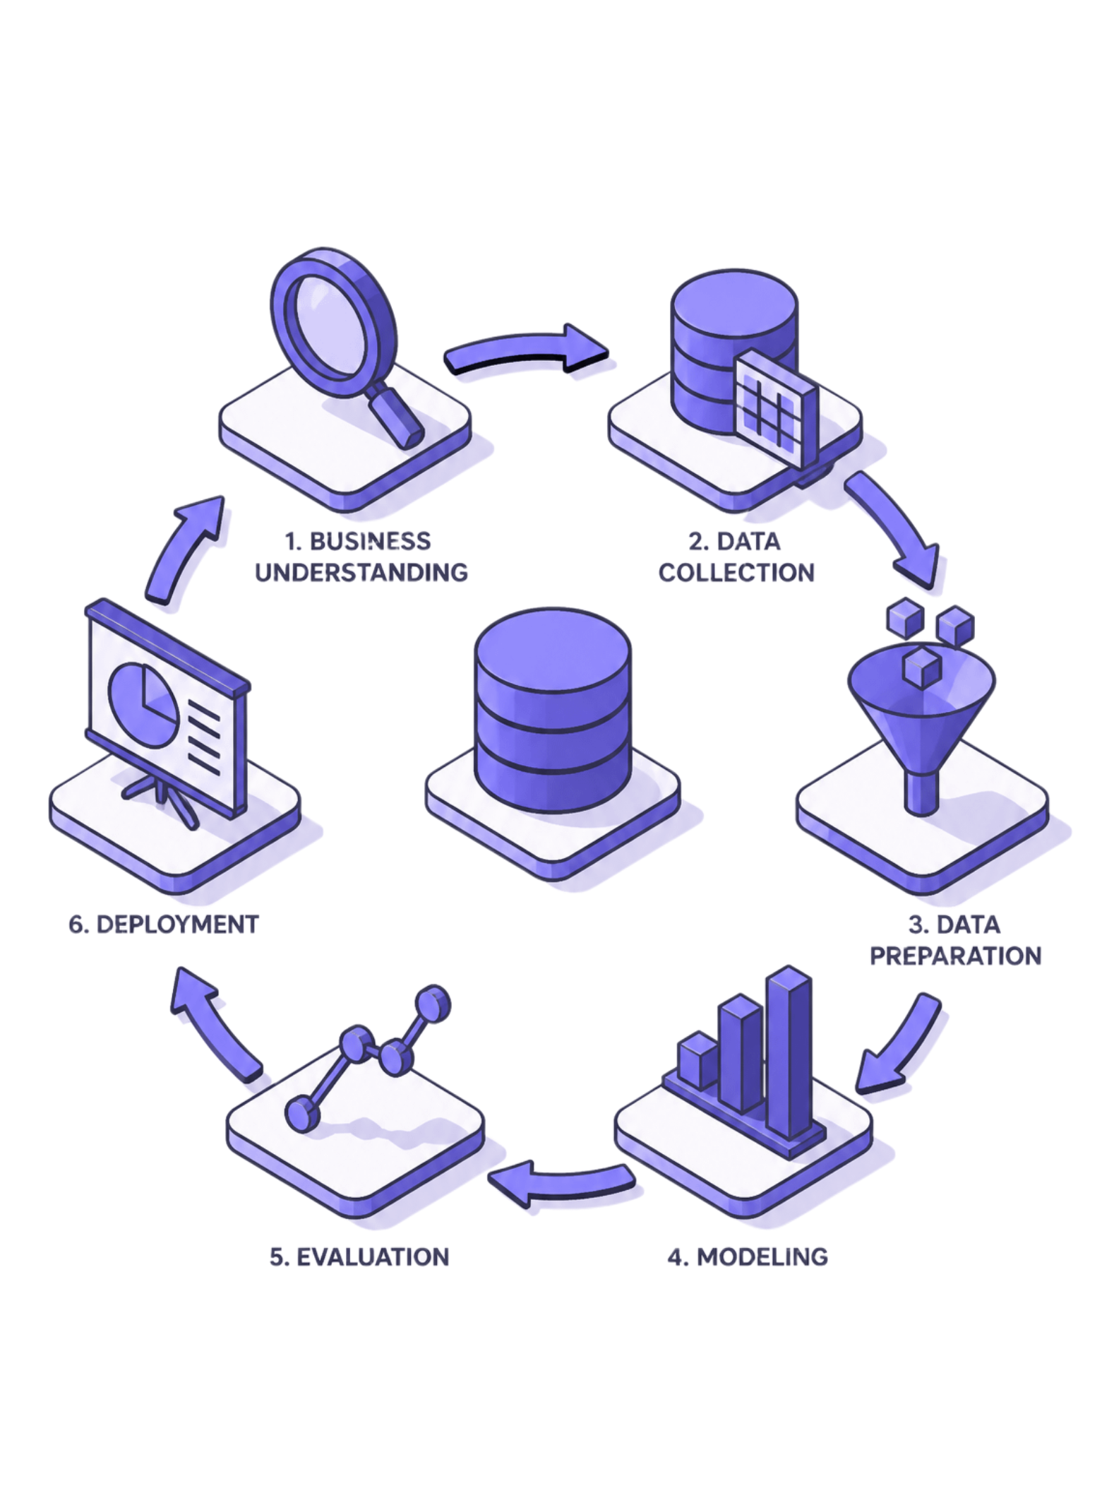



The Data Science Life Cycle
Every data science project follows a structured, iterative path — from understanding the problem to deploying a model that drives real-world decisions.
Phase 1
Problem Definition & Data Collection
Phase 2
Data Preparation & Exploration
Phase 3
Modeling, Evaluation & Deployment

Slide 3
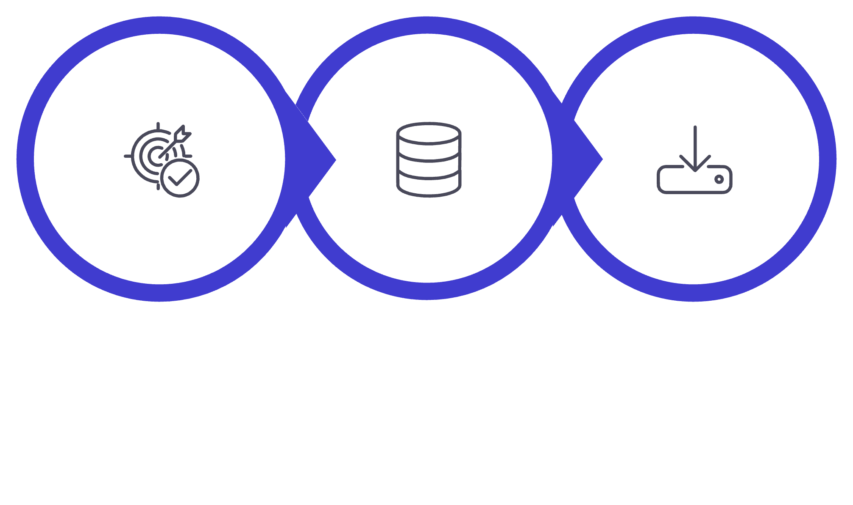

LIFE CYCLE — PHASE 1
Problem Definition & Data Collection
Understand Goal
Identify Sources
Data Collection
Phase 1 sets the foundation for the entire project — a well-defined problem and quality data are essential for everything that follows.

Slide 4
LIFE CYCLE — PHASE 2
Data Preparation & Exploration
1
2
3
Data Cleaning
Exploratory Data Analysis
Feature Engineering
Fix errors, remove duplicates, and fill in missing values.
Create new variables to help make models work better.
Find patterns and trends using charts and graphs.

Slide 5
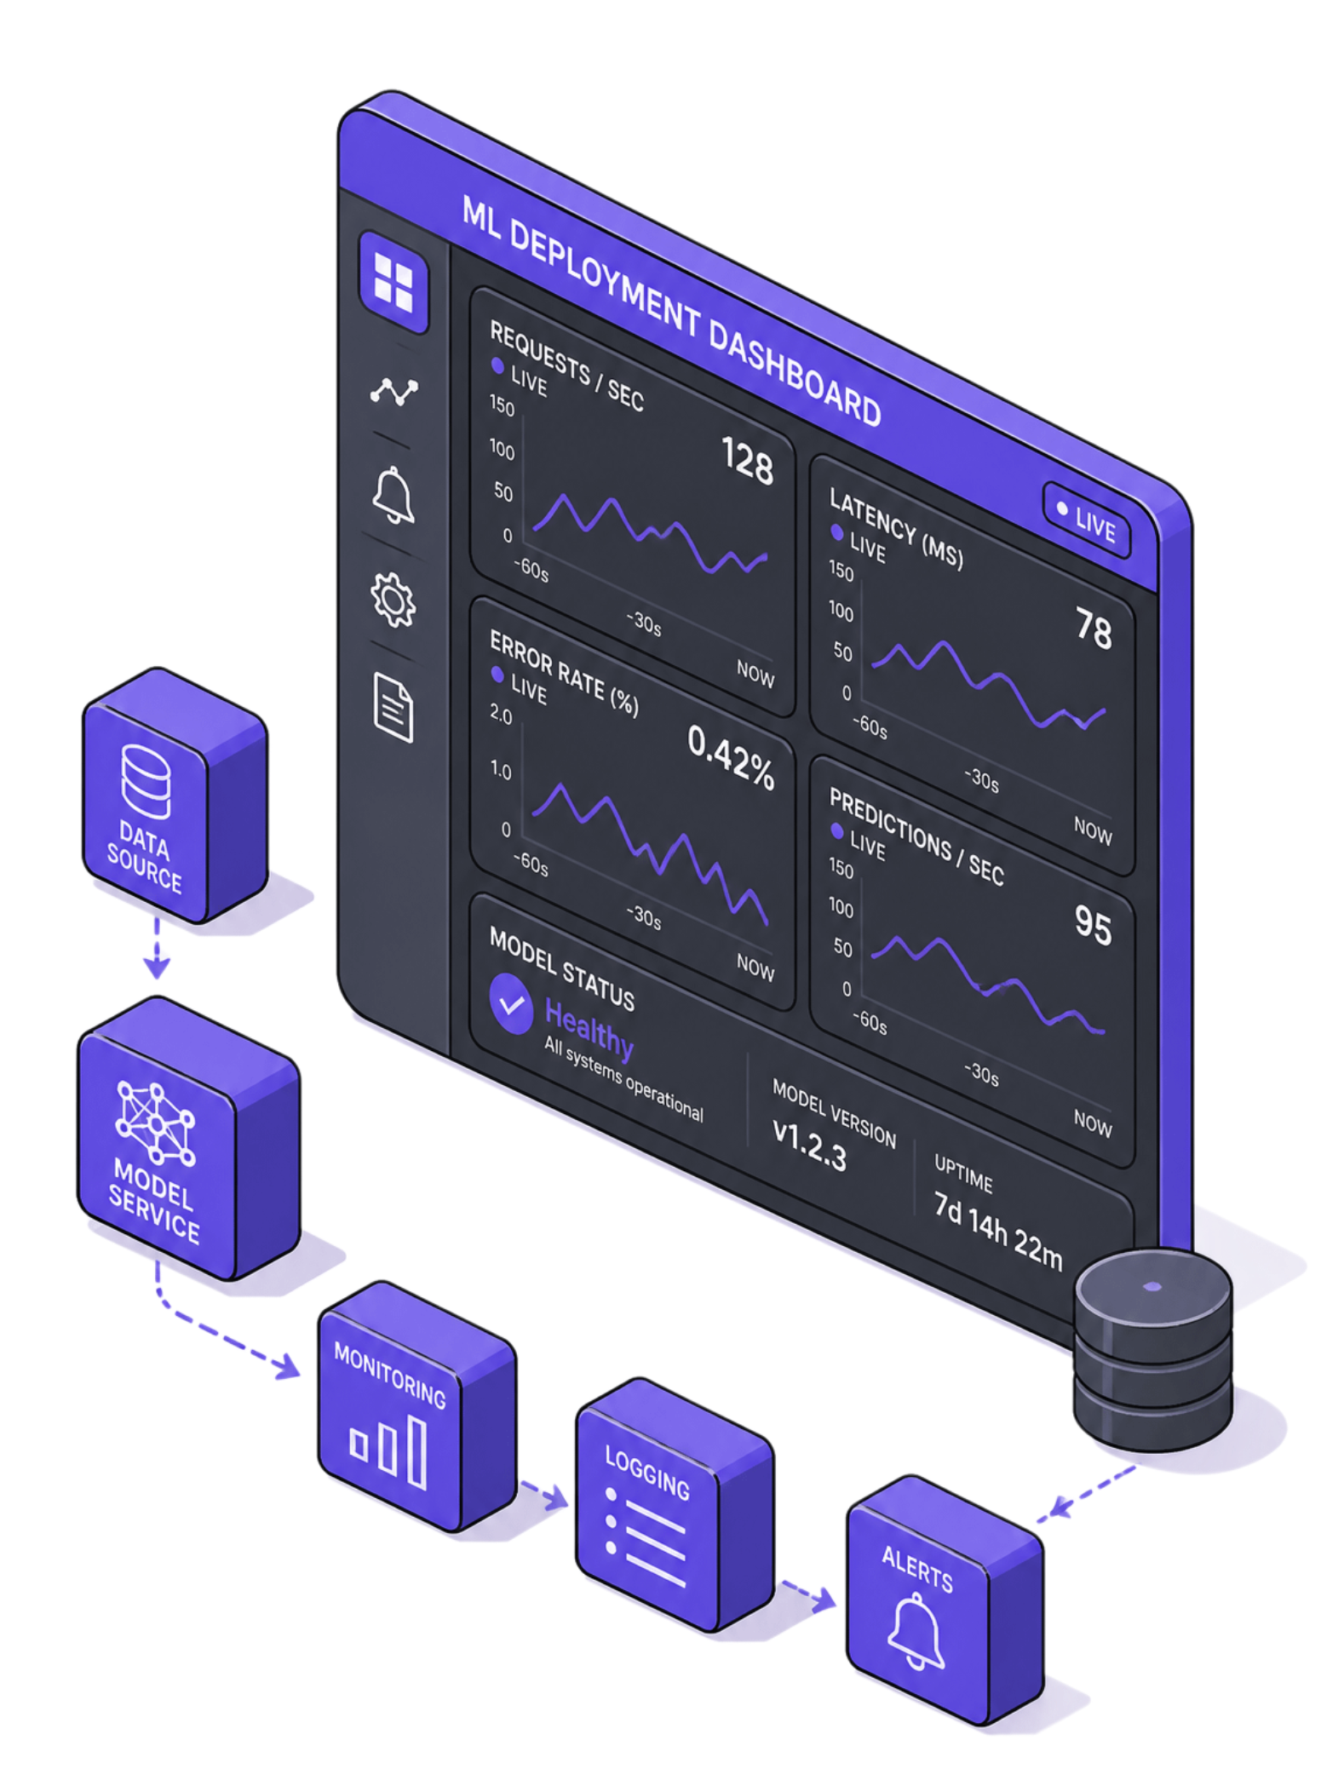
LIFE CYCLE — PHASE 3
Modeling, Evaluation & Deployment
Model Building
Model Evaluation
Train machine learning models using algorithms.
Test how well the model works with new data.
Deployment
Put the model into use for real-world tasks and monitor it.

Slide 6
APPLICATIONS
APPLICATIONS OF DATA SCIENCE
Manufacturing
Transportation
Entertainment
Predicting machine failures for proactive maintenance and optimized production schedules.
Optimizing logistics, routes, and traffic flow for efficiency and reduced environmental impact.
Personalizing content recommendations and analyzing audience engagement for targeted experiences.

Slide 7


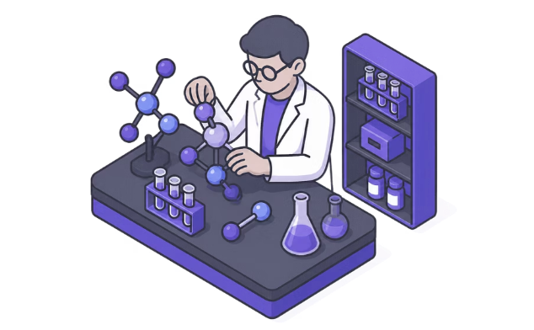
APPLICATIONS
Healthcare & Medicine
Disease Prediction
Medical Imaging
Drug Discovery
Finding health issues early using patient data.
Spotting tumors in X-rays and scans with AI.
Speeding up the creation of new medicines.

Slide 8
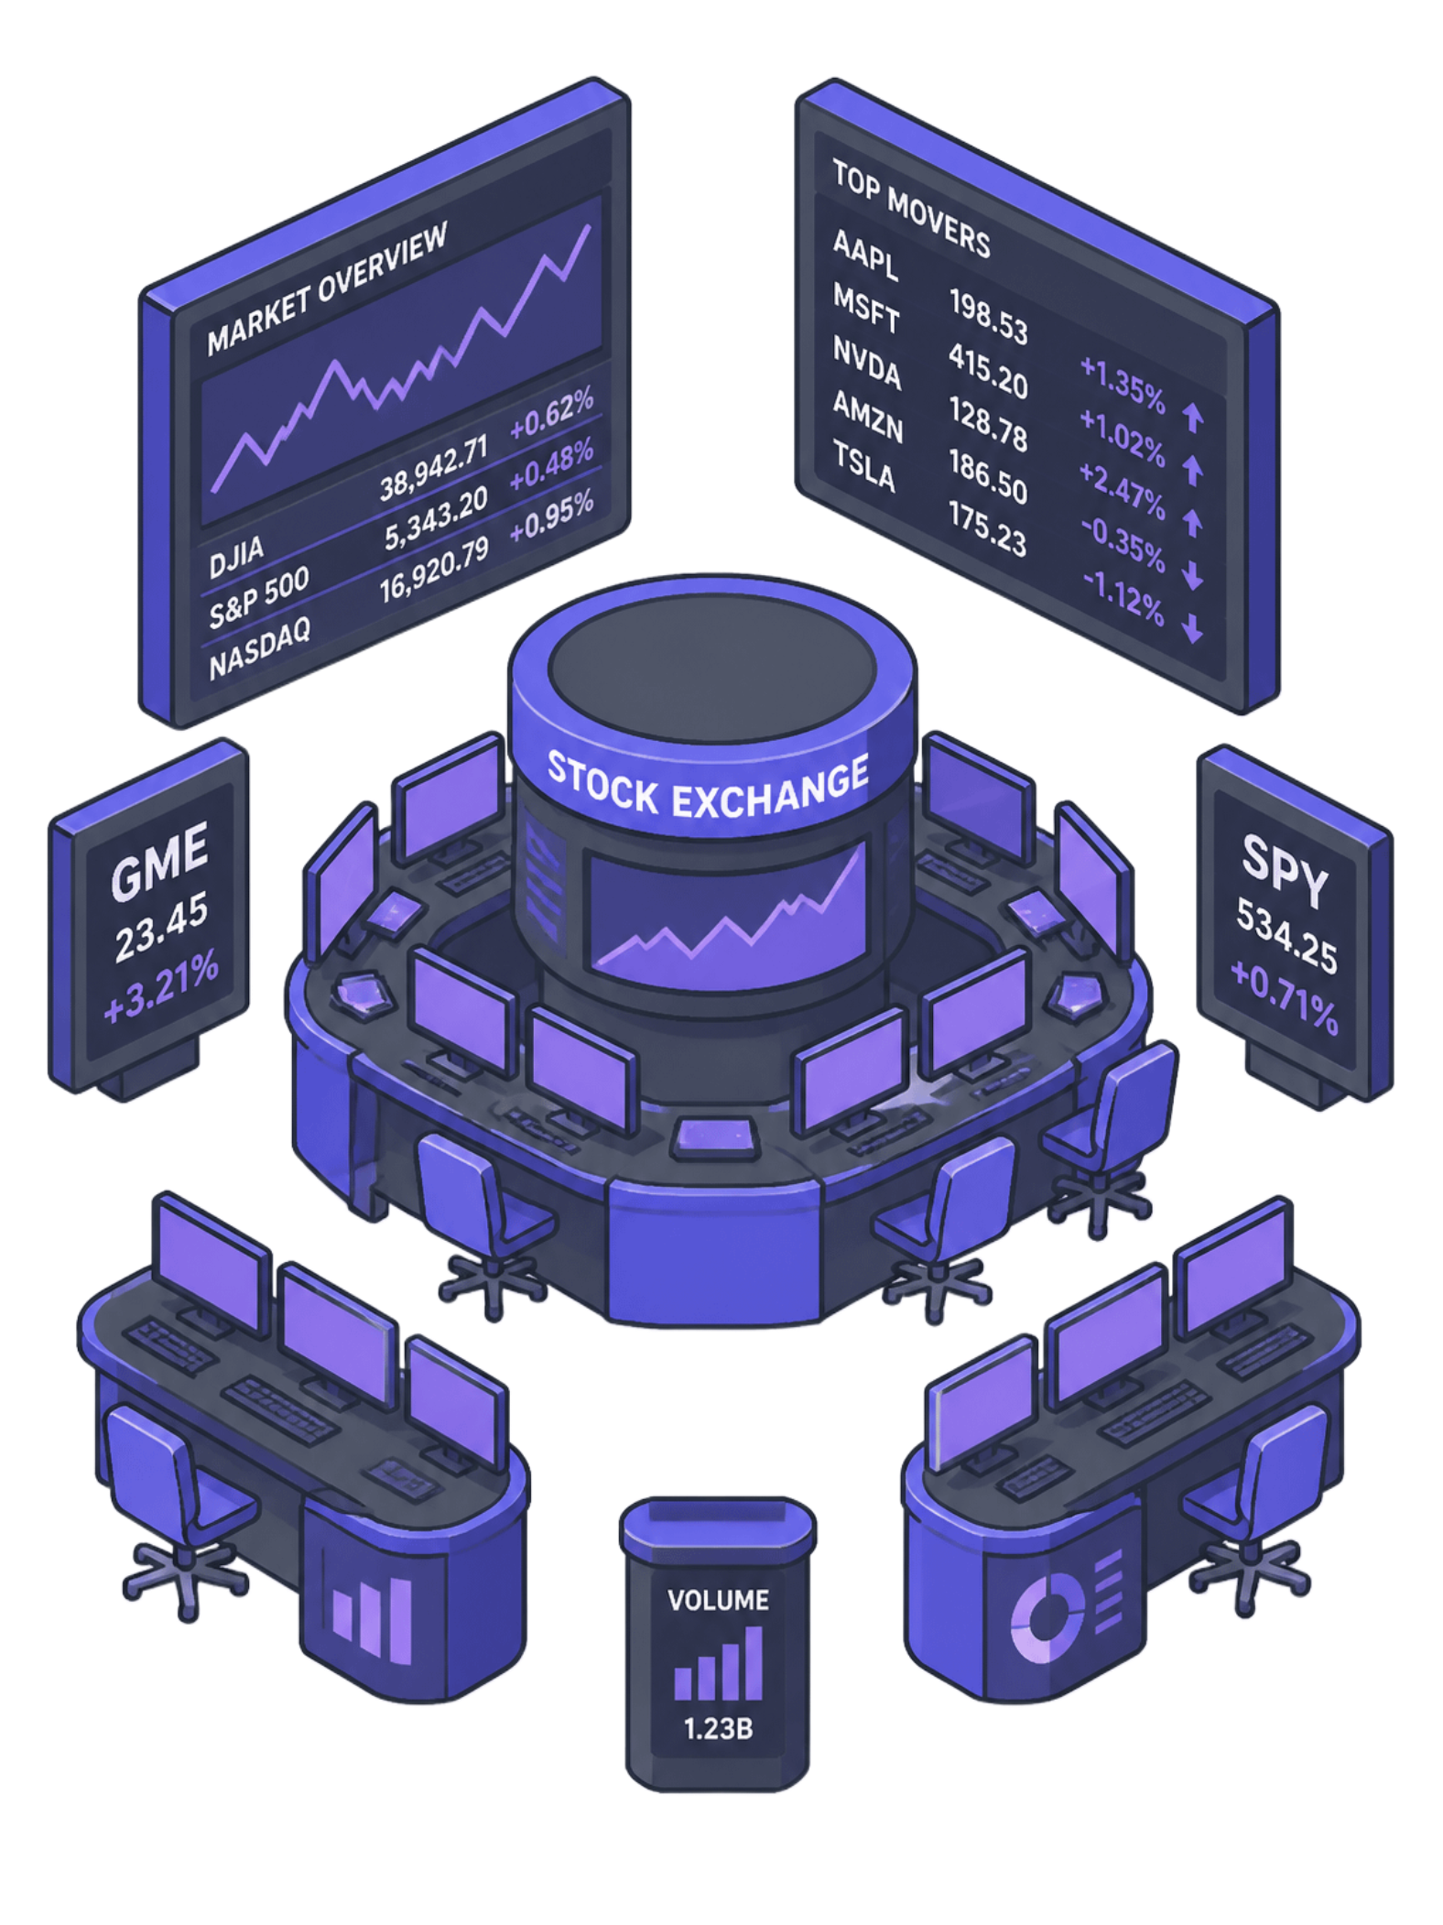
APPLICATIONS
Finance & Banking
Fraud Detection
Catching fake credit card charges right away.
Risk Management
Checking if a person can pay back a loan.
Algorithmic Trading
Making fast trades in the stock market.

Slide 9
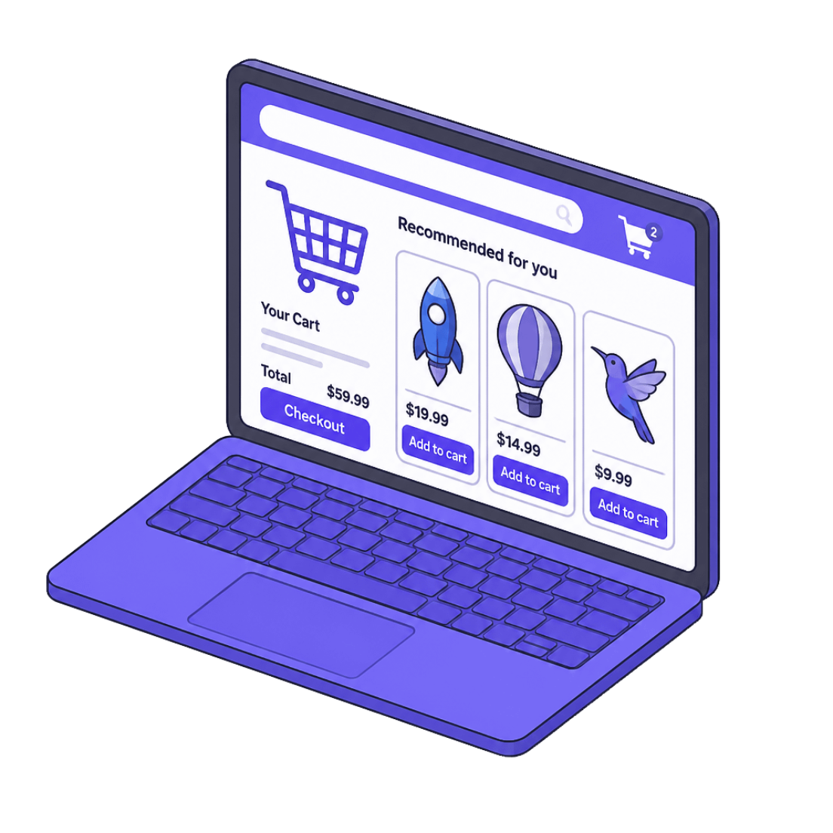
APPLICATIONS
E-Commerce & Retail
Product Recommendations
Price Optimization
Inventory Management
Changing prices based on supply and demand.
Keeping the right amount of goods in stock.
Showing items you might want to buy.

