Slide 1
ADVANCED DATA STRUCTURES
By
S Neelima
Sr. Asst.Prof.
Dept of Information Technology
Aditya Engineering College(A)
Surampalem.

Slide 2
UNIT-I

Slide 3
Dictionaries and Hashing
A dictionary is a container of elements from a totally ordered universe that supports the basic operations of inserting/deleting elements and searching for a given element.
In this chapter, first, we introduce the abstract data type Set which includes dictionaries, priority queues, etc. as subclasses.

Slide 4
Sets:
The set is the most fundamental data model of mathematics.
A set is a collection of well defined elements. The members of a set are all different.
There are special operations that are commonly performed on sets, such as Union, intersection, difference.
      The union of two sets S and T, denoted S ∪ T, is the set containing the elements that are in S or T, or both.
      The intersection of sets S and T, written S ∩ T, is the set containing the elements that are in both S and T.
      The difference of sets S and T, denoted S − T, is the set containing those elements that are in S but not in T.

Slide 5
For example:
Let S be the set {1, 2, 3} and T the set {3, 4, 5}. Then
S ∪ T = {1, 2, 3, 4, 5}, S ∩ T = {3}, and S − T = {1, 2}
Set implementation:
Possible data structures include
Bit Vector
Array
Linked List
    Unsorted
    Sorted

Slide 6
Dictionaries:
A dictionary is a dynamic set ADT with the operations:
Search(S, k) – an access operation that returns a pointer x to an element where x.key = k
Insert(S, x) – a manipulation operation that adds the element pointed to by x to S
Delete(S, x) – a manipulation operation that removes the element pointed to by x from S
Dictionaries store elements so that they can be located quickly using keys
It is useful in implementing symbol tables, text retrieval systems, database systems, page mapping tables, etc.

Slide 7
Implementation:
1. Fixed Length arrays
2. Linked lists: sorted, unsorted, skip-lists
3. Hash Tables: open, closed
4. Trees
    Binary Search Trees (BSTs)
    Balanced BSTs
      AVL Trees
      Red-Black Trees
5.Splay Trees
6.Multiway Search Trees
    2-3 Trees
    B Trees
7.Tries

Slide 8
HASHING :Hashing is a technique that is used to uniquely identify a specific object from a group of similar objects.
Some examples of how hashing is used in our lives include:
In universities, each student is assigned a unique roll number that can be used to retrieve information about them.
In libraries, each book is assigned a unique number that can be used to determine information about the book, such as its exact position in the library or the users it has been issued to etc.
In both these examples the students and books were hashed to a unique number.
Assume that you have an object and you want to assign a key to it to make searching easy. To store the key/value pair, you can use a simple array like a data structure where keys (integers) can be used directly as an index to store values. However, in cases where the keys are large and cannot be used directly as an index, you should use hashing.

Slide 9
In hashing, large keys are converted into small keys by using hash fnctions. The values are then stored in a data structure called hash table.
Hash Table: A hash table (hash map) is a data structure that implements an associative array abstract data type, a structure that can map keys to values.
Using the key, the algorithm (hash function) computes an index that suggests where an entry can be found or inserted.
Hashing is implemented in two steps:
1.An element is converted into an integer by using a hash function. This element can be used as an index to store the original element, which falls into the hash table.
2. The element is stored in the hash table where it can be quickly retrieved using hashed key.

Slide 10
hash = hashfunc(key)
index = hash % array_size
In this method, the hash is independent of the array size and it is then reduced to an index (a number between 0 and array_size − 1) by using the modulo operator (%).
Hash function
A hash function is any function that can be used to map a data set of an arbitrary size to a data set of a fixed size, which falls into the hash table. The values returned by a hash function are called hash values, hash codes, hash sums, or simply hashes.

Slide 11
Types of hash function
There are various types of hash function which are used to place the data in a hash table,
1. Division method
In this the hash function is dependent upon the remainder of a division.
Then:
h(key)=Key% table size.
2=52%10 8=68%10 9=99%10 4=84%10

Slide 12
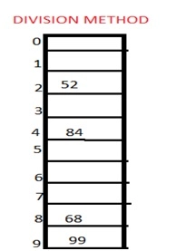
For example:-
if the record 52,68,99,84 is to be placed in a hash table and let us take the table size is 10.
Then:
h(key)=key% table size.
h(52)=52%10=2
h(68)=68%10=8
h(99)=99%10=9
h(84)=84%10=4

Slide 13
2.Multiplication method:
The simplest situation when the keys are floating –point numbers known to be in affixed range.
Algorithm:
Choose constant A in the range 0 < A < 1.
Multiply key k by A.
Extract the fractional part of k*A
Multiply the fractional part by number of slots, m.
Take the floor of the result.

Slide 14
Mathematically
h( k ) = ⌊m · (k·A mod 1)⌋
where k·A mod 1 = k·A − ⌊k·A⌋ = fractional part of k·A
In this case, the value of m is not critical and we typically choose a power of 2
Choose m = 2^{p}.
Multiply the w bits of k by floor(A * 2^{w}) to obtain a 2w bit product.
Extract the p most significant bits of the lower half of this product.
It seems that:
A = (sqrt(5)-1)/2 = 0.6180339887

Slide 15
Example:
m = 8 (implies m = 2³, p = 3)
w = 5
k = 21
Must have 0 < s < 2⁵; choose s = 13 → A = 13/32.
h(k) = ⌊m · (k·A mod 1)⌋
h( 21 ) = ⌊8 · (21·13/32 mod 1)⌋ = 4
k·A = 21 · 13/32 = 273/32 = 8 17/32 → k·A mod 1 = 17/32
→ m · ( k·A mod 1) = 8 · 17/32 = 17/4 = →4 1/4 → ⌊m · ( k·A mod 1)⌋ = 4
So that h(21) = 4.

Slide 16
3. Mid square method
In this method firstly key is squared and then mid part of the result is taken as the index.
For example:
1.consider that if we want to place a record of 3101 and the size of table is 1000.
So 3101*3101=9616201
i.e. h (3101) = 162 (middle 3 digit)

Slide 17
4. Digit folding method
In this method the key is divided into separate parts and by using some simple operations these parts are combined to produce a hash key.
For example:
1.consider a record of 12465512 then it will be divided into parts i.e. 124, 655, 12. After dividing the parts combine these parts by adding it.
H(key)=124+655+12 =791

Slide 18
5.Universal method:
Hashing is a fun idea that has lots of unexpected uses. Here, we look at a novel type of hash function that makes it easy to create a family of universal hash functions. The method is based on a random binary matrix and is very simple to implement.
The idea is very simple. Suppose you have an input data item that you have input data with m – bits and you want a hash function that produces n – bits then first generate a random binary matrix (M) of order nxm.
The hash function is h(x) = Mx Where x to be a binary vector

Slide 19
For example
Suppose you have a key 11, the binary form is 1011 and it is a four bit input value(m) and want to generate output a three bit hash value(n).
Then generate a random matrix gives say:
( 0 1 0 0 )
M = ( 1 0 1 1 )
( 1 1 0 1 )
and if the data value was 1011 the hash value would be computed as:
( 0 1 0 0 ) (1) (0)
h(x) = Mx = ( 1 0 1 1 ) (0) = (1)
( 1 1 0 1 ) (1) (0)
(1)

Slide 20
There are a number of other ways to look at the way the arithmetic is done that suggest different ways of implementing the algorithm.
The first is to notice that what you are doing is anding each row with the data column vector. That is taking the second row as an
example: ( 1 0 1 1 )And (1 0 1 1) = (1 0 1 1)
and then you add up the bits in the result: 1+0+1+1=1
now the index is 010, convert that into decimal is 2.
There is no.of other ways to look at the way the arithmetic is done that suggest different ways of implementing the algorithm.

Slide 21
Collision Resolution Techniques:
In general, a hashing function can map several keys into the same address. That leads to a collision. The colliding records must be stored and accessed as determined by a collision – resolution techniques.
There are two broad classes of such techniques:
Open Hashing (also called separate chaining) and
Closed Hashing (also called open addressing)
The difference between the two has to do with whether collision are stored outside the table (open hashing), or whether collision result in storing and of the records at another slot in the table (closed hashing).

Slide 22
Open Hashing:
The simplest form of open hashing defines each slot in the hash table to be the head of a linked list. All records that hash to a particular slot are placed on that slot’s linked list.
The below figure illustrates a hash table where each slot stores one record and a link pointer to the rest of the list.

Slide 23
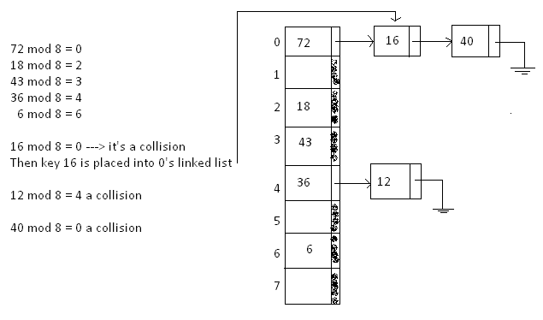

Slide 24
Any key that hash to the same index are simply added to the linked list; there is no need to search for empty cells in the array. This method is called separating chaining.

Slide 25
Open Addressing or Closed Hashing:
Like separate chaining, open addressing is a method for handling collisions. In Open Addressing, all elements are stored in the hash table itself.
So at any point, size of the table must be greater than or equal to the total number of keys (Note that we can increase table size by copying old data if needed).

Slide 26
a) Linear Probing:
In linear probing, we linearly probe for next slot.
let hash(x) be the slot index computed using hash function and S be the table size
If slot hash(x) % S is full, then we try (hash(x) + 1) % S
If (hash(x) + 1) % S is also full, then we try (hash(x) + 2) % S
If (hash(x) + 2) % S is also full, then we try (hash(x) + 3) % S and so on

Slide 27
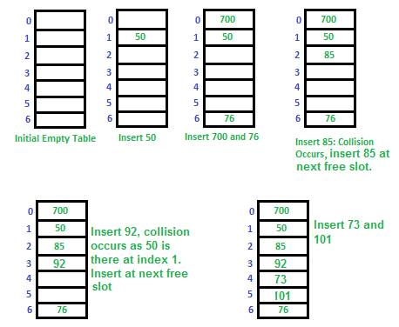
Let us consider a simple hash function as “key mod 7” and sequence of keys as 50, 700, 76, 85, 92, 73, 101.

Slide 28
Clustering: The main problem with linear probing is clustering, many consecutive elements form groups and it starts taking time to find a free slot or to search an element

Slide 29
Quadratic Probing
To resolve the primary clustering problem, quadratic probing can be used. With quadratic probing, rather than always moving one spot, move i² spots from the point of collision, where i is the number of attempts to resolve the collision.
The probe sequence of quadratic probing is
hash(key)
( hash(key) + 1 ) % m
( hash(key) + 4 ) % m
( hash(key) + 9 ) % m
⁞
( hash(key) + k2 ) % m

Slide 30
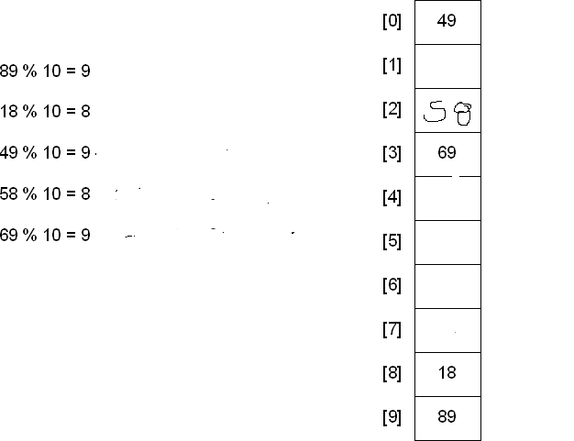
For Example

Slide 31
H(49)=49%10=9
9+1*1=10%10=0 free so insert 49 in 0th index
H(58)=58%10=8 collision
8+1*1=9%10=9 not free
8+2*2=12%10=2 free
H(69)=69%10=9 collision
9+1*1=10%10=0 not free
9+2*2=13%10=3 free

Slide 32
Double Hashing
Double hashing uses the idea of applying a second hash function to the key when a collision occurs. The result of the second hash function will be the number of positions from the point of collision to insert.
There are a couple of requirements for the second function:
It must never evaluate to 0
Must make sure that all cells can be probed
A popular second hash function is : H₂(key) = R – (key % R)
Where R is a prime number that is similar than the size of the table

Slide 33
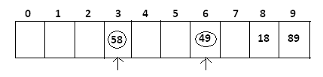
Table size = 10
Hash₁ (key) = key % 10
Hash₂ (key) = 7 – (key % 7)
Because 7 is a prime number than the size of the table

Slide 34
Insert keys: 89, 18, 49, 58, 69
Hash (89) = 89 % 10 = 9
Hash (18) = 18 % 10 = 8
Hash₁ (49) = 49 % 10 = 9; it’s a collision
Hash₂ (49) = 7 – (49 % 7) = 7; positions from location 9
Hash₁ (58) = 58 % 10 =8; it’s a collision
Hash₂ (58) = 7 – (58 % 7) = 5; positions from location 8

Slide 35
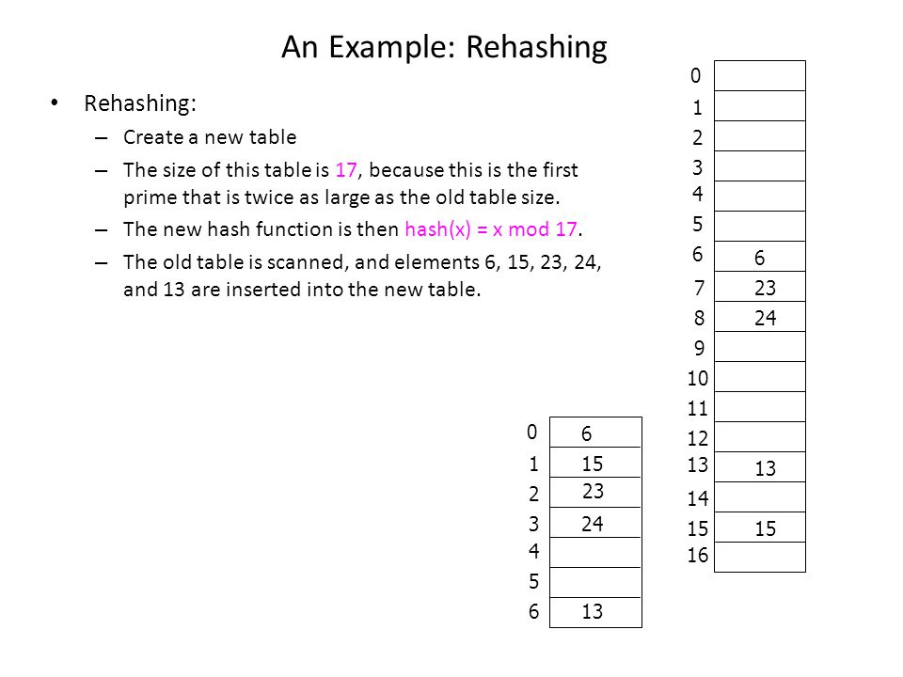

Slide 36
Thank You

