Slide 1

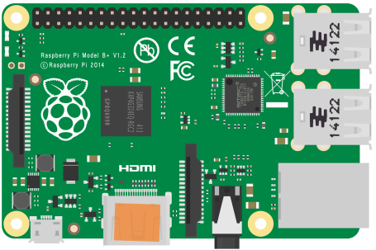
Front-end Back-end
keyboard_controller.js
var move = {
"data": ‘true',
"val": ‘up‘
};
Socket connection keyboard_controller.js
keyboard_controller.js
var move = {
"data": ‘true',
"val": ‘up‘
};
GET keyboard_controller.jade
keyboard_controller.jade
Press up button
Send move JSON
object
Hard Soft
Control Raspberry pi GPIO
gpio_controller.js
function up() {
console.log("up");
wra.write(1);
wrb.write(0);
wla.write(0);
wlb.write(1);
}

Slide 2
RGB
0 235 0
RGB
0 196 0
RGB
200 200 200
RGB
128 128 128
RGB
100 100 100
RGB
63 63 63
RGB
0 0 0

