Slide 1
A WEB-BASED PROTOTYPE FOR REMOTE CAR DIAGNOSTICS
Dragos Duca
Iulia Lazaroaie
Bogdan Lupu
Ciprian Mierea

Slide 2
What is the project all about?
Background
Having to go every time to the service to solve some sort of error in your car‘s dashboard is time and nerve consuming
Here is a remote diagnostics tools which could work for every car

Slide 3
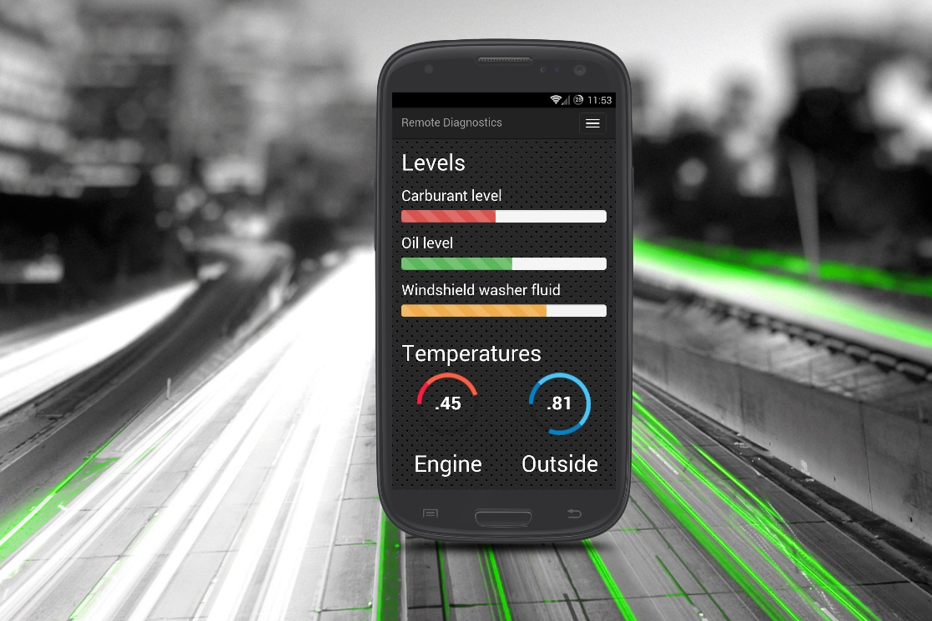

This application is for the automotive industry
You just connect to the web application which communicates with the car through a Raspberry Client via Wi-Fi
Here you can see different values for any part of the car

Slide 4
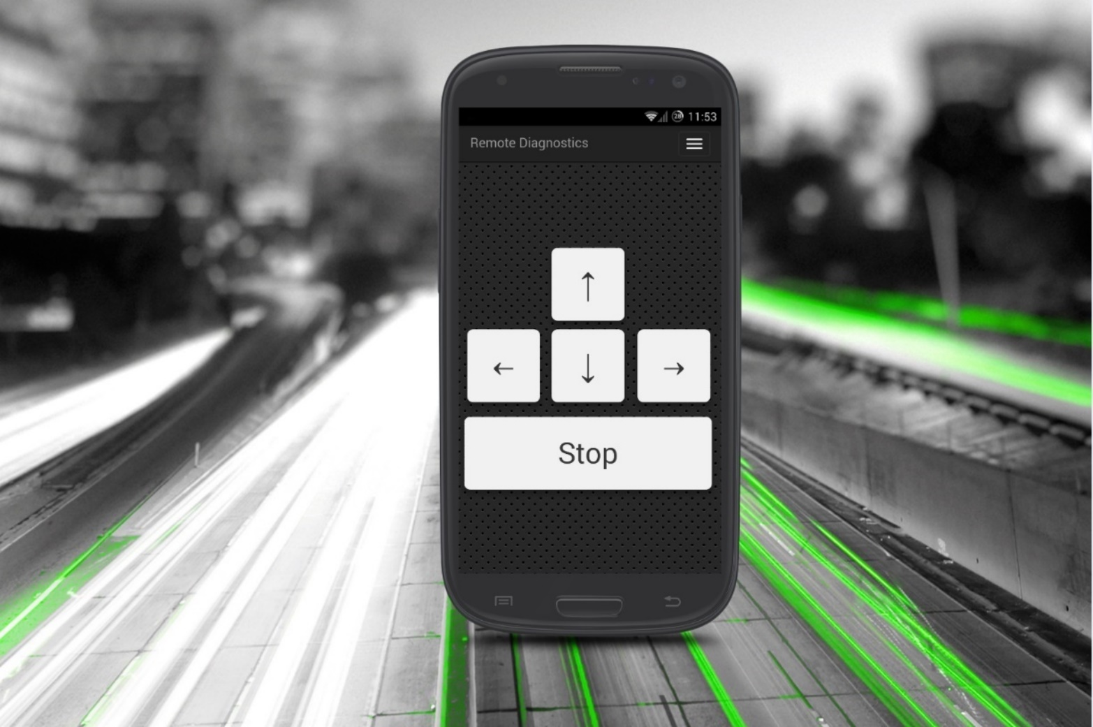
Keyboard requirement

Slide 5
Keyboard Controller
Description: Having some sort of direction controller for the steering of the car is necessary for the car to move.
Rationale: So the user can manipulate the car’s position and motion
Origin: Remote Diagnostics Team
Fit criterion: The car can move forward, backwards, left, right and it can stop
Dependencies CAN network can be accessible from the keyboard controller

Slide 6
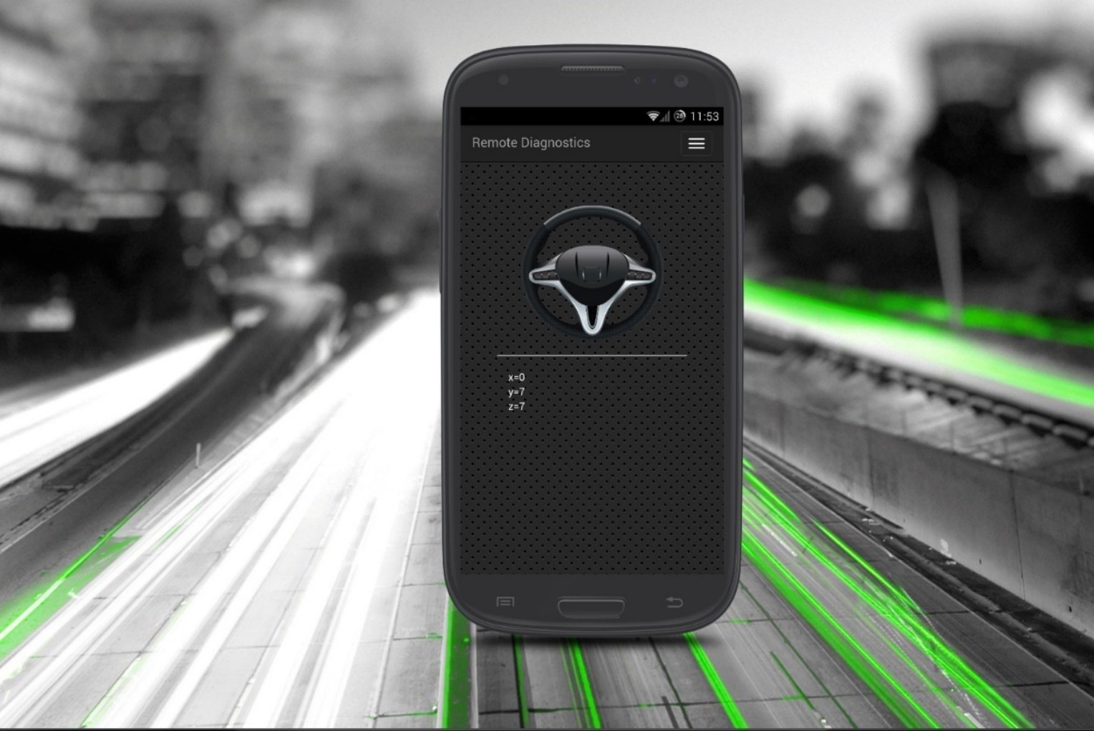
Gyroscope requirement

Slide 7
Gyroscope Controller
Description: Use the Z-axis accelerometer sensors from the phone to control the car instead of using keyboard controller
Rationale: Faster usage than a keyboard
Origin: Remote diagnostics team
Fit criterion: The movement of the car
Dependencies: CAN network can be accessible from the gyroscope controller

Slide 8
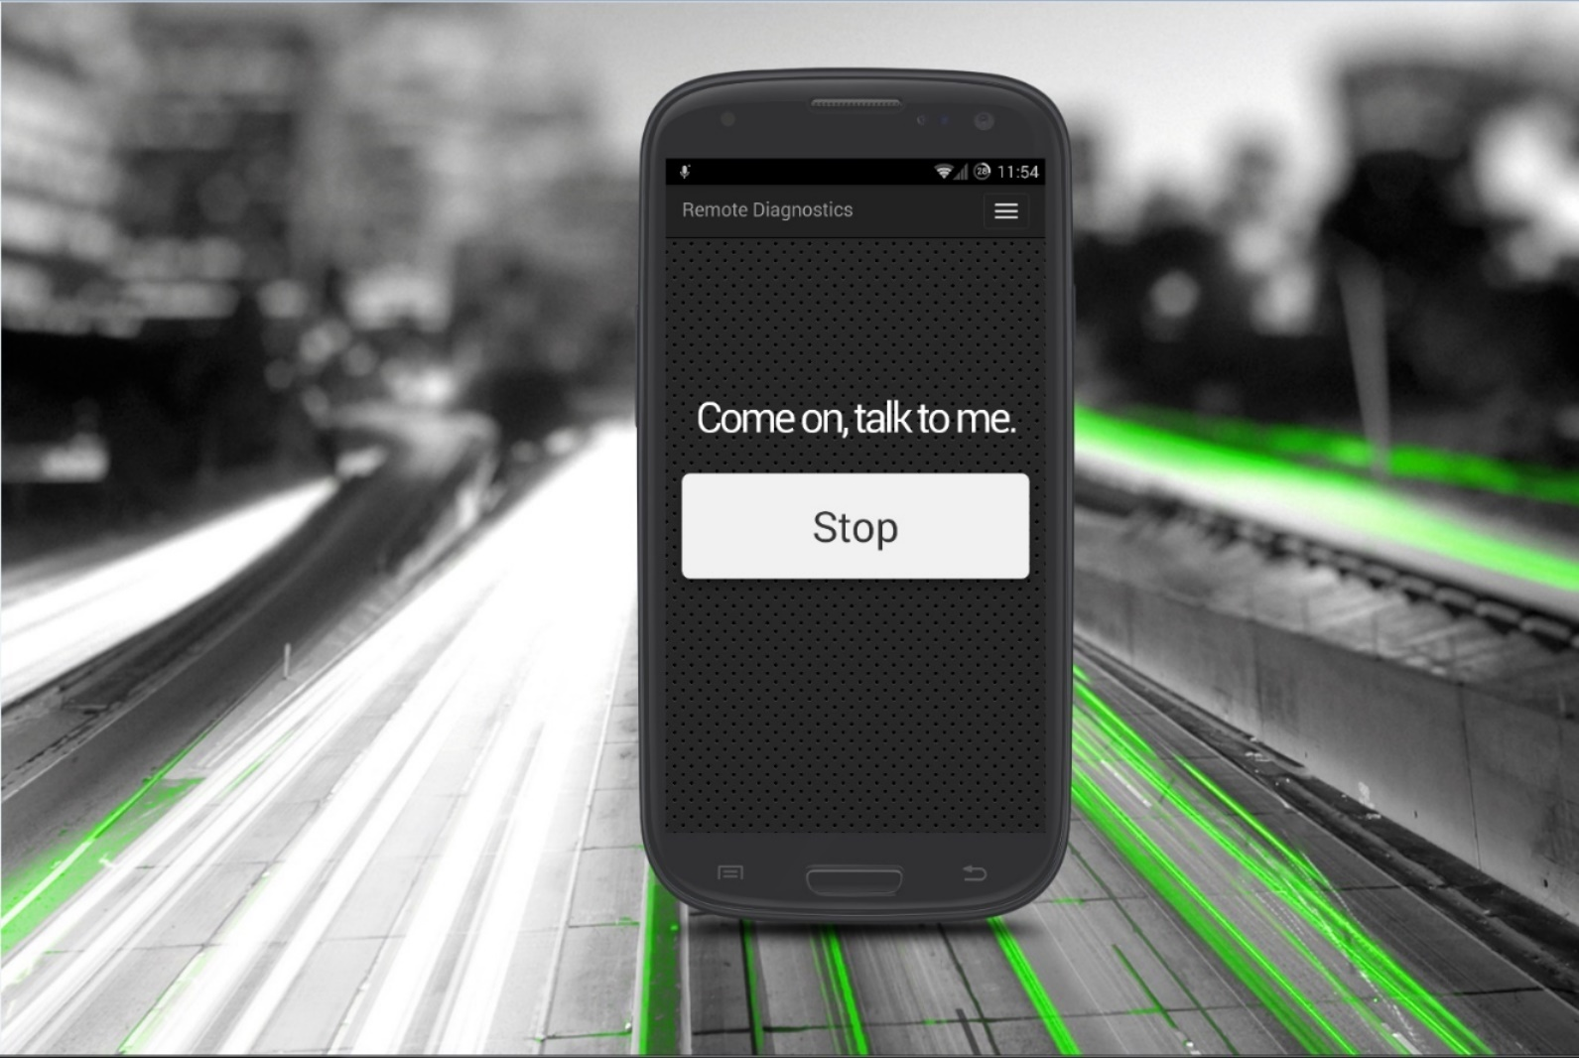
Speech requirements

Slide 9
Speech Controller
Description: Through voice control same results can be achieved as the keyboard and gyroscope controller
Rationale: Most modern software has the ability to control something through voice commands
Origin: Remote diagnostics team
Fit criterion: Moving the car using voice commands
Dependencies: Accessing the CAN network through voice and having a microphone on the phone

Slide 10
Performance requirements
Description: System needs to be as optimized as possible so every user will be able to use it.
Rationale: Most users will get annoyed from application responses that are longer than 3 seconds and will quit using the application
Origin: common sense
Fit criterion: Makes the application user friendly
Dependencies: Skilled developers to implement

Slide 11
Safety requirements
Description: Valid driving license for the user is needed
Rationale: You should not be able to control a car without knowing the current legislation laws and a basic training to control a car
Origin: The law
Fit criterion: Ensures the user stays alive
Dependencies: Having a valid driving license

Slide 12
Why should we have this project? (1/2)
Motivation
For customers
Easy, flexible and cheaper solution to remote diagnose a car
For developers
In the automotive domain Javascript is meerly used and this project is a good opportunity to show the power of Javascript.
For the management: What is the business case for this project?
What are the expected benefits?
Selling argument – this is a solution that is currently missing from the automotive industry, thus ensuring and easy market penetration
Money – the solution is cheap to produce, which will ensure a cheap retail price
Notes:
Introduce with (see Kano Model …)
Benefits (money, less work, spare time, …)
Fear (you could get hurt if you don‘t have this …)
Delight …

Slide 13
Time savings – for developers you don’t need to train them in special technologies as most of them already know Javascript
- for customers it reduces the time needed to book a scanner from a car dealership

Slide 14
Why should we have this project? (2/2)
Motivation
For the management: What is the business case for this project?
The bussiness case for this project is composed from the facts that the solution is highly scalable, cheap to maintain and the idea is young in the automotive industry thus not having to deal with competitors
Technology
Faster, more accessible, widely spread in other industries
More, better features
Unify the remote diagnostic of cars under the same roof (instead of having proprietary solutions for every brand)
Notes:
Introduce with (see Kano Model …)
Benefits (money, less work, spare time, …)
Fear (you could get hurt if you don‘t have this …)
Delight …

Slide 15
Who will use your solution in the end …?
Everyone from car owners to car dealerships and manufacturers

Slide 16
Who will work on the project
List the persons in the project
1. Dragos Duca
Role: architect, developer
Involvement: 100%
2. Iulia Lazaroae
Role: scrum master, project manager
Involvement: 100%
3. Bogdan Lupu
Role: architect, developer
Involvement: 100%
4. Ciprian Mierea
Role: architect, system administrator
Involvement: 100%
Notes:
Use this to commit the management to realy give you these people!!

