Slide 1
S
SUPERBID
Building an Estimate in SuperBid
From the owner's schedule to a signed bid form — a live 35-minute walkthrough for estimators (SuperBid v0.31.0)
SuperBid v0.31.0 · September 2026
Notes:
Welcome. In about 35 minutes we will build one estimate from an empty file to a printed bid form in SuperBid 0.31.0. The running example is a City of Edmonton watermain renewal: 1,200 m of 300 mm PVC, eight hydrant assemblies, asphalt and curb reinstatement. Ask everyone to have SuperBid open. The built-in demo bid is imperial, so I will build the metric example live and use the demo only where a screen needs data already in it. Questions are welcome at any stage; each stage ends with a natural pause.

Slide 2
Agenda
Two layers: cost and price
The workflow in eight stages
A
B
Stages 1–5: file, schedule, rates, crews, costing
Stages 6–8: quotes, bid summary, checks
C
D
Proposal, reports, saving, undo and history
E
SuperBid · Building an estimate
2
Notes:
Walk the agenda in one minute. The first two slides are ideas, not clicks: the cost layer versus the price layer, and the eight stages we follow. Then it is hands-on: create the file, bring in the owner's schedule, set rates and crews, cost each line, level quotes, set markups and bond, run the checks, and print the proposal. We close with how saving, undo and history work, because those questions come up in every training. Tell the group the manual chapters follow the same order, so they can find any step again later.

Slide 3
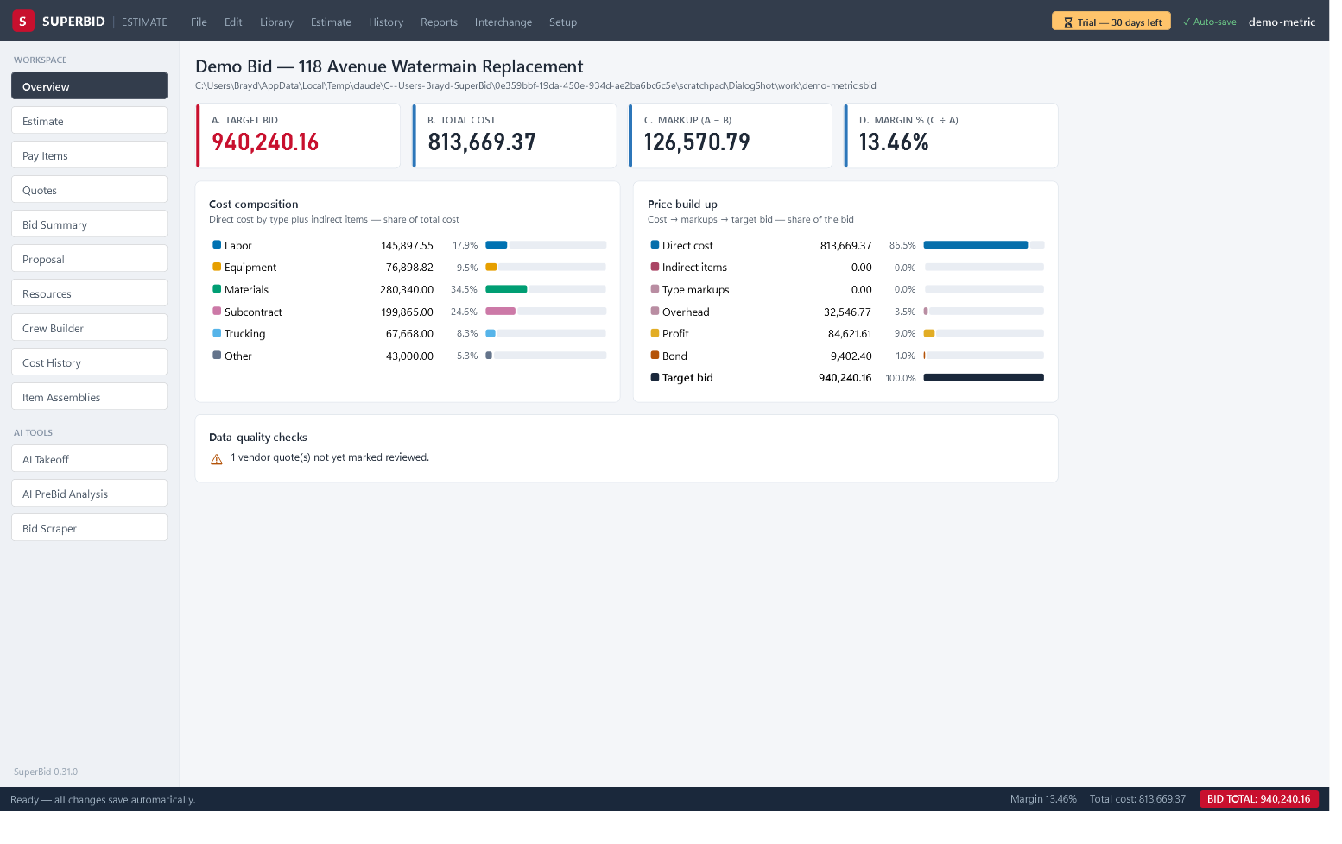
Two layers: cost on the Estimate screen, price on Bid Summary
Cost layer: Estimate screen — crews, production rates, materials, plugs
A
Price layer: Bid Summary — markups, bond, spread across pay items
B
Overview cards: A TARGET BID · B TOTAL COST · C MARKUP · D MARGIN %
C
Colour rule: white = input · gray = calculated · blue = your override
D
SuperBid · Building an estimate
3
Notes:
Press Ctrl+1 for the Overview on the demo bid. Point at the four cards. A TARGET BID is the number you submit. B TOTAL COST is direct cost plus the indirect pool. C MARKUP (A − B) is everything between them, and D MARGIN % is C over A. The cost layer is built on the Estimate screen; the price layer is built on Bid Summary, which spreads markups, indirects and bond across the pay items. Then press Ctrl+2 and read the legend in the Cost items bar: white = input, gray = calculated, blue = your override. Blue means a number was typed over a calculation, so overrides are never hidden.

Slide 4
The workflow at a glance
Create the estimate — File ▸ New Estimate…
Cost the items — Estimate
1
5
Import the owner's schedule — Pay Items
Level and award quotes — Quotes
2
6
Set resources and rates — Resources
Set markups, bond and spread — Bid Summary
3
7
Build crews — Crew Builder
Check, then print the proposal — Overview, Proposal
4
8
SuperBid · Building an estimate
4
Notes:
This is the map for the session. Point at the WORKSPACE rail: Overview, Estimate, Pay Items, Quotes, Bid Summary, Proposal, Resources, Crew Builder, Cost History, Item Assemblies. Show Ctrl+1 through Ctrl+9 and Ctrl+0 switching screens; each shortcut commits the cell you are typing in first. Then point at the green ✓ Auto-save chip in the top bar and the status message Ready — all changes save automatically. There is no Save command; every committed edit is already in the .sbid file. Say that we now start from an empty file and follow the stages in order.

Slide 5
01
Stage 1 · Create the estimate
File ▸ New Estimate… (Ctrl+N) · Name it, pick its folder, choose what to start from · Starter library or your own master estimate
Notes:
Say what happens in this stage: we name the file, choose its folder, and decide what the estimate starts from. Mention the three entry points: File ▸ New Estimate… with Ctrl+N, the New Estimate… button on the welcome screen, and File ▸ New from Template… for a copy of a master. Tell the group that the starter library is illustrative metric content meant to be edited, and that most companies end up with a master estimate that holds their own rates, crews, indirects and terms. Two slides follow: the welcome screen and the dialog itself.

Slide 6
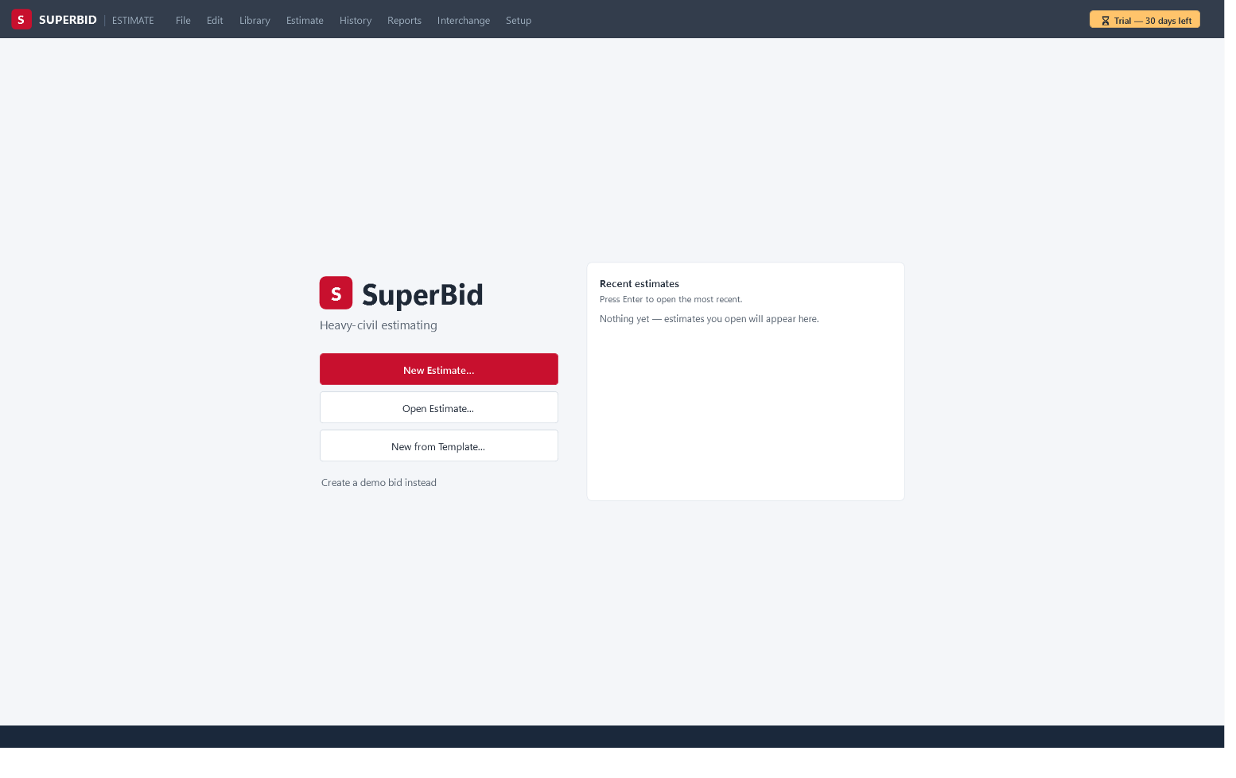
The welcome screen
New Estimate…, Open Estimate…, New from Template…
A
Recent estimates lists your last 8 files; click to open
B
Create a demo bid instead builds the Maple Street sample (imperial)
C
Press Enter to open the most recent
D
SuperBid · Building an estimate
6
Notes:
Start SuperBid without a file so the welcome screen shows. On the left, point at New Estimate…, Open Estimate… and New from Template…, and the link Create a demo bid instead. On the right, the Recent estimates card lists up to 8 files you have opened, file name over folder path; click one to open it. The hint says Press Enter to open the most recent. Explain that only one estimate is open at a time: opening another replaces the current one, and nothing is lost because every edit was already saved. Click New Estimate… to move to the dialog.

Slide 7
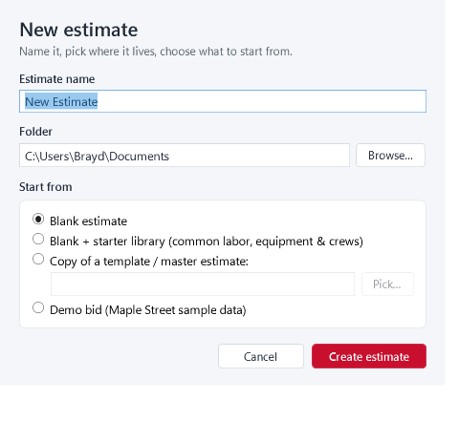
The New Estimate dialog and the starter library
Estimate name: 2026-051 Belgravia Watermain Renewal — becomes the file name
A
Folder: Browse… (defaults to your last estimate's folder)
B
Start from: Blank + starter library (common labor, equipment & crews)
C
Or Copy of a template / master estimate: → Pick…
D
Create estimate writes the .sbid at once; Create a new one? keeps the old file as <name>.replaced-<stamp>.sbid
E
SuperBid · Building an estimate
7
Notes:
In the New Estimate dialog type the Estimate name 2026-051 Belgravia Watermain Renewal over the default; it becomes the file name. Check Folder or click Browse…. Under Start from pick Blank + starter library (common labor, equipment & crews). Say what arrives: six labour classes, six machines, two materials priced per M3, crews PIPE1, GRADE1, CONC1 and CURB1, and assemblies PIPE-TRENCH, CONC-FLAT and CURB-GUTTER, all with illustrative rates. Point at Copy of a template / master estimate: and Pick… for teams that already have a master. Click Create estimate; the .sbid is written at once. Explain that answering Yes to Create a new one? does not destroy the old file: the new one is built beside it and swapped in only once complete, the old one is renamed <name>.replaced-<stamp>.sbid in the same folder, where File ▸ Open… still lists it, and the status bar says where it was kept.

Slide 8
02
Stage 2 · Import the owner's schedule
Pay Items (Ctrl+3): the owner's Schedule of Prices · Excel, AI (PDF/Excel), DOT .COL, or by hand · Pay Qty vs Forecast Qty
Notes:
Introduce the Pay Items screen, Ctrl+3. A pay item is one line of the owner's Schedule of Prices: number, description, unit and quantity. The schedule drives everything: each leaf pay item automatically gets a matching top-level row on the Estimate screen, which is where cost is built. This screen holds structure and quantities only; unit prices, locks and exclusions live on Bid Summary. Say there are three ways to bring the schedule in, plus hand entry, and that we will use the AI import on the City's tender PDF.

Slide 9
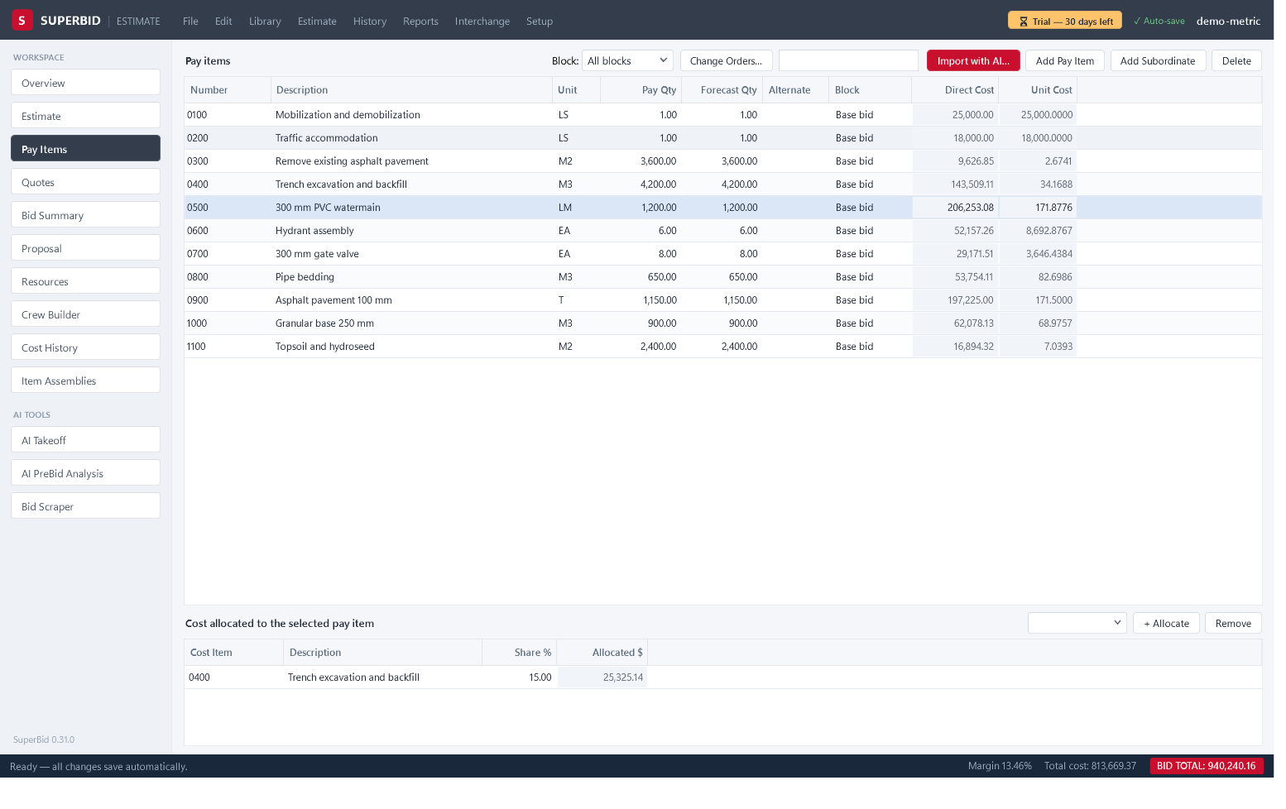
Pay Items: three ways in, plus hand entry
Interchange: Import pay items from Excel… / Import DOT proposal (.COL)…
A
Import with AI… reads the tender PDF's Schedule of Prices
B
Add Pay Item / Add Subordinate for hand entry
C
Every leaf pay item gets a mirrored top-level row on Estimate
D
Typed units fold: m³ → M3, tonne → T, each → EA
E
SuperBid · Building an estimate
9
Notes:
On Pay Items show the toolbar: Import with AI…, Add Pay Item, Add Subordinate, Delete. Open Interchange to show Import pay items from Excel… and Import DOT proposal (.COL)…; for Excel the header row needs an item-number column such as Item or Number and a quantity column such as Qty or Quantity. Click Add Pay Item to show the New Pay Item dialog: Item number, Description, Unit, Owner quantity, Forecast quantity, Alternate group, then Add pay item. Type 0100 Mobilization, LS, 1. Note that typed units fold: m³ becomes M3, tonne becomes T. Switch to Estimate (Ctrl+2) to show the mirrored row.

Slide 10
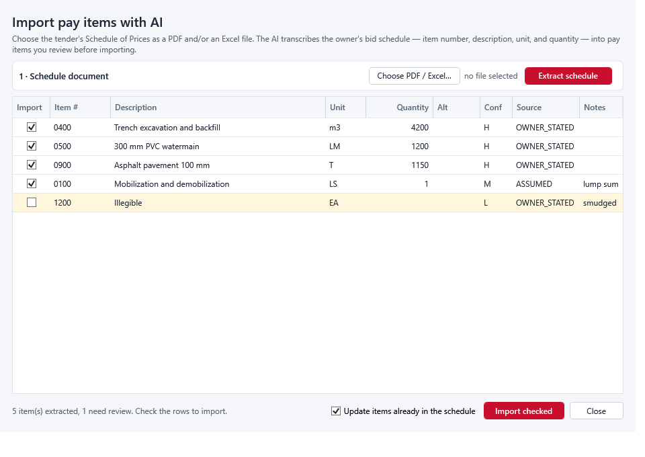
Import the schedule with AI from the tender PDF
Key saved under Setup ▸ AI & Bid Scraper settings…
A
Choose PDF / Excel… → Extract schedule
B
Amber rows need attention; Conf is H, M or L
C
Blank Quantity = the AI could not read it; you type it
D
Import checked — the whole import is one Ctrl+Z step
E
SuperBid · Building an estimate
10
Notes:
Click Import with AI…. If no key is saved it will tell you; keys live under Setup ▸ AI & Bid Scraper settings…. Click Choose PDF / Excel…, pick the Schedule of Prices pages from the tender, then Extract schedule. Walk the review grid: amber rows need attention, Conf is H, M or L, a blank Quantity means the AI could not read it and you type it, Source reads OWNER_STATED except for a lump sum with no printed quantity. Leave Update items already in the schedule ticked for an addendum re-import. Click Import checked; the summary box appears and the whole import is one Ctrl+Z step.

Slide 11
Our example schedule: Pay Qty vs Forecast Qty
Number | Description | Unit | Pay Qty | Forecast Qty
0100 | Mobilization | LS | 1 | 1
0200 | 300 mm PVC watermain c/w bedding | M | 1,200 | 1,200
0300 | Hydrant assembly | EA | 8 | 8
0400 | Asphalt reinstatement | M2 | 2,400 | 2,600
0500 | Curb and gutter replacement | LM | 300 | 300
SuperBid · Building an estimate
11
Notes:
Here is the schedule we now have. Explain the two quantity columns on Pay Items. Pay Qty is the owner's number: unit price times Pay Qty is the extended amount on the bid form. Forecast Qty is your takeoff, what you expect to build, and the estimate costs against it; if it is 0, Pay Qty is used. Type 2,600 into Forecast Qty on 0400 to show that trench-width overrun on asphalt is carried in cost without touching the bid form. Estimate Check flags a gap over 25%, so this one passes. Mention that AI Takeoff writes Forecast Qty only and never moves Pay Qty.

Slide 12
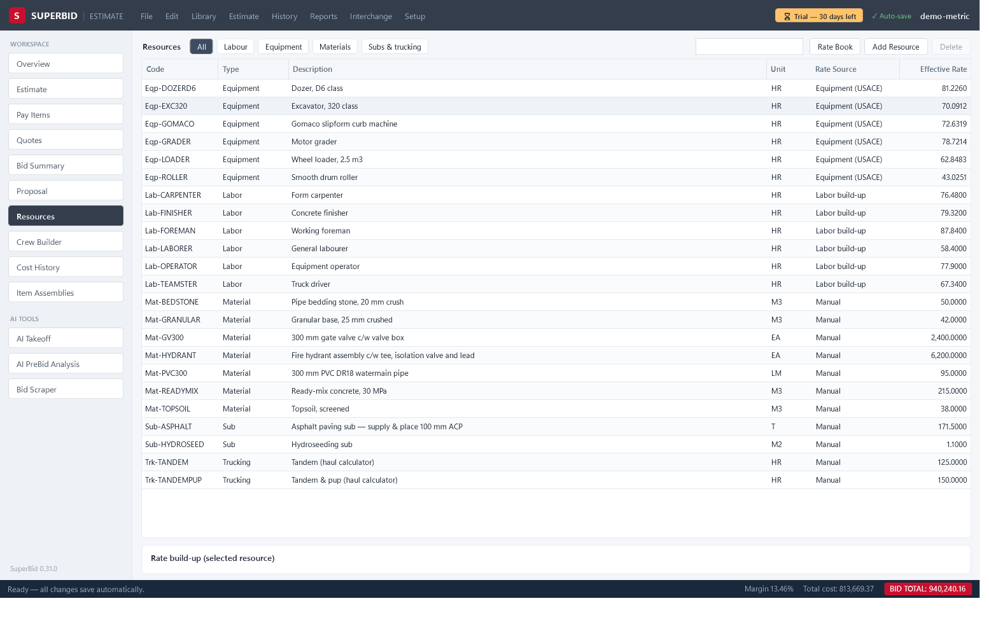
Stage 3 · Resources: five types, four rate sources
Types: Labor, Equipment, Material, Sub, Trucking
A
Labour and equipment are hourly — used only through crews
B
Rate Source: Manual, Labor build-up, Equipment (USACE), Rate book (%)
C
Build-up: 38.00 × 1.42 + 12.00 fringes = 65.96 $/hr
D
Add Resource starts at Unit HR — change it to M3, M, T, EA
E
SuperBid · Building an estimate
12
Notes:
Define the term: a resource is the smallest priced thing, a labour class, machine, material, sub item or trucking rate. Labour and equipment are hourly and used only through crews; materials, subs and trucking hang on cost items. Press Ctrl+7 and show the pills All, Labour, Equipment, Materials, Subs & trucking. Click Labour, then Add Resource; rename the code to Lab-PIPELAYER. In Rate Source choose Labor build-up and in the card type Base wage $/hr 38.00, Fringes $/hr 12.00, Burden % 42; Effective: reads 65.96. Click Materials, Add Resource, code Mat-PVC300, and change Unit from HR to M before typing the Manual rate. Point at Mat-BEDSTONE from the starter library at 50.00 per M3. Typing into Effective Rate on a build-up row is ignored; edit the card.

Slide 13
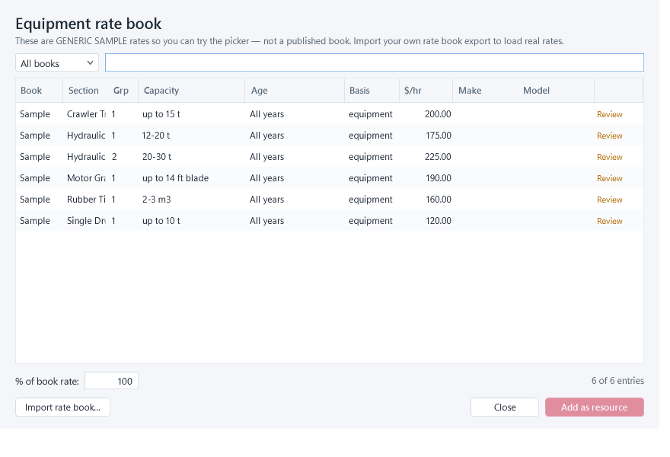
Price a machine from the rate book at a percent of book
Rate Book button on the Resources screen
A
Import rate book… loads your CSV — replaces, never merges
B
Search cat 336, pick the line, % of book rate: 85
C
Add as resource → Eqp-CAT-336 at 212.50 $/hr
D
Basis all-found already includes the operator
E
SuperBid · Building an estimate
13
Notes:
Click Rate Book on the Resources screen. SuperBid ships no published rates; the six Sample lines are placeholders until you click Import rate book… and load your company's CSV extract, which replaces the whole stored book. Type cat 336 in the search box, click the line, and set % of book rate: to 85; the preview reads = 212.50 $/hr. Click Add as resource; the status reads Eqp-CAT-336 → 212.50 $/hr (85% of 250.00). The dialog stays open so you can add a fleet, then Close. Point out Basis all-found means the operator is included, so do not add one to the crew as well.

Slide 14
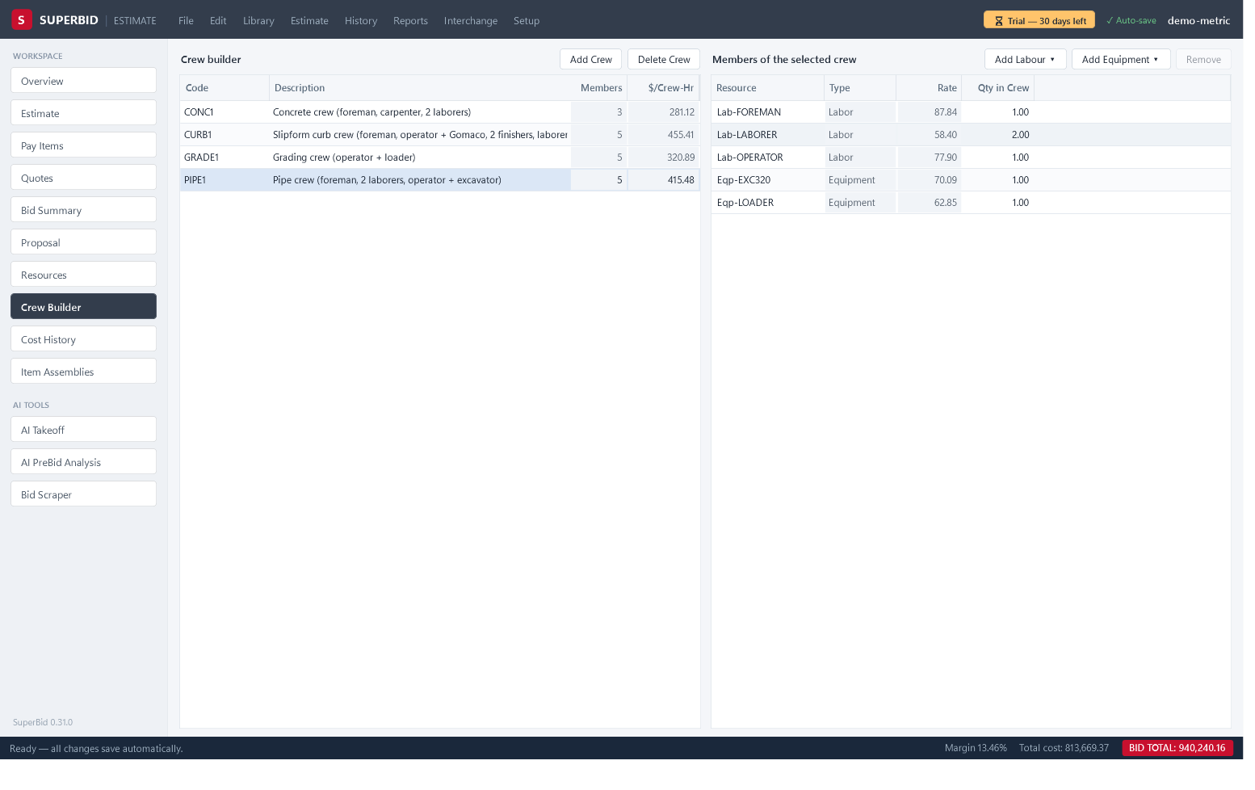
Stage 4 · Crews: who and what is on the pipe crew
Crew Builder (Ctrl+8): Add Crew, rename CREW1 to PIPE2
A
Add Labour ▾ and Add Equipment ▾ pick from the catalogue
B
Qty in Crew: 0.5 for a foreman shared between crews
C
$/Crew-Hr × Crew Hrs = Labor+Equip on every item
D
One rate basis per estimate: bare USACE or loaded charge-out
E
SuperBid · Building an estimate
14
Notes:
Press Ctrl+8. Click Add Crew and rename CREW1 to PIPE2 with a description. With it selected click Add Labour ▾ and pick Working foreman — 110/hr, then General labourer — 75/hr twice; click Add Equipment ▾ and pick Excavator, 320 class (30 t) — 175/hr. Explain the message: an existing resource with that code stem is reused at its own rate; otherwise a Manual resource is created at the menu's starter rate. Set Qty in Crew, for example 0.5 on the foreman shared with another crew. Read $/Crew-Hr. Warn that starter-library machines carry bare USACE costs while the menu's rates are loaded charge-out numbers; pick one basis per estimate.

Slide 15
03
Stage 5 · Cost the items
Estimate (Ctrl+2): one cost item per activity · Methods and productivity factors · Materials, haul, assemblies, indirects
Notes:
This is the longest stage. A cost item is one row on the Estimate screen: a unit, a forecast quantity, a cost method and either a crew with a production rate or a plugged price, plus any materials, subs and trucking beneath it. Top-level rows came from Pay Items; you add detail rows under them and cost the bottom rows only, because parents roll up. Four slides: methods and productivity factors, materials and the haul calculator, assemblies, and the indirect-cost checklist. Keep the status bar in view; BID TOTAL and the Δ chip move with every edit.

Slide 16
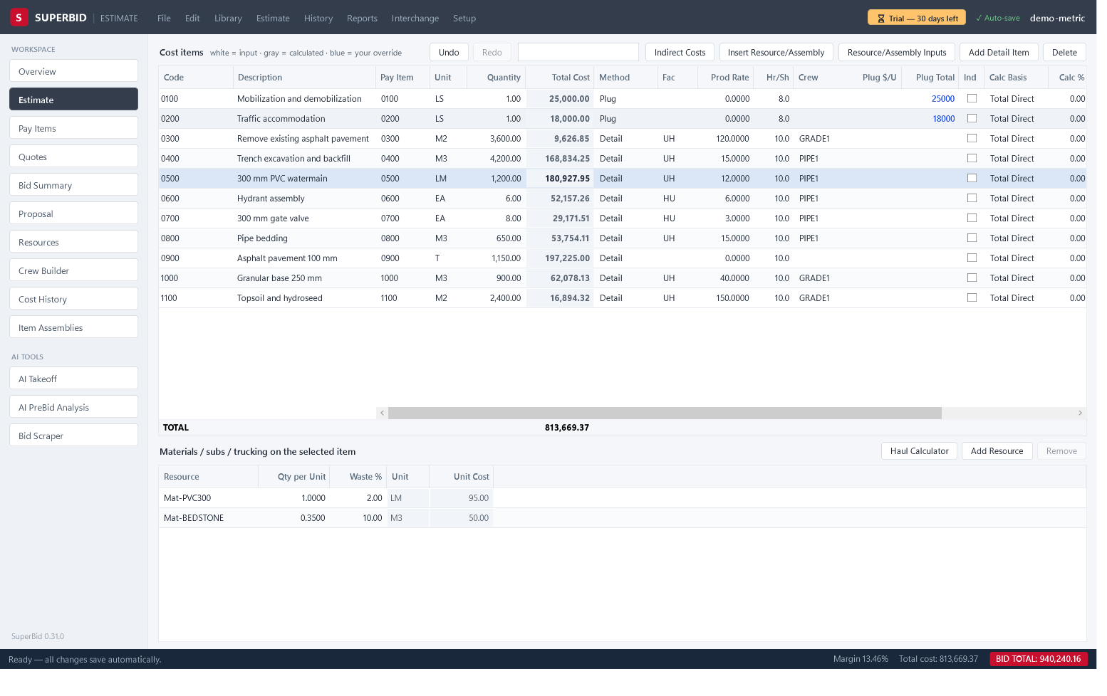
The Estimate screen: methods and productivity factors
Top-level rows come from Pay Items — cost the leaves only
A
Method: Detail, Plug, Subcontracted, Calculated (plus Quick, Comparison)
B
Fac UH + Prod Rate 30: 1,200 m = 40 Crew Hrs
C
Add Detail Item nests bedding, backfill, testing under 0200
D
Plug $/U or Plug Total — blue, your override
E
SuperBid · Building an estimate
16
Notes:
Press Ctrl+2 and select 0200. Leave Method as Detail, click Crew and pick PIPE2, set Fac to UH and Prod Rate to 30: 1,200 m at 30 m per crew-hour gives 40 in Crew Hrs, and Labor+Equip fills in. Show the other factor types in Fac: HU hours per unit, US units per shift, MU manhours per unit, CH total crew-hours. Click Add Detail Item to add a child under 0200 for pressure testing; a row that already carries a crew refuses children, so clear it first. For 0100 Mobilization set Method to Plug and type Plug Total; it shows blue. Set 0400 to Subcontracted with Plug $/U until the quote is awarded.

Slide 17
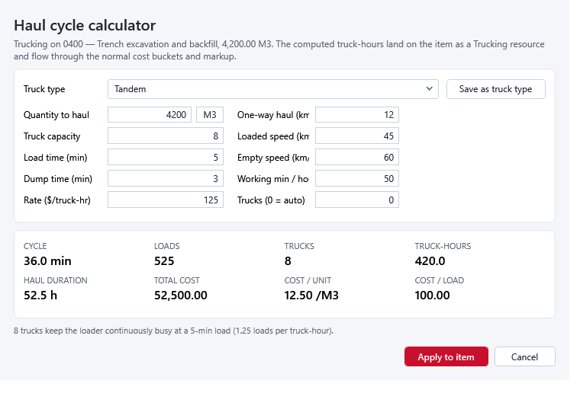
Materials, subs and trucking; the Haul Cycle Calculator
Lower grid: Materials / subs / trucking on the selected item
A
Add Resource, or Insert Resource/Assembly ▸ Resources… for several
B
Qty per Unit + Waste %: pipe 1.0 at 2%, bedding 0.35 M3 at 5%
C
Haul Calculator: km, speeds, load and dump minutes → COST / UNIT
D
Apply to item lands a Trk-TANDEM trucking line
E
SuperBid · Building an estimate
17
Notes:
With 0200 selected, look at the lower grid Materials / subs / trucking on the selected item. Click Add Resource, change Resource to Mat-PVC300, Qty per Unit 1, Waste % 2; add Mat-BEDSTONE at 0.35 per metre with 5% waste. For several at once use Insert Resource/Assembly ▸ Resources…, tick them, set Qty / unit and Waste %, click Insert. Then click Haul Calculator: pick a Truck type, fill Quantity to haul, One-way haul (km) 12, Truck capacity, Loaded speed (km/h), Empty speed (km/h), Load time (min), Dump time (min), Rate ($/truck-hr), leave Trucks (0 = auto). Read COST / UNIT, then Apply to item; a Trk-TANDEM line lands in the grid.

Slide 18
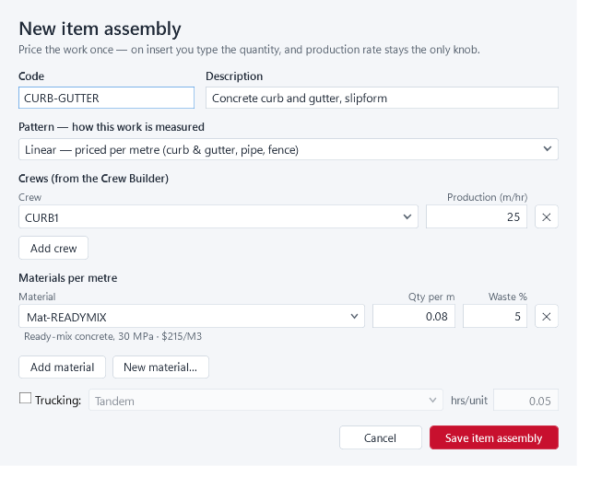
Assemblies: price it once, reuse it on every bid
Item Assemblies (Ctrl+0): New item assembly… guided builder
A
Pattern: Linear, Area, Gravel / asphalt, Tonnage, Per unit
B
Crews with Production (m/hr); Materials per metre with Waste %
C
Insert Resource/Assembly ▸ Assembly… places it under the selected row
D
Resource/Assembly Inputs → change values later → Update
E
SuperBid · Building an estimate
18
Notes:
Press Ctrl+0 for Item Assemblies. Click New item assembly…: give it a Code and Description, choose a Pattern such as Linear — priced per metre, add a crew under Crews (from the Crew Builder) with its Production (m/hr), add lines under Materials per metre with Qty per m and Waste %, and click Save item assembly. Back on Estimate, select 0500 Curb and gutter and click Insert Resource/Assembly ▸ Assembly…; pick CURB-GUTTER from the starter library, fill the inputs, watch the preview, click Insert. A container row with generated items appears under 0500. Later, select any generated row, click Resource/Assembly Inputs, change a value and click Update.

Slide 19
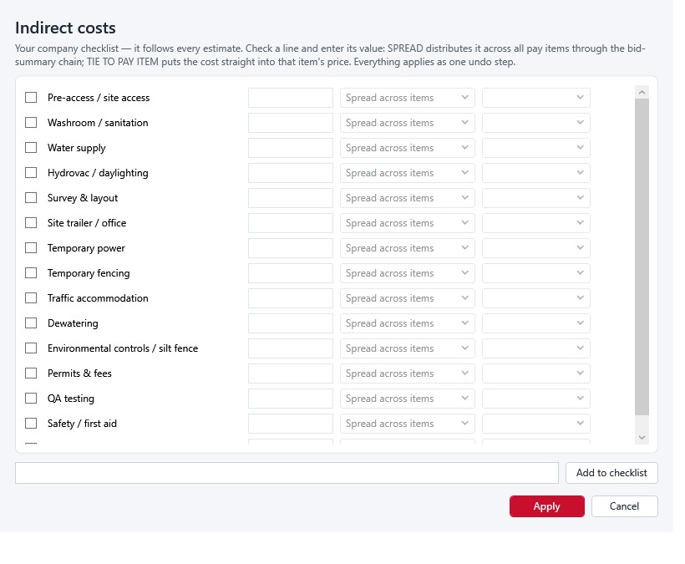
Indirect costs: the general-conditions checklist
Indirect Costs button in the Cost items bar
A
Tick the lines that apply; type each lump sum
B
Spread across items, or Tie to pay item (0100 Mobilization)
C
Add to checklist keeps company lines for every future estimate
D
Apply creates Plug items coded IND-…, flagged Ind
E
SuperBid · Building an estimate
19
Notes:
Click Indirect Costs in the Cost items bar. Tick the lines that apply to this job and type each lump sum: site supervision, temporary water, traffic accommodation, bonding and insurance. Choose Spread across items so the dollars go into an INDIRECTS group flagged Ind and are shared by the markup chain, or Tie to pay item to land them in 0100 Mobilization. Add a company line in the box and click Add to checklist; it is saved for every future estimate. Click Apply: each ticked line becomes a Plug item coded IND-…. Untick a line and Apply again to remove it. Show the Ind column on the grid afterwards.

Slide 20
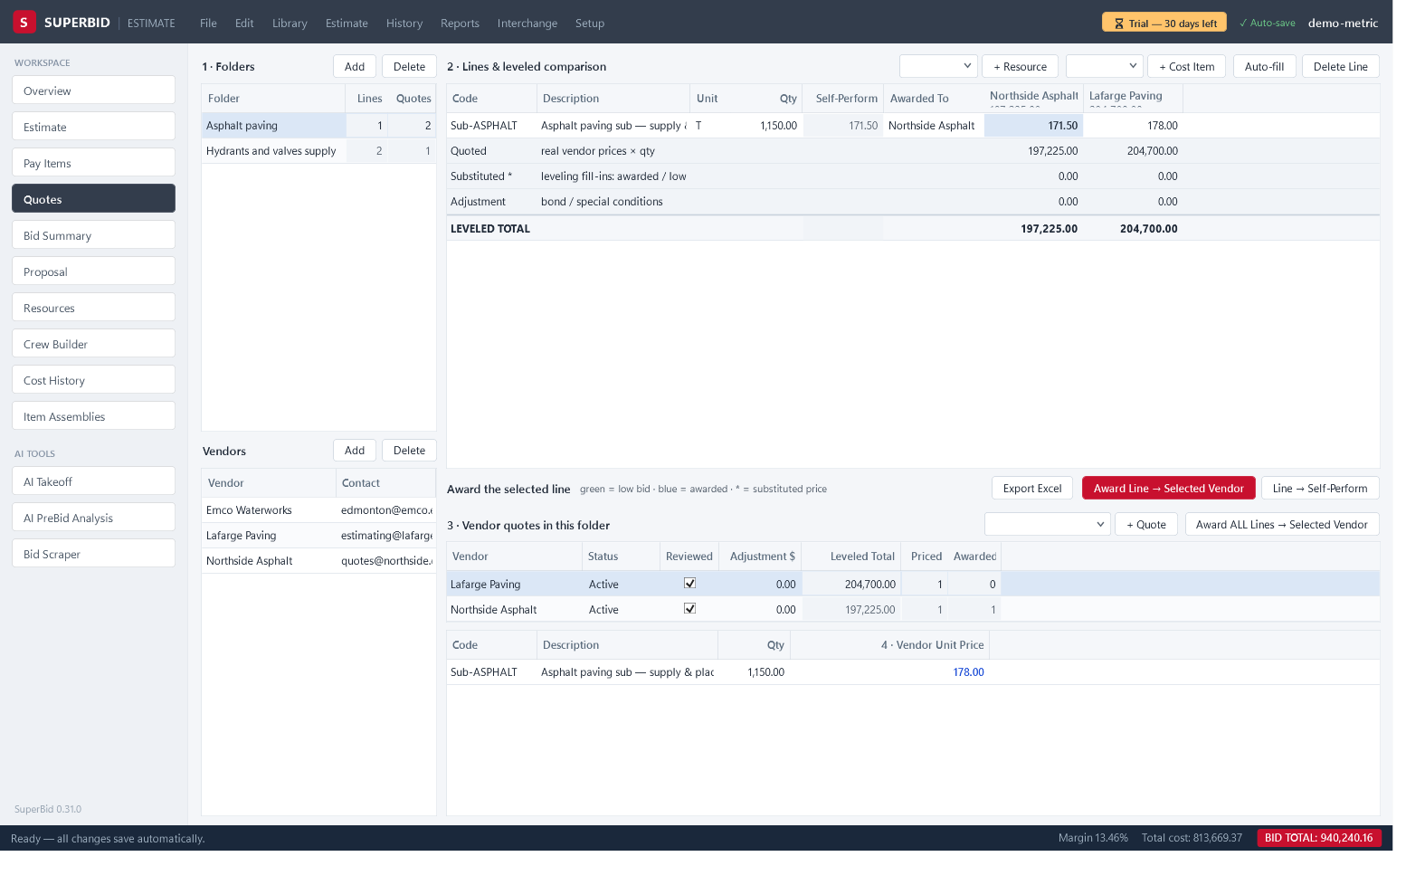
Stage 6 · Subcontractor and supplier quotes: level, then award
Quotes (Ctrl+4): folder → lines → vendors → prices
A
+ Resource for Mat-PVC300; + Cost Item for the paving scope
B
Leveling fills blanks: awarded → lowest active → self-perform (*)
C
green = low bid · blue = awarded · * = substituted price
D
Award Line → Selected Vendor reprices the estimate; tick Reviewed
E
SuperBid · Building an estimate
20
Notes:
Press Ctrl+4. Under 1 · Folders click Add and rename it Pipe & fittings. In the line bar pick Mat-PVC300 and click + Resource; the Qty is the estimate's demand including waste, 1,224 m. Under Vendors click Add twice and name the suppliers, then + Quote for each. Select a quote row and type prices in 4 · Vendor Unit Price; leave a line blank if not quoted. Point at green cells, the * substitute marker and the four footer rows ending in LEVELED TOTAL. Select the line and the winning quote, click Award Line → Selected Vendor: the resource becomes Manual at the vendor price. For 0400 add a folder with + Cost Item so the paving sub prices the whole scope. Tick Reviewed.

Slide 21
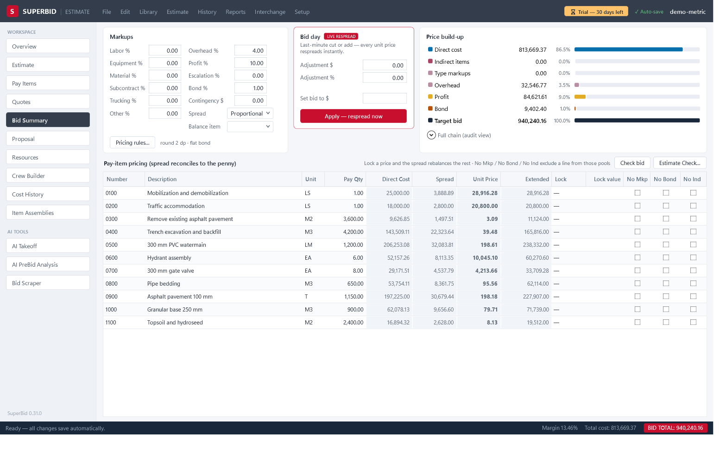
Stage 7 · Bid Summary: markups, bond and the spread
Markups card: type markups, Overhead %, Profit %, Escalation %, Bond %, Contingency $
A
Chain: direct → indirect → escalation → markups → overhead → profit → bond
B
Bond grosses up to exactly Bond % of the final bid
C
Spread: Proportional or Even; Balance item 0100 absorbs the pennies
D
Full chain (audit view): Residual must read 0.00
E
SuperBid · Building an estimate
21
Notes:
Press Ctrl+5. In the Markups card type Labor % 10, Equipment % 10, Material % 5, Subcontract % 5, Overhead % 8, Profit % 6, Bond % 1, pressing Tab after each; the grid and BID TOTAL respread at once. Explain the order: direct, indirect, escalation, type markups, overhead, profit, contingency, bid-day adjustment, bond. Bond is grossed up so it is exactly 1% of the final bid. Leave Spread on Proportional and set Balance item to 0100, a lump sum with quantity 1, which absorbs the rounding pennies exactly. Expand Full chain (audit view) and read Residual 0.00; that is the sign the bid form will foot.

Slide 22
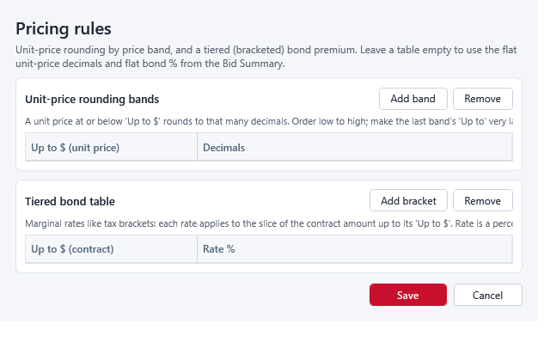
Locks, exclusions, bid-day adjustment and pricing rules
Lock: Price, Markup % or Margin % with a blue Lock value
A
No Mkp · No Bond · No Ind keep a line out of a pool
B
Bid day card (LIVE RESPREAD): Adjustment $ or Adjustment %
C
Set base bid to $ → Apply — respread now hits an exact base-bid total
D
Pricing rules…: rounding bands and a tiered bond table
E
SuperBid · Building an estimate
22
Notes:
Stay on Bid Summary. On 0300 Hydrant assembly set Lock to Price and overtype Lock value with the unit price the City expects; the displaced dollars move to the unlocked lines and BID TOTAL does not change. Show that Markup % and Margin % locks take whole-number percents. Tick No Bond on a line a sub is bonding separately. In the Bid day card type −15,000 in Adjustment $ to show a cut, then type 1,250,000 in Set base bid to $ and click Apply — respread now; the status bar confirms (with alternates it says the base bid was set and alternates are unchanged). Click Pricing rules… to show Add band for rounding decimals and Add bracket for a tiered bond table, then Save.

Slide 23
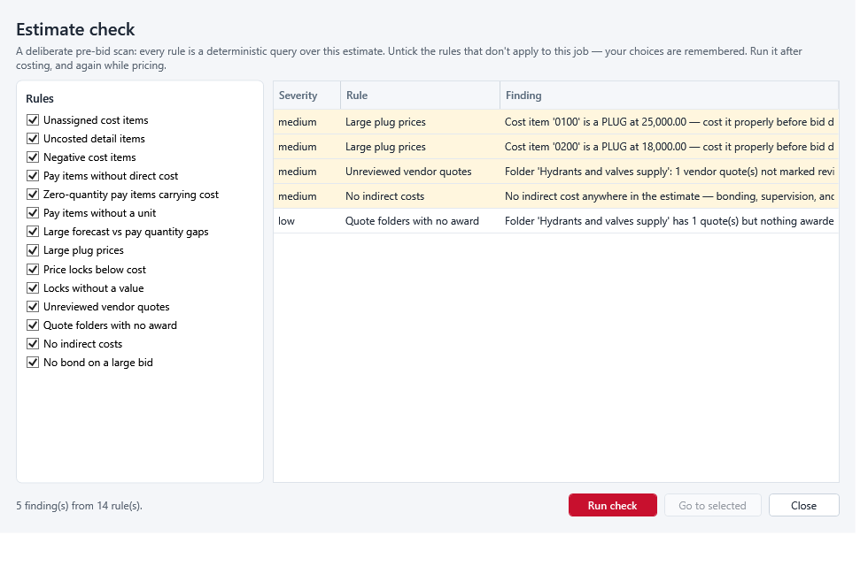
Stage 8 · Check the bid before it leaves
Check bid → Overview Data-quality checks; click a ⚠ line to jump
A
Estimate ▸ Estimate Check… → Run check → Go to selected
B
Forecast vs pay gaps over 25%, missing units, zero-quantity items with cost
C
Price locks below cost · Locks without a value · No bond on a large bid
D
Unreviewed vendor quotes · Quote folders with no award
E
SuperBid · Building an estimate
23
Notes:
Click Check bid on Bid Summary. SuperBid jumps to Overview and the status bar reads Bid readiness: all checks clear or a count. In Data-quality checks click a ⚠ line; SuperBid switches screen and selects the row. Then choose Estimate ▸ Estimate Check…. Untick rules that do not apply, click Run check, double-click a finding or use Go to selected. Name the rules they will meet most: forecast versus pay gaps over 25%, pay items without a unit, Price locks below cost, Locks without a value, No bond on a large bid, Unreviewed vendor quotes and Quote folders with no award. Rule choices are remembered between runs.

Slide 24
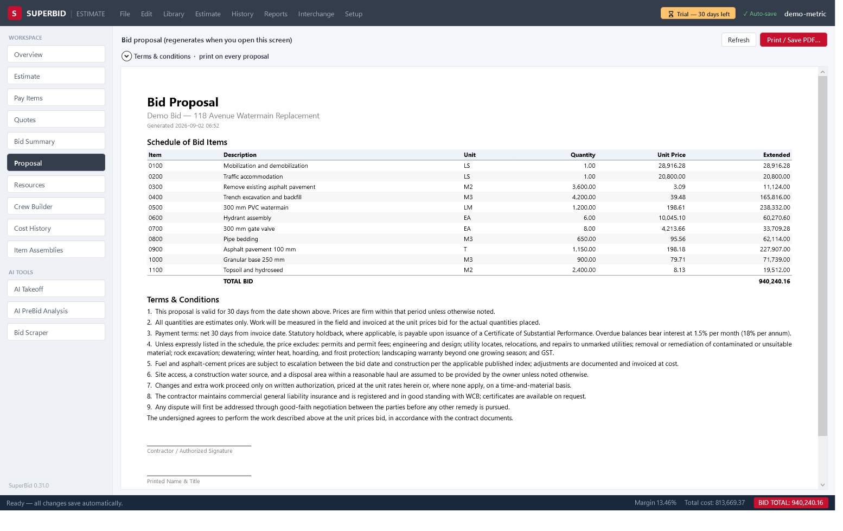
Proposal, reports and Excel exports
Proposal (Ctrl+6) regenerates the bid form each time you open it
A
Terms & conditions: Standard clauses…, Save as company default
B
Print / Save PDF… → Report Preview: Print…, Save as PDF…
C
Reports: Bid Summary, Cost Item Detail, Crew Analysis, Quote Summary, Audit Trail
D
Interchange: Export estimate to Excel workbook…, Export job-cost budget (Excel)…
E
SuperBid · Building an estimate
24
Notes:
Press Ctrl+6; the bid form regenerates each time the screen opens. Expand Terms & conditions · print on every proposal, click Standard clauses…, tick Validity, Payment & holdback and Winter work, click Apply to proposal, then Refresh. Click Save as company default so new estimates start with these terms. Click Print / Save PDF…; in the Report Preview window use Print… or Save as PDF…. Open the Reports menu: Bid Proposal…, Bid Summary…, Cost Item Detail…, Crew Analysis…, Quote Summary…, Audit Trail…. Under Interchange show Export estimate to Excel workbook… and Export job-cost budget (Excel)… for accounting. Warn that change-order items print at 0.00; price them in Estimate ▸ Change Orders….

Slide 25
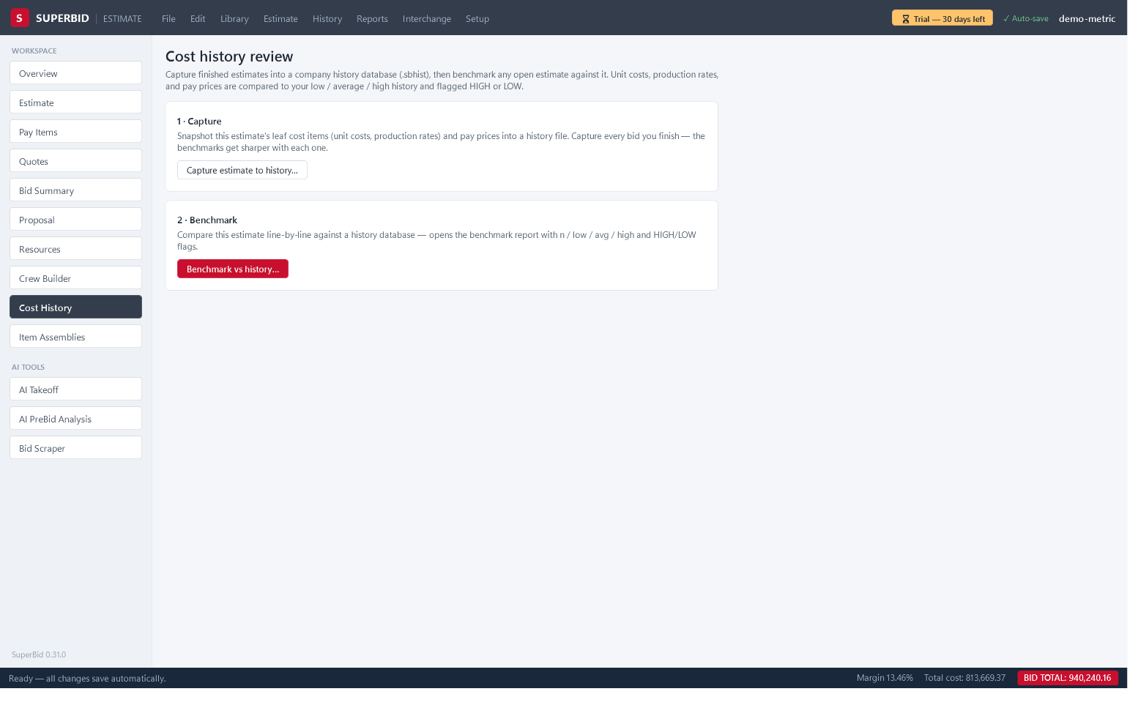
Wrap-up: saving, undo, audit trail and history
✓ Auto-save: every committed edit is already in the .sbid
A
Ctrl+Z / Ctrl+Y walk one history, stored inside the file
B
Reports ▸ Audit Trail…: every labelled change, newest first
C
History ▸ Capture estimate to history… → company-history.sbhist
D
History ▸ Benchmark vs history… flags HIGH / LOW against past bids
E
SuperBid · Building an estimate
25
Notes:
Answer the three questions every team asks. Saving: there is no Save; the ✓ Auto-save chip means the .sbid already holds every committed edit. Back up by copying the file, but only after closing it, because SuperBid holds it open. Undo: Ctrl+Z and Ctrl+Y walk one history for the whole file, stored inside it, so yesterday's changes can still be undone; Reports ▸ Audit Trail… lists every labelled change newest first, times in UTC. History: press Ctrl+9, click Capture estimate to history…, save to company-history.sbhist and click OK on the History capture message. On the next bid click Benchmark vs history… and read the HIGH and LOW flags against your own past unit costs and production rates.

Slide 26
Questions, and where to get help
The manual's chapters follow today's stages
Licence keys: sales@superbid.ca with your machine ID (per computer)
Problems: support@superbid.ca with the SuperBid.App.exe --selftest output
Setup ▸ Check for updates… keeps you on the latest version
Questions?
Notes:
Thank the group. Repeat that the manual chapters follow the same order as today's stages, so any step they saw can be found again. Licences are per computer: Setup ▸ License key… shows the machine ID to send to sales@superbid.ca. For problems, run SuperBid.App.exe --selftest from the install folder with SuperBid closed and email %TEMP%\superbid-selftest.txt to support@superbid.ca. Setup ▸ Check for updates… confirms they are on the latest version. Open the floor for questions, and offer to walk through anyone's real tender on the spot.

