Slide 1
Kimo Makes Dinner
I’m tired and it’s been a stressful week, so this is my pp

Slide 2
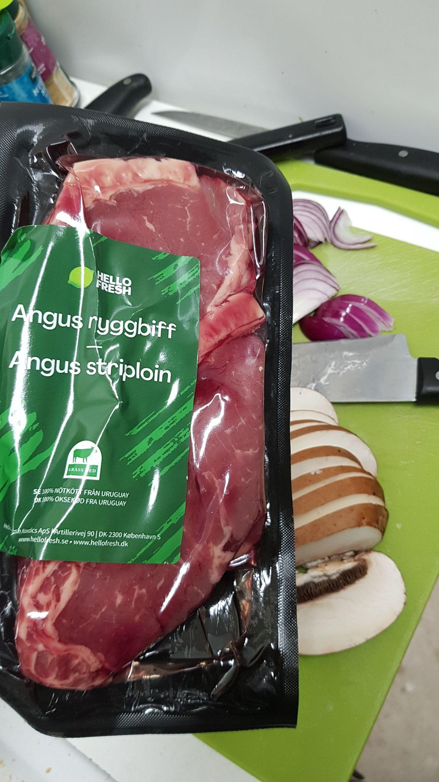

Angus beef

Slide 3
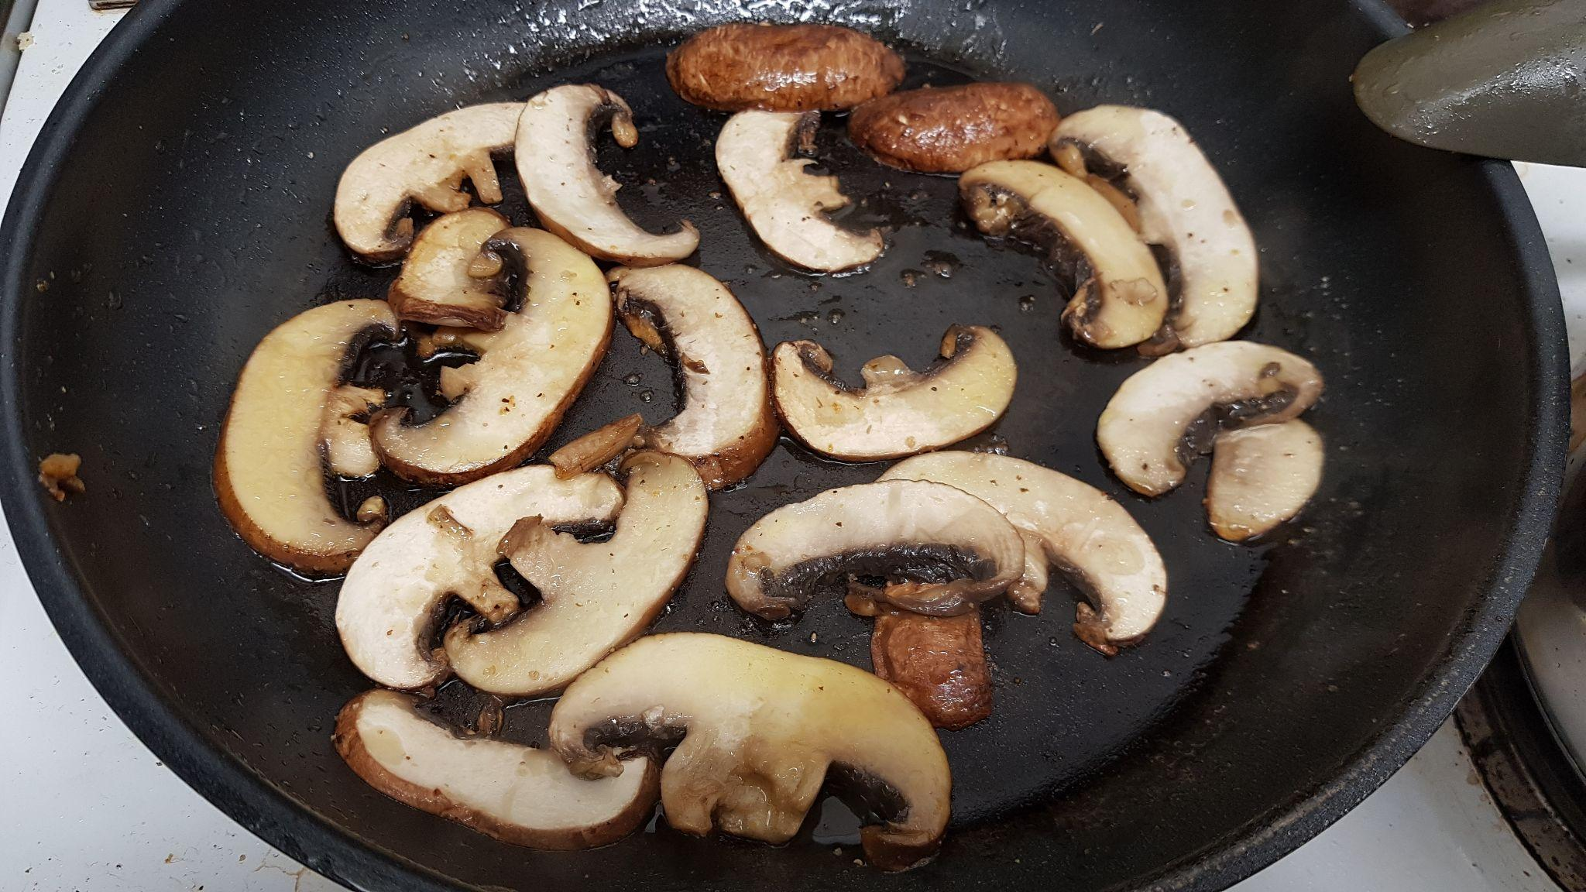
Portobello mushroom

Slide 4
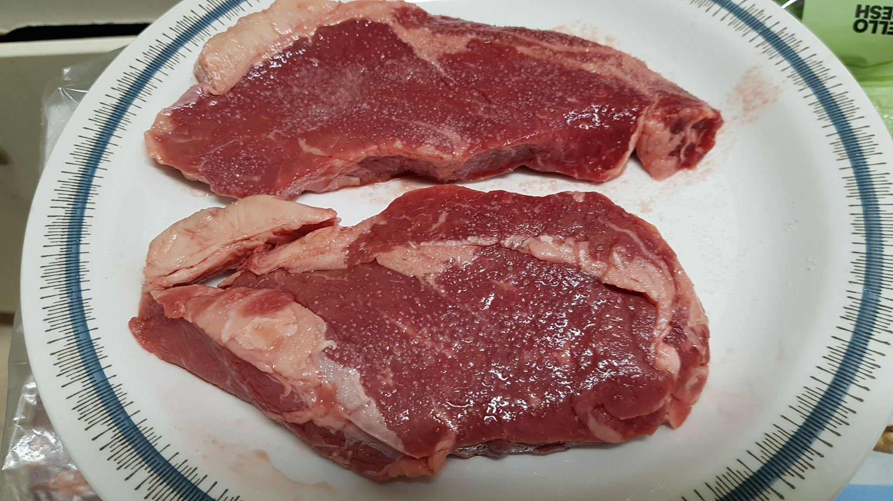
Mmmmm Angus beef

Slide 5
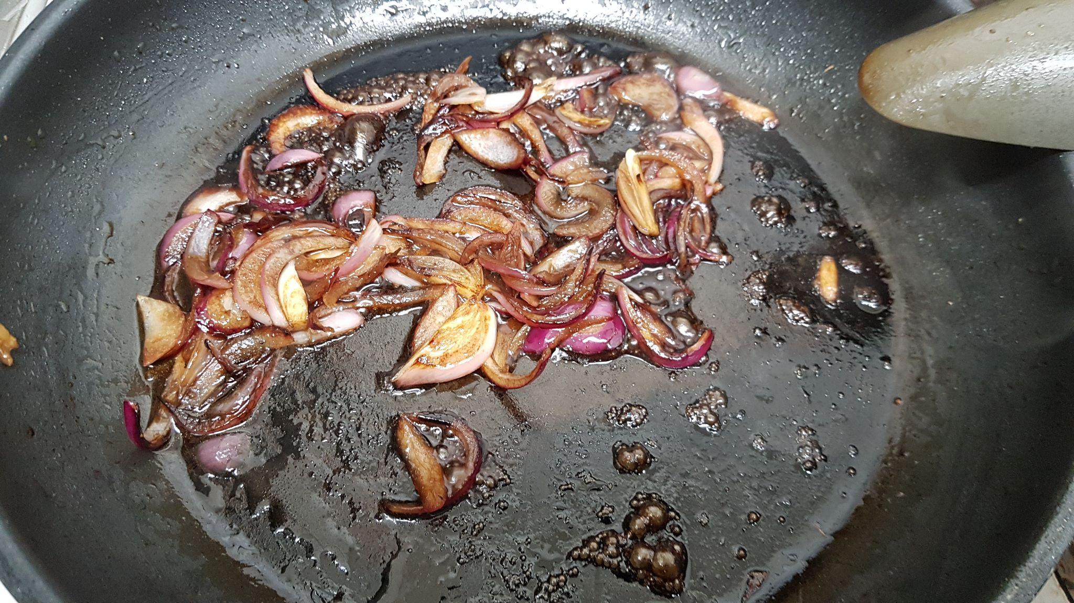
Red onion Balsamic vinegar

Slide 6
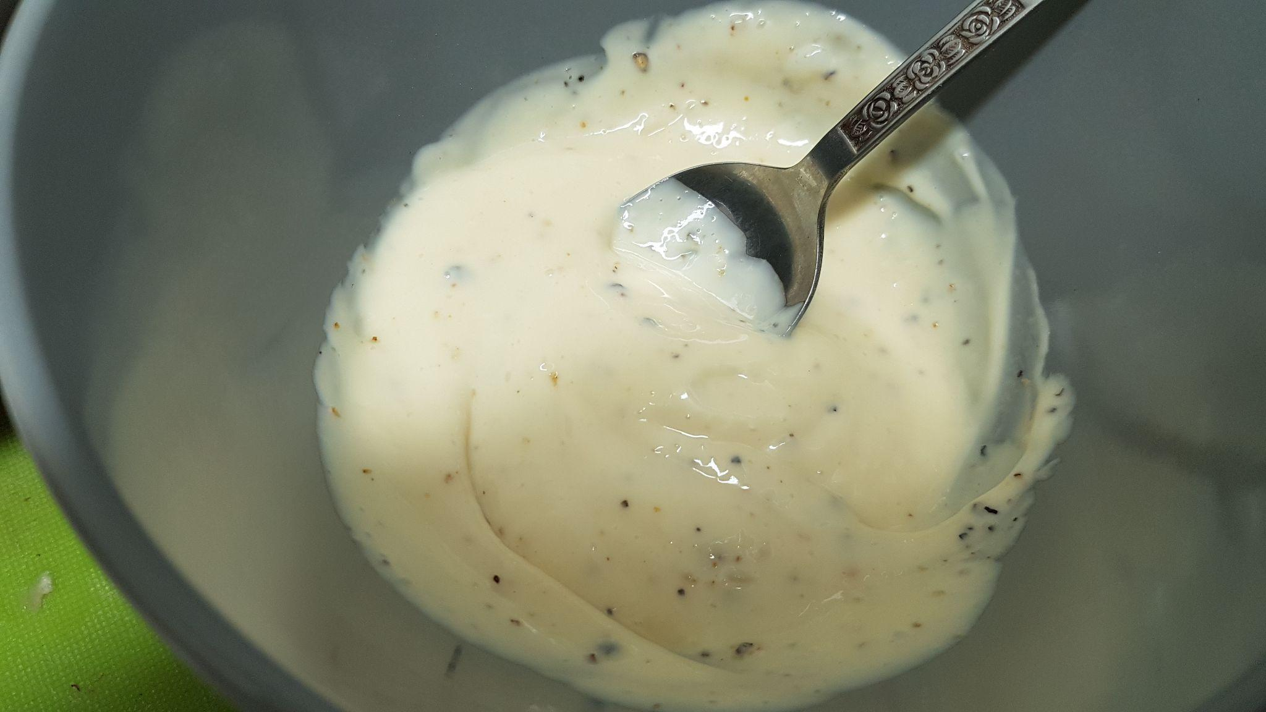
Aioli

Slide 7
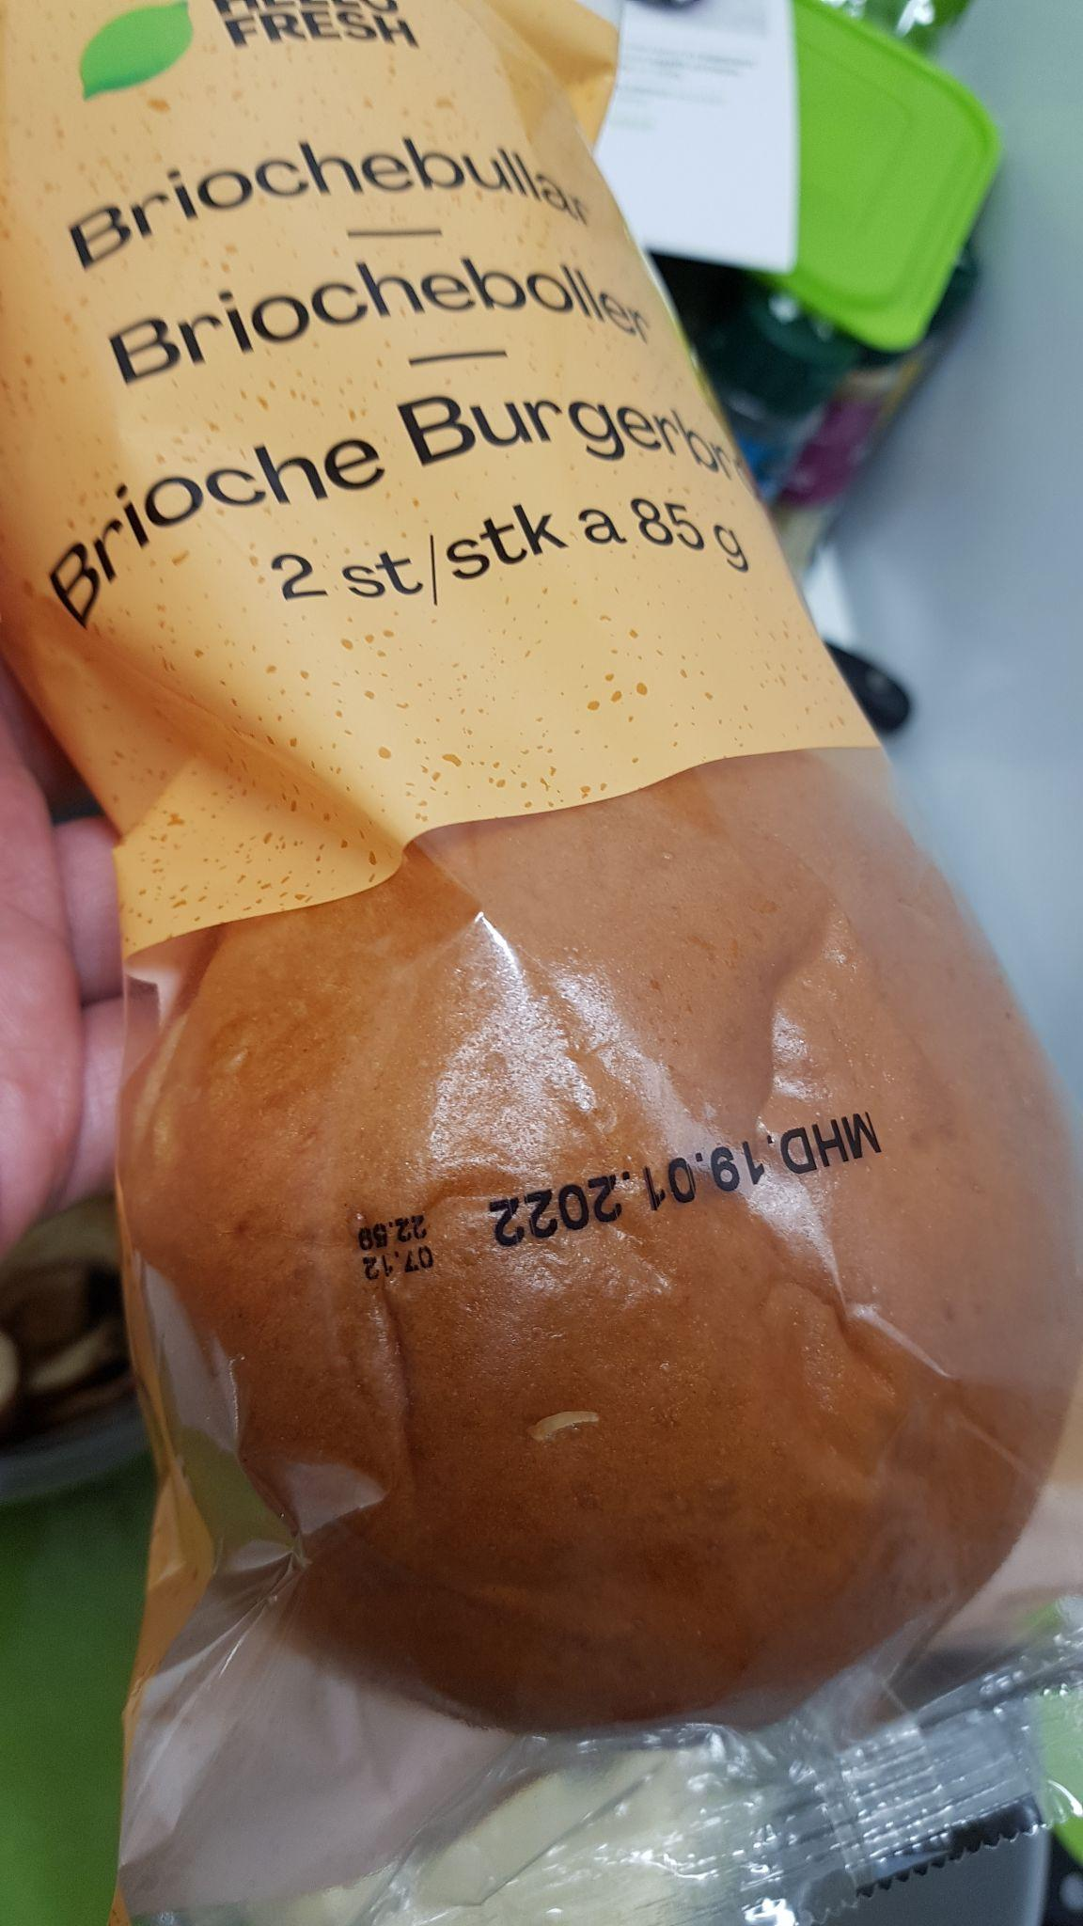
Brioche

Slide 8
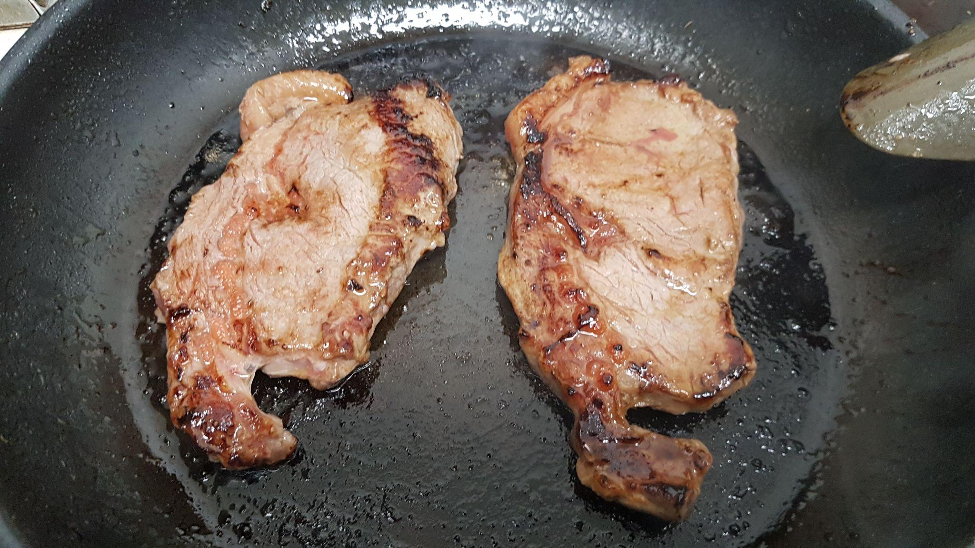
Angus beef

Slide 9
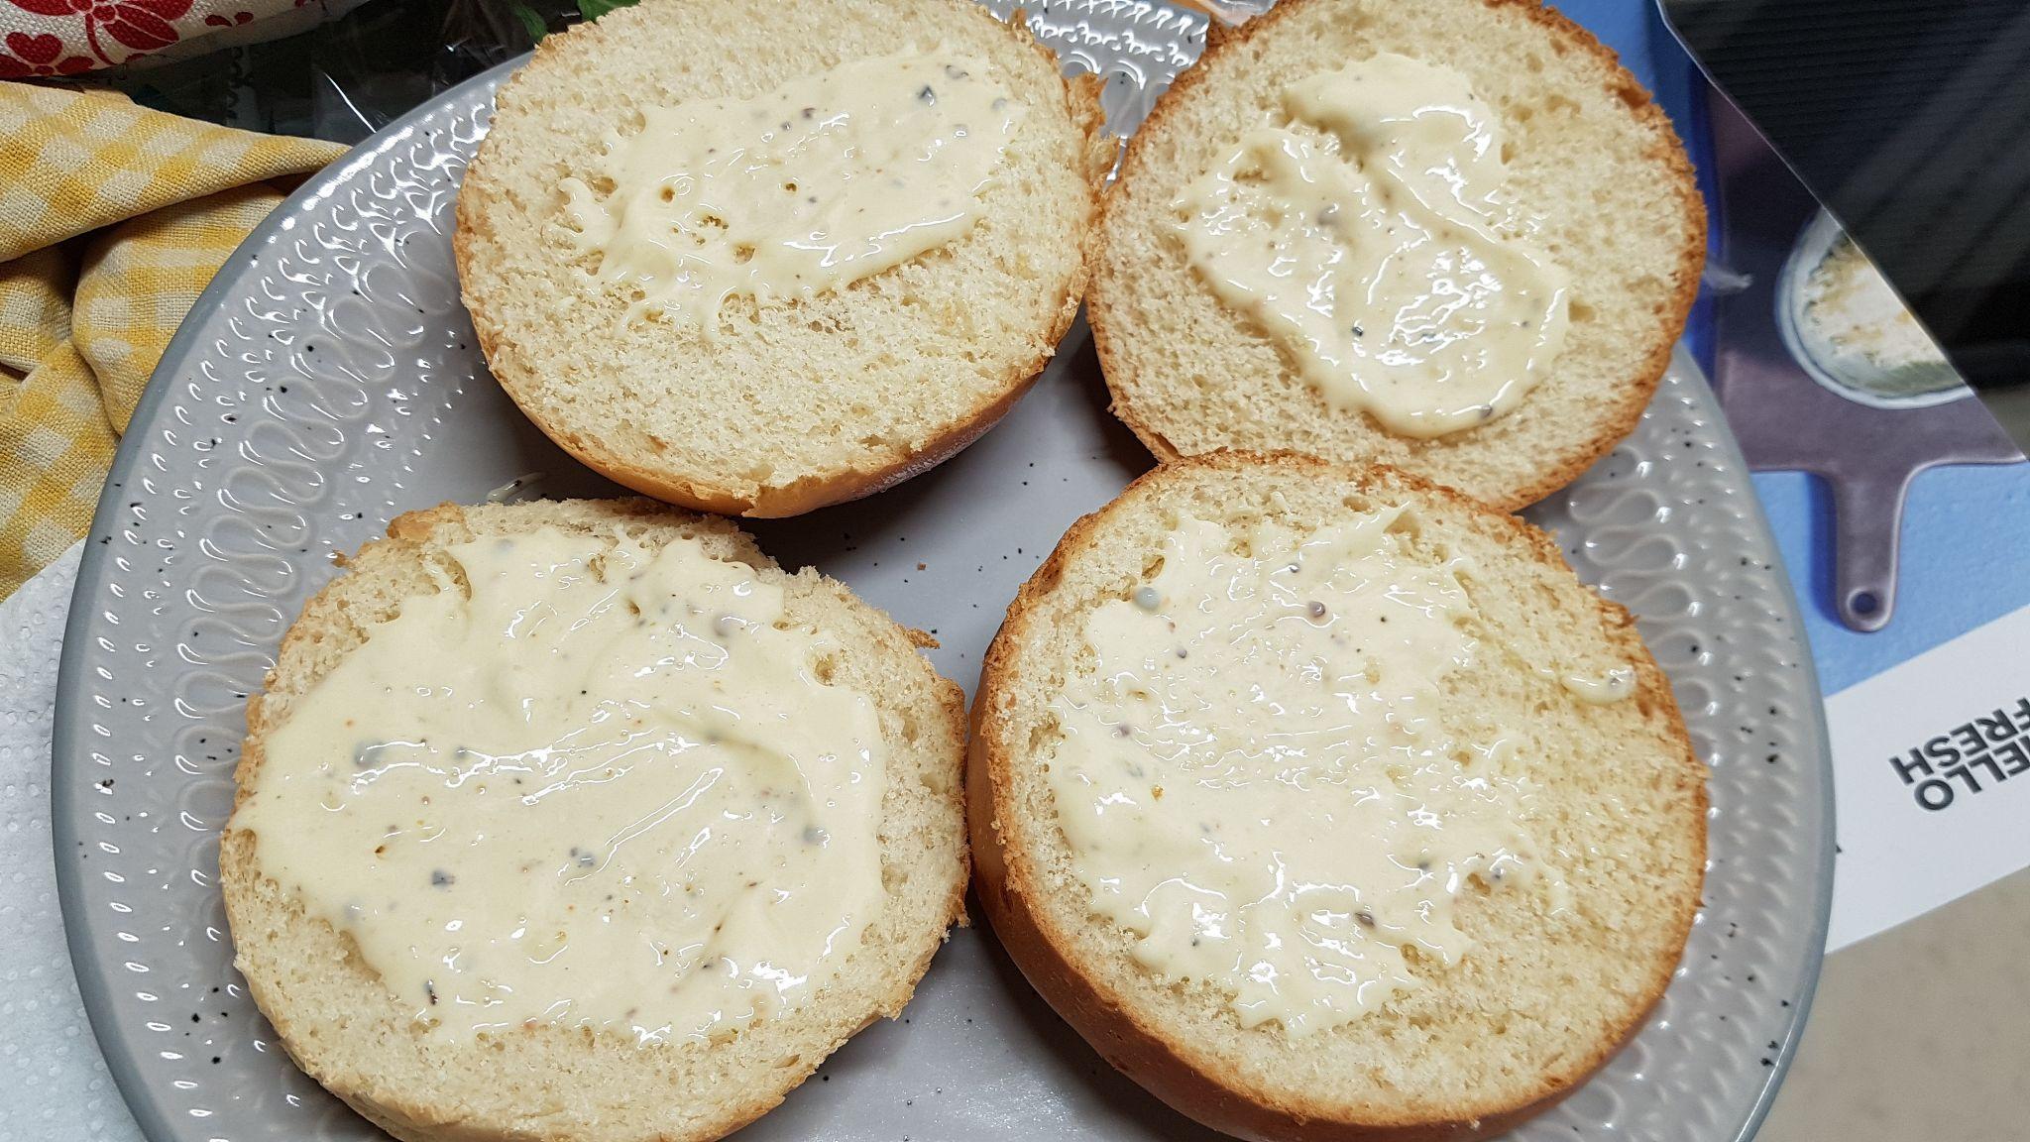
Toasted Brioche + Aioli

Slide 10
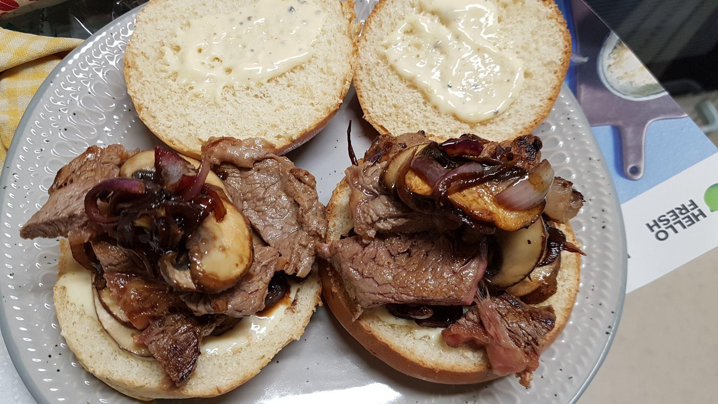
Coming together

Slide 11
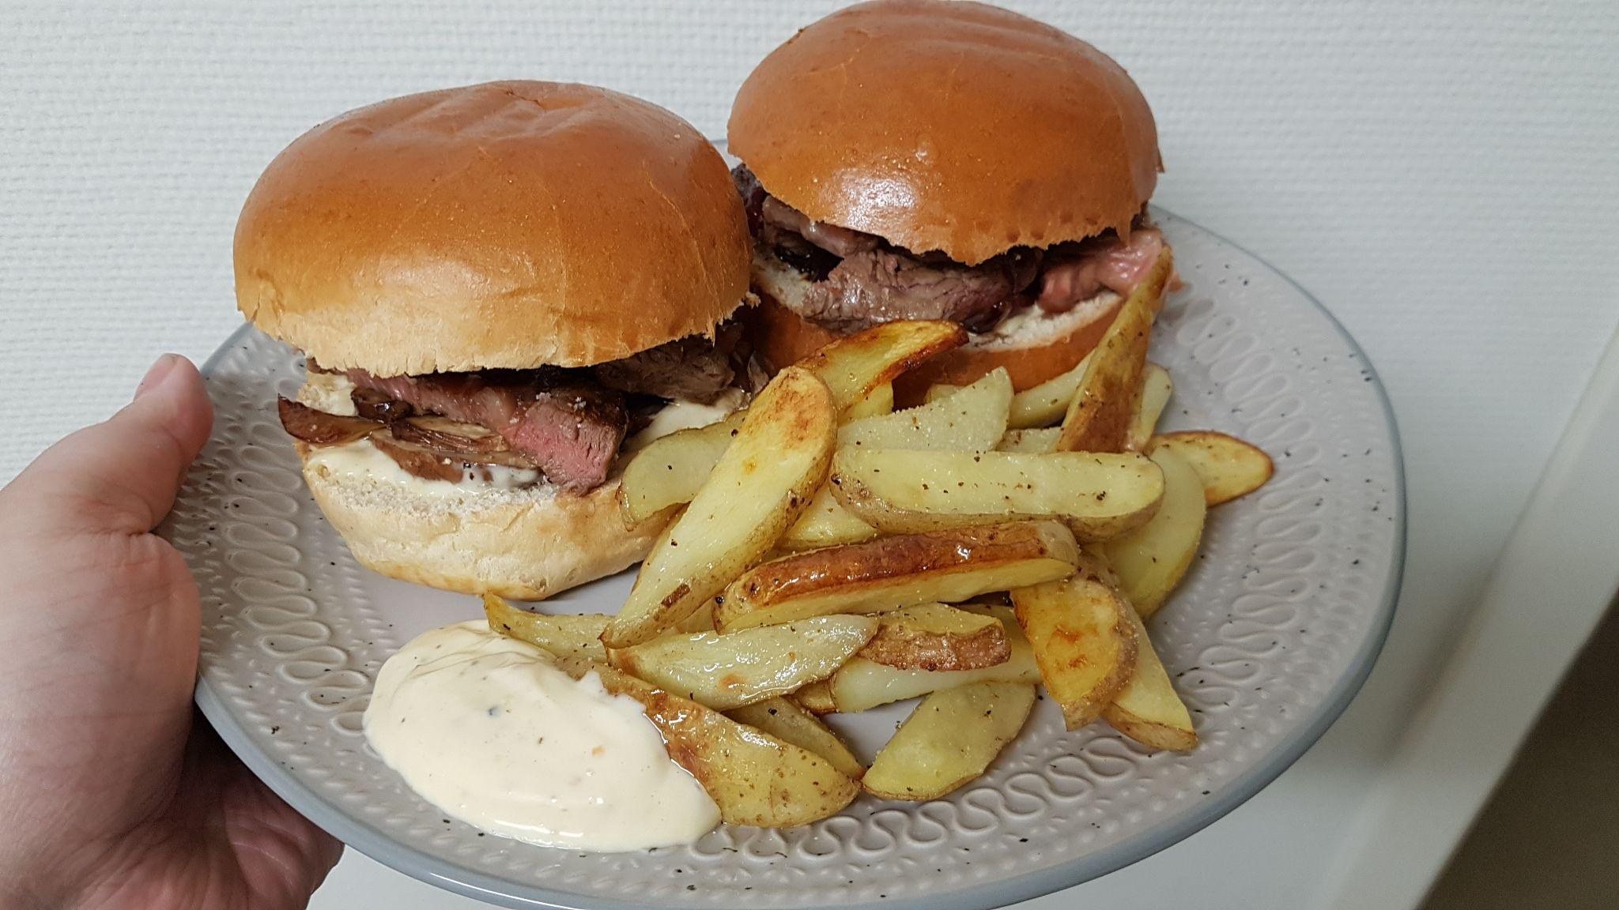
I did not snap a pic of my potatowedges in their natural habitat

Slide 12
That was dinner time with Kimo
My food is now cold

Slide 13
Oh and Welcome Gabes better half
I hope you don’t think Gabes friends are super weird

