Slide 1
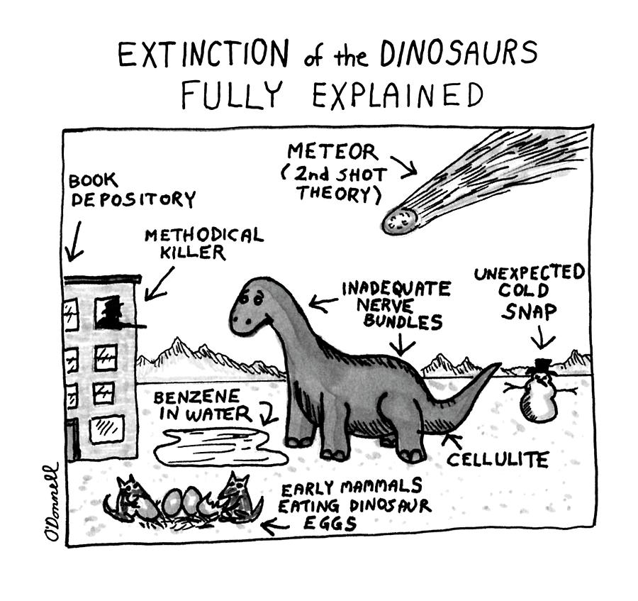
Lesser known theories for what happened to the dinosaurs

Slide 2
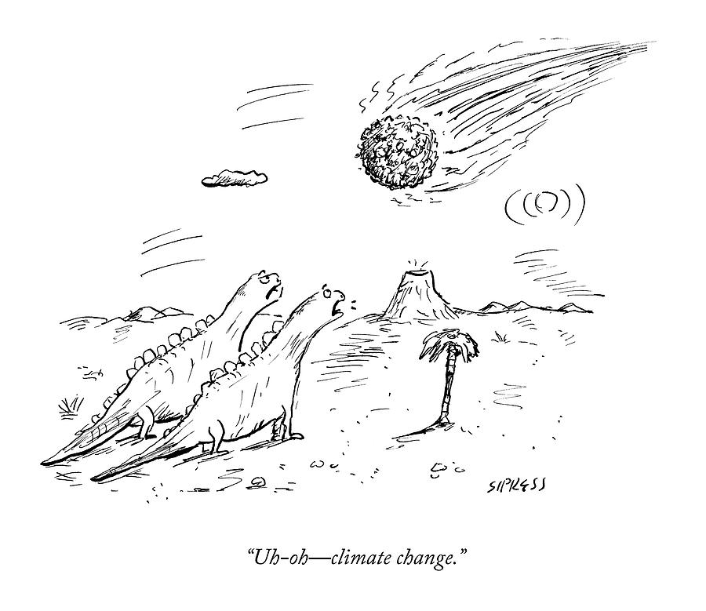
The ”official” narrative
”Official” theories:
BiG rOcK
VUlCaNic ActIViTY
ChaNGING oxIGEN lEvELs

Slide 3
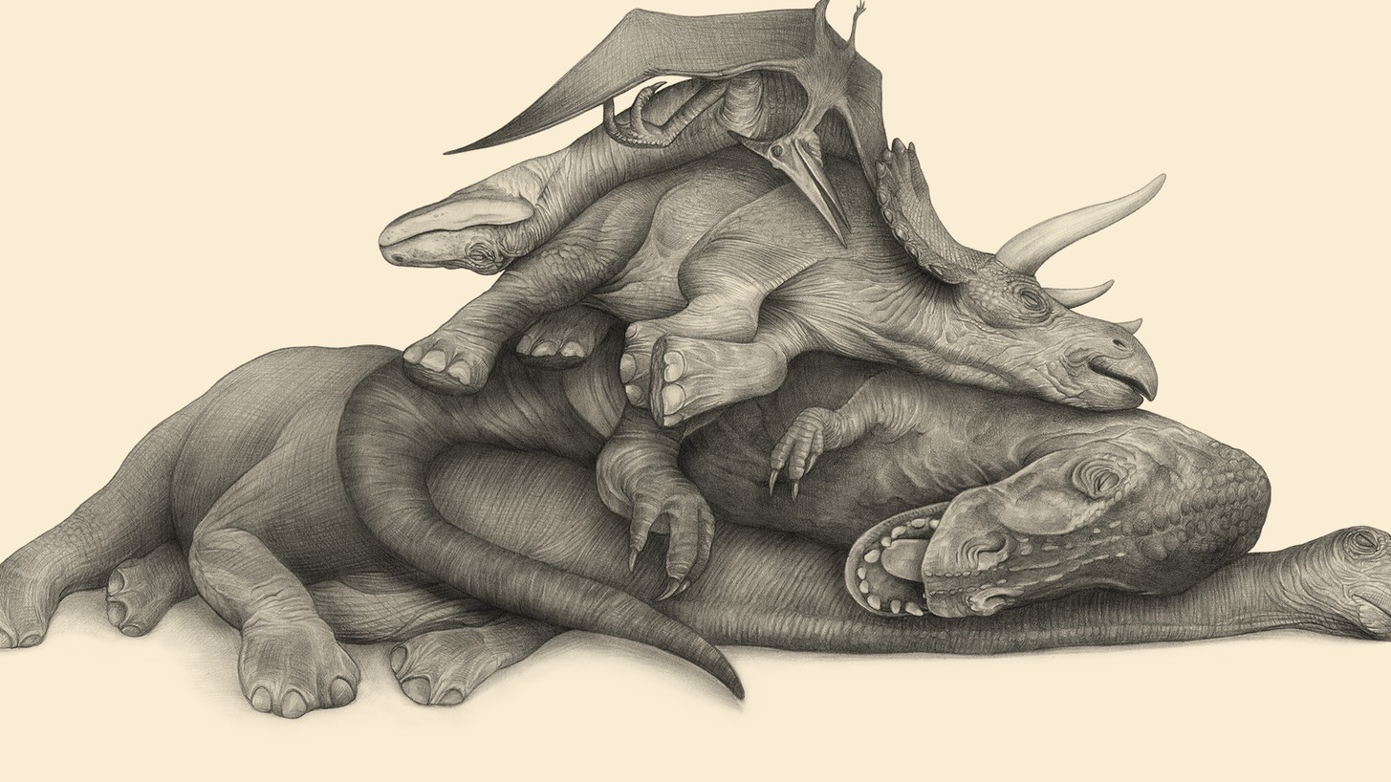
Ritual mass sucide

Slide 4
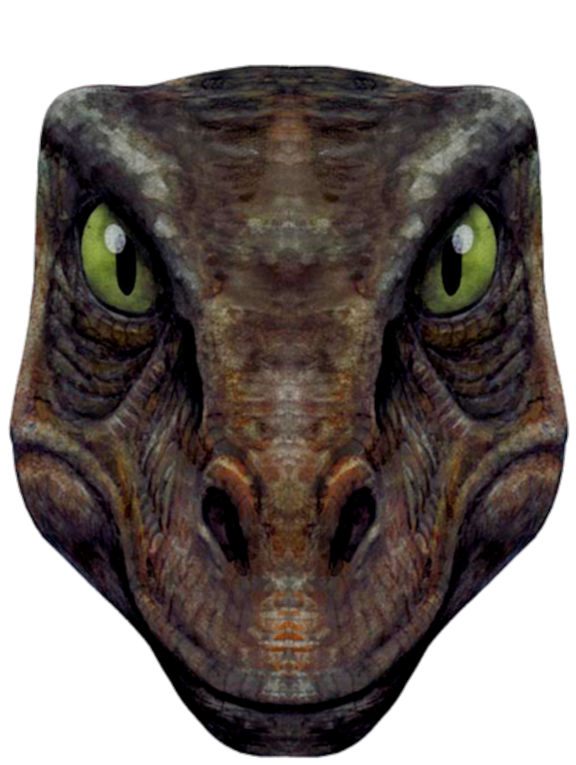
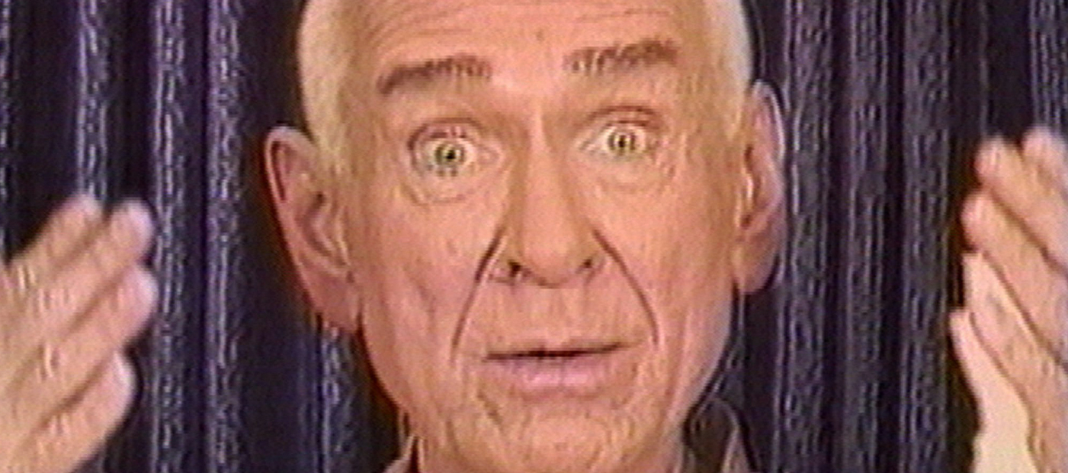
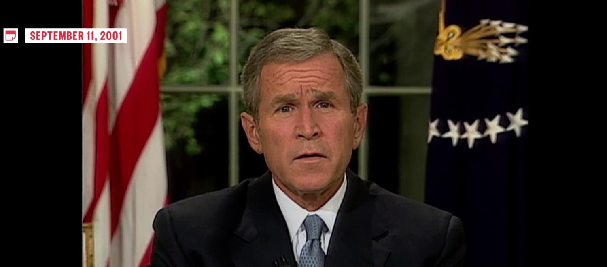
Two theories
1997 Heavens gate
Why not dinsosaurs too?
Speaking of revelation
George W Bush
Faith is ironys greatest servant

Slide 5
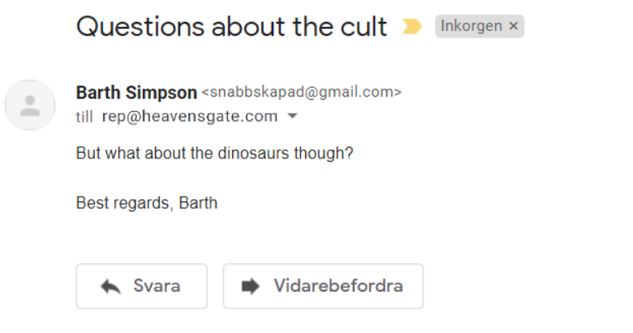
Sources for the revelation…
Heavensgate’s email
He totally pussed out and edited this together

Slide 6
Thank you for attending my ted talk
Sources Lindberg, A, Can you point to that dinosaur? Vol 4., New York 1999 A dream I had when I was fifteen Other letter I faked from prestigious journals

Slide 7
Resons why Gabes girlfriend should join
She is a cool gal
We can find out if gabe picked the right one
Nice pure blood

