Slide 1
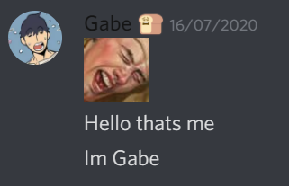

Why is Gabe so slow
And why Gabe’s girlfriend is better

Slide 2
He is not prepared
He could have uploaded it before
Could have asked someone in private who’d be stream
Could also have both converted and uploaded at the same time

Slide 3
She is better because….
She took pity on the fool
She makes him happy
She’s not Gabe
She’s supportive of him, even though he’s………

Slide 4
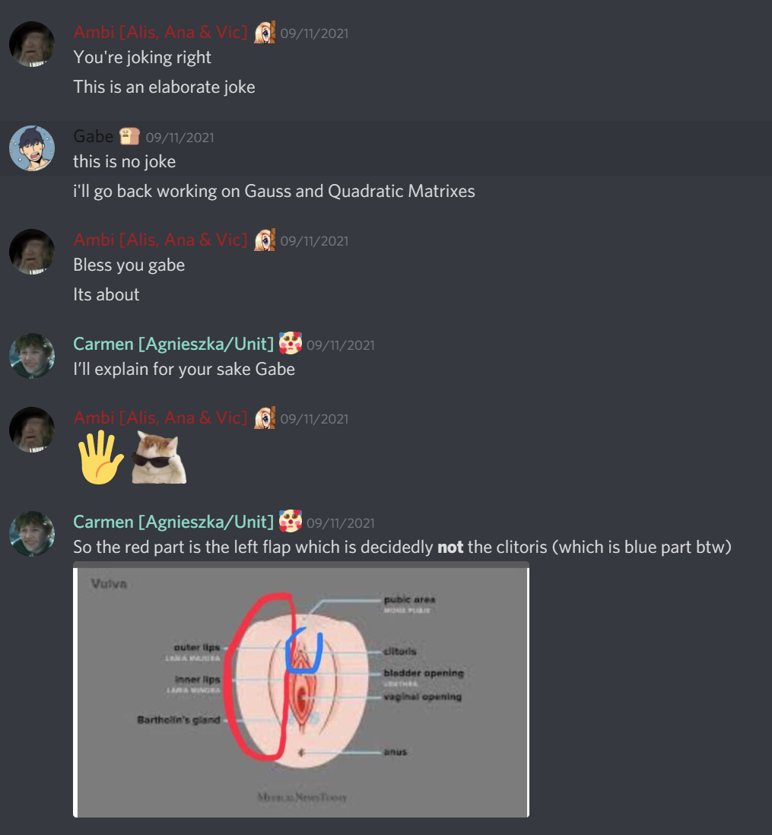


Gabe is…
Oblivious
Uneducated
In need of knowledge
Mistreating his poor girlfriend, how can you not know this?
His poor girlfriend, she really should join the server

Slide 5


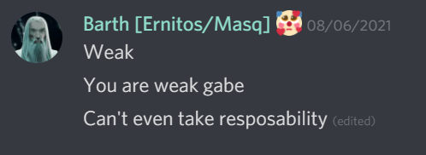

Gabe is…
An idiot
Weak
Dissapointing

Slide 6

