Slide 1
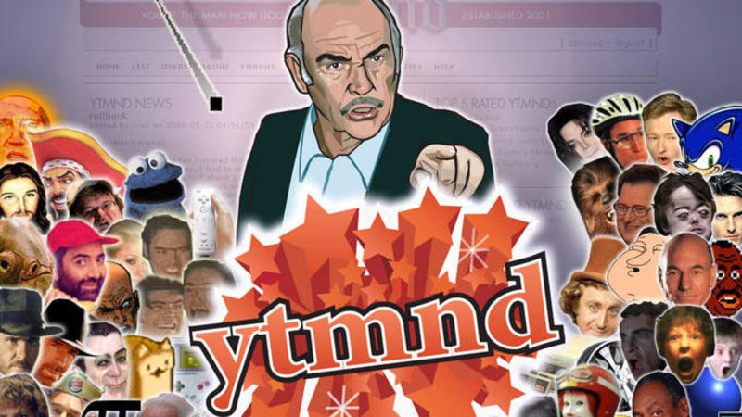
You’re the man now dog
The history of YTMND.com

Slide 2
So what is YTMND?
It’s a very old school memesite, where you originally stitched together gifs and audio, and gave it a fitting name which in turn became the url to the actual meme.
There’s been tons of shitty ones and a couple of golden ones, throughout the history of YTMND.
Some have aged poorly.

Slide 3
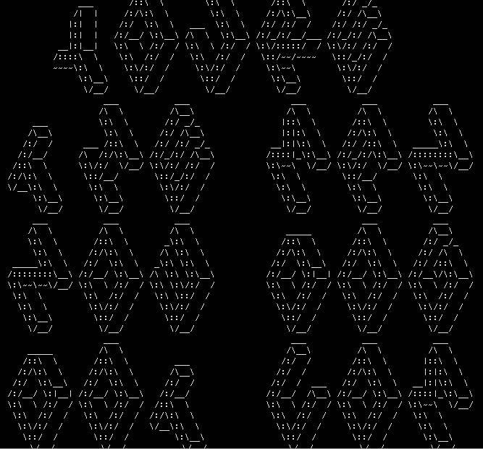

Origin
July 6th 2001 the site Yourethemannowdog.com was created. The quote comes from a line by Sean Connery in the 2000 movie “Finding Forrester” .
April 1st 2004 the domain ytmnd.com registered.
April 25th first notable site was submitted by ShittyMcShit, picard.ytmnd.com
November 25th 2005 saw a redesign with comments, news, content management etc.
December 14th 2005 a “sponsored pages” was added, donations to get featured on the frontpage, launched as a fundraiser.

Slide 4
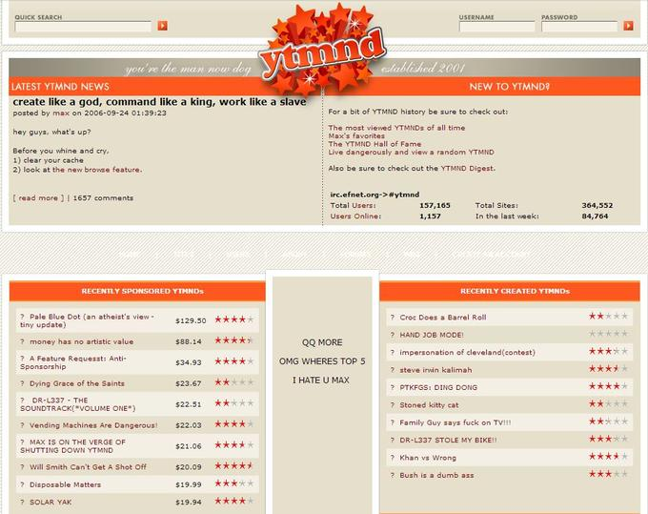
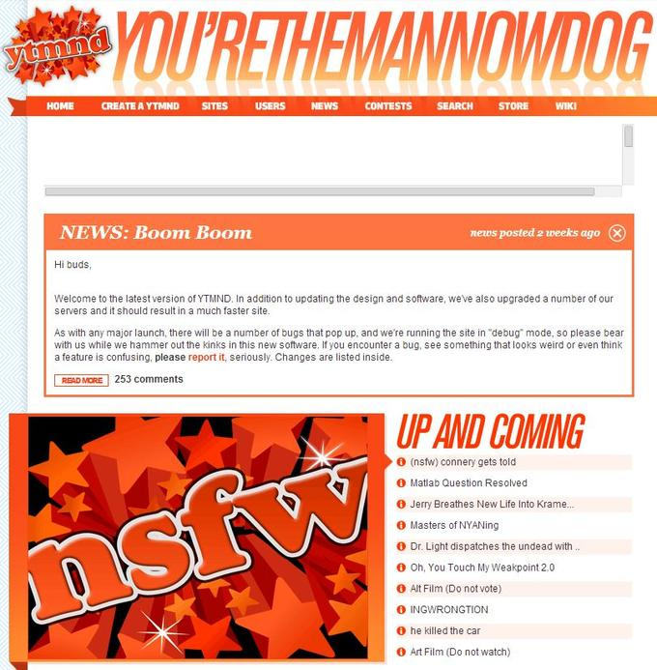
And we keep going
September 24th 2006 another redesign, added browsing feature.
July 16th 2011, the last redesign and an update of the software, going from XHTML to HTML 5

Slide 5
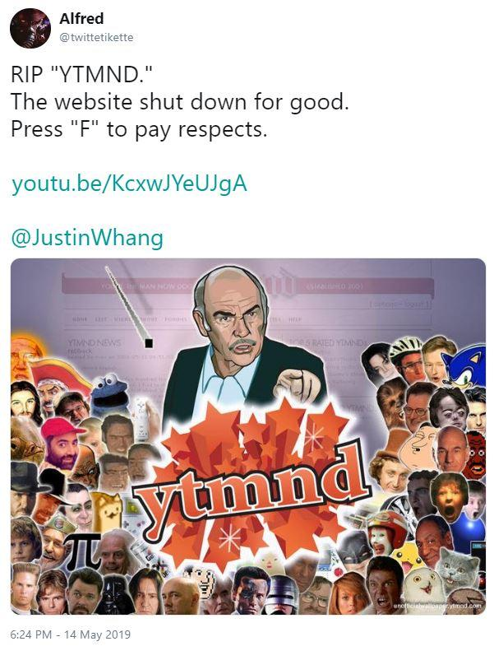
The fall
“Besides being a time capsule I don’t really see a reason for it to continue to exist… It seems like the internet has moved on. And I’ve moved on too. I don’t have much interest in the site beyond it being good memories.”
On august 29th 2016 Gizmodo published an article titled “Who Killed YTMND?”
It featured an interview with the founder and owner.
"YTMND has suffered a catostrophic failure. Whether or not the site will ever be back is still undecided. I am actively working on data recovery, but who really knows what the future holds. Join the chat to reminisce, or if you have concerns about the direction in which your life is heading, feel free to send an email to support @ ytmnd.com (and expect to be ignored)."
May 13th the site was offline.

Slide 6
The site is up again, at some point in time it came back.
Here’s a few of the more famous ytmnds
NEDM (not even doom music)
Lol Internet
A winner is you
Safety not guaranteed
Anime is not Original
Moskau barrel roll
Secret Nazi
Catch that man
Cosby Bepop
Epic Manouvre
Sonic Says
Conan Is...
Prof X had ONE weakness
Notes:
1997 TNG

Slide 7
I hope you all enjoyed
This trip down Memery lane.

