Slide 1
Welcome to my PP

Slide 2
Why we need racism
WAR!!

Slide 3
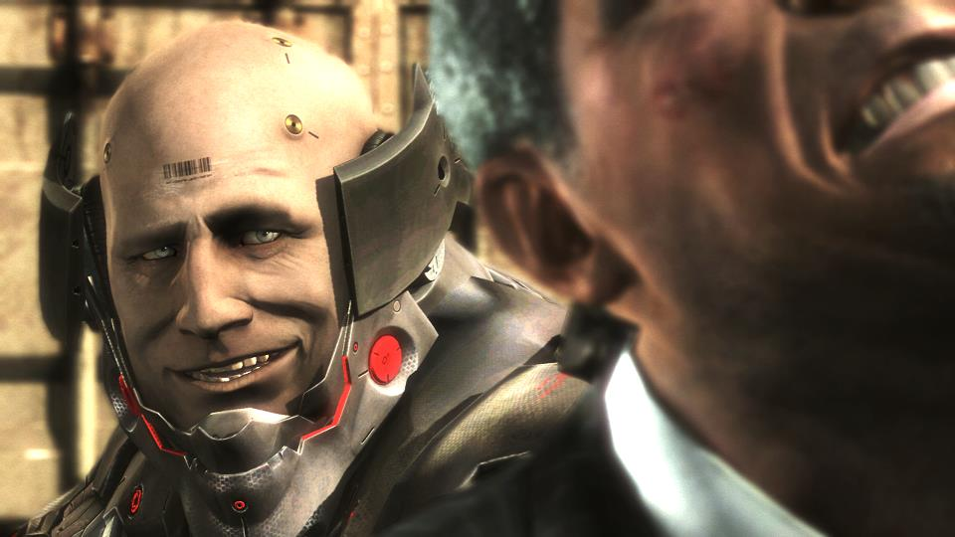
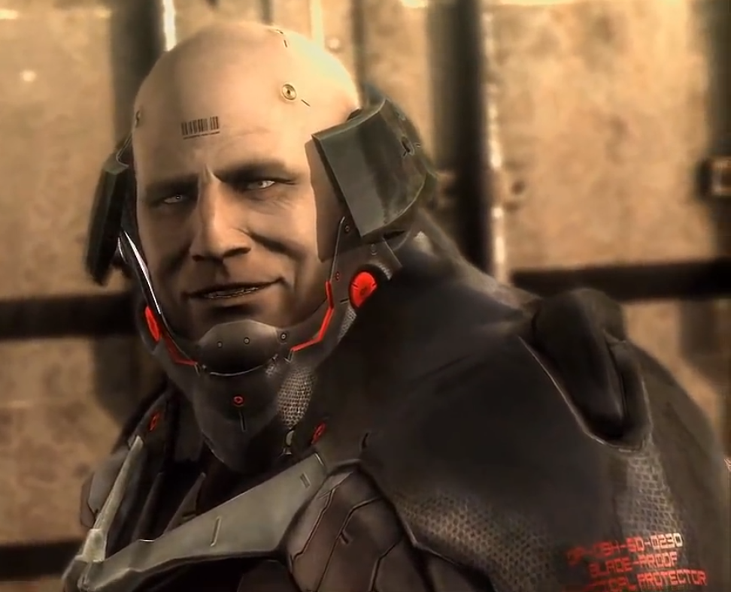
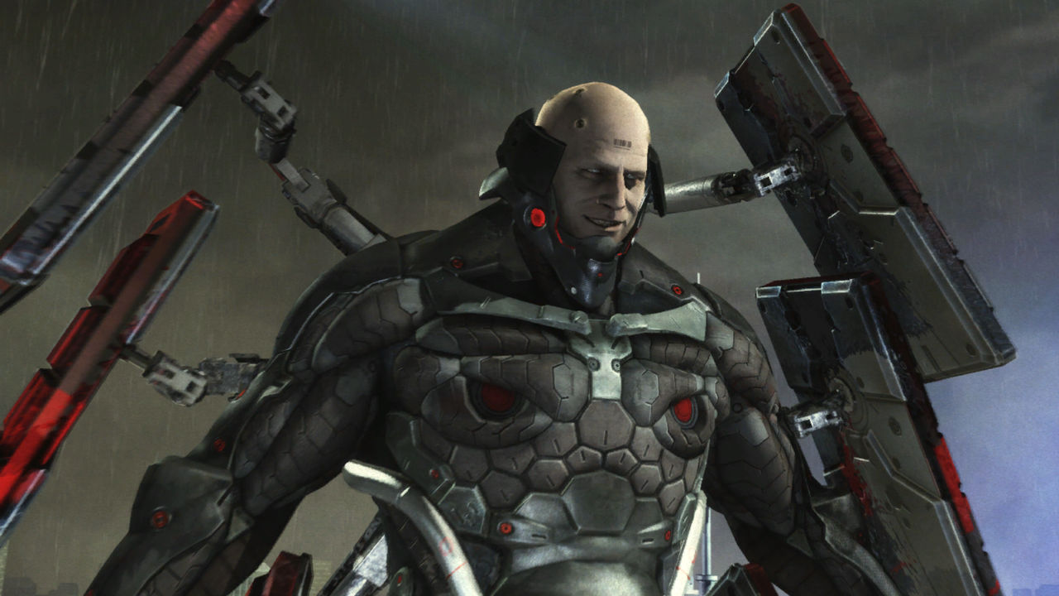
Why we need racism
WAR!!

Slide 4

"What about all the good things war has done for us? Why don't we ever hear speeches about that? Jobs, technology, a common purpose… All we're sayin' is… GIVE WAR A CHANCE!"

Slide 5

I fucking love war
I want to fucking kill people for money and destroy cultures and history

Slide 6
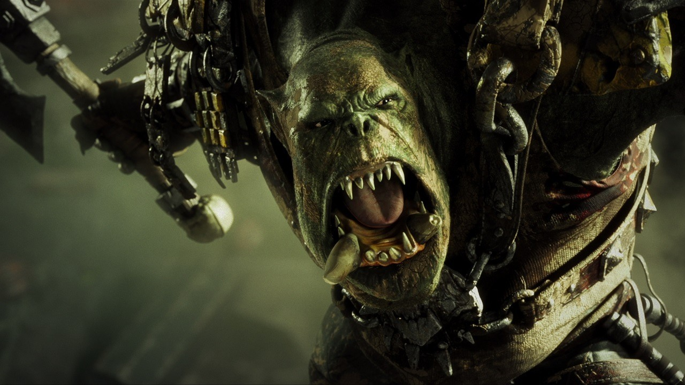
To sum things up I’d like to say
WhhhAAAAAAAAAAAAAAAAAAAAAAAAAAAAAAAAAAAAAAAAAAAAAAAAAAAAAAAAAAAAAAAAAAAAAAAAAAAAAAAAAAAaaa

