Slide 1
Clayrans
The rat people of the Desert

Slide 2
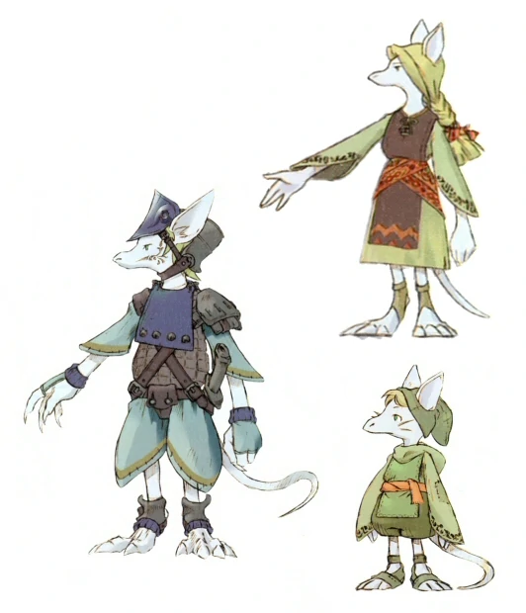
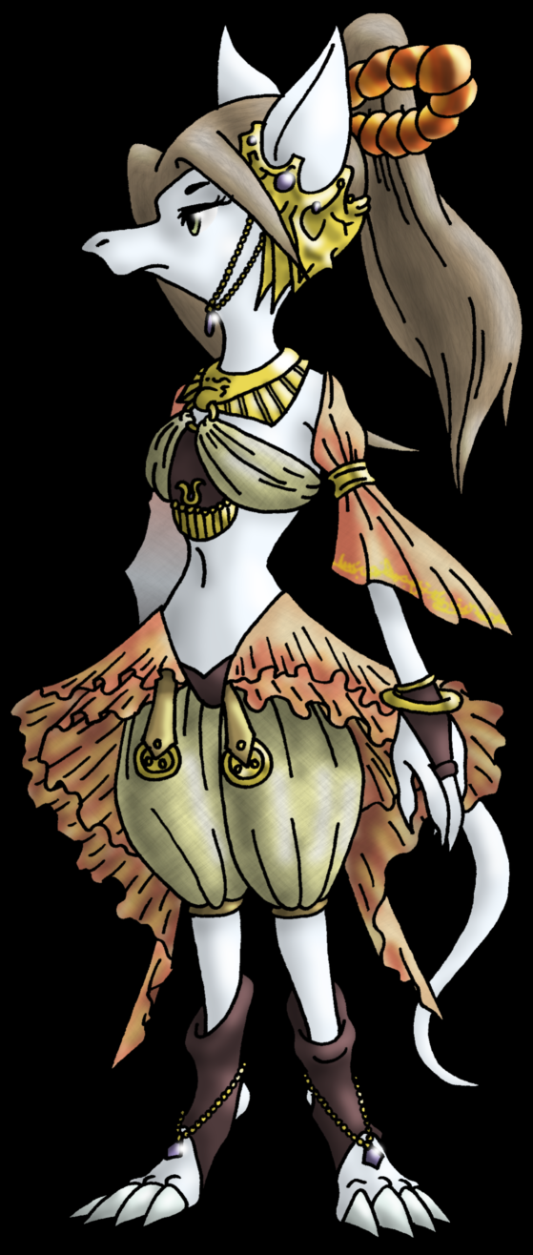
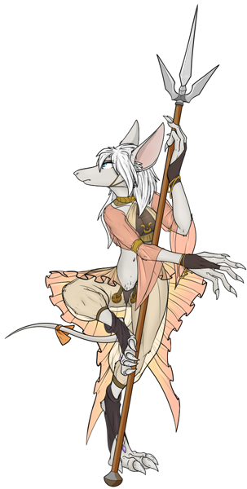

Slide 3
Characteristic
- Ability score: +2 Dex +1 Wis
- Age: Clayrans reach adulthood at age 5 and live up to 30 years
- Size: Clayrans average at around 4 feet and weight about 40 pounds. Your size is medium
- Speed: Base walking speed is 30
- Small Build: Your size is considered small when moving through enemy spaces and for squeezing
- something else idk maybe caste related

Slide 4
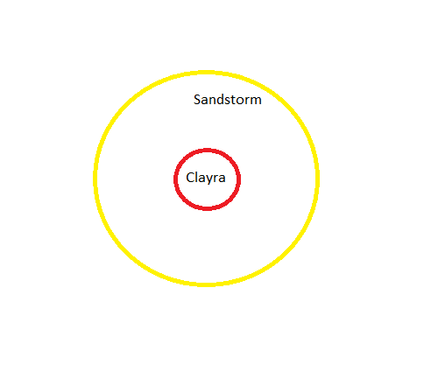
Last Bastion of Clayra
est. Population: 20000
is the last remaining city of the clayran empire
located underground
surrounded by a magical barrier and a Sandstorm

Slide 5
Society
Clayrans live really social democracy and are closely tied to each other. after reaching adulthood they get placed in one of the Castes
Castes are split into:
Military
Workers
Seers
Live Isolated away from other races, only contact is through trade

Slide 6

Military
Lowest rank: Guards of the City
Elite Rank: Sand Shark Riders, Dragoons(Dragon Hunters)
Magical Rank: Seers

Slide 7
Religion
Clayrans don't follow any gods and pray to their Ancestors (past high Seers)
High Seers are considered the strongest Spell casters and the wisest Clayrans
They have to follow a long and dangerous path alone after which they get a mysterious and powerful gift
High Seers are considered to be Immortal
Past High seers and their gifts:
First High Seer Skrovkok (could bring back the dead)
Second High Seer Pobbi (could see visions of the future)
Third High Seer Vonkar (could give the gift of magic to those that did not possess it, sacrificed himself creating the Sandstorm)
Fourth and current High Seer Rikkez (Has a pact with an Adult Blue Dragon)

Slide 8
Pillar of Eternity
Giant crystal shaped out of Magicite
located in the heart of the City and most guarded location
powers all the magical devices in the city, the Barrier and the Sandstorm
gets powered by the Great Parting

Slide 9
The Great Parting
Clayrans that reach a certain age are expected to partake in the great parting
The Great Parting is performed by the High Seer themselves
in this Ritual the involved get their soul and lifeforce removed to power the lasting spell that protects the city
this is considered a great honor as even after death they can help and protect their people and families

