Slide 1
ADD Brain time
Life for me with add
Nothing is in a particular order

Slide 2
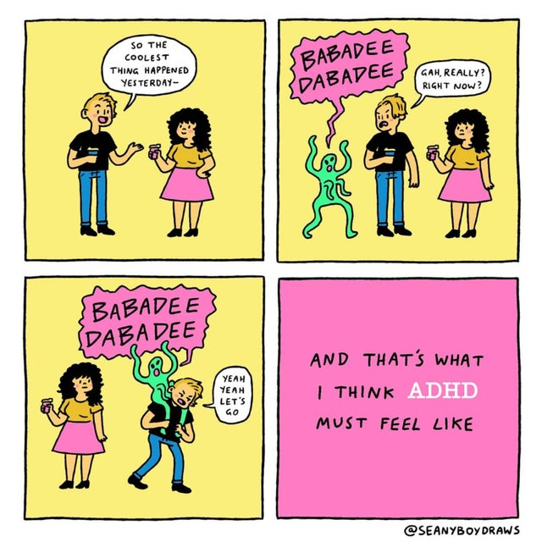
Some issues I have
Planning
Organisation (these are actually different things for me)
Getting stuck in my own head
No overview
No concentration (the classic)
Unability to perform a task
Needing a certain level of stimuli
Don’t forget to play the devildriver: sail song (or awolnation)
The link for others later perhaps: https://www.youtube.com/watch?v=torc9P4-k5A&ab_channel=NapalmRecords

Slide 3
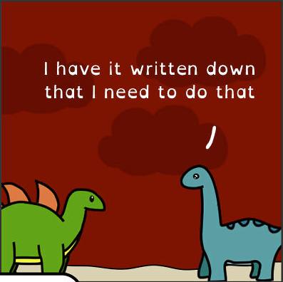
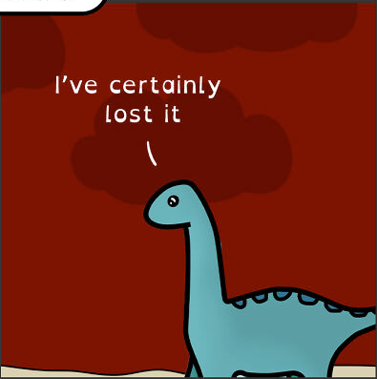
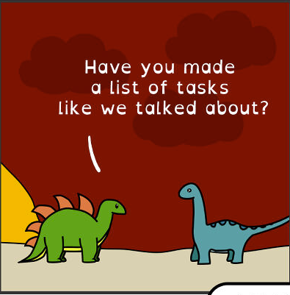
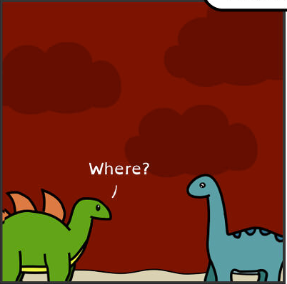
Planning Organisation Overview
When to do what task?
What’s my schedule? When do I have the actual time for it?
Which steps do I have to go through to achieve the goal?
I know the tasks, I know the planning, how do I keep track of these things? Where are my lists? HOW do I do it?
What are tasks?
What makes up a task? What’s a necessary step to do? What’s first? Which has priority?

Slide 4
Stimuli Balance
Too little
Too much
Layers of distractions
Always having music on (except sleep)
Having more music on
Being able to follow several conversations
Being aware of actions of others without paying attention
Not being able to stay in vc with many people
Getting cantankerous
No focus, too much going on

Slide 5
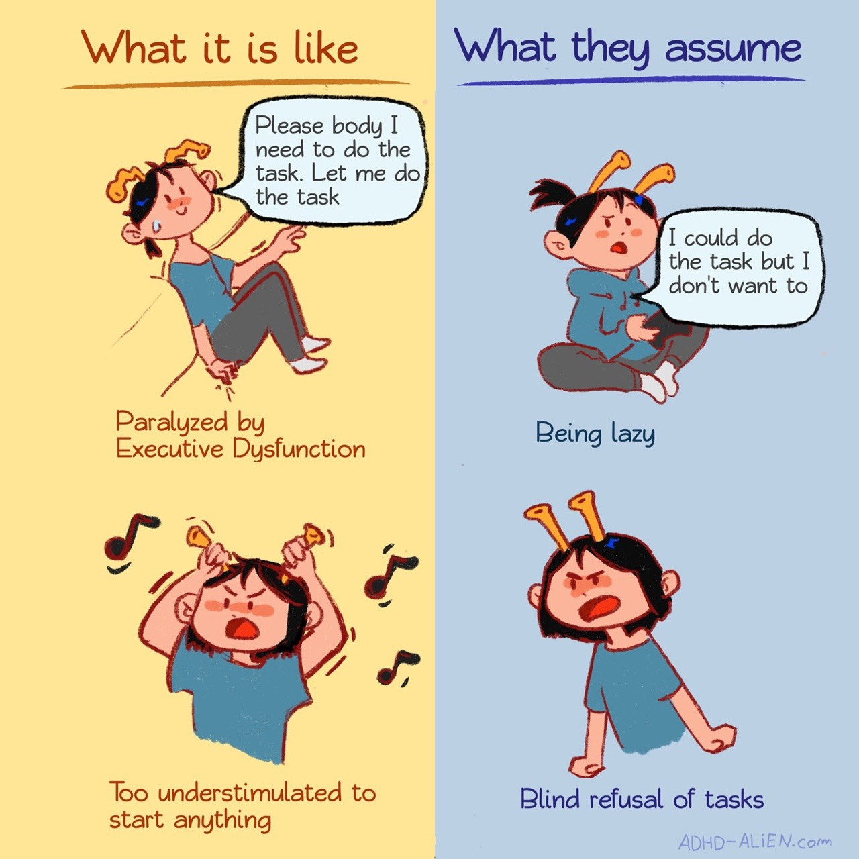
No task performance
Several reasons
No focus
Hyperfocus on a different task
Literally unable too (difficult to explain)
What kind of tasks?
Any
Good
Bad
Fun
Unfun
I hate not being able to order the tickets I want even though I sit here, and have checked everything

Slide 6
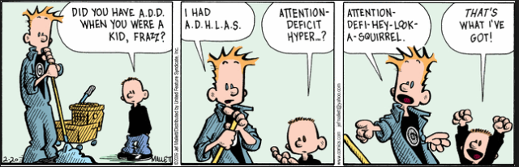
ADHD Symptom groups
Concentration
Quickly distracted
No overview (being late)
No overview (debts)
Bad planning/organisation
Staring a lot, finishing little
Dreamy, slow, vague
Chaotic, forgetful
Best procrastinator
Hyperactivity
Always busy,
Constantly having a running engine
Inner restlessness; storm in da head
Always ticking, making noise, moving, fidgetting
Not stopping with talking
Impulsiveness
Saying things without thinking
Acting first, then thinking
Interupting converstations
Impatient
Impulsively making big decisions

Slide 7
10 min of my thoughts, mostly cuz it took too long to write them all down and I got distracted
Gabe is master trash
His fucking poor gf, dating literal trash
staph
Turn that shit up
I can’t show this enough
No, not the best
Poke: lemme spit on you
What was that thing again show me da way
Fucking ugandan knuckles
Still thinking of that other band
Why do I still have to do stuff
Car still needs to go
Carmen
Lemme go back to the music that I just heard cuz what was it that I wanted to type?
Farris goes pee
godverre
Pretty solid team, internal cannon, something something, waht did he say again?
I should go to bed actually
tiddies
Tiddies tiddies tiddies tiddies tiddies tiddies tiddies tidies Tiddies tiddies tiddies tiddies tiddies tiddies tiddies tidies
Tiddies tiddies tiddies tiddies tiddies tiddies tiddies tidies
Tiddies tiddies tiddies tiddies tiddies tiddies tiddies tidies
Tiddies tiddies tiddies tiddies tiddies tiddies tiddies tidies
Tiddies tiddies tiddies tiddies tiddies tiddies tiddies tidies
Tiddies tiddies tiddies tiddies tiddies tiddies tiddies tidies
Tiddies tiddies tiddies tiddies tiddies tiddies tiddies tidies
Tiddies tiddies tiddies tiddies tiddies tiddies tiddies tidies
Tiddies tiddies tiddies tiddies tiddies tiddies tiddies tidies
Tiddies tiddies tiddies tiddies tiddies tiddies tiddies tidies
Tiddies tiddies tiddies tiddies tiddies tiddies tiddies tidies
Tiddies tiddies tiddies tiddies tiddies tiddies tiddies tidies
Tiddies tiddies tiddies tiddies tiddies tiddies tiddies tidies
Woo-hoo Woo-hoo
The radio is still on, wtf is playing
Gotta read lup’s writing, and jarex and gabe’s disabled
I was doing something, what was I doing
Lupus thoughts, what he be thining of?
Klikken voor een tekstvak is fucking stupid, where is the snelkoppeling for this shit
Ummmm mundo file band was…
Piano, thugs, something
Diamonds and guns?
I should listen to… what should I listen to acutually?
Rammstein? 5fdp? Why am I thinking so hard rn? What was the thing again
Internal cannon
Burn burn, just gonna burn
Lights out, turn on the radio
Wtf is my brother doing righ tnow (I dont’actually know)
Thank you gabe
Whgat was that other band
League is stupid
this
Carmen prey, gabe retard
Do I wanna join league?
My feet are cold, my back hurts, I’m warm, wtf
Fiddlesticks Scarecrow
Voiceline Fiddlesticks is a waifu – Amber 2022
Ping ping plong goes the piano in the song
Do I need new clothes?
I’ve to go back averythginadldk;fja;dlkfja;dlkfj
TRANSPLANTS
My brain, it’s normal, I swear, ping ping said the discord
Who else wanted I to go eat sushi with?
I need to see amber, knives, and go get food
Give me the fucking snelkoppeling

Slide 8
The part where I don’t really do sleep
Lived on an average of 30 hours during my teens (per week)
Went down to an occasional 10 (or 6)
Now averaging on 42 a week
Takes a lot of willpower, and anything can fuck it up (like playing a boardgame with friends in the evening)
Needing like 58
The brain literally takes 2 hours longer to go into ‘sleep mode’ than normal

Slide 9
The part where I sit staring at this without thinking what I wanted to write about

Slide 10
Upsides (cuz it ain’t all bad, just more unseen)
Generally more creative
Fast brain linkage
Snappy
Thinking outside of the box
Witty (cuz you make connections faster ya know)
Actually able to have several streams of thoughts/concentration going can be handy sometimes
Honest (by accident heh) (cuz you are saying things before thinking)

Slide 11
Remember the part where I sit staring? Without thinking?
The void beckons

Slide 12
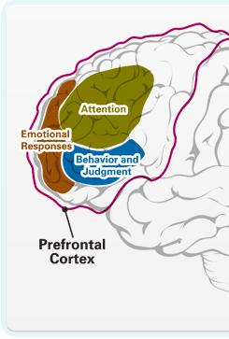
Page for when I remember things
Another symptom is forgetfullness
I got diagnosed when I was… 25? Or 24, quite late
Diagnose has helped me put some things in perspective
My brain is literally different
I’m already late to my own funeral (song)
Gotta get carmen a bday gift
Go do the task you need to do ffs
I need to order meds again, I’m out
Misophonia (fuck anyone who has a ticking clock)

Slide 13
Any Questions?

