Slide 1

How to Duplomacy
Powered by Stellaris Powered by Boredom Powered by derp

Slide 2
Q&A:
Whats Stellaris?
Answer: Here’s a pic.

Slide 3
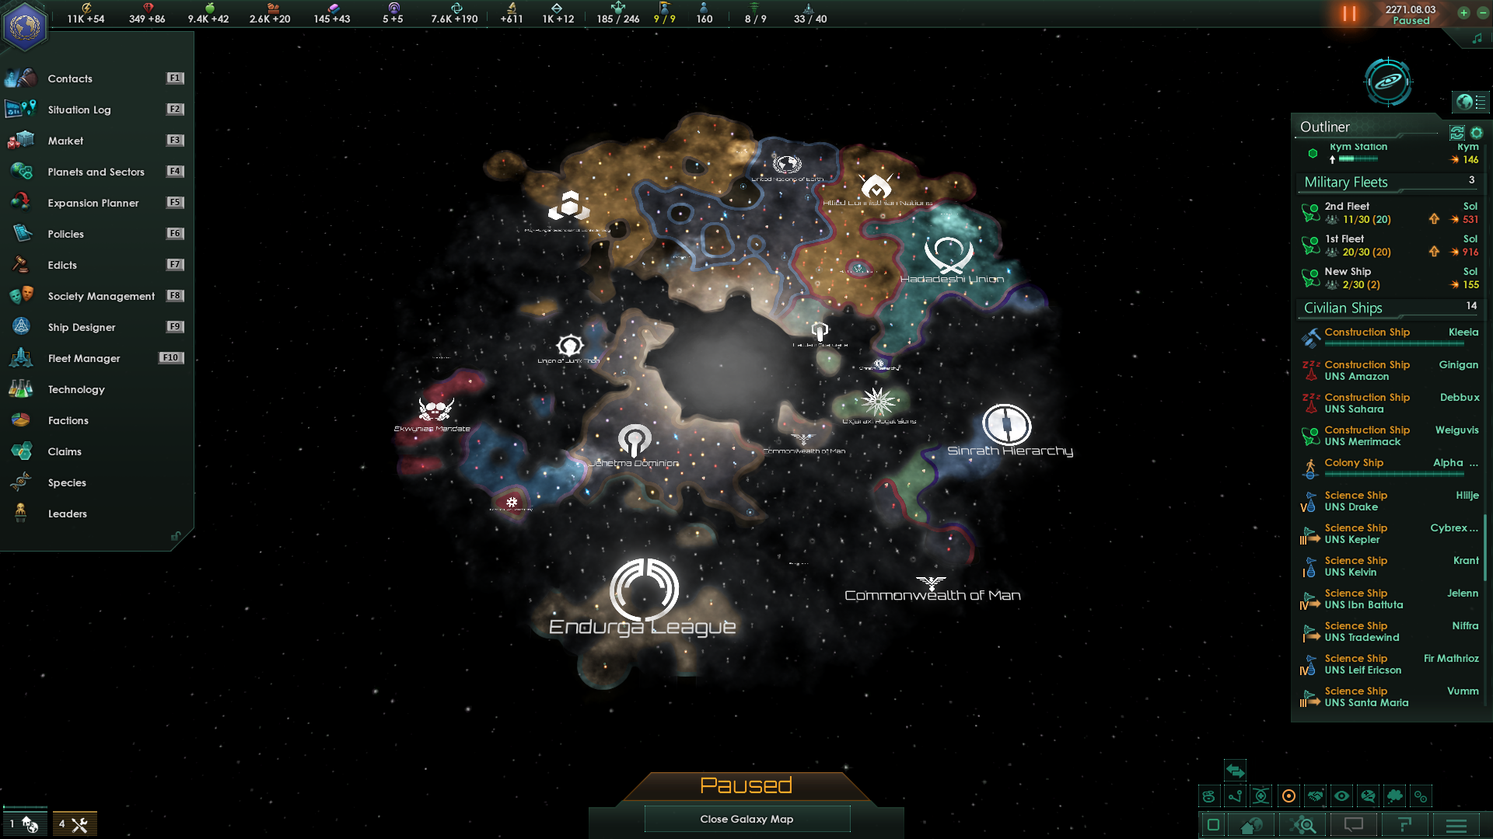

Slide 4
Q&A:
Why is the title smaller?
Answer: new ppp design trend (can share later)

Slide 5
Conditions:
Pacifist: no wars, no conflicts, no!
Ignore fleet: minimum hard power, max soft.

Slide 6
Tip 1
Panic

Slide 7
Tip 2
Claim as much space as possible

Slide 8
Tip 3
Make ‘First contacts’ fast,
Note: First contacts are mini quests for every race.
Hope they are friendly

Slide 9
SUPRIZE
They aren’t
Panic!

Slide 10
Tip 4
Send envoys
Envoying makes them (hate you less) like you more
The more, the better!

Slide 11
Tip 5
Build research buildings

Slide 12
Tip 6
Build research buildings!!!!

Slide 13
Tip 7
Research everything!
Research is love, Research is life!
Research magically makes you better at everything, even envoys!

Slide 14
SUPRIZE
Another neighbor!
Panic!

Slide 15
Tip 9
This is literally my recreation of my 1st stellaris game
If I’ll continue I might risk spoiling the later game.
There’s so much happening there
Im addicted, send help!

Slide 16
end
Thanks for watching

