Slide 1
Wurrzag da
Great Green Prophet

Slide 2
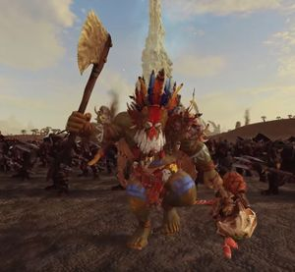
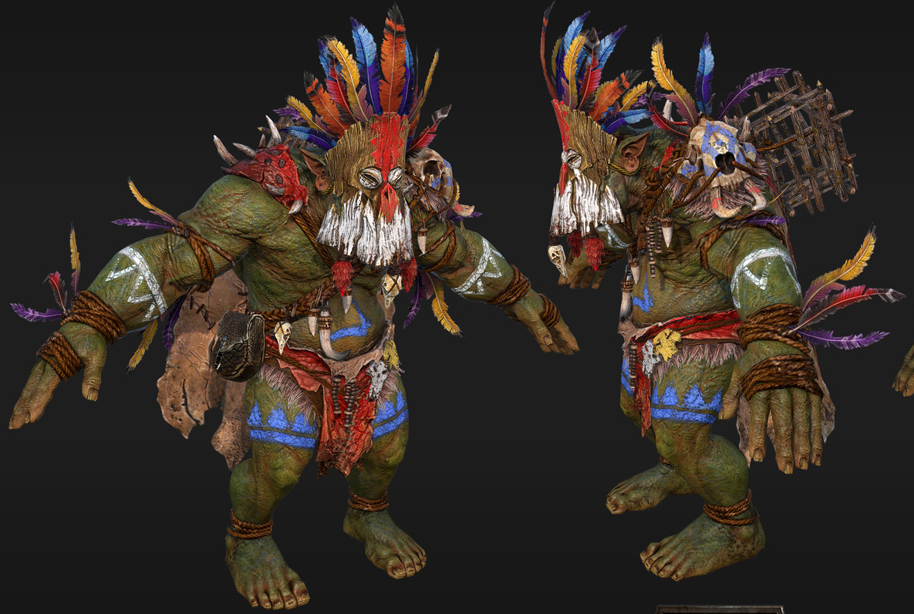
Wurrzag Ud Ura Zahubu
Who is he?
Wurrzag Ud Ura Zahubu or otherwise known as Da Great Green Prophet, is a savage Orc that at an early age showed a penchant for Waaaaagh energies.
He could often be found trancing, floating in the air with green lightning arcing off him.
Some Orcs, namely the current Shaman of the Bone Nose Tribe did not like that Wurrzag showed this much potential, he might replace him after all.
And replace him he did, It would seem that Gork (Brutal Cunning) and Mork (Cunning Brutality) had plans for Wurrzag.

Slide 3
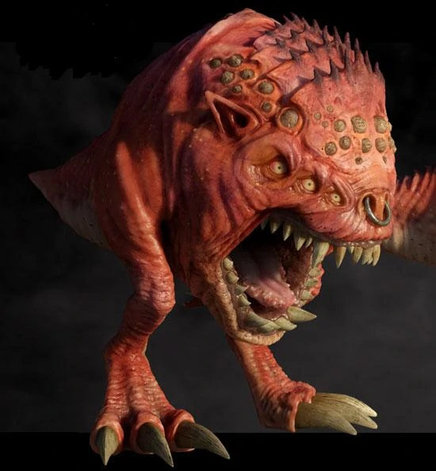
One day magical energies uncontrollably arced out of his eyes and he unintentionally transformed the now former shaman of the Bone Nose Tribe into a Squigg.
Now understandably the tribe did not like this, and while they were preparing to ritually eat Wurrzag for his deed, the now Marinated Wurrzag entered a trance and told them a tale of a time long ago, when the Bone Nose tribe ruled the lands.
Wurrzag rekindle their spirit of conquest and now filling in for the transformed shaman, Wurrzag led the warriors towards the nearest Lizardmen city.

Slide 4
Wurrzag continued travelling and conquering, he saved the Spotted Skullz tribe in the Land of the dead, and they gave him a Bonewood Staff.
In the Badlands, Wurrzag raised new effigies of Gork and Mork, and he received the War Boar named Spleenrippa from the Iron Pig Tribe.
He spoke with other tribal Shamans at every stop of his journey, he was seeking out the best Big Bosses and the most promising Warbosses. The message he carried was always the same.
“Gork an' mork are koming, now iz 'da time for 'da greenskins ta take wot should be deirs”

Slide 5
Da Great Green Prophet
A lot of things happened during his travels and as the End Times began, Wurrzag found the biggest and best Warboss that he had been looking for all this time.
He found Grimgor Ironhide The Fist of Gork.
Grimgor wanted to just kinda plant his axe right in the middle of the shaman’s mask, but Wurrzag was too valuable.

Slide 6
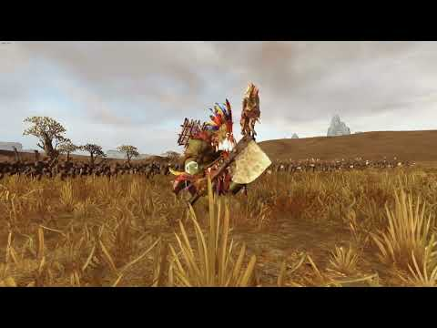

Slide 7
Hope you enjoyed
I had no imagination nor strength in my mind or body, so I made this.
Thank you for listening.

